Slide 1
Benchmark Review # 4 Clinic and Laboratory procedures

Slide 2
Five Types of Microorganisms
infections are caused by a variety of obligate intracellular, gram-negative bacteria from the genera Rickettsia
Bacteria-
A unicellular microorganism that vary in their morphology.
Virus-
A microorganism that can only reproduce themselves within a host.
Protozoa-
A single cell organism that attaches itself to other microorganisms.
Fungi-
A Simple plant the depend on other life forms for nutritional source.
Rickettsiae:
Infections are caused by a variety of obligate intracellular, gram-negative bacteria from the genera Rickettsia

Slide 3
Disease Prevention
What is sanitization?
The process of applying antimicrobial agents to non-living objects to destroy microorganisms.
What is disinfection?
The process of applying antimicrobial agents to non-living objects to destroy microorganisms
What is sterilization?
The elimination of all transmissible agents from a surface, a piece of equipment, food, or biologic culture medium, including spores.

Slide 4
Infection Cycle
1. Reservoir host:
Infected by pathogen(ex.Animals and people)
2. Means of exit:
From the reservoir host(ex. Mouth, open wounds, throat ect.)
3. Means of transmission:
From one person to another(ex. person coughs: contaminates hands)
4. Means of entry:
Into the host(ex. Mouth, urinary tract)
5. Susceptible host:
One capable of being infected(ex. Poor health, resistance is low)
Page 617

Slide 5
Safety Procedures
What is OSHA? Occupation Safety and Health Administration
A federal agency of the United States that regulates workplace safety and health.
What is CDC? Center for disease control
Where you report all communicable diseases.

Slide 6
Blood Borne Pathogen
Hepatitis B:
Acute infection of the liver transmitted through blood or body fluids
Hepatitis C:
A liver disease caused by the hepatitis C virus: the virus can cause both acute and chronic hepatitis infection, ranging in severity from a mild illness
HIV:
Is a lentivirus (a subgroup of retrovirus) that causes the acquired immunodeficiency syndrome

Slide 7
Techniques for Preventing Pathogen Transmission
What is biohazard?
Organism, or substance derived from an organism, that poses a threat to human health.
What are MSDS Sheets?
Material Safety Data Sheets(list of all chemicals in the office and info)
What is an incident report?
A recording of detailed information regarding an emergency situation and it handling.

Slide 8
Body Measurements And Vital Signs 14 questions
Vital signs(cardinal signs) are used by health care personnel to identify the measurement of body functions that are essential to life
The four vital indicators are:
Temperature
Pulse
Respiration
Blood Pressure
The correct measurement of vital signs is extremely important
Never-ever estimate the measurement

Slide 9
Temperature
Demonstrate ability to measure and read temperature
The accurate measurement of temperature can help the physician make a diagnosis
Average Oral Axillary Rectal
normal 98.6 97.6 99.6
temperature:
Range: 97.6- 99.6 96.6-98.6 98.6-100.6
Page 645
Slight fever 99.6-101.0
Moderate 101.0-102.0
Severe 102-0-104.0
Dangerous 104.0-105.0
Fatal over 106.0
Page 646

Slide 10
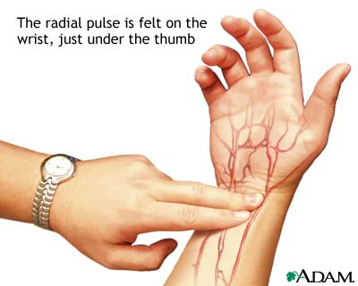
Pulse
Demonstrate ability to measure pulse
The average adult pulse rate 72 beats per minute
Pulse rate is directly related to age, the younger the person, the faster the heartbeat
Age Pulse rate
Less than 1 year 100-170
2-6 years 90-115
6-10 years 80-110
11-16 years 70-95
Midlife adult 65-80
Older adult 50-65
The pulse can be felt in several locations on the body(page 659)

Slide 11
Respirations
Demonstrate the ability to measure respiration:
The normal respiration rate for adults is 16 to 20 times per minute
Newborns: range 30 to 80
Early childhood: range 20 to 40
Late childhood: 16 to 20
Abnormally slow respiration rate is known as?
Bradypnea
Abnormally fast respiration rate is known as?
Tachypnea

Slide 12
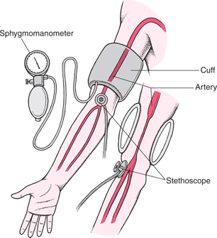
Blood Pressure
Demonstrate ability to measure BP
The term blood pressure means the fluctuating pressure that the blood exerts against the arterial walls as the heart alternately contracts and relaxes
An adult should have a systolic pressure less than 120 and a diastolic pressure less than 80
Above 140/90 indicates stage 1 hypertension
Above 160/100 indicates stage 2 hypertension
Page 667
Pulse oximetry:
Oxygen and Pulse
Hypoxia:
Below normal oxygen <90%

Slide 13
Body Measurements And Vital Signs
Demonstrate ability to measure height and weight:
Why is height important?
Why is weight important?
Describe the procedures to obtain height and weight How many inches are in a foot?
How many inches are in a foot?
12 in
How many feet is 72 inches?
6 feet
How many inches is 4 feet?
48 in
What is BMI?
Body mass index

Slide 14
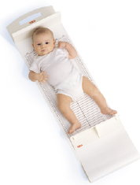
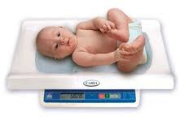
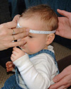
Review Physical Exams 10 Questions
Measure the height of a baby from infancy to 36 months by recumbent length
Weigh infants unclothed for greater accuracy
Head Circumference(OFC) measured one inch above the ears(up to 36 months)
Page 747-748(growth and development)
Page 749 growth charts

Slide 15
Obtain an accurate patient history
C/C
Chief complaint: the main reason for seeking medical care
Pain scale:
0/10
NKDA:
No known drug allergies
Subjective information:
Felt by the individual but not perceptible by others
Objective:
Clinical evidence

Slide 16
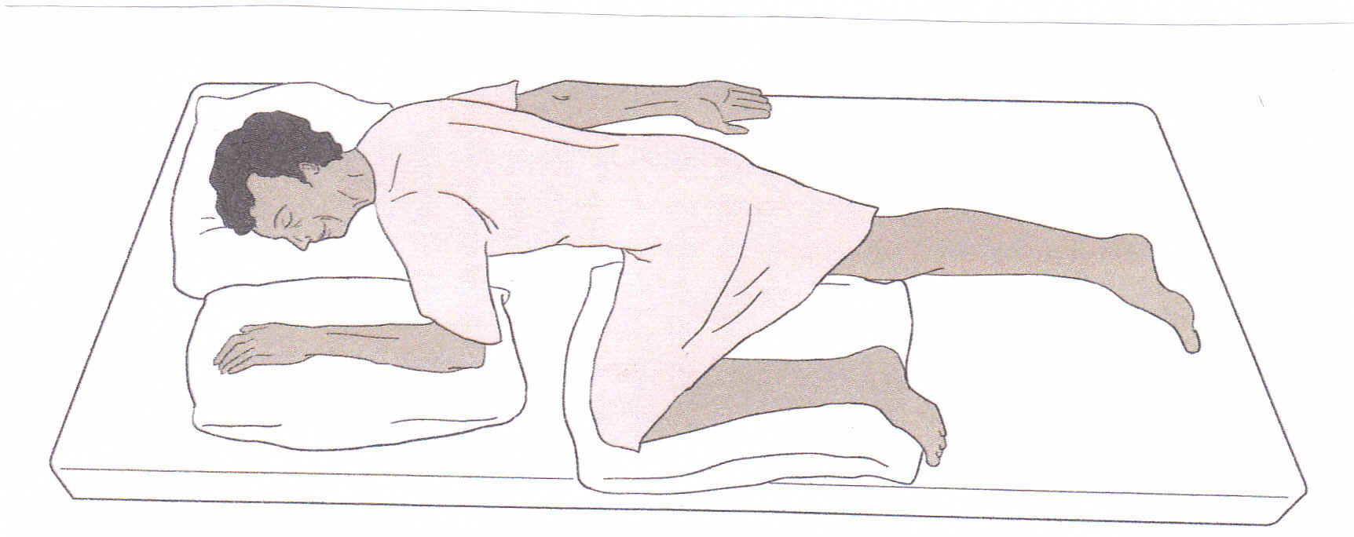
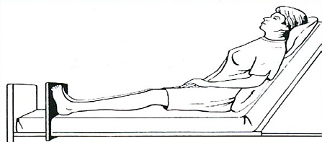
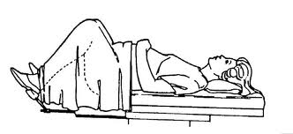
Examination Positions
A B
C
D
E

Slide 17
Review
A. Horizontal recumbent or supine
B. Prone
C. Sims
D. Semi-Fowlers
E. Lithotomy
Page 696-702 know the exams, what they are used for and identify the medical assistants duties for assisting the physician

Slide 18
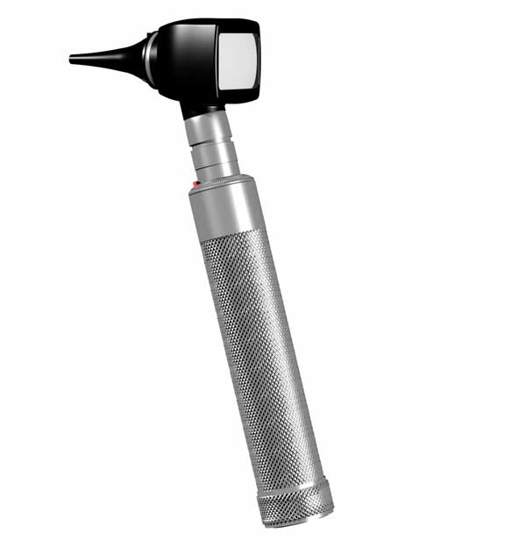
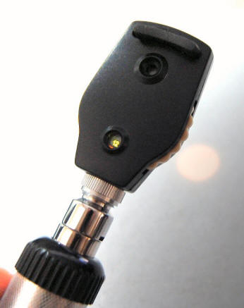
Eye and ear examination

Slide 19
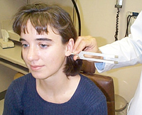
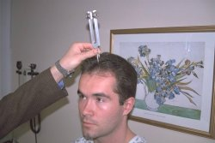
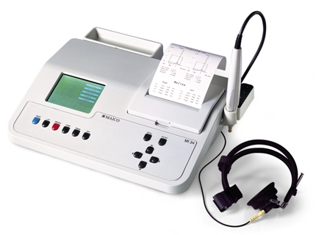
Ear examinations
Tuning fork test for vibrations to be heard
Rinne test(mastoid bone behind the ear)
Weber test(forehead or vertex of the head)
page 691
Audiometer:
Tympanogram: test the condition of the middle ear and mobility of the eardrum

Slide 20
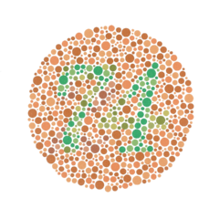
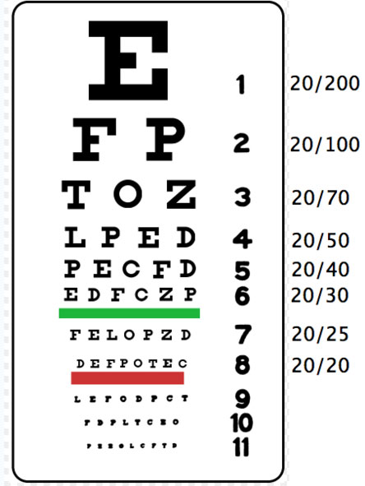
Eye examination
Snellen Chart:
Distant vision chart
Jaegar Chart:
Near vision acuity(patient reads a chart at a distance of 14 to 16 inches from the eyes)
Ishihara:
Color vision acuity

Slide 21
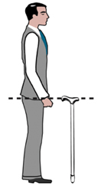
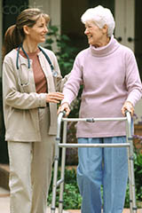
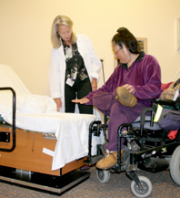
Cane, Crutches, Walker, and Wheelchair
Cane should be adjusted so that the patients elbow is flexed at approximately 25 to 30 degree angle
Crutches should be 2 to 3 inches below the patient’s axilla
The walker height should be adjusted at the patient’s hip level
Wheelchair: page 997(assisting
patient from wheelchair to exam
table)

Slide 22
Review
Identify drug Classifications:
Anticoagulant:
Prevents or delays or slows blood clotting(Heparin, Coumadin)
Antipyretics:
Reduces fever(Tylenol, Aspirin)
Sedative: Produces a calming effect without causing sleep(Phenobarbital)
Antihistamines:
Acts to counteract histamine(allergies/cold) Benadryl
Antitussives:
Prevents or relives cough(Codeine)
Antibiotic:
Is destructive to or inhibits growth of microorganisms(fights bacterial infection) Penicillin, Augmentin
Analgesics:
Relives pain(Acetaminophen, Ibuprofen)
Anticonvulsant:
Prevents convulsions(Dilantin)
Hypoglycemic: Lowers blood glucose level(Insulin)

Slide 23
Controlled Substances Schedule
Schedule 1
Illegal, not prescribed
Schedule 2
High potential for addiction and abuse
Schedule 3
Moderate to low potential for addition or abuse
Schedule 4
Lower potential for addition or abuse
Schedule 5
Low potential for addition or abuse

Slide 24
Pharmacology
PDR:
Physician Desk Reference
Pink section:
Brand name of the drug
Blue section:
Classification of the drug
White section:
Manufactures index

Slide 25
Pharmacology and Administration of Medications 18 questions
Dosage calculations:
Always remember this formula:
What you want X Quantity it comes in
What you have 1

Slide 26
Review
6 rights for administrating medications?
Right patient
Right medication
Right dose/amount
Right route
Technique
Time

Slide 27
Medication Administration
How do you withdraw medication from a vial? Ampule?
Intradermal is given at what angle?
10 to 15
Subcutaneous is given at what angle?
45
Intramuscular is given at what angle?
90(massage area after)

Slide 28
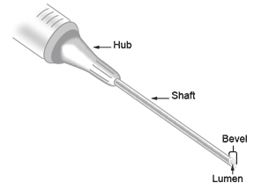
Medication Administration
What are the parts of the syringe/needle(page 923)

Slide 29
Medication Administration
Oral medications:
Sublingual, buccal, liquid, tablet, capsule
Hold the medicine cup at eye level when pouring(oral medications)
Transdermal: including lotions, ointments, and creams

Slide 30
Review Basic Concepts of Asepsis and Sterilization
Aseptic hand wash:
Wash one hand for 15 seconds. Clean under the fingernails and wash your wrist, do the other hand, keep hands lower than elbows
Surgical hand wash:
Scrub each side of each finger, between the fingers, and the back and front of the hand for two minute, proceed to scrub the arms, keeping the hand higher than the arm at all times
Disinfecting instruments:
Applying antimicrobial agents to objects to destroy microorganisms
Sterilization:
Autoclaving
Wrapping instruments:
Use double thickness, and complete en-closer to prevent pathogenic entry
Standard precautions:
Wash hands, wear PPE
Viruses:
Simple microorganism , capable of reproducing
Bacteria:
Unicellular microorganism cause disease
Protozoa:
Parasites
Fungi:
Parasitic plants(mold)

Slide 31
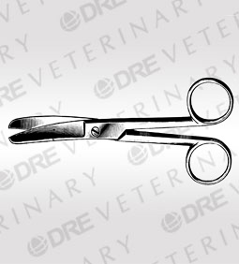
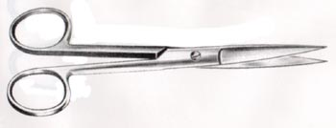
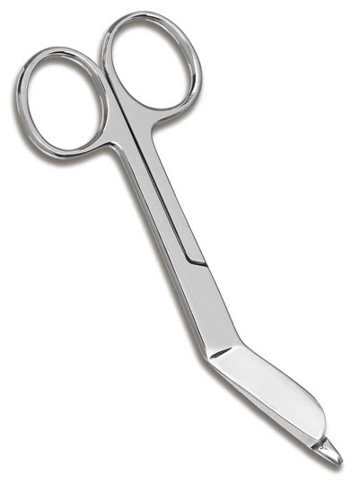
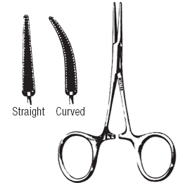
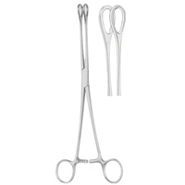
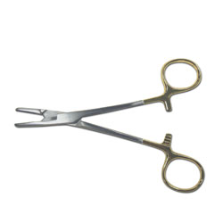
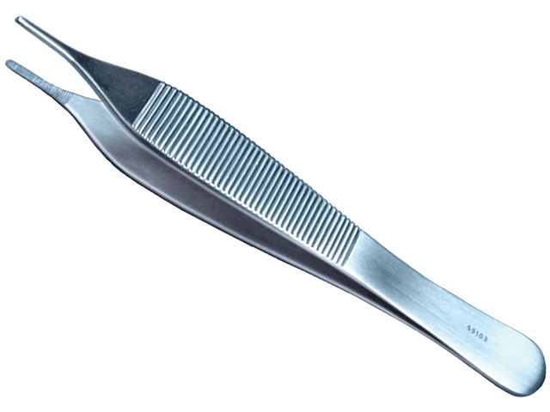
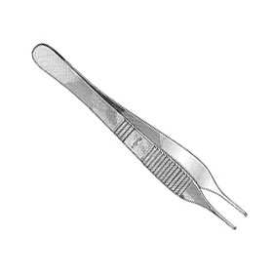
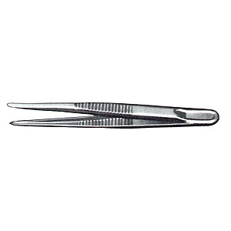
Review Assist with Basic Minor Surgery 4 questions
A B
C D E
F G H
I

Slide 32
Review
A. Straight, sharp-sharp scissors
B. Curved, blunt-blunt scissors
C. Side curved bandage scissors
D. Mosquito hemostat
E. Sponge-holding forceps
F. Needle holder
G. Tissue forceps with teeth
H. Addison tissue forceps
I. Thumb forceps

Slide 33
Review
Opening a sterile pack:
Gather all the flaps in the palm of your hand and drop onto the sterile field
Prepare patient for surgery:
Prepare everything the day before, have them sign a consent form, use antiseptic, circular motion, from site outward, shave at a 30 degree angle
Apply sterile gloves:
Grasp the fold of the inside of the cuff of the gloves with the thumb and fingers of your dominant hand
Insert your non-dominant hand into the glove on with your dominant hand by the turned-down cuff
Insert the fingers of your gloved non- dominant hand under the folded-down cuff of the glove, and insert your dominant hand

Slide 34
Review
Suture removal:
Put on gloves
Apply antiseptic solution(ask for allergies)
Remove suture(see below)
Pull on the suture with the forceps toward the healing lesion so that no stress is put on it
Use steri-strips if ordered
Suture tray:
Disposable scalpel, Hemostat, Needles and suture material, Suture scissors, Thumb forceps, Gauze squares(4x4’s), Anesthetic medication vial(lidocaine), given by the physician, Syringes, Towels, Bandages

Slide 35
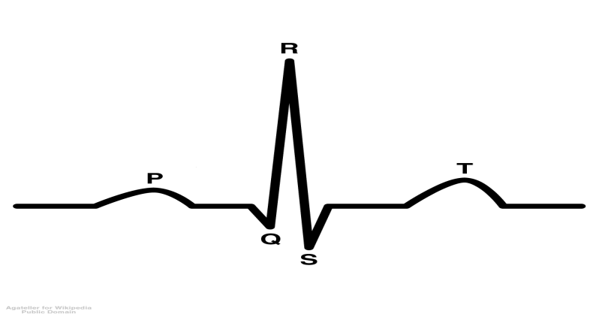
ECG 4 Questions
P wave:
first wave, atrial depolarization
QRS wave:
this represents the spread of the electrical impulse through the ventricular muscle (depolarization)
T wave:
represents repolarization
How do you prevent artifacts on a ECG?
Provide privacy, Prevent chills, Patient must be relaxed, Patient should be away from walls and electrical cords, Wipe away any creams, lotions, creams, ect

Slide 36
EKG Colors of Leads
RL- Green
LL- Red
RA-White
LA- Black
V1- Red
V2- Yellow
V3- Green
V4- Blue
V5- Orange
V6- Violet (purple)

Slide 37
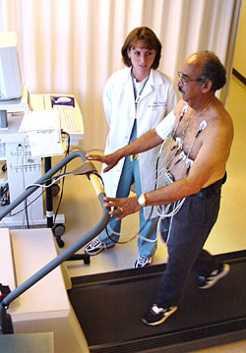
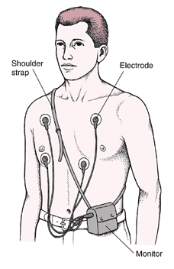
Stress Test and Holter monitoring
Other tests used for heart functions:
The stress test is done while a
patient is exercising on a
treadmill(with ECG)
The MA will monitor the blood pressure
This can detect the unknown cause of the patient’s heart trouble
Holter monitor: is a test done over a period of 24 hours: for intermittent or irregular chest pain

Slide 38
Assist with Minor Surgery
Prepping a surgical site:
Apply all solutions to the skin in a circular pattern(center-outward)
Page 886
Putting on sterile gloves: page 889-890
Removing sutures: grasp the suture knot with thumb forceps, and place the curved tip of the suture removal scissors just next to the skin under the suture and clip
Gently pull the suture up and toward the incision with the thumb forceps to remove(page 897)

Slide 39
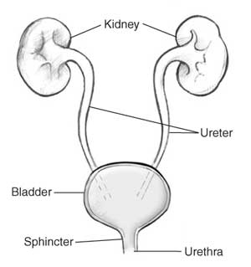
Physicians office laboratory 10 Questions
Identify the organs of the urinary tract?

Slide 40
Physicians office laboratory
How do you explain a clean catch midstream specimen collection
Female 3 wipes front to back, catch midstream
Males wipes circular motion, catch midstream
Page 802

Slide 41
Review
Reagent Strips:
Urine pH:
Should be slightly acidic to fight off bacteria
Protein:
Is normally not found in the urine(hard exercise, pregnancy, kidney disease)
Ketones:
When fat is broken down for energy, negative ketones is normal(DM, low carbohydrate diet)
Bilirubin and Urobilinogen:
Negative is normal(liver problems or disease)
Hematuria(blood in the urine):
A normal urine sample should not have any detectable blood(kidney or prostate problems)
Nitrite:
Is normally not found in urine(positive means bacteria possibly UTI)
Glucose:
Negative is normal (when the blood sugar level is very high, as in uncontrolled diabetes, the sugar spills over into the urine)

Slide 42
Review
Urine Microscopic exam:
Urine sediment:
is a centrifuged deposit suitable for microscopic examination for the presence of erythrocytes(RBC), leukocytes(WBC), casts, crystals, bacteria, fungi, parasites, mucous, and sperm(males)

Slide 43
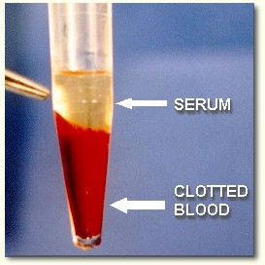
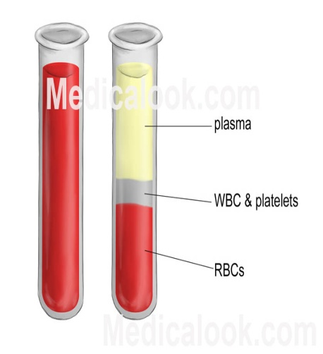
Review
Function of RBC
Oxygen
Function of WBC
Infection
Platelets:
Clot blood
Plasma:
Plasma is a clear and yellowish fluid part of the blood(mostly water) for donation
Serum:
Serum is the liquid part of the blood after the coagulation(for blood tests)

Slide 44
Review
ERS normal range
Male 0-15, female 0-20
Hemoglobin:
Is measured if anemia is suspected in the patient(usually along with hematocrit)
Females:12 to 16 g/dl, males: 14 to 18 g/dl
Hematocrit range
Females: 37-47% males: 40-54%
Range for fasting Glucose
80 to 120 mg/dl
RBC range:
Men 4.6-6.0 million females 4.2-6 million
WBC range:
5,000-10,000
Platelet range:
150,000-350,000
Total Cholesterol
<200

Slide 45
Review
Skin puncture:
Lancets are designed to control the depth of the dermal puncture(wipe the first drop of blood away, use middle or ring finger, never use a finger on an infant)
The vein(s) used most often use for a venipuncture?
Antecubital area, Median cubital vein, Cephalic vein, Basilic vein

Slide 46
Review
HCT:
The hematocrit is a simple yet reliable test to measure the percent volume of red blood cells per volume of whole blood
CBC:
Complete blood count(RC,WBC, HCT, HGB)
PKU:
Phenylketonuria(a condition in which your body can't break down an amino acid and protein)
FBS:
Fasting blood sugar
GTT:
Glucose tolerance test
Hemoccult:
Blood in stool
Gram positive:
Will stay purple
Gram negative:
Will not take the stain and turn pink

Slide 47
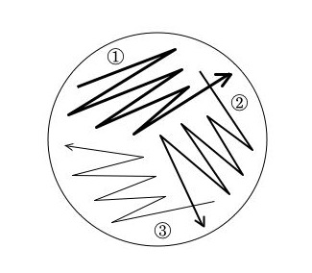
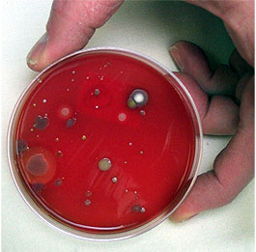
Review
Prepare a culture

Slide 48
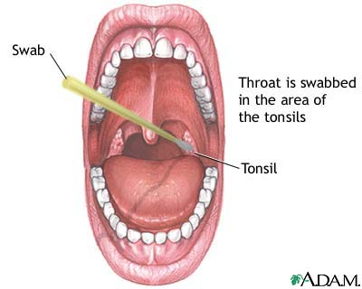
Review
Obtain a throat swab specimen:
First the throat is swabbed with a
sterile, nonabsorbent rayon-fiber swab
The swab is inserted into with the reagents to extract the Strep A antigen(If there is a strep A antigen the test will be positive)

Slide 49
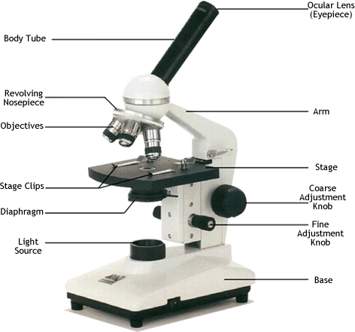
Parts of The Microscope

