Slide 1
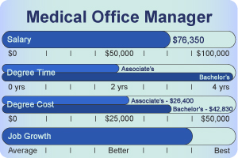
Chapter 10
Medical Office Management

Slide 2
Medical Office Management
Many factors affect the overall operation of the medical office
The office should be safe, secure, and friendly
The office needs a day- to-day operation
The fiscal operation of the office also requires someone to manage the daily receipts, expenditures, and other financial matters

Slide 3
A Safe, Healthy Environment Throughout The Medical Office
The medical assistant is a part of the team responsible for recognizing any safety, security, or operational hazards
Physicians place a great deal of responsibility and confidence in their medical assistants ability to handle the administrative affairs of the office

Slide 4
Safety In The Workplace Environment
The physicians office environment must ensure the health and safety of the staff and all patients
The effort to reduce or eliminate exposure to harmful organisms is known as infection control
Sick or infected patients may also expose other patients
It is extremely important to take extra precautions with infection control
For the protection of employees and patients, federal and state agencies have established legislation dealing with policies, procedures, and guidelines to reduce disease transmission
Occupational Safety and Health Administration(OSHA), deals with requirements with safe working conditions

Slide 5
Safety In The Workplace Environment
The United States Public Health Department has a Center for Disease Control and Prevention(CDC), that is responsible to collect data pathogens and diseases and establish guidelines to prevent their spread
It was this agency that established guidelines concerning contact with blood and bodily fluids referred to as universal precautions, this was developed to control the spread of Hepatitis and AIDS

Slide 6
Safety In The Laboratory Area
Chemicals in the laboratory must be labeled and stored properly
The testing of patient’s urine, blood, and other specimens requires special procedures
Containers for the disposal of used equipment and biohazardous waste must be readily accessible

Slide 7
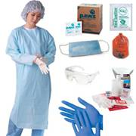
Personal Safety
All health care workers must practice standards precautions to protect themselves against HIV, hepatitis, or other infectious diseases
All patients should be considered infected
Protection involves the use of appropriate barrier precautions to prevent any exposure

Slide 8
Spills And Dropped Objects
It is important to clean up all bodily fluid spills immediately
Universal precautions must be observed by using gloves, and placing materials in a biohazard waste container
Use a 10% solution of bleach
Glass fragments must be picked up using a brush or broom and discarded in a puncture free container(sharps)

Slide 9
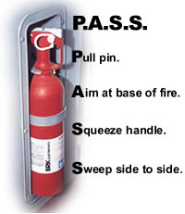
General Office Safety
Fire prevention is very important to everyone’s safety
The office should have an established policy regarding the procedure to follow in case of fire
All patient must be evacuated from the building, and the fire department must be notified
When appropriate, knowing the location of the fire extinguisher and using it properly could prevent a fire from spreading

Slide 10
Banking Terms
The medical assistant who works in the front office must have a good working knowledge of banking and basic accounting procedures
Banking Terms:
Agent: a person authorized to act for another person
ATM: an automatic teller machine
Bank statement: a record of a checking account sent to the customer
Cashiers check: the purchaser pays the bank the full amount of the check
Certified check: is a form of check for which the bank verifies that sufficient funds exist in the account to cover the check, and so certifies, at the time the check is written.

Slide 11
Banking Terms
Debit card: is a plastic card that provides the cardholder electronic access to his or her bank account(s) at a financial institution
Deposit: an amount of money placed in a bank account
Deposit slip: an itemized list of cash and checks deposited in a checking account
Direct deposit: when an amount is sent electronically by the payer directly into a saving or checking account
Electronic check: a check paid directly from a checking account via the internet
Endorsement: the payee’s signature on the back of a check
Insufficient funds: a bank term used to indicate that the writer of the check did not have enough money in the account to cover the written check
Money order: is purchased for the amount desired, in this way it is similar to a certified check, used mostly by an individual who does not have a checking account

Slide 12
Banking Terms
Online banking: banking on the bank’s internet web site is called online banking
Overdraft checking accounts: accounts that allow checks to be written for a larger amount than is currently in the account
Payee: the person to whom the check is written
Payer: the person who signs the check
Postdated check: a check made out with a future date
Stop payment: a method by which the maker of a check may stop payment, the bank charges a sizable amount for this service
Traveler’s check: a special check used by individuals who are traveling and do not wish to carry a large amount of cash
Withdrawal: removal of funds from a depositor’s account

Slide 13
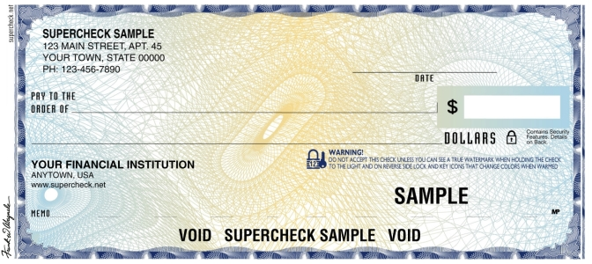
Currency, Checks, And Petty Cash
Currency is the name given to the cash money we use in our society
Features of a check:
Payee Date Name and address Numeric amount Payer signature
Financial
Institute

Slide 14
Patients Checks
Certain precautions need to be observed when accepting checks from patients:
Do not accept a third party check(this is a check made out to the patient by someone unknown)
Only accept a check for the amount due(no cash back)
Only accept a money order with one signature(two or more is invalid)

Slide 15
Endorsement
The endorsement of a check transfers all rights in the check to another party
Endorsement should always be made in ink and may be made with a pen or rubber stamp
All checks received in the office, whether in person or through the mail should be protected by endorsement at the time received

Slide 16
Making Deposits
The medical assistant is also expected to deposit cash and checks received in the office
Deposits should be prepared in a secure place out of people’s view
Currency should be sorted as following:
Put all bills of the same denomination together
Face bills the same direction, portrait side up
Stack in order from highest to lower denomination(ex: $50, $20, $10, $5, $1)
Make sure all checks are endorsed, arrange all of them face up

Slide 17
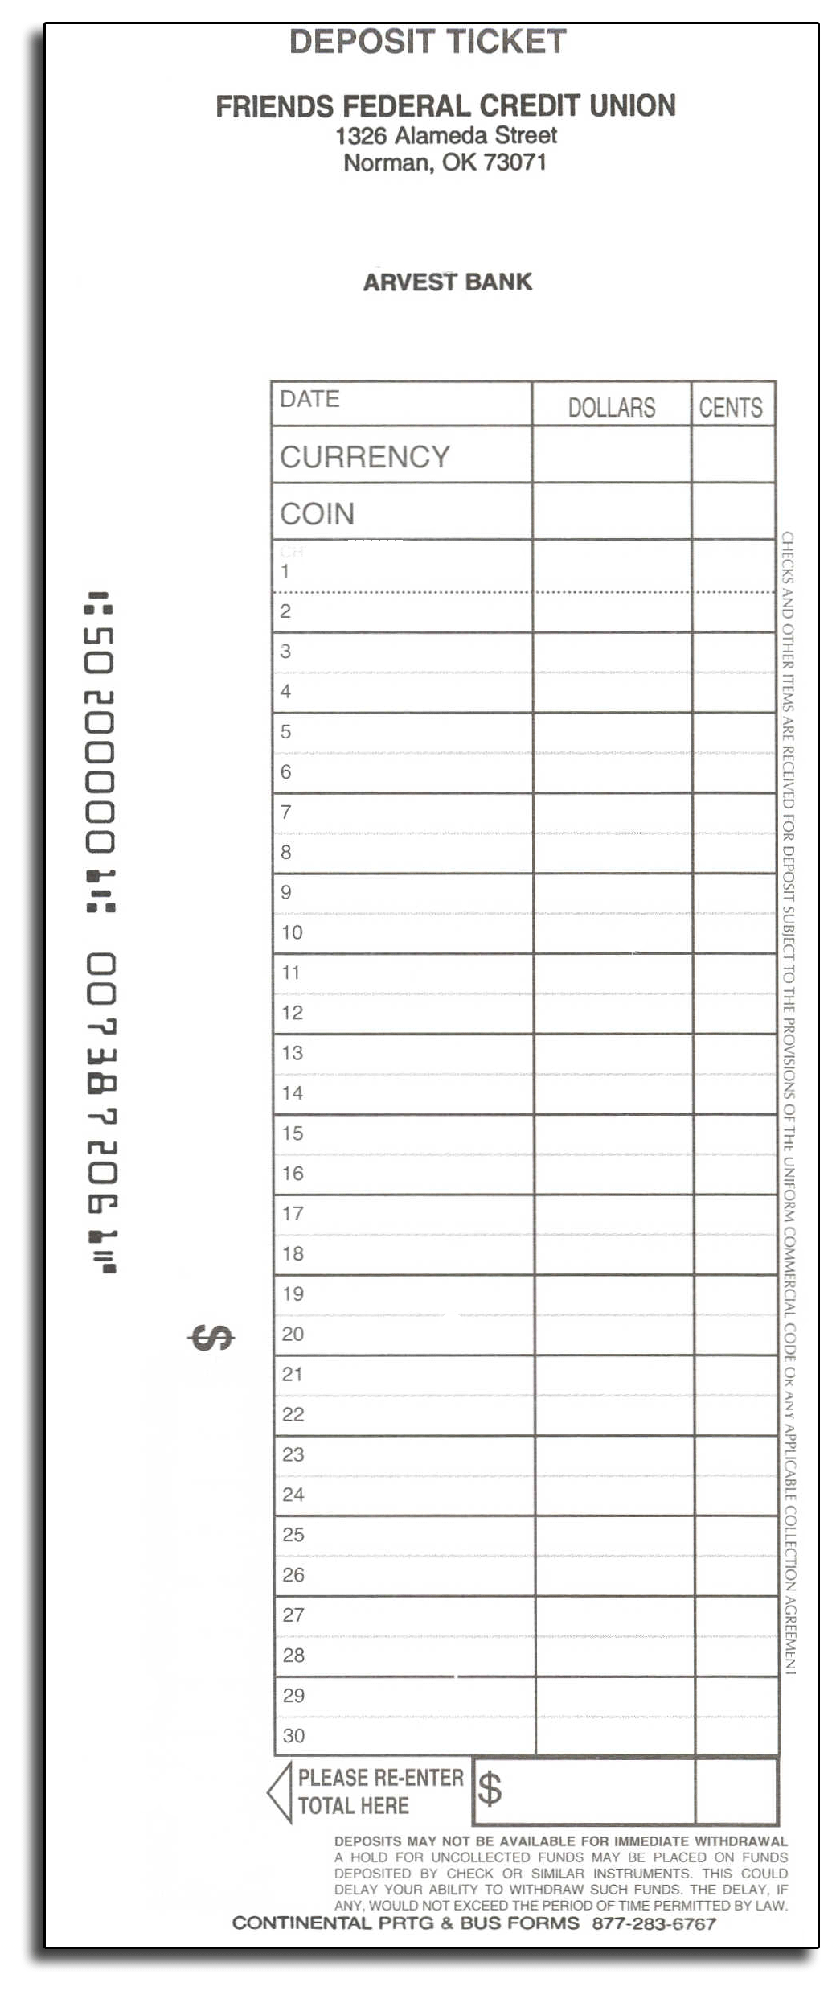
Making Deposits
Prepare a deposit slip
Use black or blue pen
Separate currency
Total the currency and record
Enter amount of coins
Enter checks by number and enter amounts
Total all the currency, coins and checks and enter on the slip
Make of copy of the slip
Enter the deposit total in the checkbook
Deposit in the bank
File and record the deposit

Slide 18
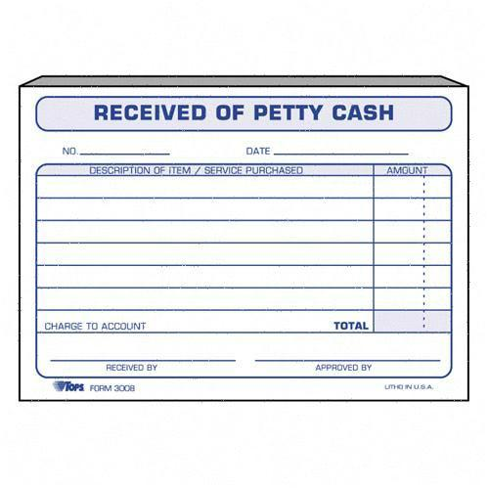
Petty Cash And Other Accounts
Since it is reasonable to write checks for small office transactions, most physicians have a petty cash fund
The office will determine the amount of the fund and for what it will be used for
The fund is established by writing a check payable to ‘cash” or “petty cash.”
The money is kept in a locked box and is often used for postage, office supplies, and charitable donations

Slide 19
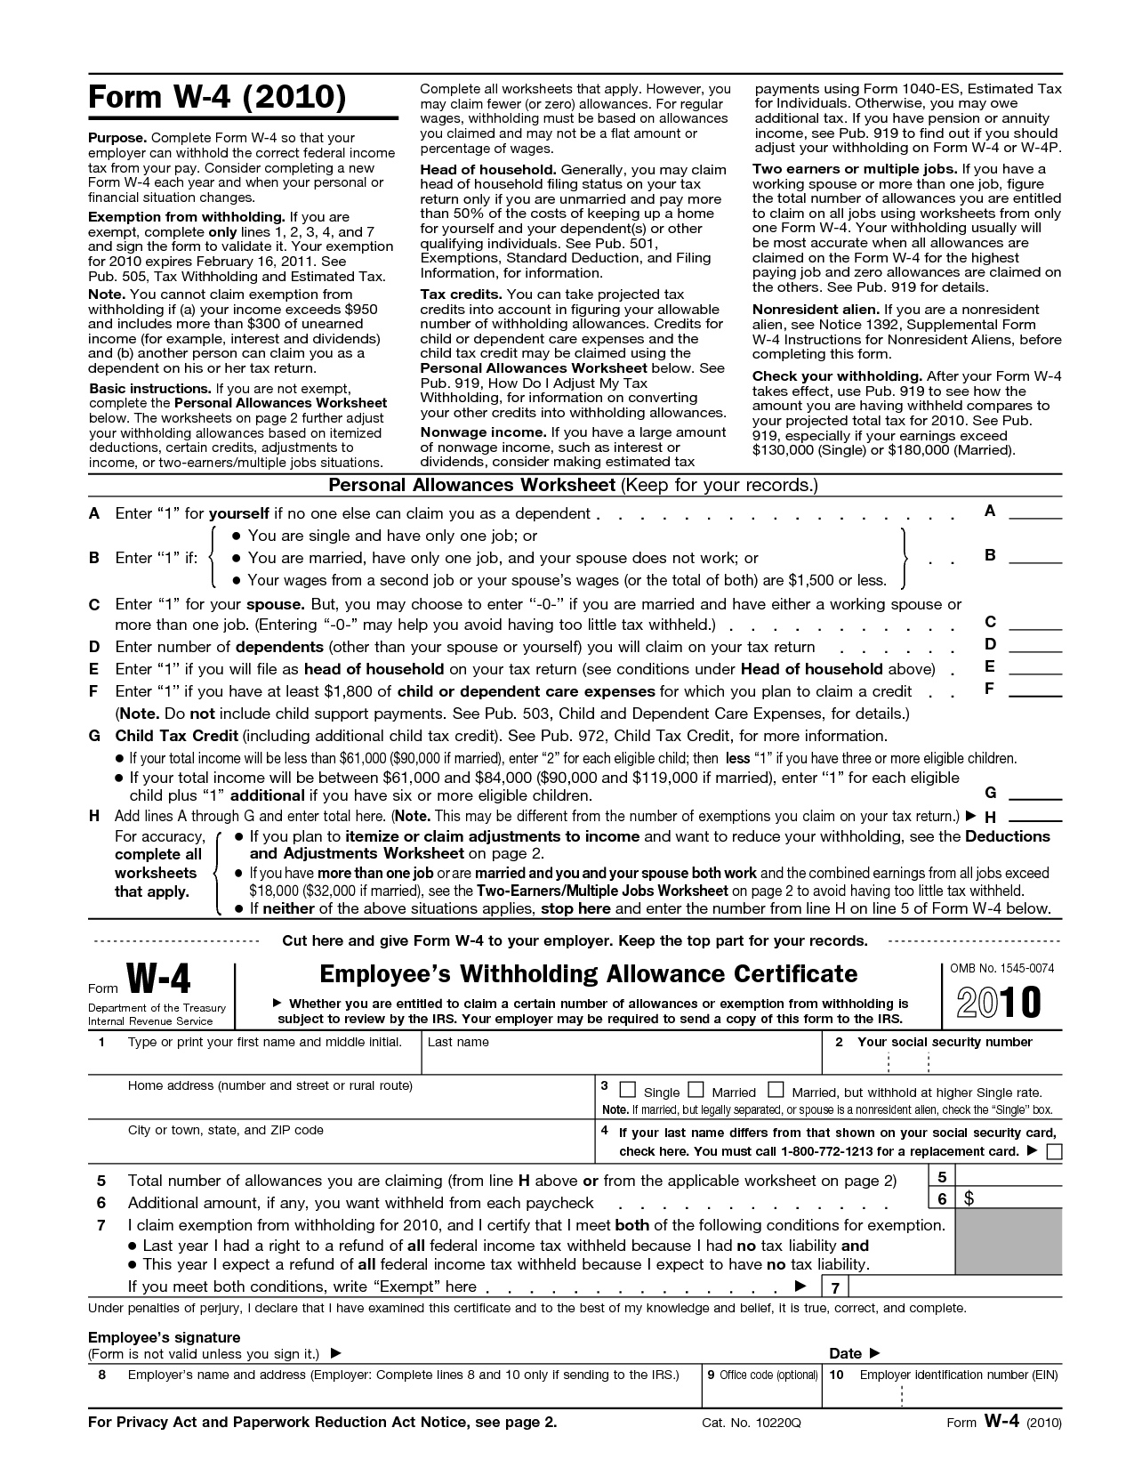
Employee, Salary, Benefits, And Tax Records
All employees in a physician’s office must have a Social Security number
This is a nine-digit number obtained for the Internal Revenue Service
Each employee must also complete an Employee’s Withholding Allowance Certificate called a W-4 form indicating the number of exemptions claims
W-4 form will have withholding figured on the basis of being single, married, and with or without exemptions

Slide 20
Medical Office Requirements And Records
The physicians office must have a federal tax reporting number, which is obtained from the IRS
Most states require employees to have an employee number
Employees must be paid hourly or salary(a fixed amount)
The Federal Fair Act regulates that employees must be paid overtime at a rate of 1 ½ times the regular rate

Slide 21
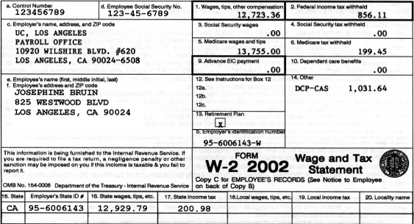
Medical Office Requirements And Records
A W-2 is a summary of all earnings for the year and all deductions withheld for federal, state, and local taxes, and must be provided to each employee by January 31st of each year

Slide 22
Benefits
Full time medical assistants can expect benefits in addition to their salary
Benefits will vary according to the situation of the employment
The following of the are examples of benefits:
Vacation: usually two weeks pay after 1 year- full time employment
Holiday pay: a minimum of six paid holidays per year
Sick time: Most will pay 3 to 5 days per year
Personal time: this is for personal matters without having to use vacation or sick time, usually 3 paid days per year
Bereavement time: this is for a family or close friend’s death, the amount of time will depend
Jury duty: some employers will pay for jury duty with a court order
Paid time off(PTO): this time will be based upon the date of hire, and percentage of time accrued each pay period

Slide 23
Benefits
Health Insurance: may be available with a co-payment, some employers only pay medical insurance to full time employees
Disability Insurance: will cover a percentage of the salary if the employee is unable to work because of a disability condition
Another nice benefit some physicians may permit is complimentary lunches from drug companies

