Slide 1
The Urinary System
Chapter 11 Unit 11

Slide 2
The Urinary System
The urinary system removes waste products, certain salts, and excess water from the blood and eliminates them from the body
At the same time, it reabsorbs the elements needed to maintain the proper ratio
The urinary system performs three main functions:
1. Excretion: the process of removing waste products and other elements from the blood
2. Secretion: by which urine is produced
3. Elimination: the emptying of the urine from the bladder storage

Slide 3
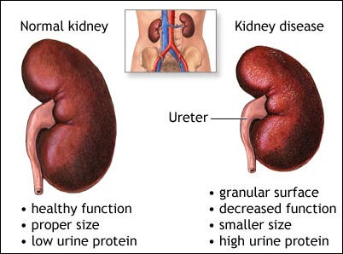
The Urinary System
The major work of the system is performed by two organs called the kidneys
The well being of the human body depends heavily on the functions of the kidneys
When waste products are not remove from the blood, they build up, producing fatal toxicity

Slide 4
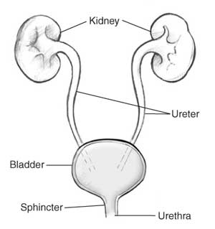
The Urinary System
After the kidneys have performed their functions, the waste material urine, is carried through the ureters, one for each kidney, to temporary storage in the bladder
When an adequate amount has been accumulated, the bladder expels the urine through the urethra, eliminating it from the body

Slide 5
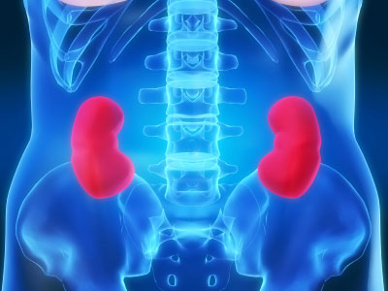
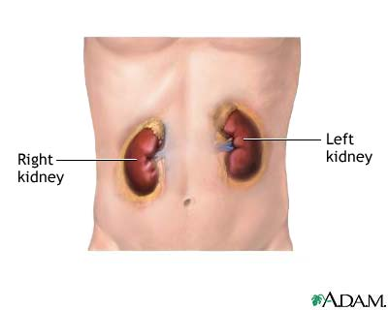
The Kidneys
The kidneys are shaped like lima or kidney beans
Each kidney is about 4½ inches long, from 2 to 3 inches wide, and about an inch thick, and it weights about ¼ pound
The kidneys are located on each side of the vertebral column, high up on the posterior wall of the abdominal cavity, between the muscles of the back
The left kidney is slightly higher than the right(sits under the liver)

Slide 6
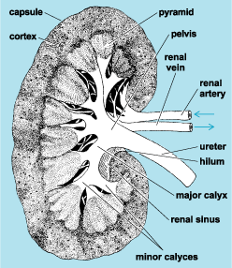
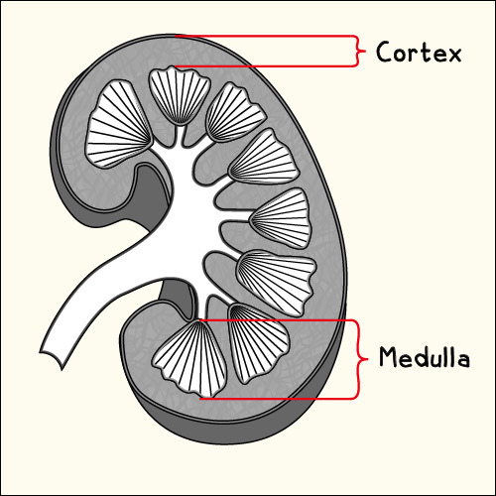
The Kidney
Externally, the kidney is covered with a tough, fibrous capsule
The concave border has a notch called the hilum(nerves) through which the renal artery enters
An outer layer is the cortex, and the inner layer is the medulla(both aid in the reabsorption of water)

Slide 7
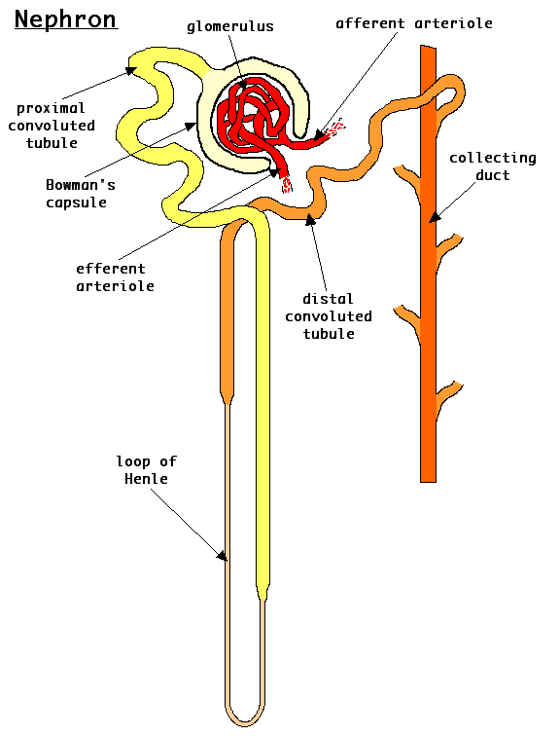
The Nephrons
The life-preserving service of the kidneys is performed by microscopic units called nephrons
Each kidney has over 1 million of these units, which altogether contain roughly 120 million filters and tubes

Slide 8
The Nephrons
In an average day, a person takes in 2,500 ml of fluid(2 ½ quarts) and generates another 300 ml(10 ounces) of water(from cells)
About 1,500 ml (1 ½ quarts) is eliminated as urine each day
Some moisture is lost through feces, respiration, and through the skin

Slide 9
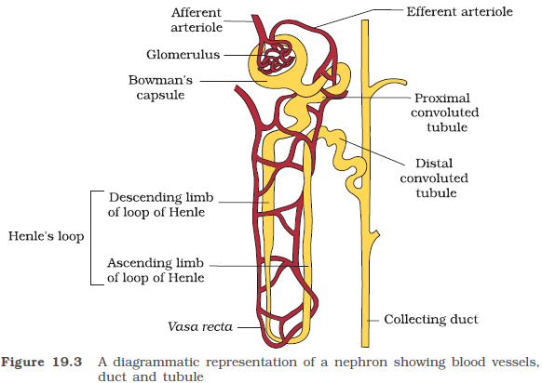
The Nephrons
The structure resembles a funnel with a long, twisted tail
The top is a double-walled hollow capsule called the Bowman's capsule(performs the first step in the filtration of blood to form urine)
Each capsule contains a cluster of about 50 capillaries called the glomerulus(the functional unit of the kidney)

Slide 10
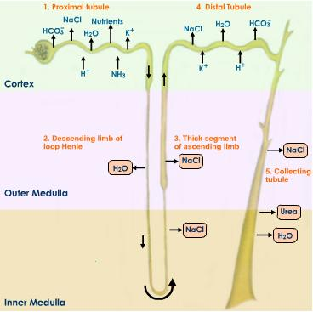
Filtration and Re-absorption
Filtration is the first process in the formation of urine
Blood enters the capsule by the way the arteries(blood vessels), carrying waste products, water, salt, urea, and glucose
By a reabsorption process, 99% of the filtrate is returned to the bloodstream(glucose, vitamins, salts)
Patients with diabetes spill sugar frequently, this is referred to as spilling over the threshold

Slide 11
Urinary Output
Anything that increases the volume of blood in the capillaries increases the output of urine
For example, a large fluid intake increases the volume of blood and the output of urine
Dehydration or disease, decreases blood volume and urine output
When the body urine output dips below 500 ml per day in adults, the condition is termed as oliguria(low output of urine)
This is a serious condition and needs immediate medical attention as decreased urine output often indicates a life-threatening conditions like kidney failure.
However, proper medical treatment can prevent any deleterious effects on the body

Slide 12
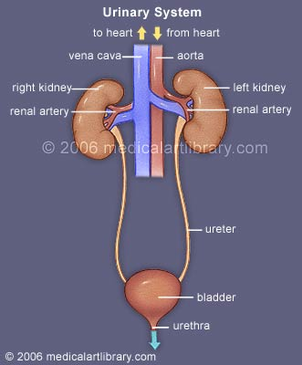
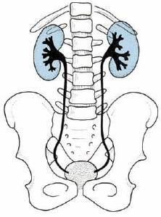
The Ureters
When urine exits the kidney, it enters a long tube known as a ureter
There is one ureter at the central portion of each kidney
Each ureter funnels the urine down into the bladder
The ureters begin with a widened upper portion, continuing as a long, slender, muscular tube approximately 10 to 12 inches in length
Peristaltic waves, at a rate of one to five minutes, move the urine down the ureters to enter the posterior wall of the bladder

Slide 13
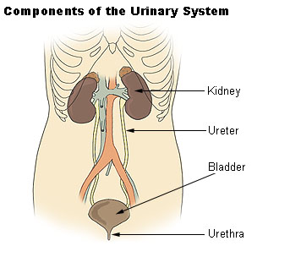
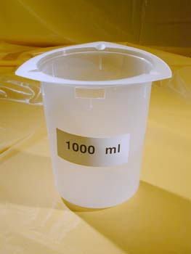
The Urinary Bladder
The bladder is a muscular organ lying behind the pubis
The lining has many folds giving it the ability to expand
The bladder serves as reservoir for urine, collecting approximately 250 mL before the urge to void(urinate) is felt
The capacity of the bladder is two to three times this amount and may by in excess of 1,000 mL(1 liter)

Slide 14
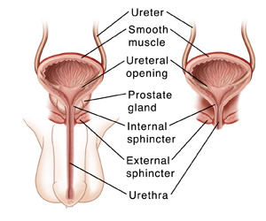
The Urethra
The urethra is a tube leading from the bladder to an exit from the body
In the female, it is a straight tube about 1 ½ inches in length
In the male, the urethra, is about 8 inches, extending internally from the bladder down through the prostate gland and out through the penis, the male urethra also serves as a passageway for semen
A circular muscle sphincter within the urethra permits voluntary control of bladder function
This control, requires an intact nerve supply and motor area of the brain

Slide 15
Dialysis
When your kidneys are healthy, they clean your blood
They also make hormones that keep your bones strong and your blood healthy
When your kidneys fail, you need treatment to replace the work your kidneys used to do
Unless you have a kidney transplant, you will need a treatment called dialysis
Dialysis is a process for removing waste and excess water from the blood, and is used primarily to provide an artificial replacement for lost kidney function in people with renal(kidney) failure
The term artificial kidney is refers to as a kidney dialysis unit

Slide 16
How Dialysis Works
You access the bloodstream by a fistula or graft, one or two needles are inserted into it at the start of each dialysis session
Plastic tubes attached to these needles connect them to a special filter called an artificial kidney
The blood leaves the body via one needle, and is pumped through the artificial kidney
There is an artificial membrane in the artificial kidney, it removes wastes and extra fluid
The clean blood is then returned to the body via another needle
Both needles are removed at the end of the session
Only a small amount of blood (about 200ml or less than 1 cup) is outside your body at any one time
Dialysis usually needs to be performed three times a week
Each treatment takes 3 to 6 hours
The patient may feel tired and weak after treatment

Slide 17
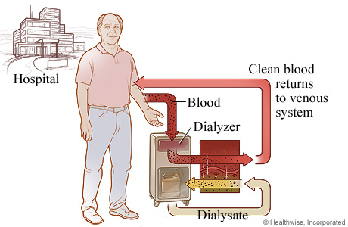
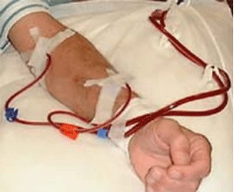
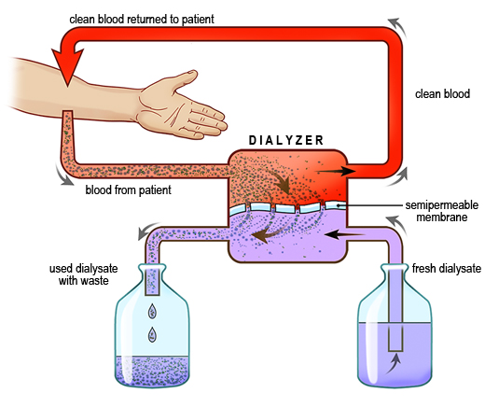

Slide 18
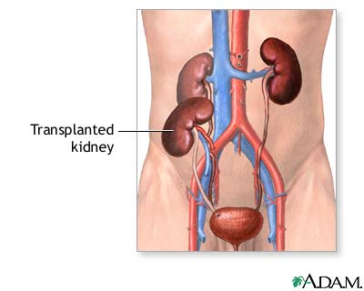
Kidney Transplant
The transplantation of body organs is always at risk of recipient rejection; however, the kidney can usually be successfully transplanted, and the survival of the transplant has been markedly improved by medications
Only one donated kidney is needed to replace two failed kidneys, making living-donor kidney transplantation an option

Slide 19
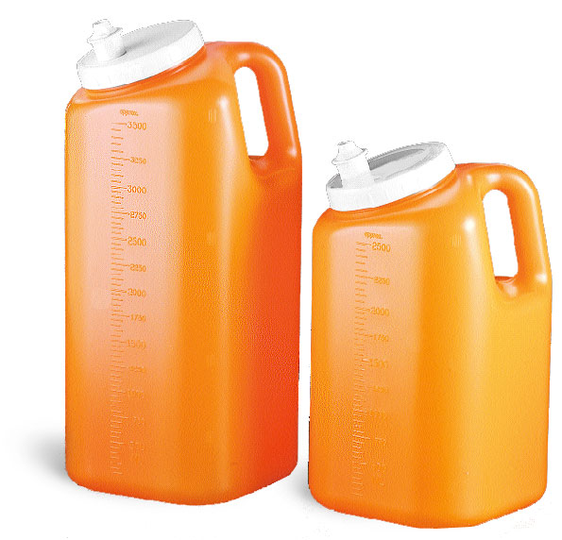
Diagnostic Examinations
24 hour urine test: collects all urinary output, from a specified hour one day until the same time the next day
This test is noninvasive (the skin is not pierced), and is used to assess kidney (renal) function
The container must be kept cool(in the refrigerator) during this time until it is returned to the lab for analysis

Slide 20
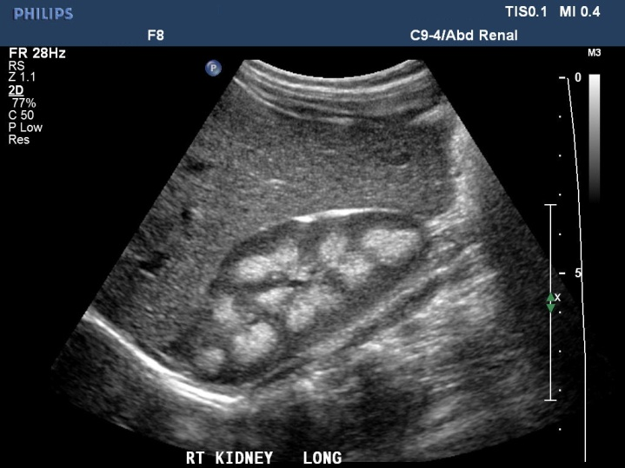
Diagnostic Examinations
Kidney ultrasound: this is a noninvasive procedure used to assess the size, shape, and location of the kidneys
Ultrasound technology allows quick visualization of the kidneys and related structures from outside the body
This may also be used to assess blood flow to the kidneys

Slide 21
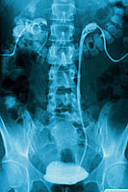
Diagnostic Examinations
Intravenous pyelogram (IVP) is a invasive special xray examination of the kidneys, bladder, and ureters
This procedure involves an inject with iodine-based contrast (dye) into a vein in the arm
A series of x-ray images are taken at different times to see how the kidneys remove the dye and how it collects in your urine
This test checks for any obstructions or disease

Slide 22
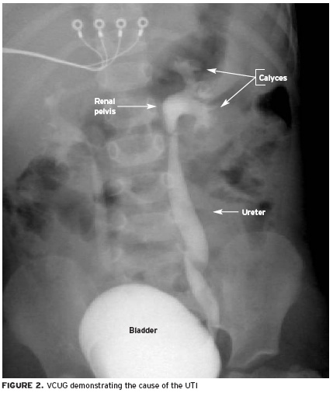
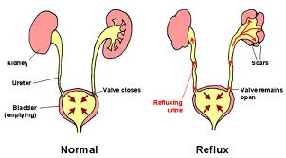
Diagnostic Examinations
Voiding cystourethrogram(VCUG): is a minimally invasive test that uses a special x-ray technology called fluoroscopy to visualize your child's urinary tract and bladder A VCUG can help diagnose reflux a condition in which urine flows the wrong way, from the bladder back up to the kidneys and to determine why a child has recurring urinary tract infections

Slide 23
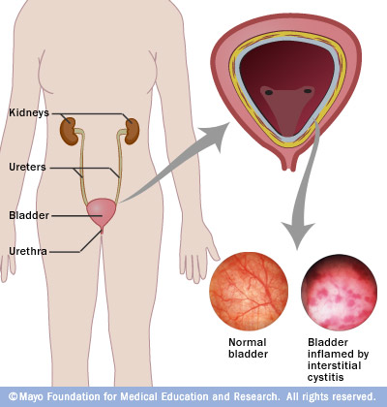
Diseases And Disorders
Cystitis: inflammation of the bladder
Most of the time, the inflammation is caused by a bacterial infection, in which case it may be referred to as a urinary tract infection (UTI)
A bladder infection can be painful and annoying, and can become a serious health problem if the infection spreads to your kidneys

Slide 24
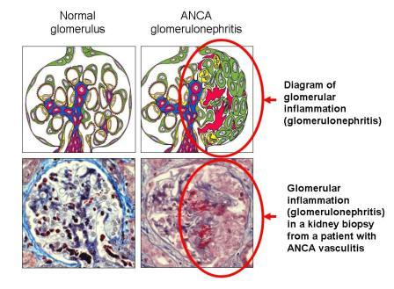
Diseases And Disorders
Glomerulonephritis: inflammation of the glomerulus of the nephron
This can occur following a bacterial infection of the respiratory tract, the urinary tract, or the bloodstream(immune system)
Symptoms include: hematuria or abdominal swelling

Slide 25
Diseases And Disorders
Incontinence: this is the uncontrollable loss of urine
85% of female suffer from this
40% are usually over the age of 60
Male’s may be affected by not as frequently as women
Stress incontinence, which is more common in women, causes urine to leak when you laugh or cough
Overactive bladder, also called urge incontinence, is caused by urinary muscle spasms that cause an urgency to urinate
Incontinence can also be caused by multiple pregnancies, being overweight, and genetic weaknesses.

Slide 26
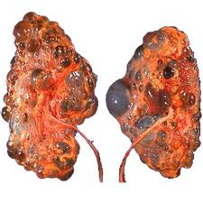
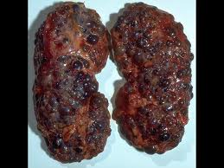
Diseases And Disorders
Polycystic disease: this is an inherited disorder
This affects the kidney with grapelike clusters of fluid filled cysts the replace normal renal tissue of the kidneys
Any urinary tract infection should be treated quickly with antibiotics
Cysts that are painful, infected, bleeding, or causing a blockage may need to be drained
There are usually too many cysts to make it practical to remove each cyst

Slide 27
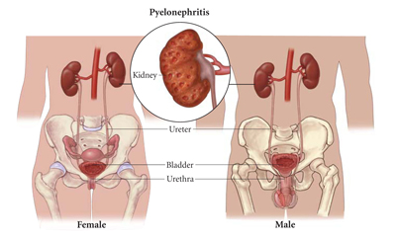
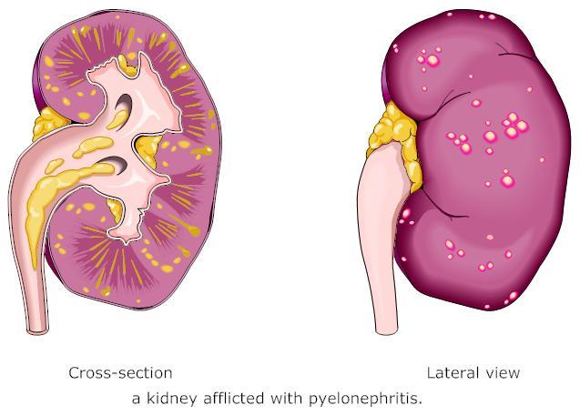
Diseases And Disorders
Pyelonephritis(kidney infection): this is the most common kidney infection
Symptoms include: back, side, and groin pain, urgent, frequent urination, pain or burning during urination, fever, nausea and vomiting, pus and blood in the urine
This is caused by bacteria typically spread from the bladder up the ureters and into the kidneys
Treatments are antibiotics and renal US

Slide 28
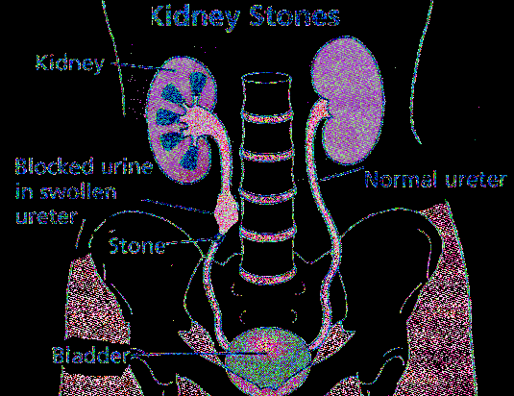
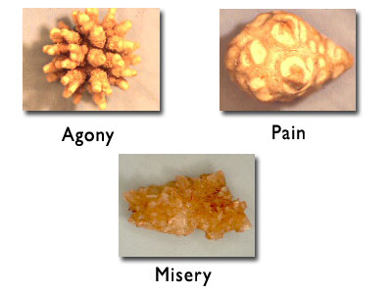
Diseases And Disorders
Renal Calculi(kidney stones): are formed by chemicals in the urine, forming crystals that stick together
They may be as small as a grain of sand or as large as a golf ball
Small stones pass out are of the kidney with the urine
Some that are larger become caught in the ureter, where they cause severe pain
Kidney stones affect primarily young to middle-aged adults, with men being affected four times as often as women

Slide 29
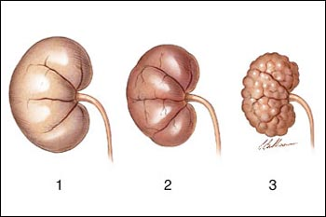
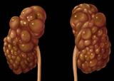
Diseases And Disorders
Renal failure: this is a critical illness that results in the sudden cessation of the kidney function
Effective medical treatment usually can overcome the problem
Acute (sudden) kidney failure is the sudden loss of the ability of the kidneys to remove waste and concentrate urine without losing electrolytes
Chronic kidney disease is the slow loss of kidney function over time.
1. Acute renal failure
2. Normal kidney
3. Chronic renal failure

