Slide 1
The Endocrine System
Chapter 11 Unit 12

Slide 2
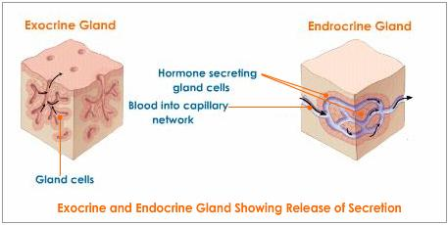
The Endocrine System
The endocrine system is made up of glands that produce and secrete hormones and substances directly in the blood stream
These hormones regulate the body's growth, metabolism (the physical and chemical processes of the body), sexual development and function
The hormones are released into the bloodstream and may affect one or several organs throughout the body
Endocrine glands are ductless, in other words, their secretions do not drain into the body by the way of a duct but are secreted directly into the capillaries of the circulatory system
Glands secreting substances through ducts are exocrine glands
Example: the pancreas secretes pancreatic juices by the way of a duct into the duodenum, so its an exocrine gland, however the pancreas also secretes insulin directly into the blood, which also makes it an endocrine gland
Review:
Endocrine glands are
ductless(endo-within)
Exocrine glands secret
through a duct(exo-away from)

Slide 3
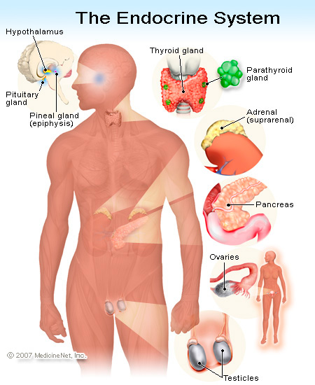
The Endocrine System
The secretions from endocrine glands are called hormones
Examples of hormones: growth and development, metabolism, the composition of the blood and bones, and sexual maturity
There are nine glands(or groups):
1. The pituitary gland
2. The thyroid
3. The parathyroid(s)
4. The pancreas
5. The adrenals
6. The ovaries
7. The testes
8. The thymus
9. The pineal body
Each gland performs a specific function

Slide 4
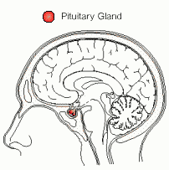
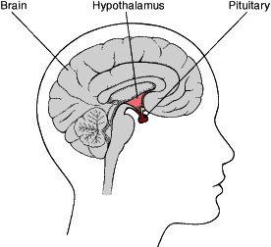
The Pituitary Gland
The pituitary gland is considered to be the “master” gland of the body, secreting a large number of hormones that affect other glands, growth, and development
This gland is so vital to the body that it is protected within a bony cradle deep within the skull

Slide 5
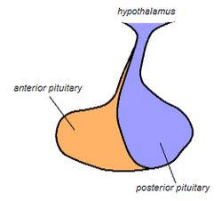
The Pituitary Gland
This tiny gland, not much larger than a pea, secretes nine known hormones
The pituitary is functionally connected to the hypothalamus
The pituitary gland consists of a large anterior lobe and a small posterior lobe

Slide 6
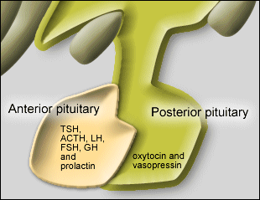
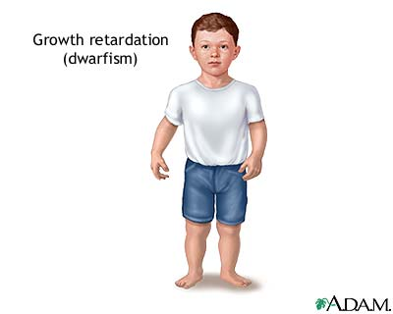
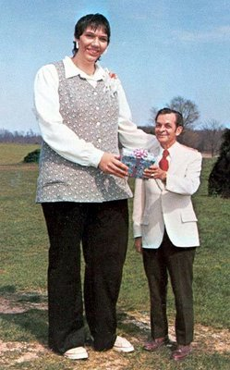
The Anterior Pituitary Gland
The anterior pituitary synthesizes and secretes the following important endocrine hormones:
1.Growth hormone: insufficient production during childhood results in dwarfism, or overproduction, gigantism

Slide 7
The Anterior Pituitary Gland
2. Thyroid stimulating hormone(TSH)
3. Adrenocorticotropic hormone(ACTH): response to stress, abnormal level could be an indication of Cushing's disease
4. Prolactin: for the production of breast milk
5. Follicle-simulating hormone(FSH) : regulates the development, growth, pubertal maturation
6. Luteinizing hormone(LH): In both males and females, LH is essential for reproduction
7. Melanocyte-stimulating hormone: increases pigmentation of the skin

Slide 8
The Posterior Pituitary
The posterior pituitary synthesizes and secretes the following important endocrine hormones:
1. Oxytocin: stimulates the contractions of the uterus during childbirth, and is responsible for the flow of milk from the breast
2. Vasopressin: constrict blood vessels, and responsible for increasing water absorption in the collecting ducts of the kidney nephrons

Slide 9
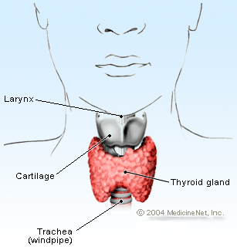
Thyroid Gland
The thyroid gland has two lobes, one on each side of the larynx
The gland is encased in a capsule of connective tissue
The thyroid gland produces three hormones:
1. Thyroxine(T4): amount of protein available in the blood to bind to the hormone
2. Triiodothyronine(T3): the T3 test is usually ordered following an abnormal TSH and T4 test
T3 functions includes growth, body temperature, and heart rate
3. Thyrocalcitonin: causes reduction of blood calcium

Slide 10
Understanding Hypothyroid and Hyperthyroid
When the thyroid, for whatever reason -- illness, stress, surgery, obstruction, for example -- does not produce enough thyroid hormone, the pituitary detects this reduction in thyroid hormone, and it moves into action. The pituitary then makes MORE TSH, to help trigger the thyroid to produce more thyroid hormone. This is the pituitary's effort to return the system to "normal" and normalize thyroid function.
A TSH that is higher than normal suggests a thyroid that is underactive and not doing its job of producing thyroid hormone. So, in general, HIGHER TSH = UNDERACTIVE THYROID HYPOTHYROIDISM

Slide 11
Hypothyroidism and Hyperthyroidism
Hypothyroidism : is a condition in which the thyroid gland does not make enough
thyroid hormone
Women, especially those older than age 50, are more likely to have hypothyroidism
Symptoms: weight gain, fatigue, cold, low blood pressure and pulse rate
Treatment includes thyroid medication and monthly lab tests to regulate thyroid levels and medication doses
Hyperthyroidism: is a condition in which the thyroid gland makes too much thyroid
hormone
The condition is often referred to as an "overactive thyroid.”
Or Graves disease
Symptoms: weight loss, irritable, restless, nervous, high blood pressure and pulse rate
Treatment includes surgical removal of the gland, or radiation to eliminate the function of the gland

Slide 12
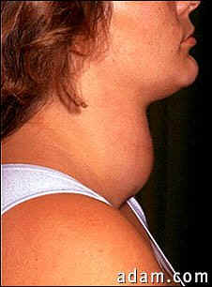
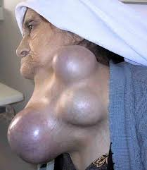
The Thyroid Gland
The thyroid gland requires iodine to form the thyroid hormones
Iodine is obtained by eating vegetables grown in soil containing iodine or by eating seafood
Lack of iodine causes the thyroid gland to enlarge
An enlarged thyroid gland is known as a goiter
South-East Asia is the highest

Slide 13
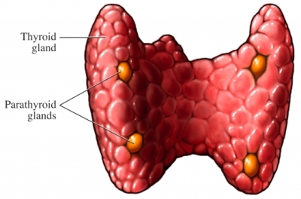
The Parathyroid Glands
The parathyroid glands, usually two pairs, are embedded on the posterior surface of the thyroid gland
These are oval, grain-of-rice-sized glands
The parathyroid glands are responsible for regulating the calcium and vitamin D contents in the blood

Slide 14
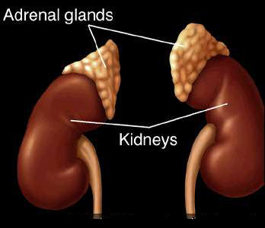
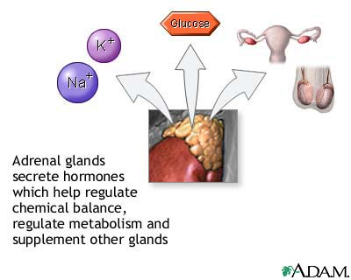
Adrenal Glands
Adrenal glands: are endocrine glands that sit atop the kidneys
The outer part of the adrenal gland is called the cortex and produces steroid hormones such as cortisol, aldosterone, and testosterone
The inner part of the adrenal gland is called the medulla and produces epinephrine and norepinephrine(that helps the liver release glucose and limits the release of insulin)

Slide 15
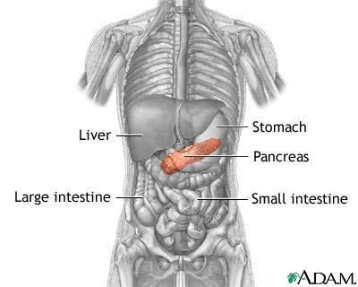
Pancreas
The pancreas is a dual-function organ(features of both endocrine and exocrine glands)
Produces pancreatic juices excreted by the way of the pancreatic duct into the duodenum to become part of digestive juices(that assist the absorption of nutrients and the digestion)
The pancreas secrete insulin (necessary for the metabolism of carbohydrates)
Hyperglycemia or high blood sugar, is a condition in which an excessive amount of glucose circulates in the blood plasma
Hypoglycemia is a condition that occurs when your blood sugar (glucose) is too low

Slide 16
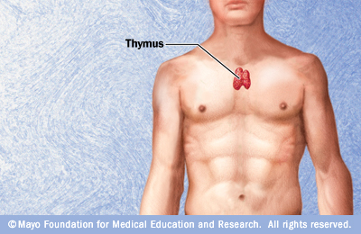
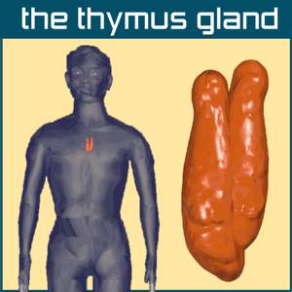
Thymus Gland
The thymus gland is a two-lobed structure located under the sternum
The thymus is fairly large during childhood but begins to disappear with the onset of puberty, becoming a small mass of connective tissue and fat in adulthood
It is involved in the production of T-cells that make up our immune system

Slide 17
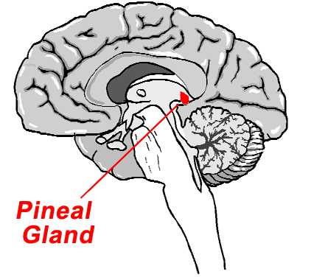
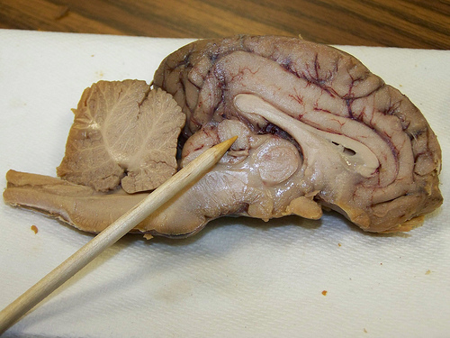
Pineal Body(gland)
The pineal body is a small mass of tissue attached by a slim stalk to the roof of the third ventricle in the brain
The pineal body is believed to produce a substance called melatonin(helps control your sleep and wake cycles), and puberty onset

Slide 18
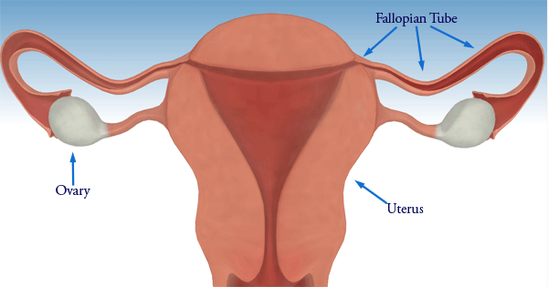
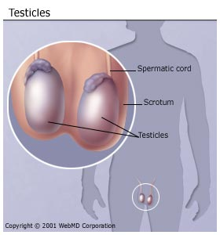
Gonads(Testes And Ovaries)
The ovaries in the female and the testes in the male are called gonads or sex glands
The ovaries are located in the pelvic cavity, one on each side of the uterus
The testes are located outside the body of the male, suspended in the scrotum
Both gonads secrets hormones that control the development of secondary sex characteristics

Slide 19
Gonads(Testes And Ovaries)
In the female, the ovaries secrete estrogen, responsible for the growth and development of female sexual characteristics, reproduction controls growth of the uterine lining during the first part of the menstrual cycle, causes changes in the breasts during adolescence and pregnancy
Another hormone, progesterone, involved in the female menstrual cycle, pregnancy
In the male, the testes produce a hormone known as testosterone, this hormone develops the primary and secondary male sexual characteristics
Before puberty, the testosterone level in boys is normally low
Testosterone increases during puberty
This causes boys to develop a deeper voice, get bigger muscles, make sperm, and get facial and body hair
The level of testosterone is the highest around age 40, then gradually becomes less in older men

Slide 20
Diagnostic Examinations
Many diagnostic exams can be performed on blood and urine tests that measure the hormones on the body
Blood sugar: should be measured fasting, to assess the function of the pancreas, including insulin
T3, TSH, T4: to measure the thyroid hormones
Urine human chorionic gonadotropin(HCG): to measure the presence of a hormone secreted by the placental cell(pregnancy)
Glucohemoglobin AIC: to measure glucose level over the pervious 3 month period

Slide 21
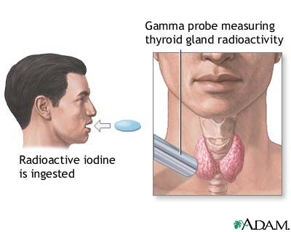
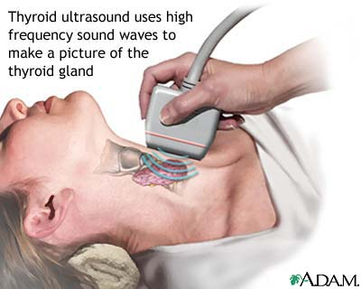
Scanning Tests
Radioactive iodine uptake test: The patient swallows a liquid or capsule containing radioactive iodine, a probe is placed over the thyroid gland along the outside of the neck, checks the function of the thyroids ability to absorb and retain iodine
Ultrasound: accesses the size of the thyroid

Slide 22
Diseases And Disorders
Acromegaly: is a chronic metabolic disorder in which there is too much growth hormone and the body tissues gradually enlarge.
It is caused by abnormal production of growth hormone after the skeleton and other organs finish growing
The cause of the increased growth hormone release is usually a noncancerous (benign) tumor of the pituitary gland
Sun Mingming ^{7 feet 9 in}
Jay Leno

Slide 23
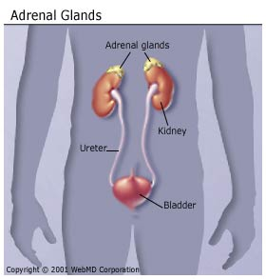
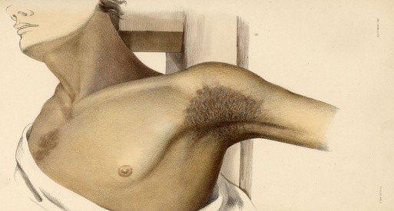
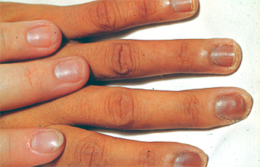
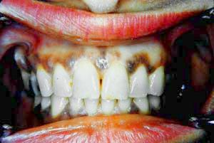
Diseases And Disorders
Addison’s disease: is a disorder that occurs when the adrenal glands do not produce enough of their hormones cortisol(lack if pigmentation)
Addison's disease occurs in all age groups and affects both sexes
Addison's disease can be life-threatening
Treatment for Addison's disease involves taking hormones to replace the insufficient amounts being made by your adrenal glands, in order to mimic the beneficial effects those naturally made hormones would normally produce

Slide 24
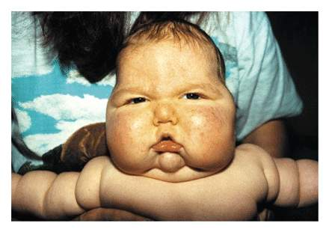
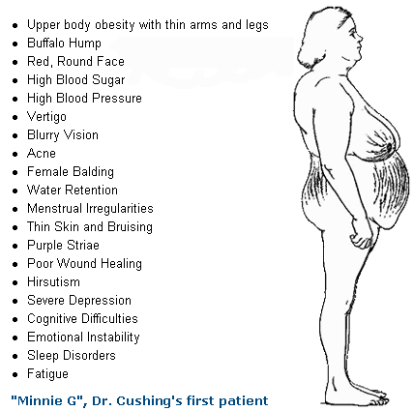
Diseases And Disorders
Cushing’s disease: this is an endocrine disorder of the adrenal glands that have physical and physiologic effects
Too much cortisol can produce some of the hallmark signs of Cushing's syndrome — a fatty hump between your shoulders, a rounded face, and pink or purple stretch marks on your skin
Cushing's syndrome can also result in high blood pressure, bone loss and, on occasion, diabetes
Treatments varies

Slide 25
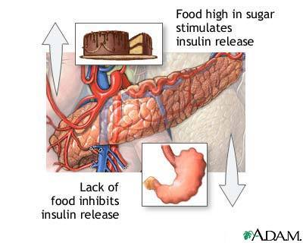
Diabetes Mellitus
Glycosuria is the medical term for sugar(glucose) in the urine
Hyperglycemia and glycosuria are the two outstanding characteristics of diabetes mellitus
Type 1 diabetes: this can occur at any age, however, it is most often diagnosed in children, adolescents, or young adults
Insulin is a hormone produced by special cells, called beta cells, in the pancreas
Insulin is needed to move blood sugar (glucose) into cells, where it is stored and later used for energy
In type 1 diabetes, beta cells produce little or no insulin
Everyone with type 1 diabetes must take insulin every day
Type 2 diabetes is a lifelong (chronic) disease in which there are high levels of sugar (glucose) in the blood
Type 2 diabetes is the most common form of diabetes
This is caused by a problem in the way your body makes or uses insulin

Slide 26
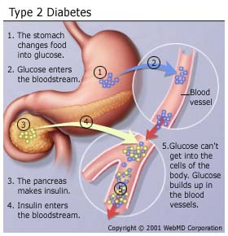
Diabetes Mellitus
High levels of glucose can cause chemical changes in the nerves that prevent the nerves from transmitting signals to different parts of the body. It also damages blood vessels that carry oxygen and nutrients to the nerves.

Slide 27
How Insulin Works
Insulin is the hormone made in the pancreas and released into the bloodstream as glucose rises
It helps sugar to enter the body’s cell, where it is used as fuel for the cell’s activity
When the sugar level rises, the pancreas secretes more insulin, when the sugar level falls too low, insulin secretion is greatly reduced
Our bodies are programmed to store glucose and fat that produce excess weight and obesity when excessive calories are consumed, which leads to diabetes and other illnesses

Slide 28
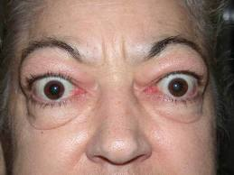
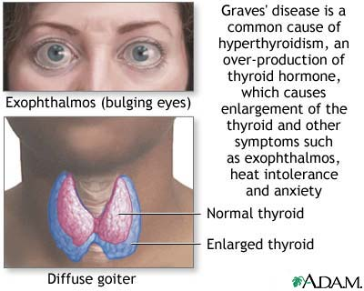
Graves Disease
This condition is the most common from of hyperthyroidism
This is an immune system disorder that results in the overproduction of thyroid hormones
This is when the thyroid gland enlarges and the patient becomes nervous, has an intolerance to heat, loses weight, sweats, has palpitations, and tumors behind the eyes
Patient may become serious ill if left untreated
Because thyroid hormones affect a number of different body systems, signs and symptoms associated with Graves' disease can be wide ranging and significantly influence your overall well-being
Graves' disease is rarely life-threatening
Treatment includes anti-thyroid medications, radioactive iodine, or surgery

