Slide 1
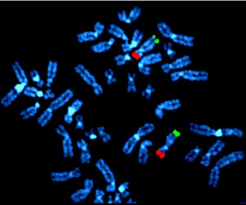
The Reproductive System
Chapter 11 Unit 13

Slide 2
The Reproductive System
The reproductive system consists of the organs that are capable of accomplishing reproduction, the creation of a new individual
All living organisms reproduce, some very simply by an asexual method or without the need of sexual contact
An example of asexual reproduction is one of the simplest forms of life, a single cell, through mitosis( sea stars, plants)
Sexual methods of reproduction are found in multi-celled forms of life, including humans

Slide 3
The Reproductive System
In each species, there are sexes, namely a male and a female
Each sex has special sex glands, or gonads, which produce sex calls(gametes)
In humans, the union of the male gamete(a spermatozoan) with the female gamete(an ovum) forms a new one-celled structure called a zygote
The zygote then undergoes mitosis to form a new individual

Slide 4
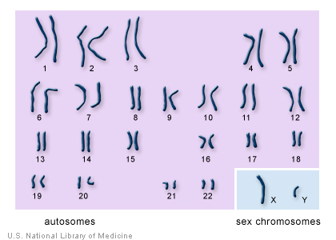
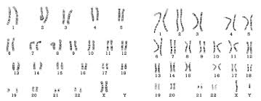
The Reproductive System
In humans, each cell normally contains 23 pairs of chromosomes, for a total of 46
Twenty-two of these pairs, called autosomes, look the same in both males and females
The 23rd pair, the sex chromosomes, differ between males and females
Females have two copies of the X chromosome, while males have one X and one Y chromosome

Slide 5
The Reproductive System
The reproductive organs are the only organs in the human body that differ between the male and female, yet there is still a significant similarity
This likeness results from the fact that male and female organs develop from the same group of embryonic cells

Slide 6
In biology, a hermaphrodite(intersex) is an organism that has reproductive organs normally associated with both male and female sexes.
There are many different reasons a person may exhibit a mix between male and female genitalia. In many cases, the individual has a "normal" genotype (XX or XY) but a mutation in some other gene that causes the genitalia to form differently. It is important to realize that every human being starts out as a "hermaphrodite," in that you possess both male and female proto-sexual organs while you are developing, and one or the other is typically suppressed/degrades depending on your chromosomal makeup.

Slide 7
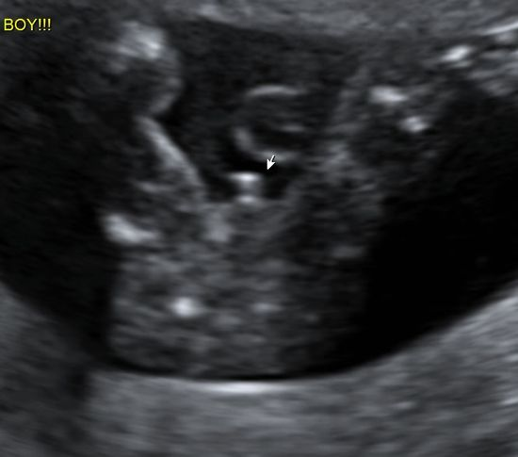
Male Reproductive Organs
When the zygote(is the initial cell formed when two gamete cells are joined by means of sexual reproduction) contains a Y chromosome, a male child with develop
About the 7th or 8th week of pregnancy, the testes begin to develop within the abdominal cavity
The sex of the fetus is evident by about the 4th month

Slide 8
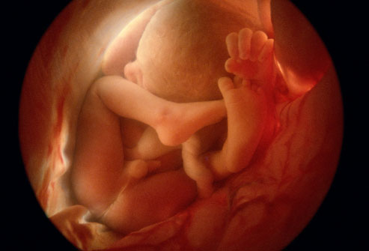
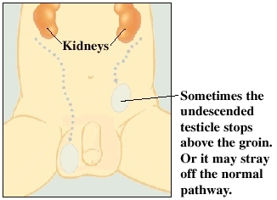
Male Reproductive Organs
During the 9th month of pregnancy, the testes move from the abdomen through the inguinal canal into the external pouch called the scrotum
If the testes fail to descend or if they return to the abdomen, a condition known as undescended testicle exists(hormone injections or surgery 3 out of 10)
The testes normally produce sperm. Sperm cannot be produced or survive in the internal heat of the body

Slide 9
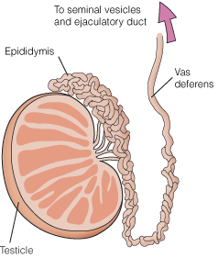
Testes/Sperm
The testes are the primary sex organs of the male
Testes have two main functions: to produce sperm and to secrete testosterone
These functions begin to occur about age 10
Sperm develop and mature in microscopic tubes in the testes
There are about 300 sections of coiled tubules, if uncoiled, are estimated to extend about a mile long
Sperm formation in an adult male requires about 74 days to mature

Slide 10
Testosterone
Testosterone aids in the maturing of sperm and causes many changes including:
Longer and heavier bone structure
Larger muscles
Deep voice
Growth of body hair
Development of the genitalia
Increased metabolism
Sexual desire

Slide 11
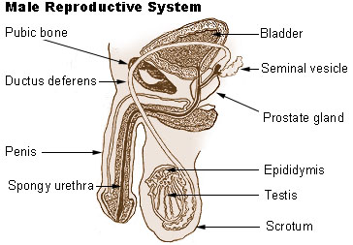
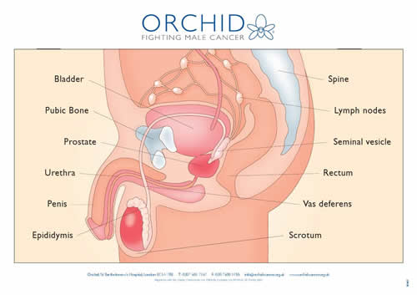
Epididymis, Vas Deferens, And Seminal Vesicles
The epididymis is a coiled structure about 20 feet long
Sits on top of the testes
After sperm are produced in the tubules, they pass into the epididymis, where a small number are stored
The vas deferens serves as the passageway for sperm to exit the epididymis, this propels sperm into the urethra and out of the penis during ejaculation
The seminal vesicles are a pair of tubes lying posterior to the bladder, these vesicles secrete a fluid that contains fructose(sugar) which provide nutrients to sperm

Slide 12
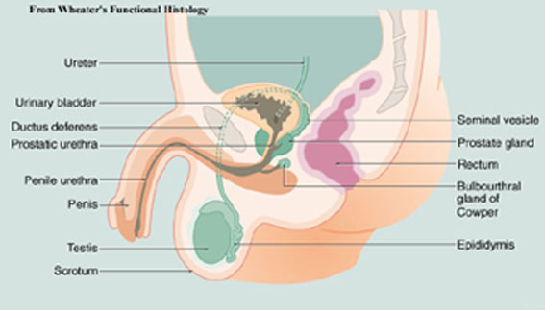
Prostate Gland and Bulbourethral Glands
The prostate gland is a donut-like structure with the urethra extending through its center
The gland is positioned just beneath the bladder, and preserves sperm
The bulbourethral glands(cowper’s gland) lies beneath the prostate and empty into the urethra(the liquid aids in the movement of the sperm)

Slide 13
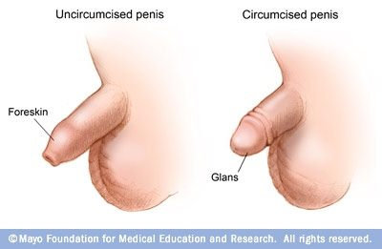
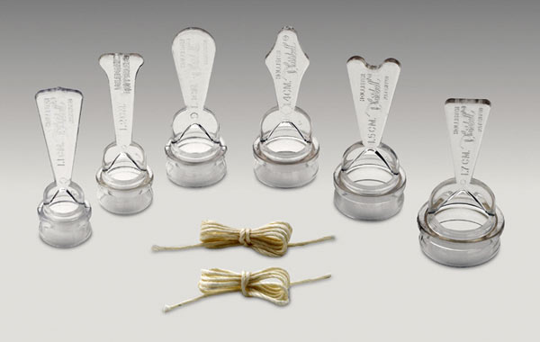
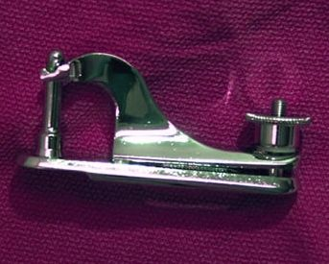
Semen And Penis
The combined secretions from all the glands and ducts along with the sperm are called semen
The penis is surrounded by a layer of subcutaneous tissue and is covered with skin
A circular fold of skin that extends down over the gland is called the foreskin
A circumcision is a surgical removal of the foreskin(helps with infections)

Slide 14
Vasectomy
Vasectomy is a simple surgical procedure to prohibit the production of sperm and effect sterilization of the male
During the procedure, the vas deferens of a man are severed, and then tied/sealed in a manner such to prevent sperm from entering into the seminal stream (ejaculate)
Sperm is still produced in the tests, but their exit is blocked and will die and be reabsorbed into the body
This procedure will have no effects on testosterone levels

Slide 15
Disease And Disorders Of The Male Reproductive System
Epididymitis: this is inflammation of the epididymis and is an uncommon infection, it may spread to the testicle
Caused by trauma, STI’s, or UTI
Erectile dysfunction or impotence: this is the inability to have or sustain an erection to complete intercourse
Caused by chronic illness, , depression, alcohol, or stress
Hydrocele: this is the presence of an excessive amount of fluid within structures around the testes
Caused by injury or inflammation, surgery is indicated to remove the fluid
Testicular torsion: Genital pain is usually nothing more than a mild and fleeting discomfort. But when it's more painful, it can be caused by a very serious condition called testicular torsion. Testicular torsion is a medical emergency that usually requires immediate surgery to save the testicle. occurs when the spermatic cord that provides blood flow to the testicle rotates and becomes twisted, usually due to an injury or medical condition.

Slide 16
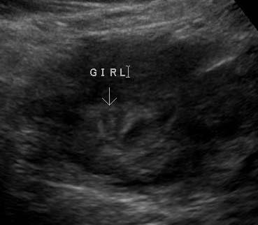
Female Reproductive Organs
Ovaries: the embryonic gonadal tissue that is to become the ovaries begin to develop about the 10th or 11th week of pregnancy

Slide 17
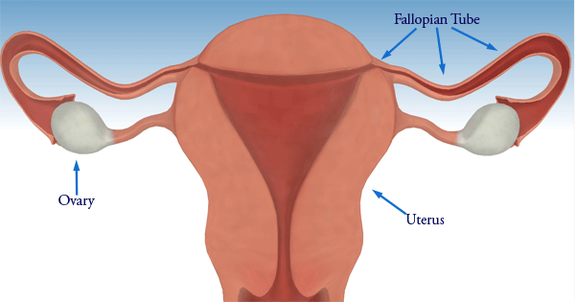
Ovaries
These two organs play a significant role in the life of every female
They have two main roles:
1. to produce the sex cell
2. to secrete hormones
These functions parallel the role of the testes in the male
It is estimated that at birth the ovary has between 200,000 to 400,000 follicles, which contain immature ova, and mature by puberty, by age 50, most of them have disappeared
The ovaries are the primary sex organs of the female
The ovaries produce estrogen, which develops the sex organs and produces secondary sex characteristics, which alter the shape and appearance of the female body

Slide 18
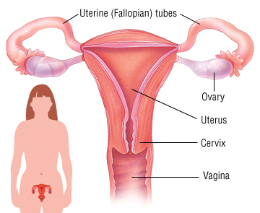
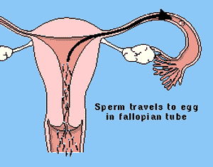
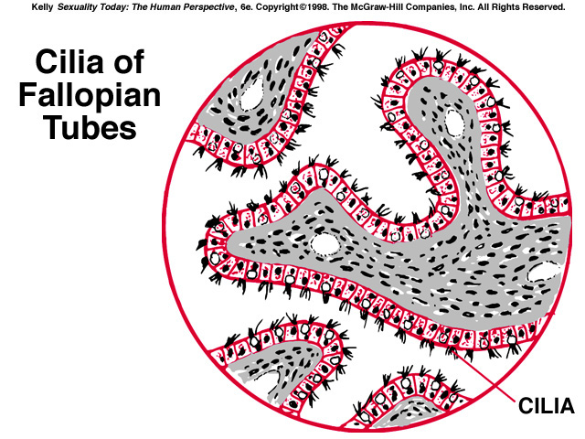
Fallopian Tubes
The fallopian tubes extend about 4 inches from the superior lateral surface of the uterus and are attached to the broad ligament
Upon ovulation, the ovum moves toward the opening of the tube
The cilia move to create a current moving the ovum toward the uterus

Slide 19
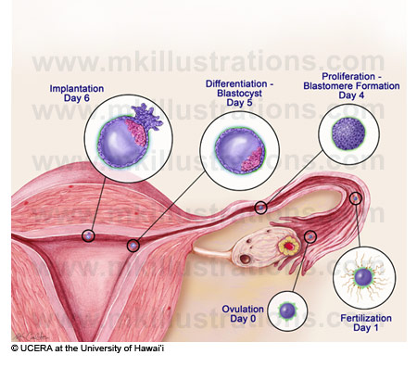
Fallopian Tubes
Normally, conception(fertilization) takes place in the outer third of the fallopian tube
Upon union, the two cells begin to multiply
The secretions of the tubes provide nutrition for the new zygote, which must now move into the uterus within 3 to 7 days for implantation and development

Slide 20
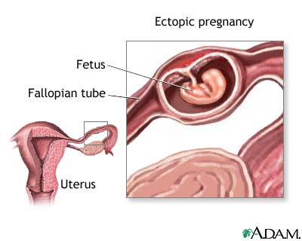
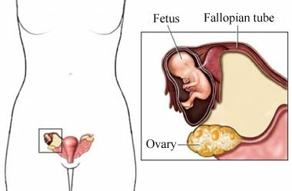
Ectopic Pregnancy
An ectopic pregnancy is an abnormal pregnancy that occurs outside the womb (uterus)
The baby (fetus) cannot survive, and often does not develop at all in this type of pregnancy
An ectopic pregnancy is often caused by a condition that blocks or slows the movement of a fertilized egg through the fallopian tube to the uterus
This may be caused by a physical blockage in the tube by hormonal factors and by other factors, such as smoking
Emergency surgery is needed for an ectopic pregnancy, this can break open (ruptures)
Rupture can lead to shock, an emergency condition
Although there have been a few reported cases of women giving birth by cesarean section to live infants that were located outside the uterus, this is extremely rare

Slide 21
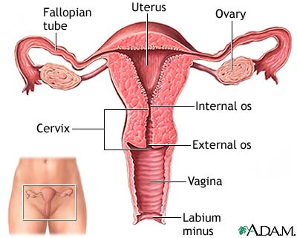
Uterus
The uterus is a thick-walled, hollow, muscular organ lying within the pelvis, behind the urinary bladder, and in front of the rectum
Once the egg has left the ovary it can be fertilized and implant itself in the lining of the uterus
The main function of the uterus is to nourish the developing fetus prior to birth
The cervix, or narrowed section is and internal opening of the vagina

Slide 22
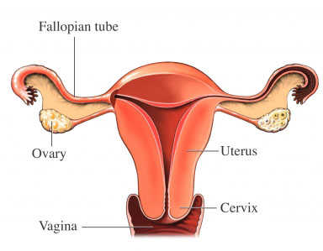
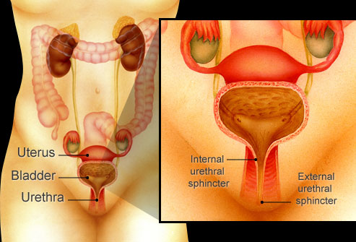
Vagina
The vaginal is a collapsible muscular tube lined with mucous membrane, which is arranged in folds
This serves as the passageway for menstruation, for sexual intercourse, and the birth canal for the delivery of an infant
The external opening is partially covered by folds of mucous membrane called the hymen

Slide 23
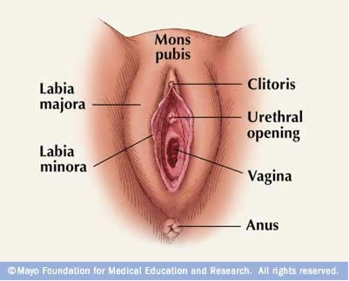
Vulva
The vulva is the area of the female external sexual structures
The large pad of fat, covered with hair is known as the mons pubis
The labia majora are the pair of rounded folds of skin on each side of the vulva
The labia minora lie within the labia majora and are covered with mucous membranes that is continuous with the lining of the vagina

Slide 24
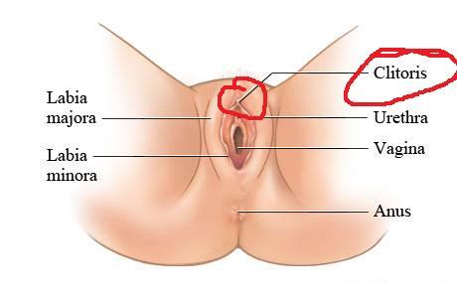
Clitoris
The clitoris is a female genital organ that includes erectile tissue, glands, muscles
and ligaments, nerves, and blood vessels

Slide 25
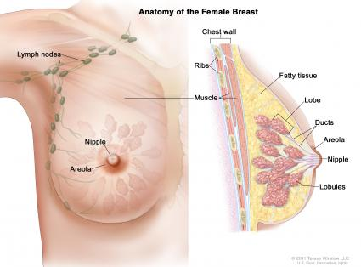
Mammary Glands(Breasts)
The mammary glands are secondary sexual structures that develop and function only in the female
Each lobe have connective tissue with grapelike clusters of secreting cells embedded in the tissue
The main ducts exit on the surface of the nipple through tiny openings
Fatty tissue is deposited around the surface of the gland, between the lobes and beneath the skin
A darkened area called the areola surrounds the nipple
About 3 days after delivery, the glands begin to secrete milk resulting from hormonal stimulation from the pituitary
The hormone prolactin stimulates the production of milk

Slide 26
Menstruation
When the ovum is not fertilized, and therefore the uterine structures prepared for reception of the embryo are not needed, the lining deteriorates and is discharged from the body in the process called menstruation
Menstruation begins at menarche(first cycle) and ends with menopause
The menstrual cycle can be divided into four phase:
1. The Follicular Phase: within the 5th day in the cycle, the pituitary secretes high levels of FSH to stimulate the ovarian follicles, and brings about ovulation
2. The Ovulation: the follicle releases the matured ovum, estrogen is at a high level, this is when you are most likely to become pregnant(day 14)
3. The Luteal Phase: this phase the egg is released from the egg follicle on the ovary(day 26)
4. Menstruation: with hormonal support gone, the lining buildup in the uterus begins to slough off, causing menstruation from day 1 to 5
What is menstruation or menses:
Hormones trigger your ovaries to produce and release one egg from either your right or your left ovary. This is called ovulation. Before ovulation occurs, your uterine lining is thickening to prepare for a fertilized egg to implant in the uterus. If an egg is not fertilized, then the uterine lining sheds. This is called menstruation or your menstrual period.

Slide 27
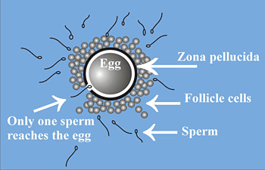
Fertilization
The miracle of reproduction begins with fertilization
The process of fertilization involves a sperm fusing with an ovum
Sperm is released at the rate of about 360 million per ejaculation and are deposited in the female vagina
The ovum must be fertilized within 24 hours or fertilization will be postponed until the next ovum is ready in approximately 1 month

Slide 28
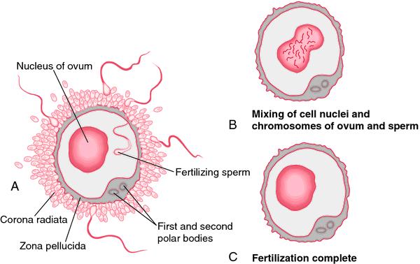
Pregnancy
About 36 hours after fertilization occurs, the zygote begins to grow from it’s one-cell beginning
It is almost beyond comprehension to realize that everything necessary to the formation of new life, the bones, muscles, blood vessels, the brain, all the organs, the skin and hair are all contained in one microscopic cell

Slide 29
Pregnancy
Pregnancy is counted in weeks(40 weeks) and trimesters:
Weeks 1-4 : You are in your first month
Weeks 5- 8: You are in your second month
Weeks 9-13: You are in your third month
Weeks 14-17: You are in your fourth month
Weeks 18-21: You are in your fifth month
Weeks 22-26: You are in your sixth month
Weeks 27-30: You are in your seventh month
Weeks 31-35: You are in your eighth month
Weeks 36-40: You are in your ninth month
First trimester: month 1-3
Second trimester: month 4-6
Third trimester: month 6-9

Slide 30
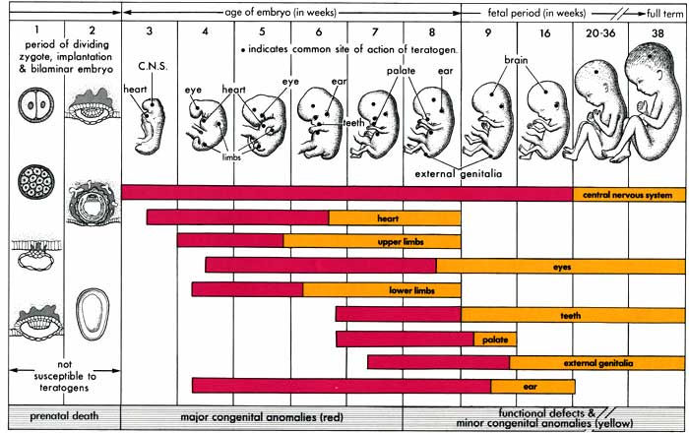

Slide 31
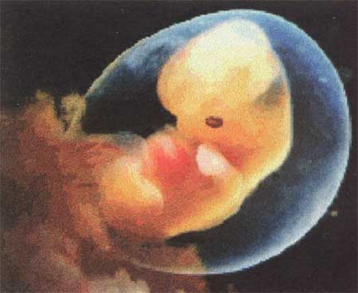
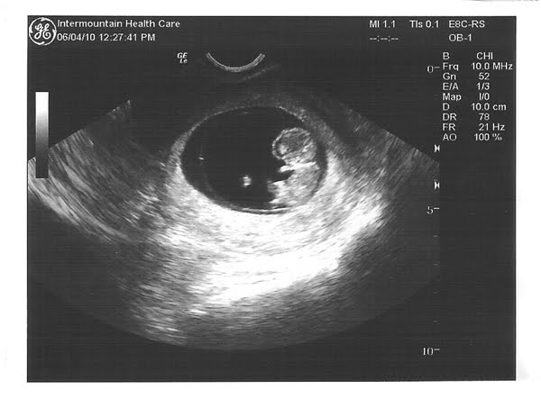
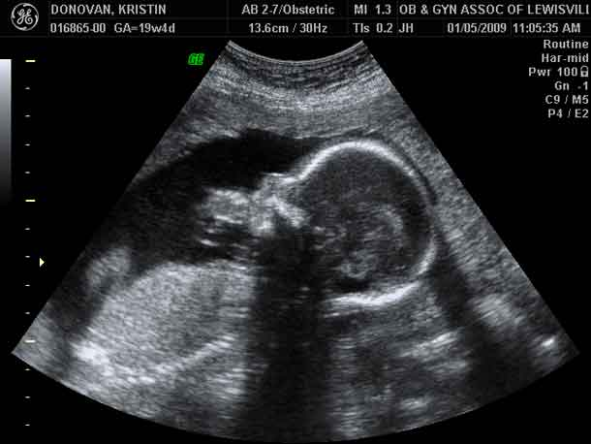
Pregnancy
The embryo develops from head down, which explains why the head is so large compared to the rest of the body
By the end of the 10th week of pregnancy, all systems are completed, even to the nail on the fingers
By week 12, the sex can be determined
By week 20, movement can be felt

Slide 32
Contraception page 580-581
Some religious groups and ethnic groups oppose birth control, however, this subject is presented factually, from a clinic viewpoint, as information required for practice as a medical assistant
Contraception implies “against” conception
Abstinence: refraining from sexual intercourse
Sterilization: tubal ligation(cutting of the fallopian tube)
Depo-provera: injection given every three months
Birth control pills: this prevents ovulation once a day pill(many different kinds)
Contraceptive ring: flexible ring inserted into the vagina once a month
Intrauterine device(IUD): a small piece of plastic material inserted into the uterus to prevent implantation of a fertilized egg(94-99%)
Diaphragm: a thin piece of dome-shaped rubber with a firm ring, inserted into the vagina to cover the cervix(6 hours), used with contraceptive cream, cleaned and inspected after each use
Condom: a thin sheath of rubber or latex that fits over an erect penis to catch the semen, one time use

Slide 33
Pregnancy Termination/Screening Tests In Pregnancy
Abortion: this is the spontaneous or induced loss of pregnancy of less than 20 weeks
The cervix is dilated and the fetus is expelled
Alpha-fetoprotein screening(AFT): this is a blood test taken at about 15 to 18 weeks of pregnancy to aid in the detection of birth defects
When positive results are obtained, another blood sample, an ultrasound, and an amniocentesis are indicated

Slide 34
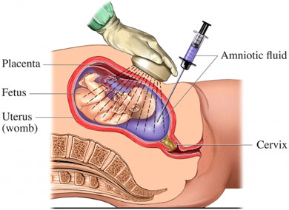
Screening Tests In Pregnancy
Amniocentesis: is a medical procedure used in prenatal diagnosis of chromosomal abnormalities and fetal infections, in which a small amount of amniotic fluid, which contains fetal tissues, is sampled from the amnion or amniotic sac surrounding a developing fetus, and the fetal DNA is examined for genetic abnormalities
A women in her 20’s have only a 1 in 2,500 chance of having a down syndrome child
By age 45, the risk increases to 1 in every 40 births

Slide 35
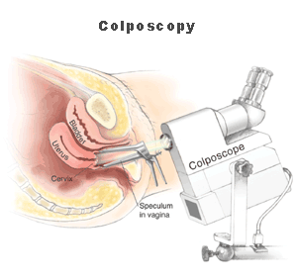
Diagnostic Tests Of The Reproductive System
Colposcopy: an examination and biopsy of the cervix using a colposcope
This is done to rule out cancer when there are abnormal pap smear results (dysplasia: a pre-cancerous condition)
A biopsy is taken from the abnormal sites

Slide 36
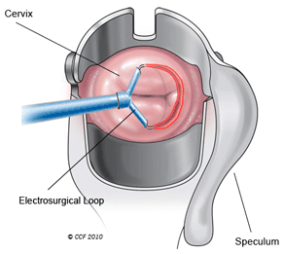
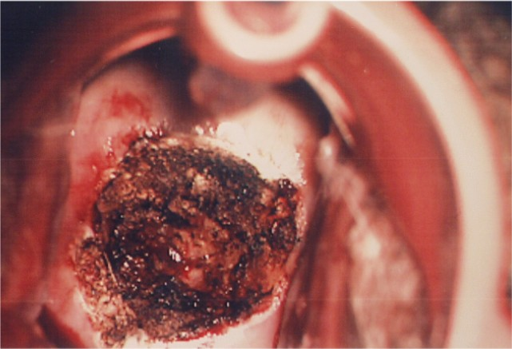
LEEP(Loop Electrosurgical Excision Procedure)
LEEP uses a thin wire loop electrode which is attached to an electrosurgical generator
The generator transmits a painless electrical current that quickly cuts away the affected cervical tissue in the immediate area of the loop wire
This causes the abnormal cells to rapidly heat and burst, and separates the tissue as the loop wire moves through the cervix

Slide 37
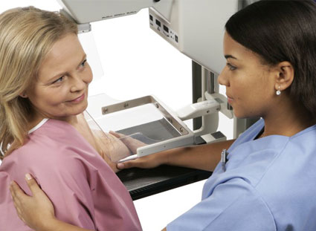
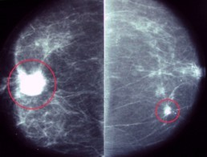
Diagnostic Tests Of The Reproductive System
Mammogram: an x-ray of the breast for the detection of malignancy
A mammogram is recommended between ages 35 to 40
Women at more risk require earlier and frequent examinations

Slide 38
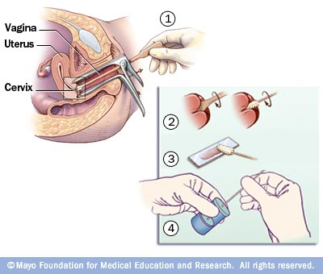
Diagnostic Tests Of The Reproductive System
Papanicolaou(pap smear)- a routine examination done on secretions removed from the cervix and upper vagina to determine the presence of cancerous cells

Slide 39
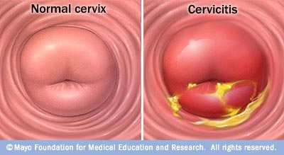
Diseases And Disorders Of The Reproductive System
Cervicitis: This is inflammation of the cervix
Symptoms: vaginal discharge and a tenderness of the cervix
Treatment may include needle aspiration of fluid

Slide 40
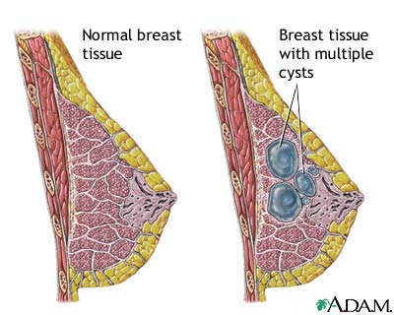
Diseases And Disorders Of The Reproductive System
Fibrocystic breast disease: This is the presence of multiple lumps within the breast tissue
The lumps may be fibrous tumors that have degenerated or cysts containing fluid
Treatment may include needle aspiration of fluid

Slide 41
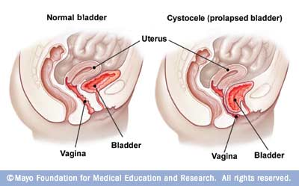
Diseases And Disorders Of The Reproductive System
Cystocele: This is the bulging of the anterior wall of the vagina and the bladder into the vaginal canal
Caused by aging, obesity, lifting of heavy objects, or chronic coughing
Surgery may be necessary to repair the vaginal wall

Slide 42
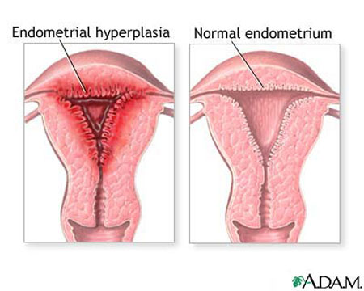
Diseases And Disorders Of The Reproductive System
Endometriosis: The presence of endometrial tissue outside the uterus, affecting the ovaries, ligaments, and peritoneal tissues
Every month, a woman's ovaries produce hormones that tell the cells lining the uterus to swell and get thicker
This can lead to pain, irregular bleeding, and problems getting pregnant (infertility)

Slide 43
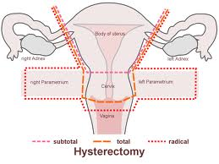
Diseases And Disorders Of The Reproductive System
Hysterectomy: this is the surgical removal of the uterus
It is one of the most common procedures performed on female patients
This is done for endometriosis, rupture, or malignancy
A hysterectomy can be performed in different ways
Hysterectomy may be total (removing the body, fundus, and cervix of the uterus; often called "complete") or partial (removal of the uterus while leaving the cervix intact)

Slide 44
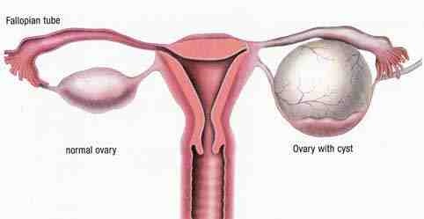
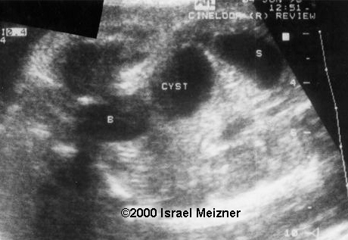
Diseases And Disorders Of The Reproductive System
Ovarian Cyst: this is a sac of fluid on an ovary, it is usually nonmalignant and small
They can occur any time between puberty and menopause
Oral contraceptives may help with hormonal cycle
Treatment may consist of observation to surgery if cyst ruptures

Slide 45
Diseases And Disorders Of The Reproductive System
PMS(premenstrual syndrome)- this condition of characteristics appears from 7 to 14 days before menstruation and usually subsides with the onset
It is estimated that 30% to 50% of women have this condition
The cause is unknown
For some reason intravascular fluid enters the body’s tissues and results in tissue edema
Treatment basically is symptomatic(IBU or Tylenol)

Slide 46
Malignancy Of The Female Reproductive Organs
Breast cancer: this is the most common malignancy among females and the number two cause of death
This can spread to any organs in the body
Symptoms include: a lump, change in shape, change in skin color, drainage, itching, or burning from the nipple
A lumpectomy: is removal of the lump
Mastectomy: is surgical removal of one or both breasts, partially or completely

Slide 47
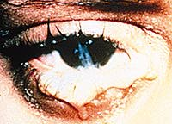
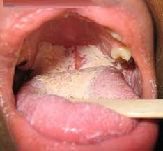
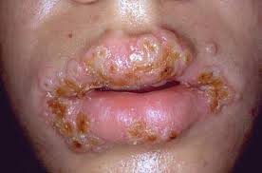
Sexually Transmitted Diseases(STDs)
Chlamydia: this is one of most frequent sexually transmitted disease in North America, affecting between 3 to 10 million people each year
Symptoms do not easily lead to diagnosis
Men may experience burning on urination and/or discharge from the penis
Women experience vaginal discharge and/or painful urination

Slide 48
Chlamydia
Sometimes Chlamydia does not have cause any visible signs
The usual treatment for Chlamydia is antibiotics
Untreated infection, however, may lead to complications
Positive Chlamydia needs to be reported to the Health Department

Slide 49
Sexually Transmitted Diseases(STDs)
Gonorrhea: this is a common veneral disease
The usual sites are the vagina, penis, rectum, and mouth
Symptoms of gonorrhea usually appear 2 - 5 days after infection, however, in men, symptoms may take up to a month to appear
There are two goals in treating a sexually transmitted disease, especially one as easily spread as gonorrhea
The first is to cure the infection in the patient
The second is to locate and test all of the other people the person had sexual contact with and treat them to prevent further spread of the disease

Slide 50
Sexually Transmitted Diseases(STDs)
Herpes simplex 2: Genital herpes is an acute, inflammatory disease of the genitalia
This is a sexually transmitted viral infection, which often produces painful sores, usually in the genital area
Once infected, an individual may carry the virus and be subject to recurrent bouts of infection
As many as 20 percent of the adult population in the United States has been exposed to the virus
Herpes simplex 1: Cold sores, which are small and somewhat painful blisters that usually show up on or around a person's lips, are caused by herpes simplex virus-1 (HSV-1) But they don't just show up on the lips
They can sometimes be inside the mouth, on the face, or even inside or on the nose
Even though HSV-1 typically causes sores around the mouth and HSV-2 causes genital sores, these viruses can cause sores in either place.

Slide 51
Sexually Transmitted Diseases(STDs)
Human Papillomavirus(HPV) Genital warts are soft growths on the skin and mucus membranes of the genitals
They may be found on the penis, vulva, urethra, vagina, cervix, and around and in the anus
Genital warts are a sexually transmitted infection (STI)

Slide 52
Sexually Transmitted Diseases(STDs)
Pediculosis Pebis(pubic lice)- "Crabs" is the common term for lice found in the pubic hair of humans
The source of infection for pubic lice is intimate contact with an infected person
Therefore, pubic lice are often transmitted during sex
Symptoms of infection with the pubic lice of crabs are itching and burning of the pubic area

Slide 53
Sexually Transmitted Diseases(STDs)
Pelvic Inflammatory Disease(PID)-this is a acute or chronic infection of the reproductive tract, including the cervix, uterus, fallopian tubes, and ovaries
Early treatment is necessary to prevent damage to the reproductive system, including infertility
Symptoms include abdominal pain, fever and vaginal discharge
PID is caused mostly by gonorrhea, chlamydia, or IUD devices

Slide 54
Sexually Transmitted Diseases(STDs)
Syphilis: This is a sexually transmitted disease (STD), often has no symptoms, treatment is available in the early stages
Signs and symptoms of syphilis include a firm, round, small, and painless sore on the genitals, anus, or mouth, or a rash on the body, especially on the palms of the hands or the soles of the feet
Utah reported 65 cases in 2010

Slide 55
Sexually Transmitted Diseases(STDs)
Trichomoniasis: This is a sexually transmitted infection caused by the parasite Trichomonas
The disease can affect both men and women, but the symptoms differ between the two groups
The infection usually does not cause symptoms in men and goes away on its own in a few weeks
The parasite cannot survive in the mouth or rectum

