Slide 1
Chapter 11 Unit 4
The Integumentary System

Slide 2
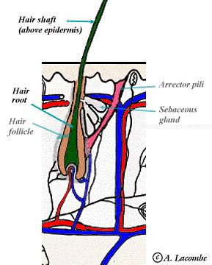
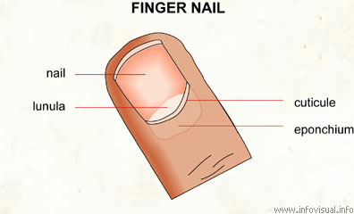
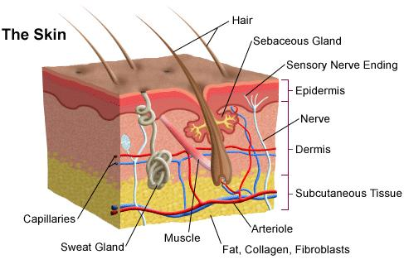
The Integumentary System
The word integumentary refers to an external covering or skin
This system includes structures we can see: hair, skin, and fingernails and parts we cannot see: sweat glands, and subcutaneous tissue below the skin
The skin is the largest organ in the body: 12%-15% of body

Slide 3
The Integumentary System
The skin is so important to survival that the loss of even a small percentage of its vital function is a cause for concern
If about one third of the skin of a healthy young adult is lost, death may result
Skin covers all the body’s surface, preventing the tissue fluids from escaping and foreign material from entering

Slide 4
Functions
The skin performs five important functions for the body:
1. Protection
2. Perception
3. Temperature control
4. Absorption
5. Excretion

Slide 5
Functions
Protects against invasion of bacteria by serving as a barrier
Perception in cooperation with the nervous system(72 feet of nerves) and the sense of touch including pain, heat, cold, and pressure
The blood in the body(about 15 feet) regulates the body's temperature, when the body’s temperature control center in the brain senses that the body is to warm, the surface vessels dilate to cool the body, sweating also occurs, when the body is to cool the surface vessels constrict to warm the body, shivering also occurs

Slide 6
Functions
The skin is capable of absorbing some material from its surface into glands (transdermal patch, lidocaine)
The excretion consists primarily of eliminating water and salt plus waste products, fluids must be replaced to maintain a proper fluid balance
The skin also combines the ultraviolet rays from sunlight with the skin to produce vitamin D

Slide 7
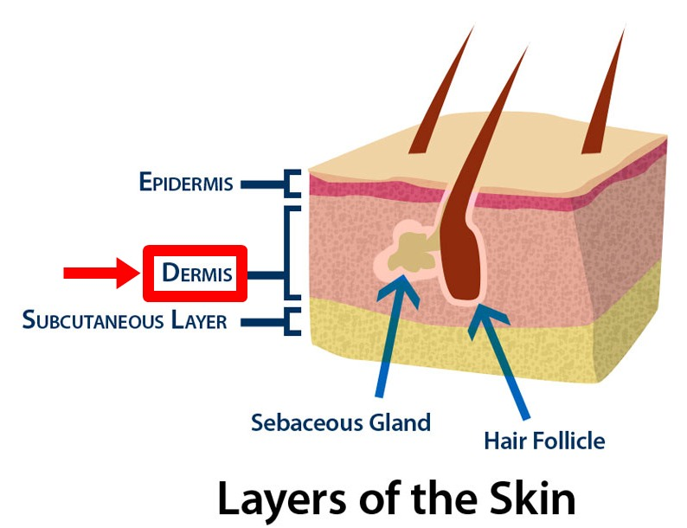
Structures Of The Skin
The skin has three layers:
1. Epidermis(on the top) – the outer, non-sensitive, nonvascular layer of the skin
2. Dermis(in the middle) - is the inner layer of skin, the dermis contains most of the skin's specialized cells and structures
3. Subcutaneous(on the bottom)- is below the dermis, filled with fat, blood vessels, and nerves

Slide 8
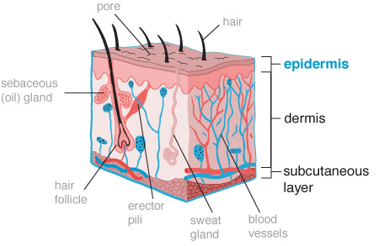
Epidermis
Thickness varies in different parts of the body
Thickest on soles of feet
Thinnest on eyelids and forehead
Has no blood or lymph vessels or nerve endings (nonvascular and non-sensitive)
Full of ridges that form whorls and patterns on the fingertips that we call fingerprints(no two people have the same)
Is protective and the greater part of its thickness is made up of dead epithelial cells that are continually being scraped off(about every 28 days)
Because its ability to produce cells rapidly, it can repair itself quickly following cuts and abrasions

Slide 9
Dermis
Considered true skin because most of the vital functions of the skin are performed or housed here
Compose of dense, fibrous tissue
Blood capillaries and nerves pass freely through the dermis to supply the epidermis
The dermis contains blood and lymph vessels, nerves, sweat, oil glands, and hair follicles

Slide 10
Dermis
The skin is strong, soft, flexible, and elastic in young people because of the presence of keratin and collagen fibers
With age, elastic fibers increase in size and collagen decreases, as a result wrinkles occur
This is more noticeable in areas where there is more facial movements, such as around the eyes and mouth

Slide 11
Glands
Sebaceous glands: secrete sebum(oil) to lubricate the hair, prevent dying of the skin and hair, decreased sebum(oil) is a consequence of getting older(more dry skin), adolescents may have an overactive sebaceous glands that become plugged by cell overgrowth(causes acne)

Slide 12
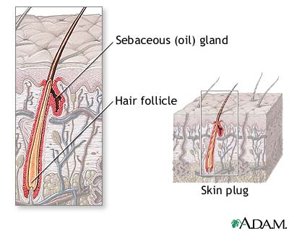
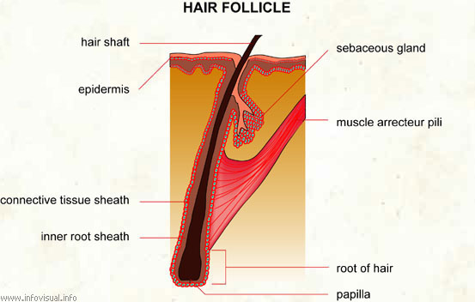
Hair
Hair follicle is the cavity which contains the hair
Hair root is part of the hair that is embedded in the dermis which contains the cells called matrix, where mitosis takes place
Hair shaft is visible part of the hair

Slide 13
Hair facts
Pigment(cell in the shaft of the hair) give hair its color(light or dark)
Hair goes gray because pigment cells in the hair base at the roots of the hair stop producing melanin(melanin is made up of specialized pigment cells called melanocytes)
Red Hair have high levels of the reddish pigment and relatively low levels of the dark pigment. Red hair appears in people with two copies of a recessive gene on chromosome 16
You have more than 100,000 hairs on your head, but you lose some every day. About 50 to 100 hairs fall out each day while you're washing your hair, brushing or combing it, or just sitting still. But don't worry, new hairs are constantly replacing those that have fallen out

Slide 14
Nail Follicles
Found on the ends of fingers and toes, nail follicles produce nails just as hair follicles produce hair
Nail root – Is deep in the dermis, new cells produce keratin (a strong protein)

Slide 15
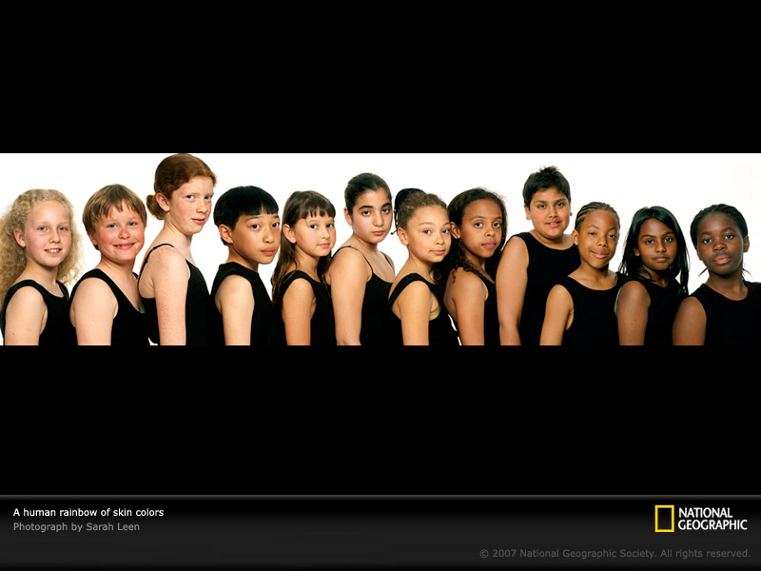
Skin Color
Human skin color is primarily due to the presence of melanin in the skin produced by cells called melanocytes
Skin color ranges from almost black to white with a pinkish tinge due to blood vessels underneath
When the skin is exposed to the sun, it becomes red because of dilation of the superficial blood vessels called erythema

Slide 16
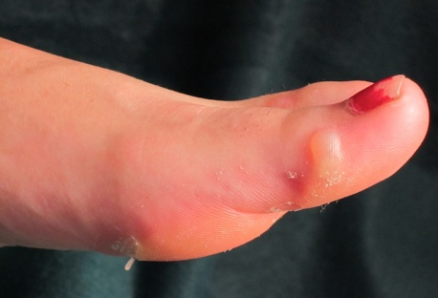
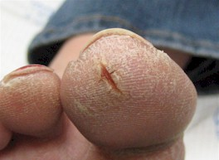
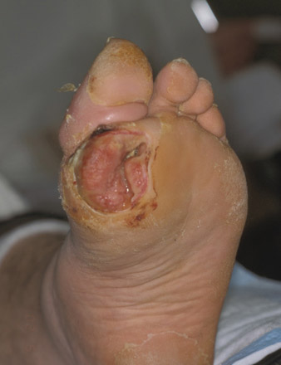
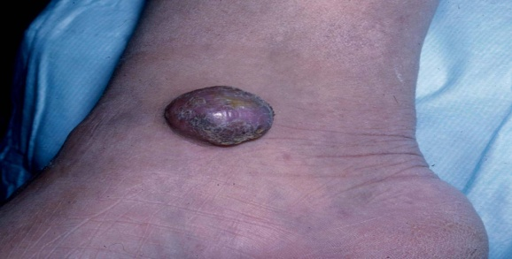
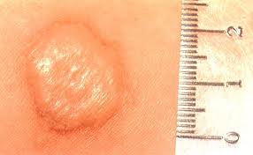
Skin Appearance(page 379)
Conditions in the skin cause changes in the appearance
These changes are known as lesions
Blister: fluid-filled area
Fissure: crack from the epidermis to dermis
(athletes foot)
Ulcer: a deep loss of the skin surface
Tumor: solid mass(benign or malignant)
Wheal: itchy, irregular shaped skin edema

Slide 17
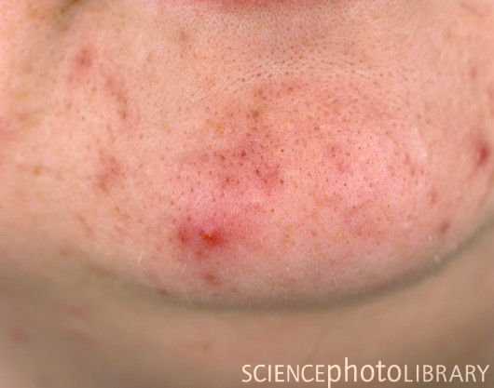
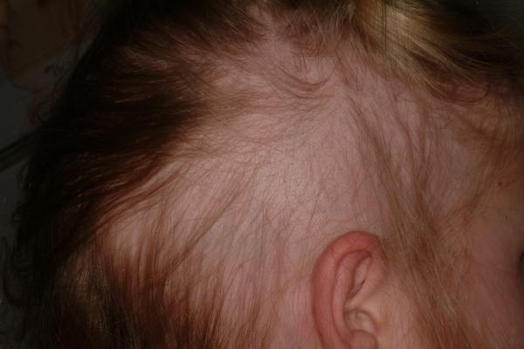
Diseases And Disorders
Acne Vulgaris: inflammation of the sebaceous glands and oversupply of sebum oil
Alopecia: the loss of hair, thinning and eventual absence of hair, caused by trauma of hair follicles and some diseases

Slide 18
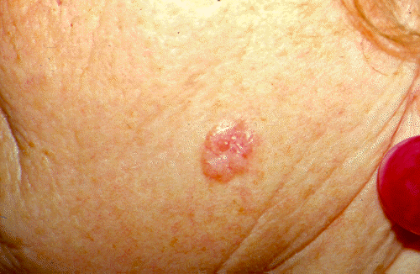
Skin Cancer
The skin may be the site of different forms of cancerous lesions
There are three types of skin cancer
1. Basal cell carcinoma: This is a slow growing locally destructive skin tumor, most common in Caucasians, with fair skin, caused by prolonged exposure to the sun

Slide 19
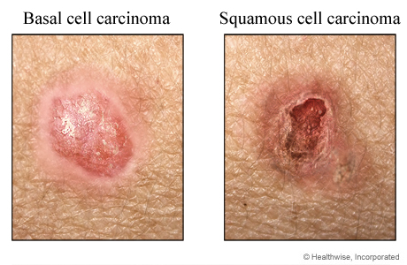
Skin Cancer
2. Squamous cell carcinoma: This is an invasive tumor with metastatic potential, evident in fair-skinned males over the age of 60, caused by sun exposure and chronic skin irritations

Slide 20
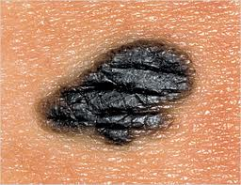
Skin Cancer
3. Malignant Melanoma: A neoplasm that develops from the pigment producing melanocytes, more common in woman than men between 50 and 70 years of age
Superficial lesions may be curable, while deeper lesions may metastasize through the lymphatic and circulatory system
The cause is exposure to sun

Slide 21
ABCDE Rules

Slide 22
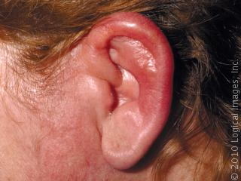
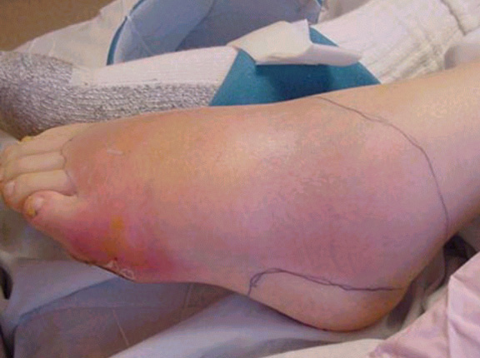
Cellulitis
This is an acute diffuse or spreading inflammation of the skin and subcutaneous tissue, characterized by swelling, pain, heat, and redness
Usually caused by staphylococcus aureus
Treatment is oral or IV
antibiotics

Slide 23
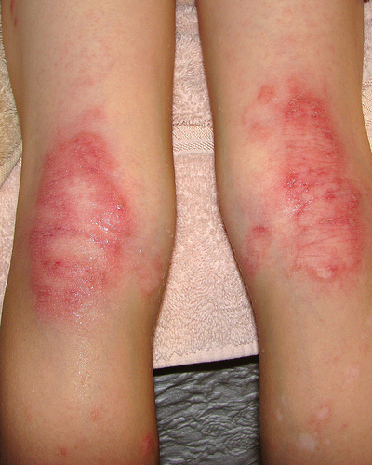
Eczema
The noncontiguous skin disease can be acute or chronic
Caused by environmental substances(clothing, medications,soaps) and stress
Treatment is topical steroids and
antibiotics if needed

Slide 24
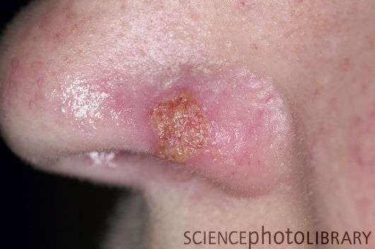
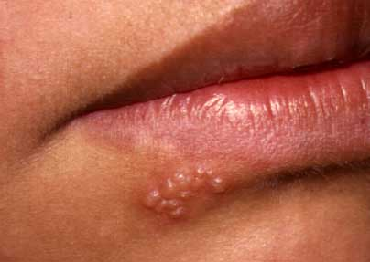
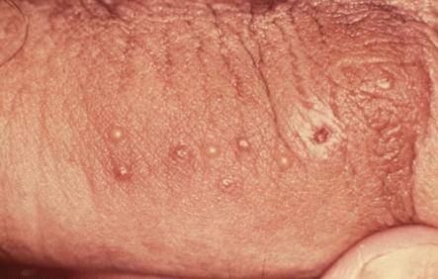
Herpes Simplex
This is a viral infection
Herpes simplex 1 is associated with lesions in the oral and nasal area
Herpes simplex 2 is associated with genital lesions
A cure for herpes has not yet been developed. Once infected, the virus remains in the body for life
Recurrent infections (outbreaks) may occur from time to time, especially in times of immune impairment

Slide 25
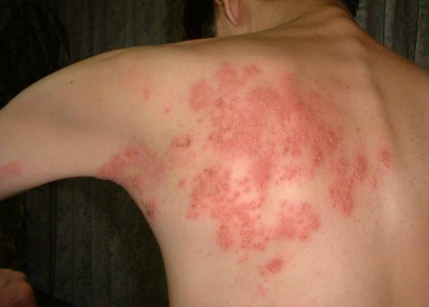
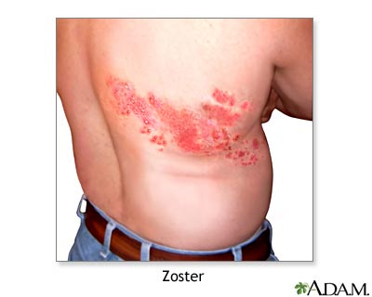
Herpes Zoster
Is an acute infection process also known as shingles
It causes severe pain in the area of the involved nerves
It is seen unilaterally
It is caused by the varicella zoster virus(chickenpox)
Shingles mostly affects older adults who have had chickenpox earlier in their lives; most commonly during childhood

Slide 26
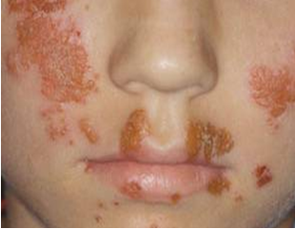
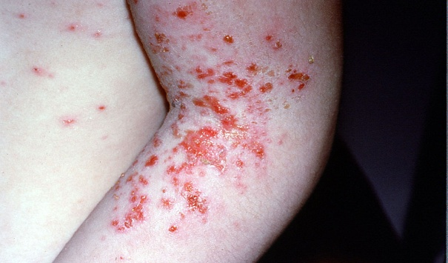
Impetigo
This is a contagious, superficial skin infection that is usually seen in children
It is caused by staph infection, person to person
Good hygiene is essential
and topical antibiotics

Slide 27
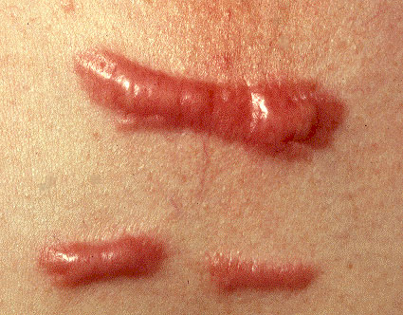
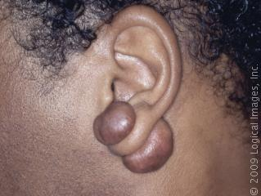
Keloid
A scar that developed excess dense tissue as it progressed through the healing process
It usually has a smooth top and a pink or purple color.
Keloids are irregularly shaped and tend to enlarge progressively.
Unlike scars, keloids do not subside over time.

Slide 28
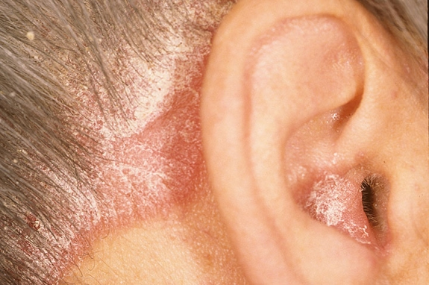
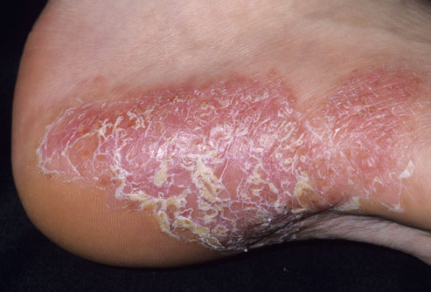
Psoriasis
Psoriasis is a common skin condition that causes skin redness and irritation, caused by the environment
Treatment are usually oral or topical steroids depending on the severity

Slide 29
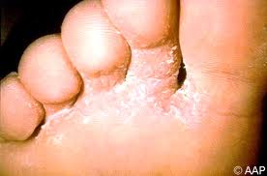
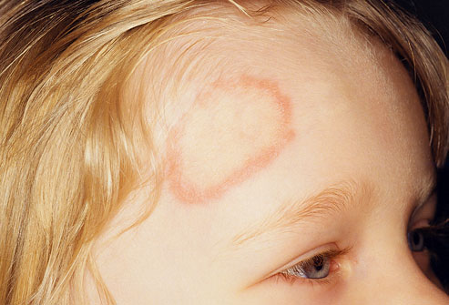
Ringworm
This is a fungus that may affect the scalp, the body, or the feet(athlete’s foot)
Ringworm can spread easily from one person to another, you can also catch ringworm from pets that carry the fungus
Treatment is an antifungal cream

Slide 30
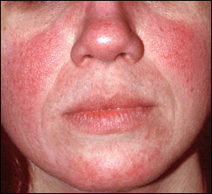
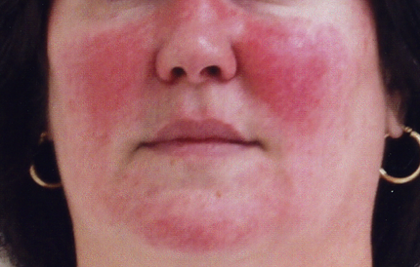
Rosacea
This is a chronic skin eruption that makes the face, especially the nose and cheeks, look flushed
It is caused from, dilation of small blood vessels in the face
Treatment : topical cortisone to reduce erythema

Slide 31
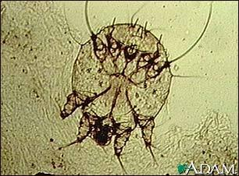
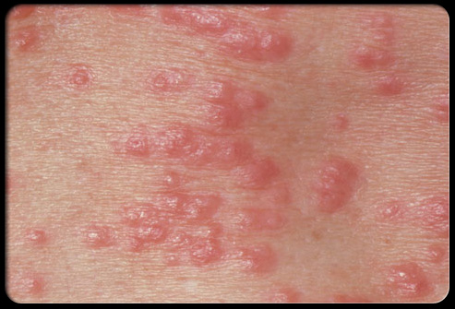
Scabies
This is a skin infestation caused by the itch mite
It is spread by direct contact with infected people, and less often by sharing clothing or bedding

Slide 32
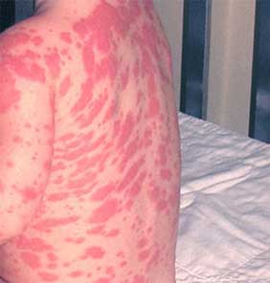
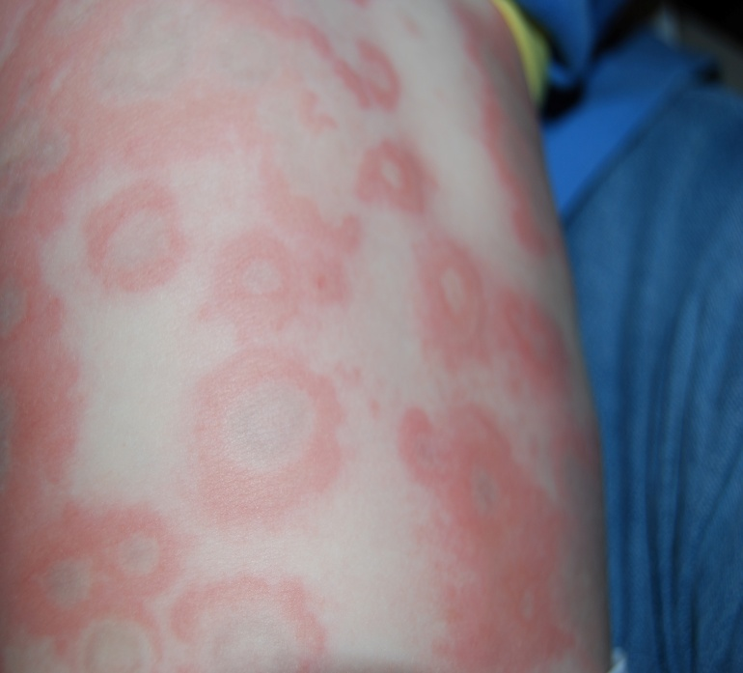
Urticaria(hives)
This is caused from a self-limiting reaction to allergens, from stress, allergic reaction, or viral infection
It appears as raised areas of erythema and edema involving the dermis and epidermis

Slide 33
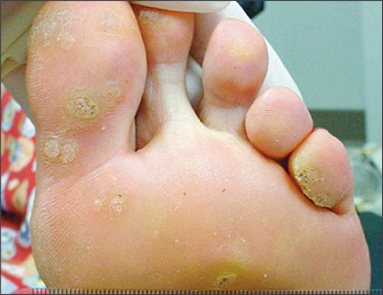
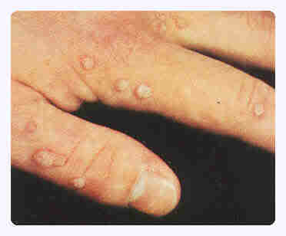
Verrucae(warts)
This is a benign(noncancerous) viral infection of the skin
Warts are caused by a family of viruses known as human papillomavirus
Warts can grow anywhere on the body
You can infect yourself again by touching the wart and then another part of your body. You can infect another person by sharing towels, razors, or other personal items

