Slide 1
The Skeletal System
Chapter 11 Unit 5

Slide 2
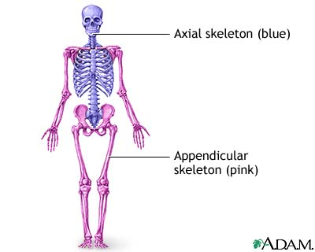
The Skeletal System
The skeletal system consists of organs called bones
Bones are living, functioning organs that use food and oxygen and perform functions just as other organs do
The skeleton is divided into sections:
Axial skeleton includes the spinal column, skull, and the rib cage
Appendicular skeleton includes the bones of the arms, hands, legs, feet, shoulders, and pelvis

Slide 3
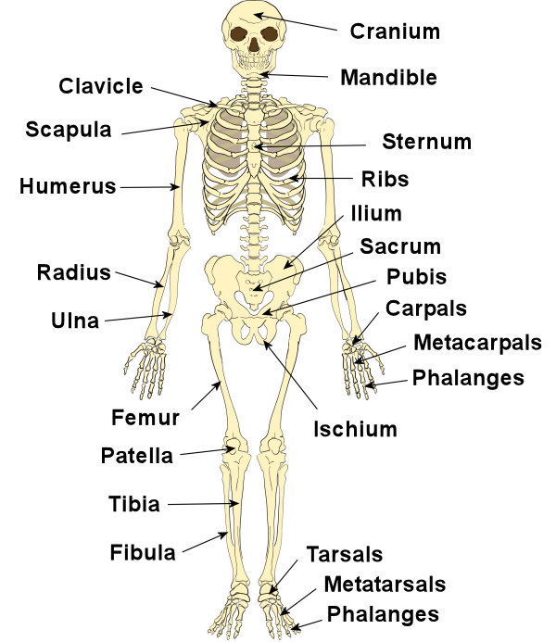
The Skeletal System
The primary purpose of the skeletal system is to support the body
The bones are as strong as cast iron, yet flexible to endure pressure, stress and shock

Slide 4
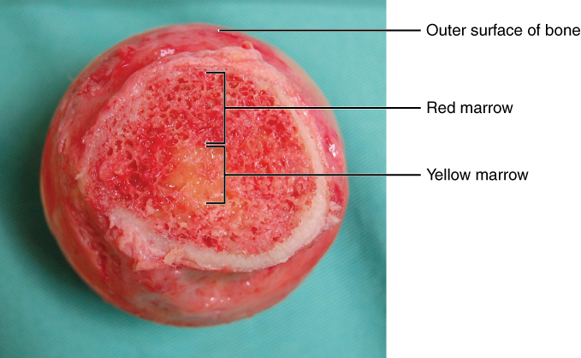
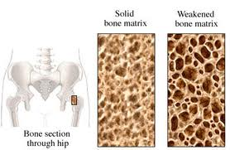
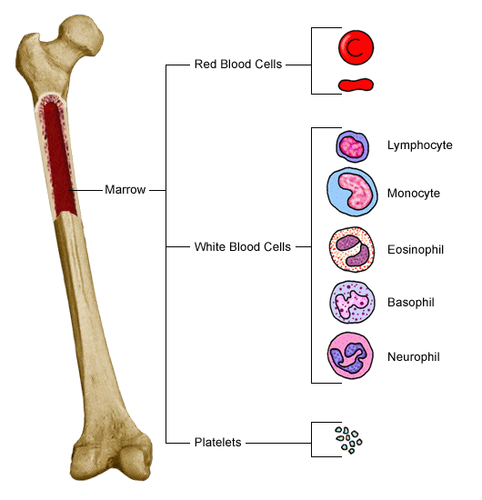
Bone Structure
Bones are 20% water
The rest is minerals(calcium, phosphorous, and magnesium) and organic matter(collagen, and protein fiber)
The opening in the spongy bone are filled with red bone marrow
Yellow marrow is the marrow that functions as fat storage

Slide 5
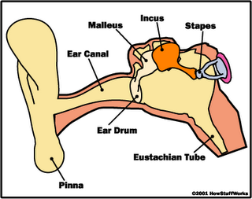
Number Of Bones
At birth, a baby has 270 bones
As the child grows, some of the bones fuse together so that in adulthood there are 206
The smallest bones in the body are in the middle ear: malleus, incus, and stapes

Slide 6
Functions Of The Skeleton
The skeleton serves at least six functions:
To support the body
To protect the vital organs
Are points of attachment for skeletal muscles
Give shape to the body
Vital function of the red and white blood cells and the platelets
Storage for the body’s supply of calcium

Slide 7
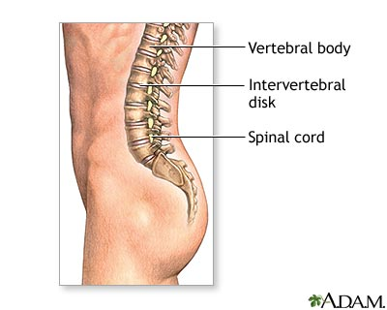
Spinal Column
The spinal column is a stack of vertebrae that supports the head and keeps the trunk erect
It protects the spinal cord , which descends from the brain through its canal
The bones are separated by intervertebral cartilage disks, this permits the column to bend and twist, walk, jump, and run

Slide 8
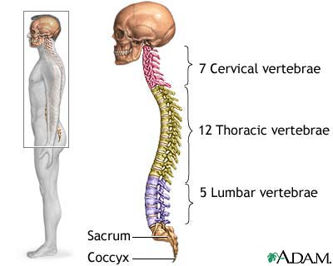
Spinal Colum
The vertebrae is named by the area of the body in which they are located
Cervical(neck)7
Thoracic(chest)12
Lumbar(back)5
Sacral(pelvic girdle)
Coccyx(tailbone)

Slide 9
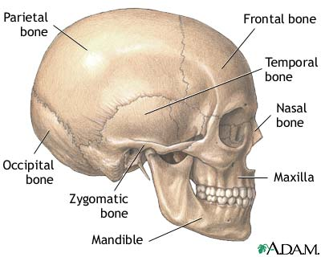
The Skull
The skull is the bone structure of the head
It consists of a cranial and a facial portion
The cranium is actually a fusion of eight cranial bones, with the vital function of protecting the brain from injury
Main bones are:
Frontal(forehead and eye sockets)
Two parietal(2)
Two temporal(2)
Occipital(back)

Slide 10
The Skull
The facial bones are the:
Mandible(lower jaw)
Maxillae(upper jaw)
Zygomatic(check bones)
These bones are not solid at
birth until 2 years of age

Slide 11
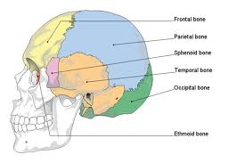
The Skull

Slide 12
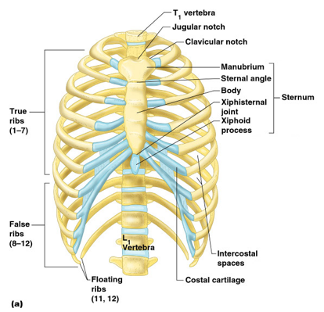
The Rib Cage
Thoracic vertebrae serve as the posterior attachment points for 12 pairs of ribs
The top 7 pairs are attached directly anterior to the sternum by cartilage(true ribs)
8 -10 are attached to the cartilage and not to the to sternum(false ribs)
This allows the rib cage to move when they are inflated to breath
The bottom two pair of ribs are called floating ribs because they are attached only to the spinal column and not to the sternum(also called false ribs)

Slide 13
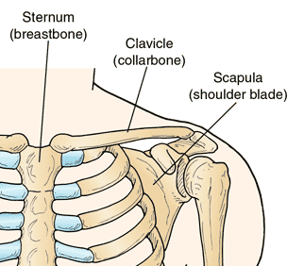
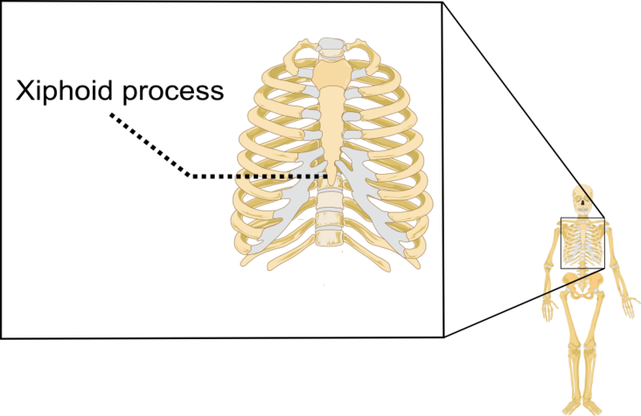
Thoracic Area
Three other bones features of the thoracic area are the:
Clavicle(collar bone)
Scapula(shoulder blade)
Xiphoid(inferior portion of the sternum)

Slide 14
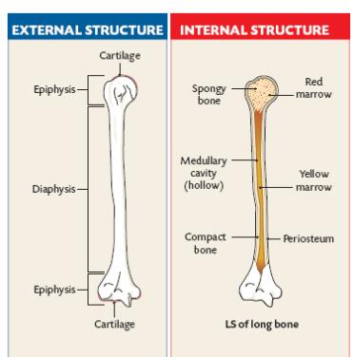
Long Bones
The long bones of the body are found in the extremities
Long bones are shaped like hollow cylinders to be strong with the least amount of weight
A typical long bone has three distinct regions:
Diaphysis: is the middle shaft
Epiphysis: is at the end shaft
Metaphysis: is the tradition segment

Slide 15
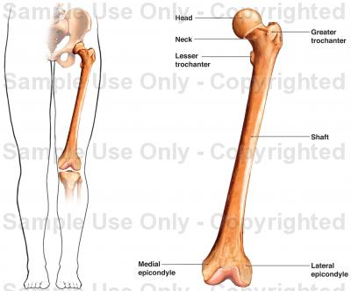
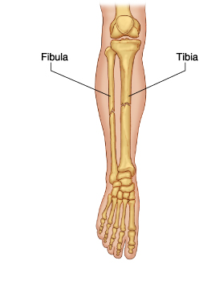
Long Bones
The femur(thigh bone)is the longest bone, extending from the hip joint to the knee
The tibia(skin bone)
The fibula
Big Tib/little fib
Or
Tuff Tib/fragile fib

Slide 16
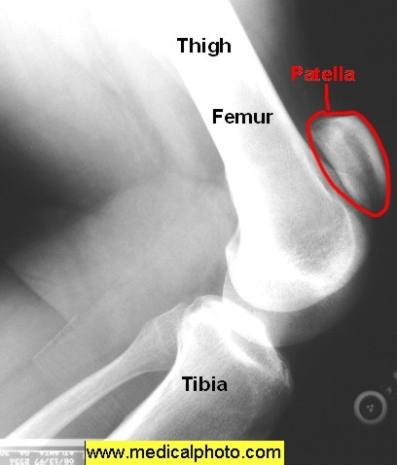
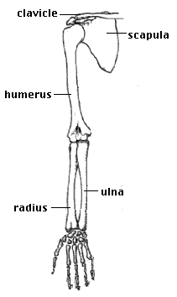
Long Bones
The small bone at the knee is known as the patella(this is a sesamoid bone)
The long bones of the upper
extremities are the :
Humerus
Radius
Ulna

Slide 17
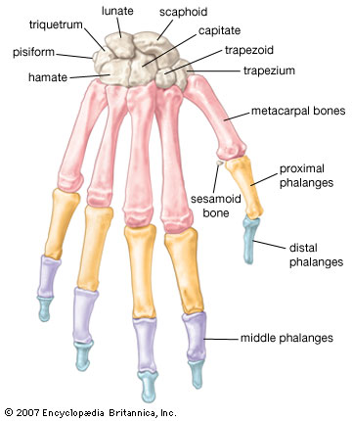
Bones Of The Hands And Feet
More than half of the bones in your body are found in your hands and feet. There are 27 in each hand and 26 in each foot, and the way that they are arranged is remarkably similar.
The hand bones(27)
The wrist bones or carpals(8)
Metacarples(5)
Phalanges(14)

Slide 18
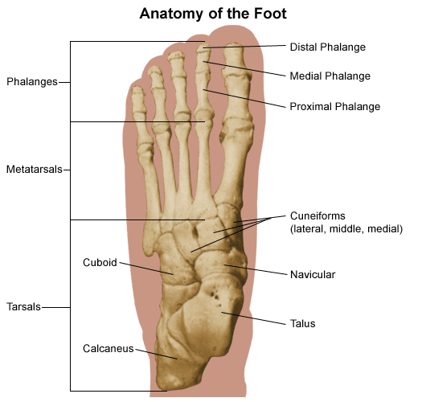
Ankle
The ankle:26
Tarsals(7)
Metatarsals(5)
Phalanges(14)

Slide 19
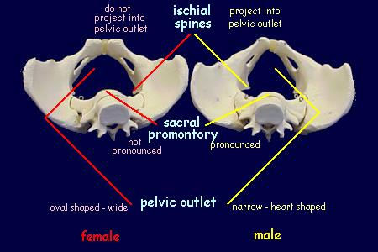
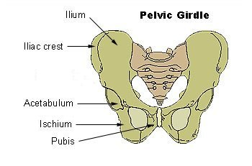
The Pelvic Girdle
The pelvic girdle provides the structure for the hip area
Two large bones(hip bones) are joined posterior with the sacrum
The top portion is called the ilium
The point at attachment is called the symphsis pubis
The posterior lower portion of the bone is called the ischium

Slide 20
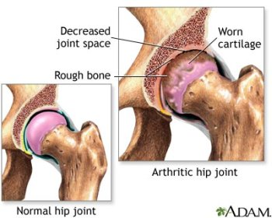
Joints
The place where two or more bony parts join together is known as an joint
Strong, flexible bands of connective tissue called ligaments hold long bones together at joints
Ligaments can stretch and often become torn as a result of injury

Slide 21
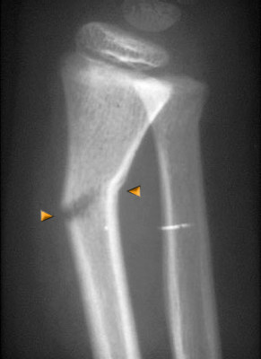
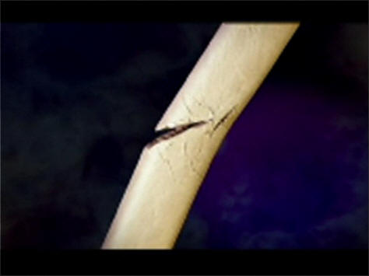
Fractures
The bones of children contain a high percentage of cartilage and are much more flexible than those of an adult
Frequently, the bone will crack under pressure but will not break all the way through
This type of break is known as a greenstick fracture

Slide 22
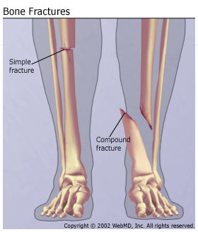
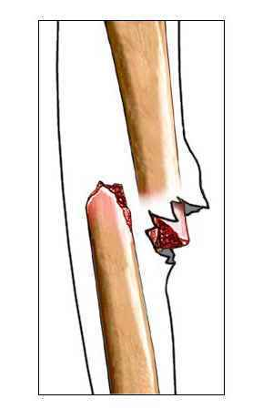
Fractures
A complete bone break in which there is no involvement with the skin surface is known as a simple or “closed” fracture
When broken through the skin’s surface, it is known as an open(compound) fracture

Slide 23
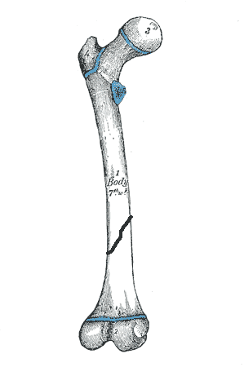
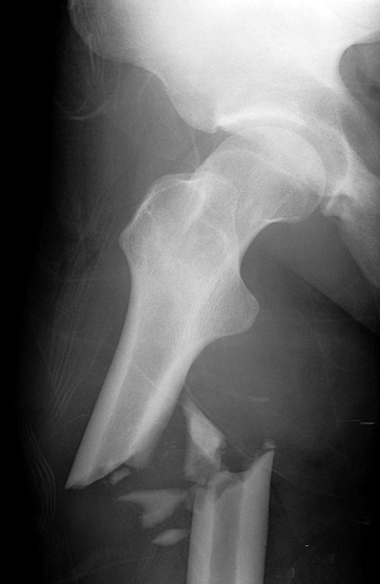
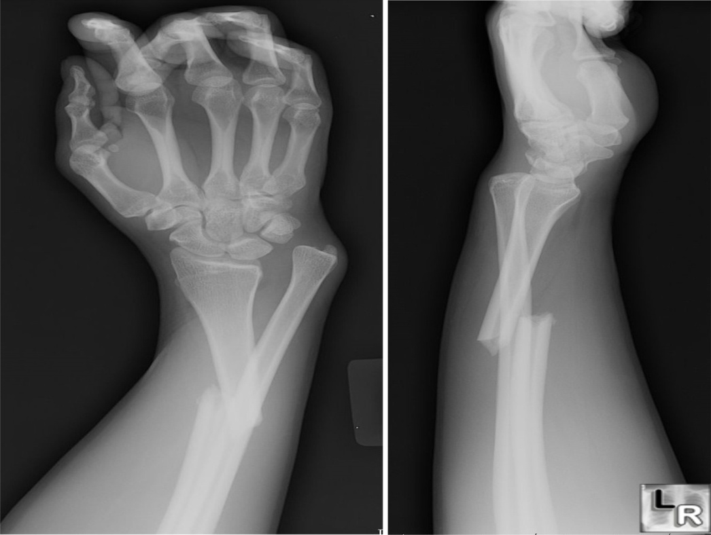
Fractures
A more involved type of fracture is called impacted, which indicated that the broken ends are jammed into each other
A comminuted fracture is one with more than one fracture line and several bones fragments

Slide 24
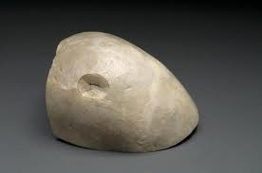
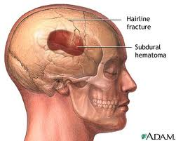
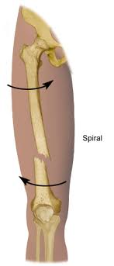
Fractures
A depressed fracture may occur with a severe head injuries in which a broken piece of skull is driven inward
A spiral fracture may occur with severe
twisting action, such as in a skiing accident,
causing the break to wind around the bone

Slide 25
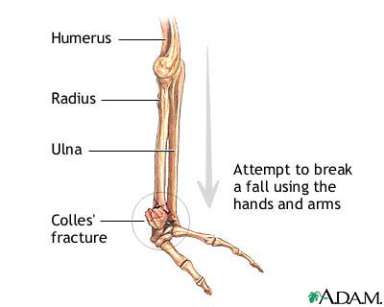
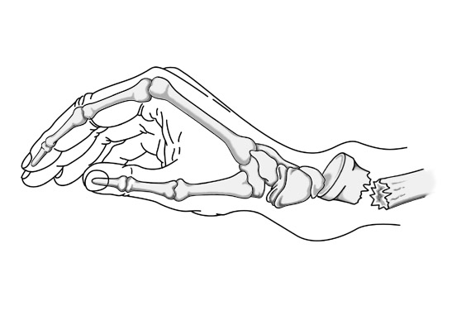
Fractures
Colles fracture is common among children
This involves the breaking and dislocating of the distal end of the radius, causing a bulge at the wrist(riding bikes, skating, climbing)

Slide 26
Long bone fractures

Slide 27
Amputation
Severe trauma, a malignant tumor, lack of circulation, or complications of other conditions, such as diabetes, may result in the need to amputate an extremity
Following amputation, a condition often occurs known as phantom limb
When the amputated stump has healed sufficiently, a prosthesis(artificial part)may be fitted

Slide 28
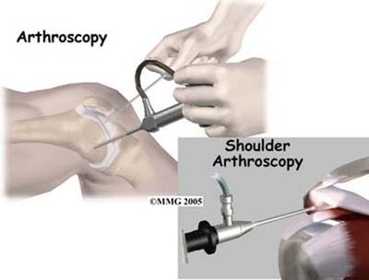
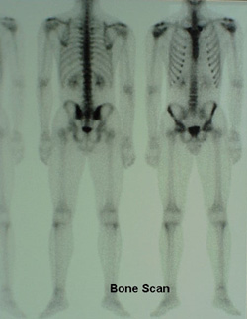
Diagnostic Examinations
Arthroscopy: This endoscopic procedure permits direct visual inspection of a joint(detects arthritis)
Bone Scan: This is a nuclear
medicine procedure using small
amounts of radioactive substance
that are injected into a vein to help
diagnose the presence of disease
based on structural appearance

Slide 29
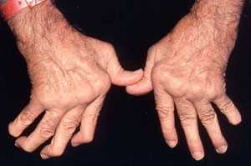
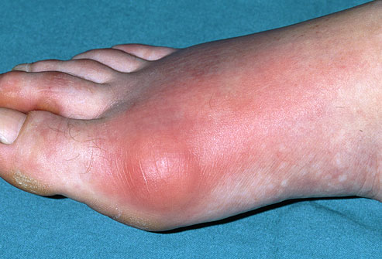
Diseases And Disorders
Arthritis: The word arthritis means joint inflammation
There are more than 100 different forms of arthritis
The most common forms are osteoarthritis, rheumatoid arthritis, gout, fibromyalgia, and lupus
Osteoarthritis: The most common form of arthritis, result from a breakdown of cartilage of the bones
Rheumatoid Arthritis: a chronic systemic
inflammation disease attacking joints
and surrounding tissue
Gout: results in severe joint pain,
most often in the big toe, this is from
deposits of uric acids and salts

Slide 30
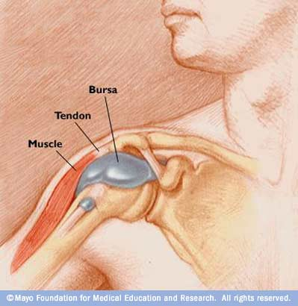
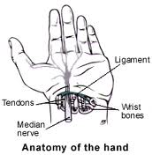
Diseases And Disorders
Bursitis: this is painful inflammation of the bursa, the bursa is located around a joint
Carpal Tunnel Syndrome: This condition results from the compression of the median nerve at the wrist

Slide 31
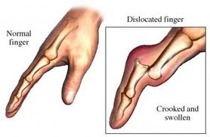
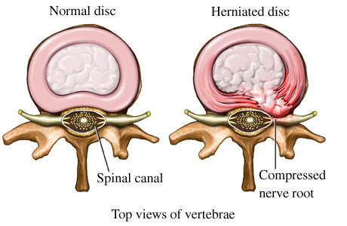
Diseases And Disorders
Dislocation: Displacement of the bones at a joint, occurs at the joints of the fingers, shoulder, knee, and hip
Herniated Disk: This is a
gel-like material within
an intervertebral disk
that has been forced
through the outer surface

Slide 32
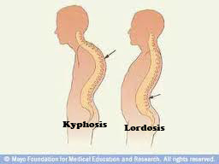
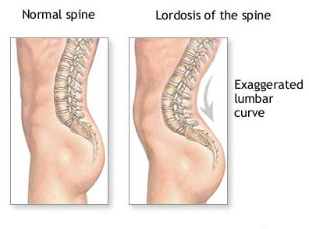
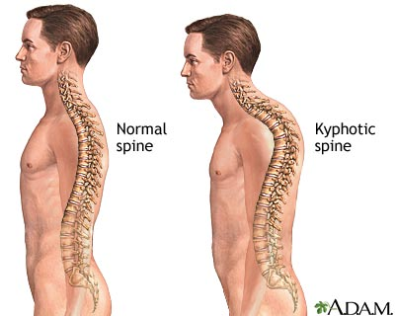
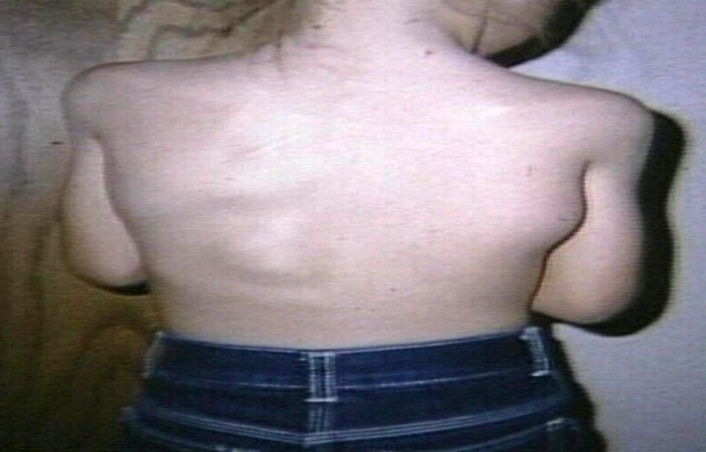
Diseases And Disorders
Kyphosis: This is the bowing of the back, usually at the thoracic level, this is viewed from side
Lordosis: This is an abnormal anterior convex curvature the lumbar spine is commonly referred to as swayback
Lumbar Myositis: An inflammation
of the lumbar back

Slide 33
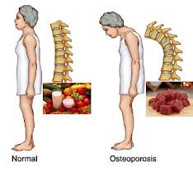
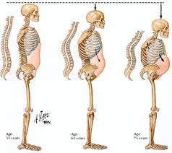
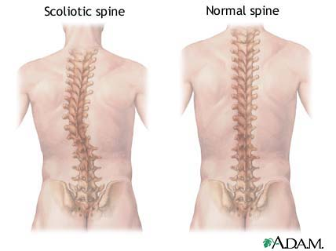
Diseases And Disorders
Osteoporosis: A metabolic bone disorder,
this is the thinning of bone tissue and
loss of bone density over time.
Scoliosis: is a medical
condition in which a
person's spine is curved from
side to side(lateral curve)

