Slide 1
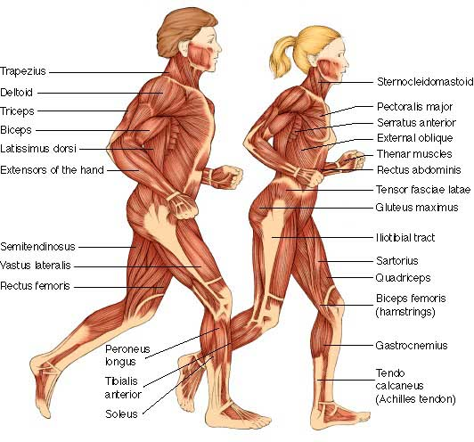
The Muscular System
Chapter 11 Unit 6

Slide 2
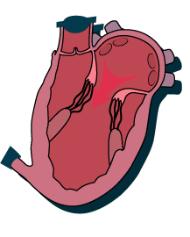
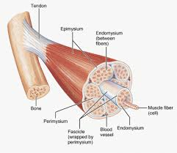
The Muscular System
There are approximately 600 muscles in the human body, about half of your body weight
Muscles are composed of muscular tissue, which is constructed of bundles of muscle fibers about the size of a human hair
The larger the muscles, the greater the fibers
Muscles perform their duties by alternating contractions and relaxing

Slide 3
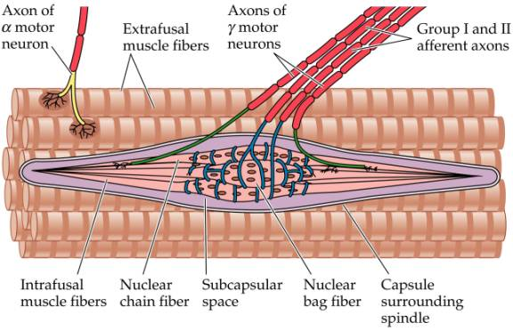
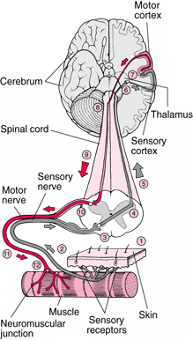
The Muscular System
All muscle activity is influenced by the nervous system

Slide 4
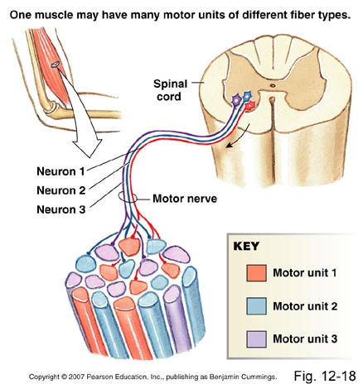
The Muscular System
The group of cells and its motor neurons are called motor units
A muscle contraction is a quick progression of events following a stimulus
When repeated stimulation occurs without a relaxation time, the muscle is maintained in a state of contraction called tetanus
This happens when we experience muscle cramps and spasms

Slide 5
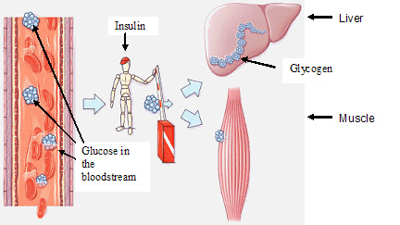
Muscle Fuel
All body tissues must have food and oxygen to survive
The muscles receive an ample supply of both because of their importance to the body’s safety and well-being
The body stores carbohydrates in it’s muscles in the form of starch called glycogen
When muscles function, they use the stored glycogen, changing it to glucose, as their source of energy
Heat is released as this fuel is used, thereby warming the body
Exercise burns glycogen

Slide 6
Functions Of Muscles
In addition to providing heat and the ability to move, muscles support the structures of the body and hold the body upright
The muscles along the back, shoulders, and neck hold the trunk and head erect while permitting great flexibility in movement
Muscles also provide protective padding to shield delicate internal organs and structure form injury
Muscles gives shape to the body

Slide 7
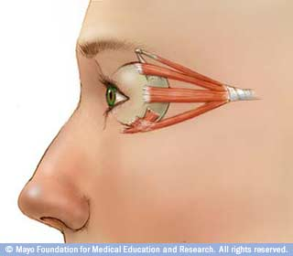
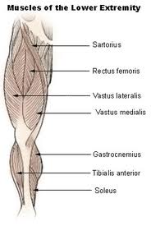
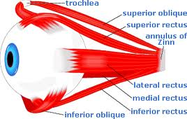
Muscle Growth
Muscle tissue changes slightly with age
Muscles grow in relation to the structures to which they are attached, for example, muscles of the eye grow very little, whereas the large muscles of the lower extremities grow considerably

Slide 8
Types Of Muscle Tissue
There are three types of muscle tissues
-Skeletal muscle tissue
-Smooth muscle tissue
-Cardiac muscle tissue

Slide 9
Skeletal muscle tissue
Skeletal, striated(striped) and voluntary or involuntary(next slide)
Attached to bones, moves the skeleton, produces heat
Essential to cause contraction
These muscles are supplied with motor nerves for simple motions like extending the arm or breathing, to doing the highly coordinated movements like walking, swimming, or skiing

Slide 10
1 Skeletal(striated)
Three names for this tissue:
Skeletal- describes its location
Striated(striped)- describes its appearance
Voluntary or involuntary - describes how it functions
Specialized to contract and bring about movement

Slide 11
2 Smooth Muscle Tissue
Nonstraited, smooth, involuntary
Found in walls of hollow organs such as blood vessels, intestines, and uterus
Helps with peristalsis(to propel food through the digestive tract)

Slide 12
3 Cardiac Muscle Tissue
Have faint striations, involuntary
Pumps blood
Composes the walls of the heart
Regulates the rate of the contraction
Cardiac muscle contracts to squeeze blood out of your heart, and relaxes to fill your heart with blood.

Slide 13
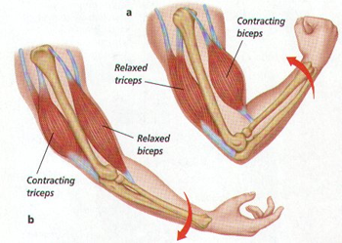
Skeletal Muscle Action
When muscle contract, they become shorter and thicker
Example: when the biceps contract to bend at the elbow, the shorter and thicker muscle become, this causes a bulge in the upper arm

Slide 14
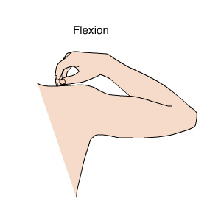
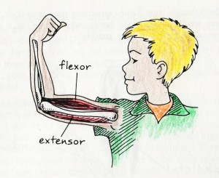
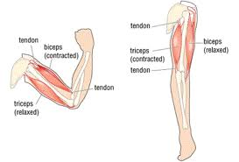
Skeletal Muscle Action
The skeletal muscle that bends a joint is called a flexor muscle
Whereas the action of straitening the joint is done by the extensor muscle
The extensor muscle that straightens the elbow is the triceps

Slide 15
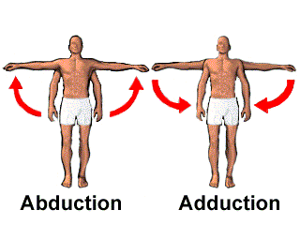
Skeletal Muscle Action
Muscle also contract to move extremities away from the body’s center line, which is known as abduction, or toward the center line, which is known as adduction

Slide 16
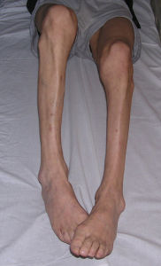
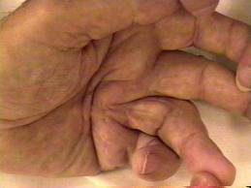
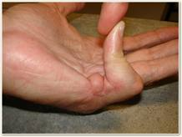
Muscle Tone
Loss of muscle tone can occur when muscles are not used, as with severe illness, elderly people, paralysis, or temporarily when an extremity has been immobilized in a cast
With prolonged lack of use, muscles will atrophy(wasting away of a part of the body)
Another condition that develops from lack of muscle use is called contracture, where the muscle become paralyzed(fingers, elbows, knee’s, and hip joints)

Slide 17
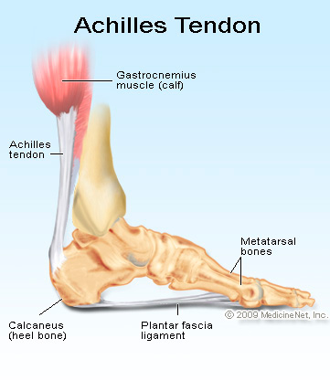
Muscle Attachment
A tendon is known as a strong fibrous structure, are attached to rough surfaces on a bone, are extremely strong and do not stretch
The thickest and strongest tendon in the human body is the Achilles tendon, which attaches the gastrocnemius muscle in the calf of the leg to the heel bone
Attached muscle to bone

Slide 18
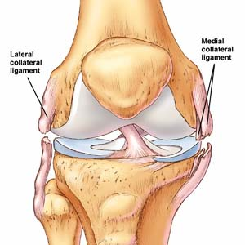
Muscle Attachment
A similar type of connective tissue is called a ligament
A ligament is flexible and supports organs and connects bone to bone
Remember: a tendon connects muscle to bone and a ligament connects bone to bone

Slide 19
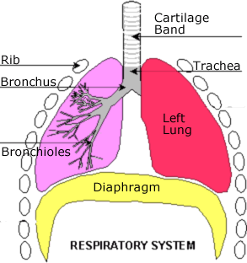
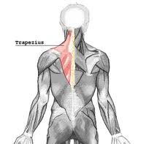
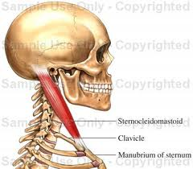
Major Skeletal Muscles
The muscle most important in breathing divides the chest cavity from the abdominal cavity, this muscle is called the diaphragm
The sternocleidomastoid and the trapezius are the major muscles of the neck and the upper back that hold the head erect and assist with its movements

Slide 20
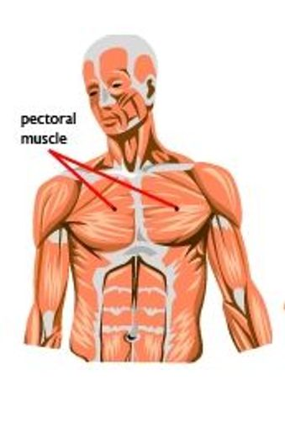
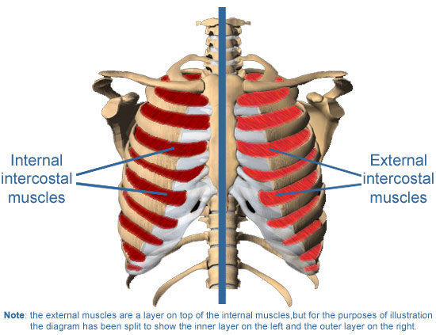
Major Skeletal Muscles
The pectoralis major is the main upper chest muscle, this enables us to flex the arm across the chest
The intercostal muscles lie beneath the pectoralis major, between the ribs, these enlarge the diaphragm during inspiration

Slide 21
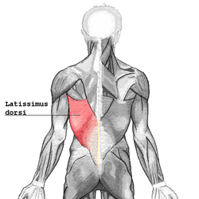
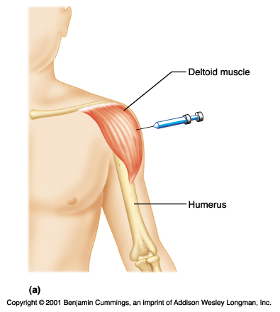
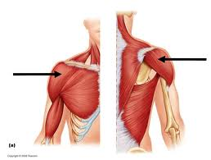
Major Skeletal Muscles
The back is covered by a large muscle called the latissimus dorsi, its main function is to extend and adduct the arm(as with swimming)
The shoulders are protected by a triangle muscle called the deltoid, which abducts the arm
The deltoid is used for small injections of medications, intramuscularly

Slide 22
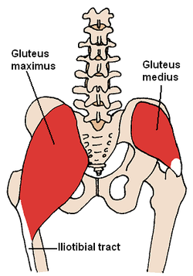
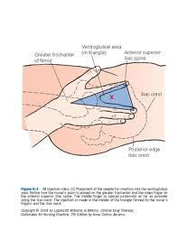
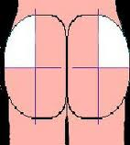
Major Skeletal Muscles(lower extremity)
The lower extremities muscles involve half of the body’s total muscle mass
The buttock are formed by the large gluteus maximus muscles, which support the body’s weight and enable use to stand erect
The upper outer quadrant(ventral gluteal) of the buttock is the site for intramuscular injections, especially for large amounts of a slowly absorbing medication

Slide 23
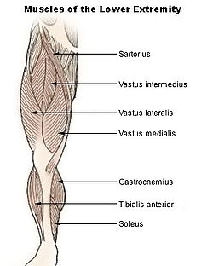
Major Skeletal Muscles(lower extremity)
The front of the thigh has the longest muscle of the body, the Sartorius, this flexes the hip and knee joints to turn the thigh outward, making it possible to sit cross-legged on the floor

Slide 24
Major Skeletal Muscles(lower extremity)
The quadriceps femoris, with four separate parts:
Rectus femoris(vastus intermedius)
Vastus lateralis(nest slide)
Vastus medicalis
Sartorius(last slide)
It is a powerful extensor of the knee and is used when we rise from a sitting position, kick a ball, or swim

Slide 25
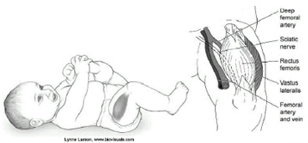
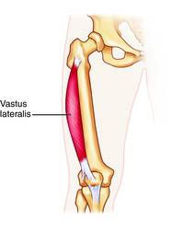
Vastus Lateralis
The Vastus lateralis is the largest part of the quadriceps femoris
This is an IM injection site, and is the standard for infants and young children because it is the safest and largest muscle for children

Slide 26
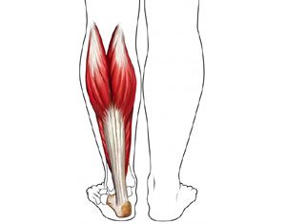
Major Skeletal Muscles(lower extremity)
The gastrocnemius is the main muscle in the calf of the leg, this permits you to stand tiptoe
It runs from its two heads just above the knee to the heel, and is involved in standing, walking, running and jumping.

Slide 27
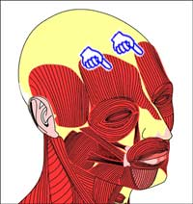
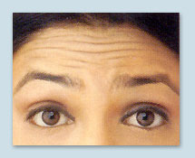
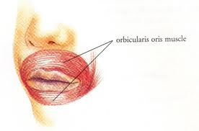
Muscles Of Expression
A number of muscles in the face enable us to show our feelings
The frontalis(frontal) muscles can raise to express surprised
The obicularis oris allows us to whistle, kiss, smile, grin

Slide 28
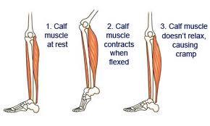
Muscle Strain And Cramps
A strain is an injury to a muscle or tendon in which the muscle fibers tear as a result of overstretching
Muscle cramps are unpleasant, often painful, caused by muscle contraction or over shortening, it can usually be relived by stretching the muscle or causing it to bear weight

Slide 29
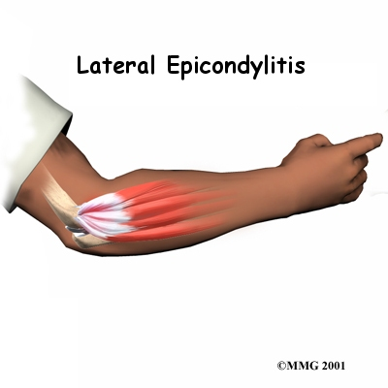
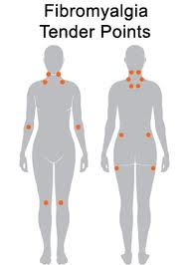
Disease And Disorders
Tendonitis: This is a painful inflammation of the tendon
Epicondylitis(also called tennis elbow): This is inflammation of a forearm tendon at the attachment on the humerus at the elbow
Fibromyalgia Syndrome: This is a chronic musculoskeletal condition characterized by
widespread pain, it affects people of all ages

Slide 30
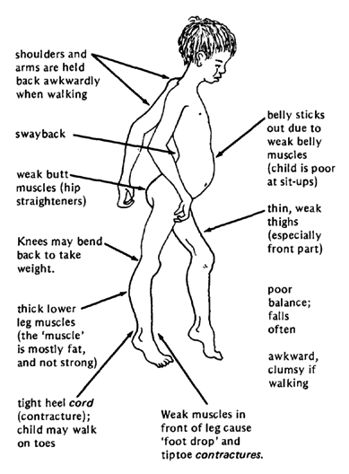
Disease And Disorders
Muscular Dystrophy: This is a group of congenital disorder results in progressive wasting away of skeletal muscle
There are several types of muscular dystrophy(listed on page 419)

Slide 31
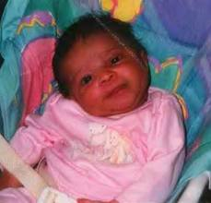
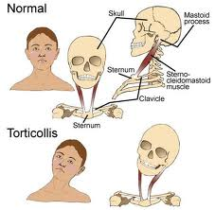
Disease And Disorders
Torticollis: This neck deformity bends the head to the affected side and rotates the chin toward the opposite side
This caused by shorting or spasm of the strenocleidomastiod neck muscle

