Slide 1
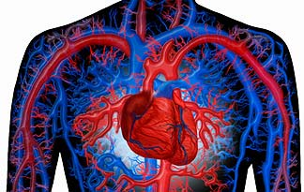
THE CIRCULATORY SYSTEM
Chapter 11 Unit 8

Slide 2
The Circulatory System
The circulatory system transports oxygen and nutrients to the body’s cells, and then transports carbon dioxide and other waste products from cells to be eliminated from the body
A few minutes’ interruption of the circulatory system can result in death
The circulatory system is composed of four main parts:
1. a pump, the heart
2. the plumbing, the blood vessels
3. the circulating fluid, blood
4. the fluid system, lymphatic system

Slide 3
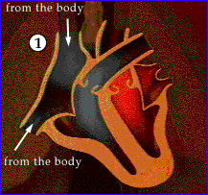
The Circulatory System
Each day the heart pumps the equivalent of 4,000 gallons of blood, at 40 miles per hour, through an estimated 70,000 miles of blood vessels
To achieve this, the heart must forcefully contract, squeezing out blood, at an average rate 72 times per minutes or 100,000 times each day

Slide 4
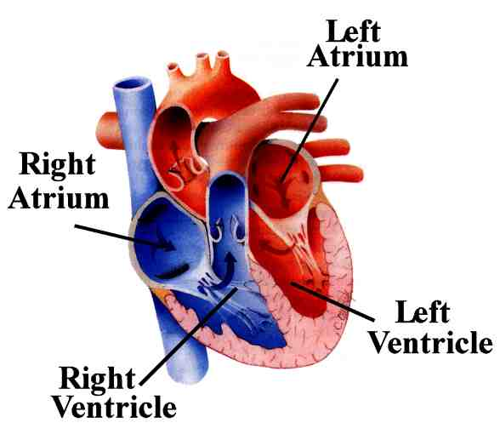
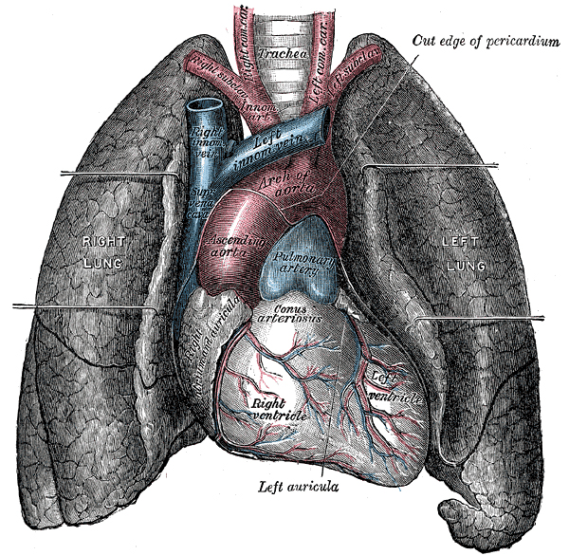
The Heart
The heart is about the size of your clenched fist and is located behind the sternum, between the lungs, with two thirds of it on the left side of the chest
It is constructed of several layers of muscles
When the muscles contract, blood is squeezed out of the heart chambers

Slide 5
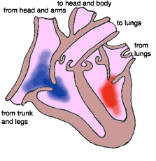
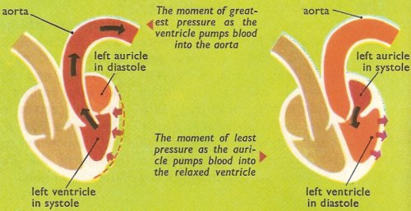
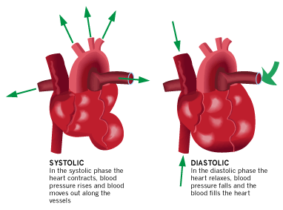
The Heart
The contraction phase is known as systole, and the relaxation phase is called diastole
Systole is the period when the heart exerts the greatest pressure on the blood
Diastole is the period of least pressure and is the time when the heart rests

Slide 6
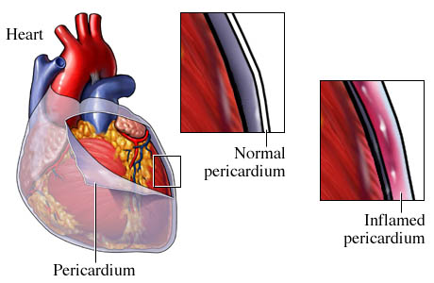
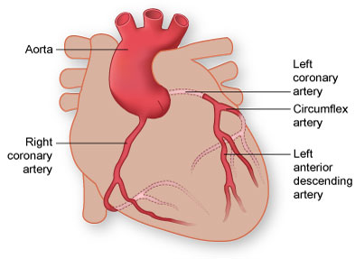
External Heart Structures
The outer wall of the heart is surrounded by a sac called the pericardium
The right and left coronary arteries enter the top of the heart from the aorta

Slide 7
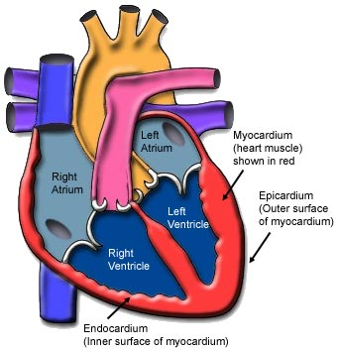
External Heart Structures
The blood vessels that carry oxygen, nutrients, and waste products are called coronary arteries and veins
The muscle wall of the heart is called the myocardium

Slide 8
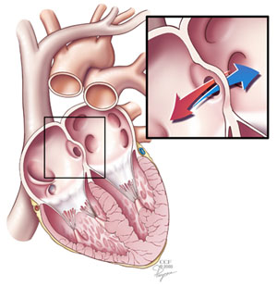
Internal Heart Structure
A tissue known as endocardium(within the heart) lines the interior surface of the heart
Internally, the heart is a double pump, divided into right and left side by a muscular wall called a septum

Slide 9
Internal Heart Structure
The right upper chamber is called the right atrium, and the lower is the right ventricle
The left side is similarly divided into a left atrium and left ventricle

Slide 10
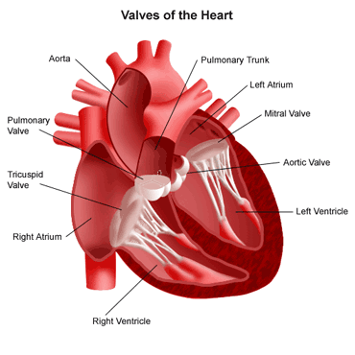
Internal Heart Structure
The chambers are separated by one-way valves that keep the blood flowing in the right direction
The tricuspid valve is between the right atrium and ventricle, and the bicuspid(mitral)value is between the left atrium and ventricle

Slide 11
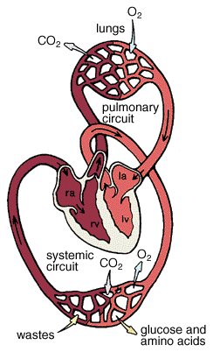
The Heart
A specific sequence of events occurs within the body as the blood is circulated
Blood flow occurs in two distinct patters:
-Pulmonary circulation between the heart and the lungs
-Systemic circulation between the heart and the rest of the body

Slide 12
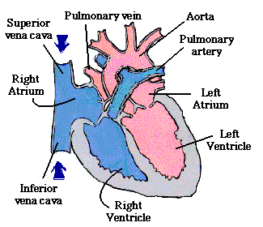
Pulmonary Circulation
Pulmonary circulation is the movement of blood from the heart, to the lungs, and back to the heart
1. Deoxygenated blood enters the superior vena cave(upper extremities) and enters the inferior vena cava(from lower extremities) and enters the right atrium
2. The right atrium contracts into the right ventricle
3. Then the right ventricle contracts sending blood into the pulmonary artery(still deoxygenated blood) Note that this is the only artery in the body that contains deoxygenated blood
4. Blood enters the lungs, here the deoxygenated blood gives up its CO2 and picks up O2
5. With a fresh supply of oxygen the blood reenters the heart as four pulmonary veins, empty into the left atrium
6. The left atrium contracts, forcing blood through the bicuspid value into the left ventricle
7. The left ventricle contracts forcefully, sending blood out of heart into the aorta
PAGE 442

Slide 13
Pulmonary Circulation Review
Superior vena cava and inferior vena cava
Right atrium to right ventricle
Pulmonary arteries to lungs(picks up O2)
Left atrium to left ventricle
To aorta
To the rest of the body

Slide 14
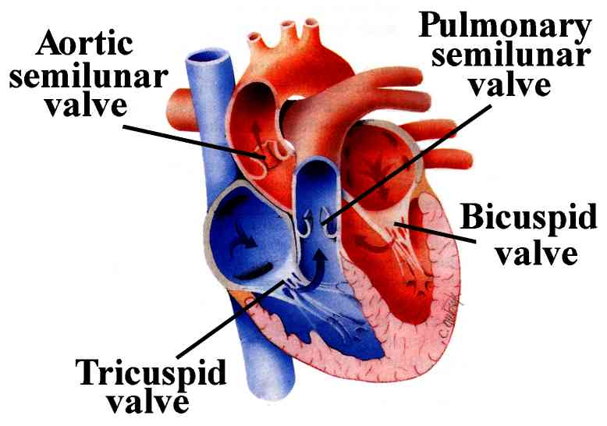
Heart Sounds
The physician listens at specific locations on the chest wall to hear specific functions of the heart
When a stethoscope is used to listen to the heartbeat, two distinct sounds can be heard
They are referred to as the lubb-dupp sounds
The lubb sound, which is the heard first, is caused by the valves slamming shut between the atria and the ventricles
The dupp, heart sound heard second, is shorter and higher pitched, it is caused by the semilunar valves closing in the aorta and the pulmonary arteries

Slide 15
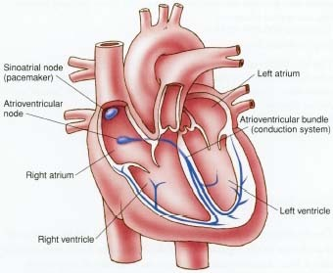
The Pacemaker
The heart beats normally as long as the cells receive the correct balance of sodium and potassium
Another essential element is the ‘”spark” from the group of nerves cells in the right atrium called the sinoatrial or SA node, also called the pacemaker, this sends blood from the atrium into the ventricles and then triggers the atrioventricular or AV node, located between the atrium and the ventricles

Slide 16
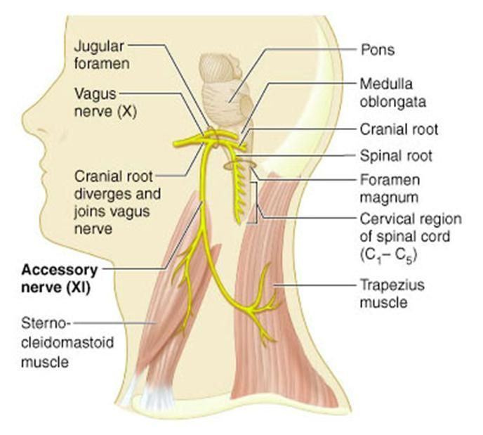
Controlling The Rate
Two nerves, the vagus and accessory have some control over the natural rate of the heartbeat
The vagus nerve slows down the heart rate (parasympathetic nervous system), whereas the accessory nerve increases the rate (sympathetic nervous system (SNS)
They may be stimulate by fear, anger, or excitement and can decrease with depression
Tachycardia: over 100 beats per minute
Bradycardia: less than 60 beats per minute

Slide 17
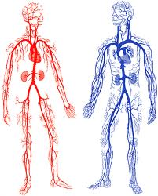
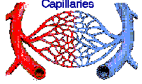
The Blood Vessels
Blood vessels are divided into three main types:
Arteries
Veins
Capillaries

Slide 18
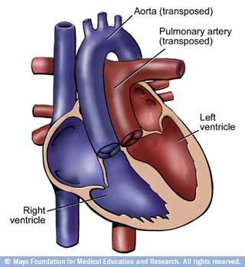
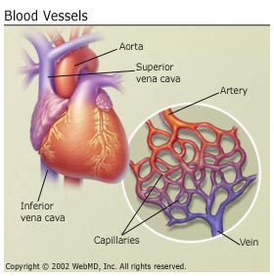
Arteries
An artery always carries blood away from the heart and usually carries fresh, oxygenated blood
The one exception is the pulmonary artery, which leaves the right ventricle of the heart on its way to the lungs to pick up oxygen

Slide 19
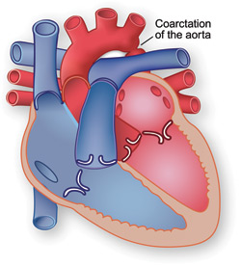
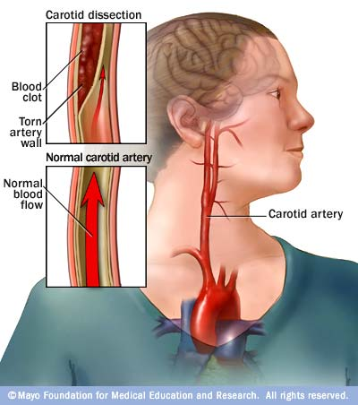
Arteries
The major arteries are listed on page 446
Aorta- the largest artery exiting in the left ventricle of the heart extending down the center of the body, all other arteries branch off the aorta
Carotid- extends up the side of the neck into the head

Slide 20
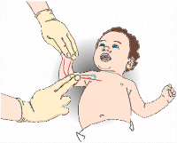
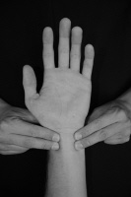
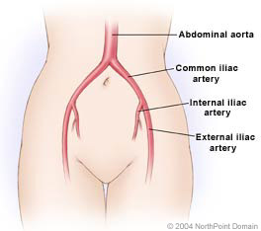
Arteries
Pulmonary- extends from the right ventricle to the lungs
Brachial- extends down the arm
Radial- extends on the thumb side of the forearm
Ulnar- extends on the little finger side of the forearm
Common iliac- branches off the abdomen aorta and extends down through the pelvis

Slide 21
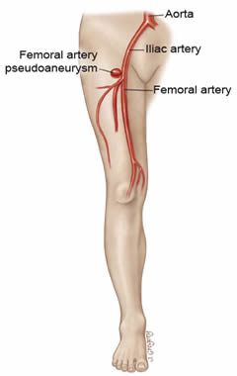
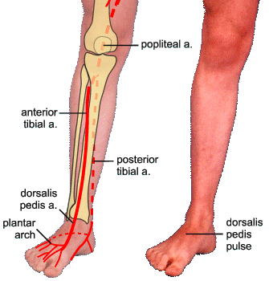
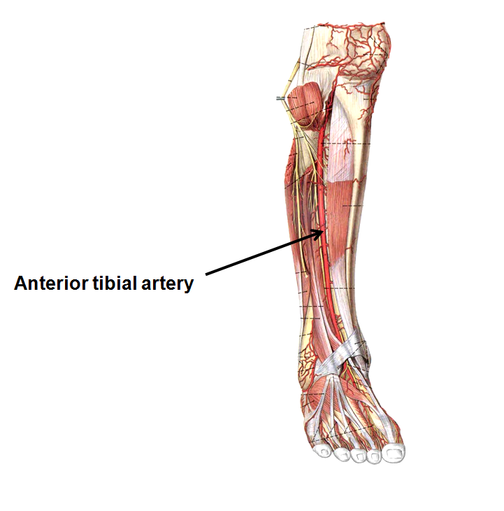
Arteries
Femoral- extends to the thigh
Tibial- extends from the femoral through the lower leg
Dorsalis pedis- extends along the top of the foot

Slide 22
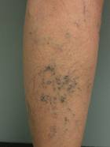
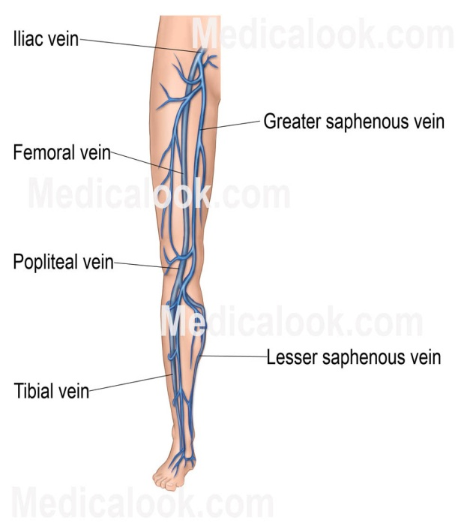
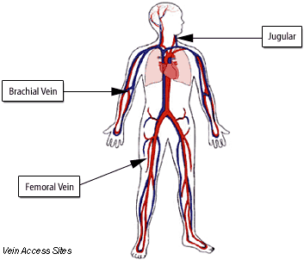
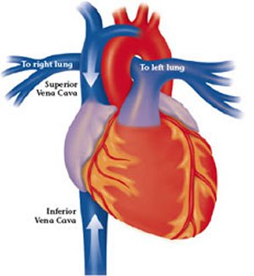
Veins
Veins are similar to arteries , except they are thinner and they lack the elastic fiber lining that lets arteries alter the size of their openings
Veins can collapse when the are not filled(varicose veins)
Deoxygenated
Major veins are listed on page 447
Tibial
Femoral
Common iliac
Inferior vena cava
Superior vena cava
Brachial
Jugular- from the head and neck

Slide 23
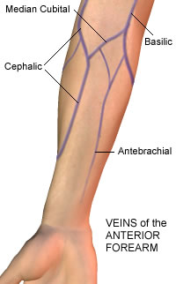
Veins
Cephalic
Median
Basilic
These vein are for blood draws

Slide 24
Systemic Circulation
Systemic circulation supplies nourishment to all of the tissue located throughout your body, with the exception of the heart and lungs because they have their own systems.
As the blood leaves the left ventricle, it enters the huge aorta
As the aorta descends through the body, the large arteries of the abdomen supplies the organs all the way down to the legs
Eventually all systemic arteries throughout the body subdivide until they become arterioles and then join the capillaries
The capillaries deliver the O2, water, and nutrients to the body’s cells and pick up the cell’s CO2 and wastes
Upon leaving the capillaries, the blood is considered deoxygenated
The capillaries join venues which become veins

Slide 25
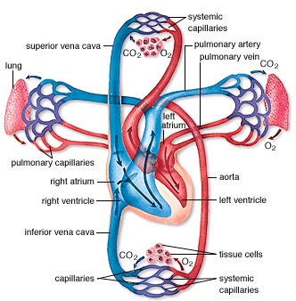
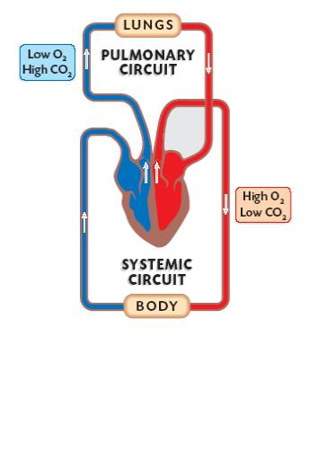
Review
Right ventricle(deoxygenated) to pulmonary artery to lungs
Left ventricle(oxygenated) to aorta to the body

Slide 26
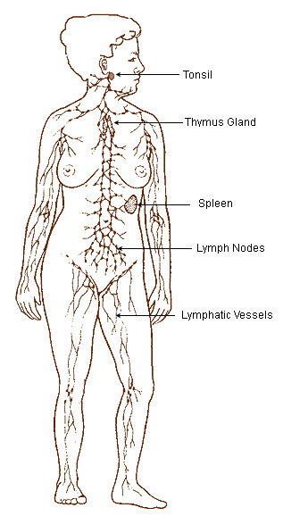
The Lymphatic System
The lymphatic system consists of lymph(a straw colored fluid), lymph nodes, lymph vessels, and the spleen
In addition, the lymphatic tissue, which produce lymphocytes(a type of blood cell), is often considered to be a part of the system which includes the tonsils, the thymus gland, and the intestinal lymphoid tissue

Slide 27
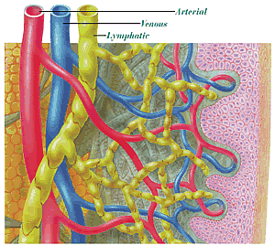
Lymph
Lymph is composed of blood plasma that filters out of the capillaries, lymphocytes, hormones, and many other substances, such as water, salt, O2, and CO2
Lymph fills the spaces between the cells and is also referred to as intercellular fluid or interstitial fluid

Slide 28
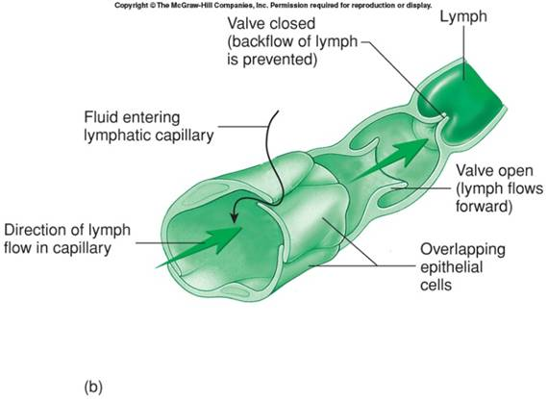
Lymph Vessels
Vessels carrying lymph are located throughout the body, somewhat like veins
They have a one-way system only, from the cells toward the heart

Slide 29
Lymph Nodes
Lymph nodes are small, round or oval structures located usually in clusters along the lymph vessel at various places in the body
Lymphocytes, a type of white blood cell, are derived from stem cells in the bone marrow
They enter the bloodstream and go to the lymph tissue to “live.”
When needed they divide and help with the white blood cells(fights infection)

Slide 30
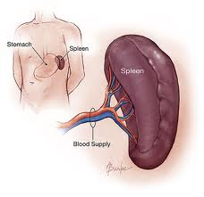
The Spleen
The spleen is an organ composed of lymphatic tissue that lies just beneath the left side of the diaphragm, in back of the upper portion of the stomach
The organ functions like a large lymph node
During an acute infection it will become enlarged and tender
Patient with leukemia may have an enlarged, firm spleen that is palpable
The spleen is filled with excess immature cells to be destroyed

Slide 31
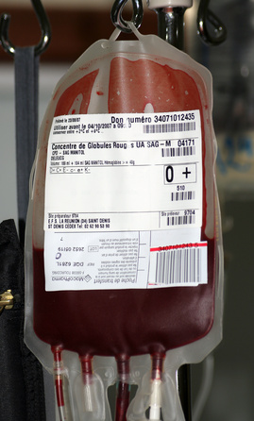
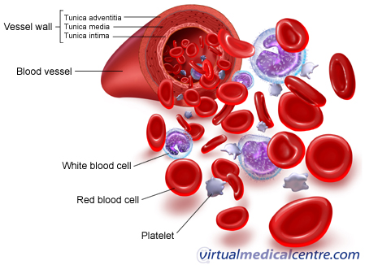
The Blood
Blood is the life giving fluid of the body
It flows through the blood vessels, transporting substances essential to the maintenance of life
The average adult has 8 to 10 pints of blood(donation is 1 pint)
A loss of 2 pints, or about 20% is cause for concern
The blood carries oxygen from the lungs to the body’s cell and cellular wastes from the cells to the appropriate organ for excretion

Slide 32
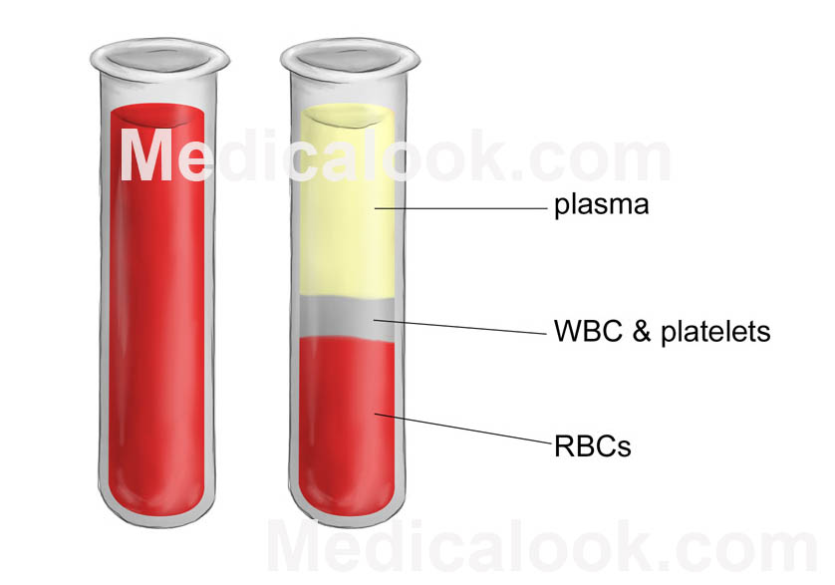
Plasma
Plasma is a straw-colored liquid that makes up a little over half the volume of blood
It is about 90% water, the remainder consists of calcium, potassium, phosphorus, and bicarbonates(electrolytes)
Plasma has three important proteins that are necessary to clot blood
Plasma is used in the treatment of serious disorders such as hemophilia and immune system deficiencies, and to make products used to help treat and prevent diseases like tetanus, rabies, measles, rubella and hepatitis B.

Slide 33
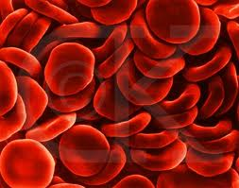
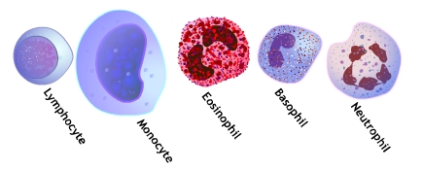
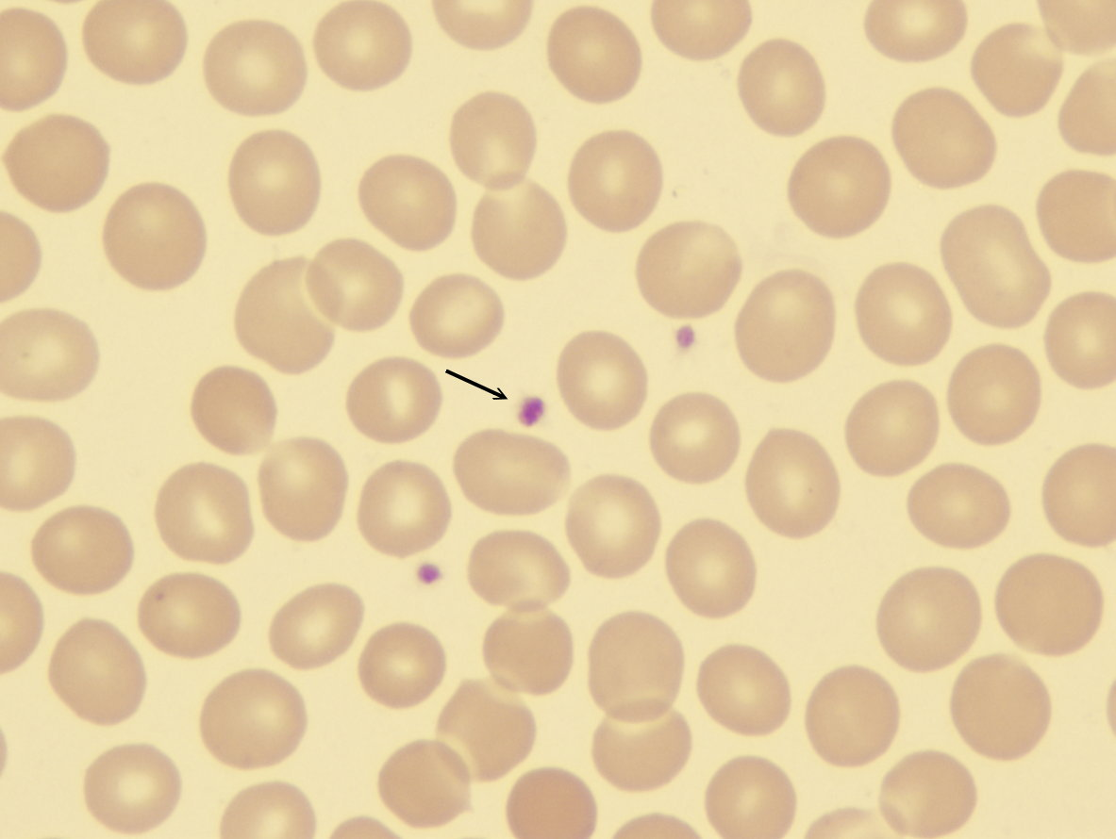
Cells
The cellular portion of the blood can be divided into three types of cells:
Red blood cells
White blood cells
Platelets

Slide 34
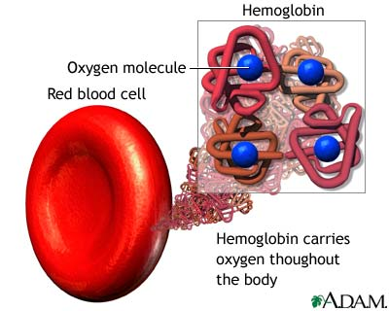
Red Blood Cells
Erythrocytes(red blood cells) are biconcave disks with very thin centers to enable them to fold over if necessary to pass through a narrow opening
Red blood cells number about 25 trillion in the body
It is red blood cells that give blood its color
A red blood cell lives about 4 months
They are produced in the bone marrow at a rate of about 1 million a second, the same rate at which they wear out
Erythrocytes obtain their color from hemoglobin
When hemoglobin is carrying a lot of oxygen it is bright red in color
As the oxygen is given up to the cells and exchanged for carbon dioxide, the color changes to the dark reddish blue that is visible in surface veins

Slide 35
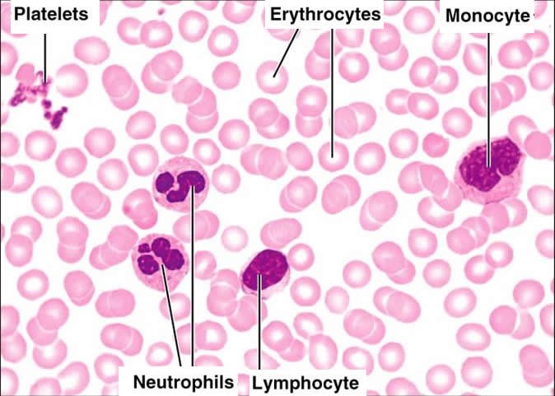
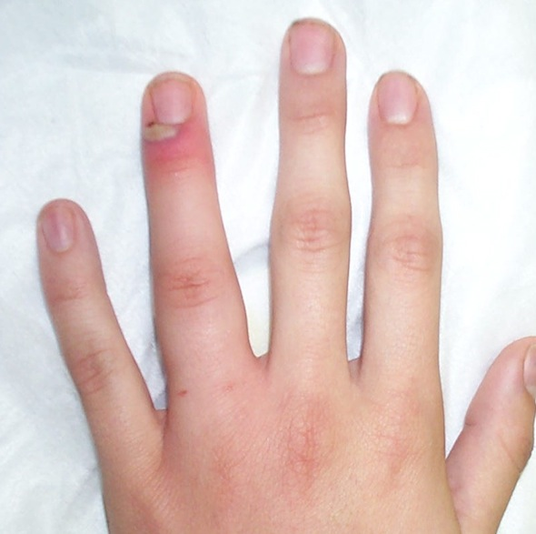
White Blood Cells
White blood cells are called leukocytes
They are present in the blood at approximately 5,000 to 9,000 per cubic millimeter, or about 1 white blood cell for every 600 to 700 red blood cell
White blood cell are about twice the size of RBCs
Leukocytes play a vital role in defending the body against invasion, moving through capillary walls into the tissue fluid to chase down bacteria
When an inflammation occurs, WBCs divide around the foreign object to prevent the spread of disease(this is when you have exudate or pus)
Exudate is composed of lymph, bacteria, and dead white blood cells

Slide 36
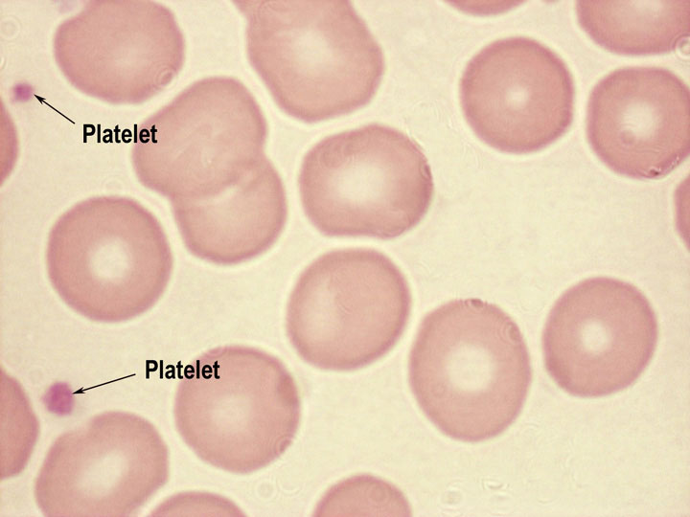
Platelets
Platelets are the smallest of the three and are present in the blood at a rate of 200,000 to 400,000 per cubic millimeter
They are also formed in the bone marrow
Platelets function in life-saving process of clotting blood
When a blood vessel is cut or damaged, it is platelets that attract this area
When there is a cut, platelets pile up at the site to form a small mass
Clotting can be assisted by applying pressure over the area to stop the blood flow until a clot can form

Slide 37
Blood Types
There are four blood types: A, B, AB, and O
The type of blood a person has depends on the presence of a protein factor called agglutinogen or antigens on the surface of the red blood cell
Type A has an A agglutinogen
Type B has an B agglutinogen
Type AB has both
Type O has neither
Page 435 shows blood types(can receive and donate)
Type AB plasma is universal which means your plasma can be received by anyone, regardless of their blood type.
Type AB plasma is universal which means your plasma can be received by anyone, regardless of their blood type.

Slide 38
Rh Factor
Red blood cells have another factor known as the Rh factor
If the red blood cell has the factor, it is said to be Rh positive
If the factor is absent, then the blood is said to be Rh negative
If a Rh negative person receives Rh positive blood, the antigen is “foreign” to that persons bloodstream
A person with Rh-positive can receive Rh positive or Rh negative blood because they already have the factor(said to be compatible)
More than 85% of people are Rh positive.
If a female who is Rh negative becomes pregnant with an Rh positive baby, a few positive cells may enter the mother’s blood at delivery and cause the production of antibodies. This could lead to life-threatening anemia — a lack of healthy red blood cells
This can be prevented in most cases with the medication called Rh immunoglobulin (RhIg).
The immune globulin prevents your body from producing Rh antibodies during your pregnancy and attacking the baby
If the antibody screen shows that you're already producing antibodies, an injection of Rh immune globulin won't help. Your baby will be carefully monitored. If necessary, he or she might be given a blood transfusion through the umbilical cord during pregnancy or immediately after delivery.

Slide 39
Cholesterol
Cholesterol is a substance in the blood from the metabolism of fats in the diet
It accumulates on the lining of blood vessels in the form of plaque
High levels of cholesterol promote heart attacks, strokes, and death
Cholesterol can often be controlled with a combination of healthy eating, exercise, weight control, no alcohol or smoking

Slide 40
Cholesterol
Cholesterol evaluation can be divided into three classifications: Total cholesterol, low density lipoprotein(LDL or bad), and High-density lipoprotein(HDL or good)
Total Cholesterol levels: less than 200 ml/dl
LDL levels: less than 100 ml/dl
HDL levels: above 60 mg/dl
Chart on page 455

Slide 41
Triglycerides
Triglycerides are common types of fats that are good for you normal amounts
They are present in food and are also manufactured by the body
High levels are a warning sign of heart disease risk
It is important to lose weight, exercise, stop smoking, and follow a diet low in saturated fats and with a limit of carbohydrates
Triglycerides levels: less than 150 mg/dl
Page 455

Slide 42
Cardiovascular Tests
Angiography: a radiologic examination of an artery after an injection of medium contrast
Doppler ultrasound: This is used to determine deep vein thrombosis(blood clot)or DVT

Slide 43
Cardiovascular Tests
Echocardiogram: this is a noninvasive test that uses ultrasound to make images of the internal structures of the heart
Electrocardiograph(ECG) This test is also called an EKG
It is perhaps the most common tool use to evaluate heart performance
The ECG is a graphic recording of the electrical activity of the heart
This test may be taking while the patient is lying or in an exercise mode, such as a bicycle or treadmill
Holter monitor

Slide 44
Diseases And Disorders
Anemia: this term indicates that certain elements are lacking in the blood(RBC) There are various types(page458-459)
Aneurysm: this is a ballooning out of the wall of an artery
there are various types(page 459-460)

Slide 45
Diseases And Disorders
Arrhythmia: this term is used to identify any abnormal changes in the heart rhythm, they range from mild to life threatening
Cerebrovascular Accident(CVA):
a condition commonly known as a
stroke, CVA is the sudden impairment
of the flow of blood to the brain,
interrupting the supply of oxygen and causing
serious damage of brain tissue

Slide 46
Diseases And Disorders
Congestive Heart Failure(CHF): This group of cardiac dysfunctions results in poor performance of the heart with related congestion of the circulatory system
Embolism: an embolus is defined as foreign matter that enters and circulates in the blood stream

Slide 47
Diseases And Disorders
Heart Failure: a condition, particularly prevalent among the older population, in which the heart pumps too weakly to supply the body with blood
Leukemia: this is a malignant disease of the bone marrow or lymphatic tissue, can be acute or chronic, the body has little defenses against any infection, bone marrow transplants are indicated, and the patient needs to be isolated
Murmur: the abnormal sound of blood flowing through a heart valve can be heard with a stethoscope, the murmur is named for the valve which is “leaking.”
Some murmurs can cause rheumatic fever or and may develop scar tissue
Artificial or pig valve replacement may be indicated if severe enough to interfere with circulation

Slide 48
Diseases And Disorders
Myocardial Infarction(MI): is a complication of coronary artery disease that results from occlusion(partial or complete) of the artery, causing myocardial tissue destruction
Heart attacks also known as myocardial infarctions, due to coronary heart disease are the number one killer in America. A heart attack is caused by a blockage in the blood supply to the heart muscle itself, causing damage to the heart muscle. Each of us needs to know our risk factors and reduce them. We need to know the warning signs of a heart attack
Chest pain, pain radiates most often to the left arm, but may also radiate to the lower jaw, neck, right arm, back and epigastrium, where it may mimic heartburn, and shortness of breath (dyspnea)

Slide 49
Draw a heart

