Slide 1
Chapter 11-8 Review
THE CIRCULATORY SYSTEM

Slide 2
Review
This is a muscular organ or pump?
Heart
This is the fluid that fills the spaces between the cells in the circulatory system?
Lymphatic system(lymph)
This is known as the contraction phase and is the highest pressure against the walls of the arteries?
Systolic pressure
This is known as the relaxation phase and is the least amount of pressure against the arteries?
Diastolic pressure

Slide 3
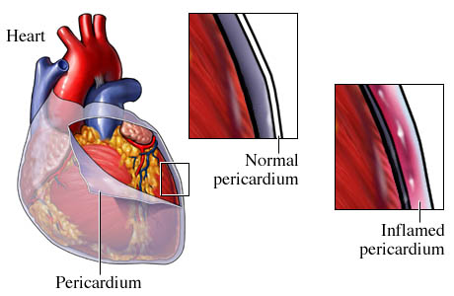
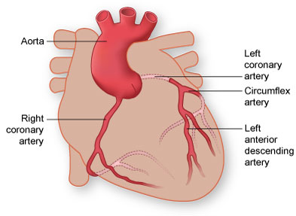
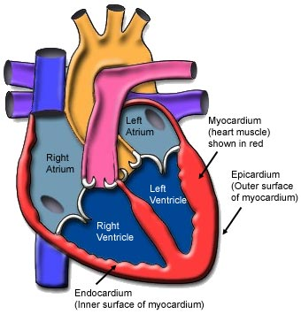
Review
The outer wall of the heart is surrounded by a sac called?
Pericardium
The coronary arteries are located?
On the outer surface of the heart
The muscle wall of the heart is called?
Myocardium
The external layer of the heart?
Epicardium
The inner lining of the heart?
Endocardium

Slide 4
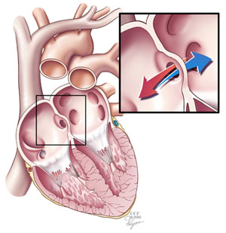
Review
The heart is divided into right and left sides by a vertical muscular wall in the center called the?
Septum
This valve that is between the right atrium and right ventricle?
Tricuspid
This valve that is between the left atrium and left ventricle?
Bicuspid(mitral)

Slide 5
Review
The circulation between the heart and the lungs?
Pulmonary circulation
The circulation between the heart and the rest of the body?
Systemic circulation
This is the only artery that carries oxygen-poor blood?
Pulmonary artery

Slide 6
Review
Vena cava
Rt atrium
Tricuspid valve
Rt venticle
Pulmonary artery
Pulmonary vein
Lt atrium
Bicuspid valve
Lt ventricle
Aorta
Rest of the body

Slide 7
Review
This is the largest artery in the body, originating from the left ventricle of the heart and extending down to the abdomen?
Aorta
All of the valves in the heart help to prevent?
Back flow of blood
This is called the pacemaker of the heart?
Sinoatrial or SA node

Slide 8
Review
Medical term for rapid heat rate over 100 beats per minute?
Tachycardia
Medical term for abnormally slow heart rate less than 60 beats per minute?
Bradycardia
Always carries blood away from the heart and usually carries fresh, oxygenated blood?
Arteries(one exception = pulmonary artery)

Slide 9
Review
This is a type of white blood cell, are derived from stem cells in the bone marrow?
Lymphocytes
The average adult has ? pints of blood
8 to 10 pints(loss of 2 pints is a concern)
Medical term for red blood cells?
Erythrocytes
Medical term for white blood cells?
Leukocytes

Slide 10
Review
A red blood cell protein that transports oxygen?
Hemoglobin
Leukocytes play a vital role in?
Fighting infection
Platelets play a vital role in?
Clotting
Erythrocytes play a vital role in?
Transporting oxygen

Slide 11
Review
This is the an antigen on the surface of the red blood cell
A blood type protein factor (positive)
What is a hematologist?
A specialist that treats diseases of the blood
This is a noninvasive test that uses ultrasound to make images of the internal structures of the heart?
Echocardiogram

Slide 12
Review
This is perhaps the most common tool use to evaluate heart performance, this test uses graphic recording of the electrical activity of the heart, used to identify heart rhythms?
Electrocardiograph(ECG/EKG)
This term(disease) indicates that certain elements are lacking in the blood(RBC), there are many different types?
Anemia
This is a ballooning out of the wall of an artery?
Aneurysm

Slide 13
Review
This term is used to identify any abnormal changes in the heart rhythm, they range from mild to life threatening?
Arrhythmia
This is a arrhythmia with a quivering action of heart(atrial)?
Atrial fibrillation
This is a arrhythmia that may be fatal unless reversed in the first few minutes?
Ventricular fibrillation
These are certain essential minerals that help keep us hydrated?
Electrolytes

Slide 14
Review
A condition commonly known as a stroke, this is the sudden impairment of the flow of blood to the brain, interrupting the supply of oxygen and causing serious damage of brain tissue?
Cerebrovascular Accident(CVA)
This group of cardiac dysfunctions results in poor performance of the heart with related congestion of the circulatory system?
Congestive Heart Failure(CHF)

Slide 15
Review
This is a malignant disease of the bone marrow or lymphatic tissue, can be acute or chronic, the body has little defenses against any infection, bone marrow transplants are indicated, and the patient needs to be isolated?
Leukemia
This is a complication of coronary artery disease that results from occlusion(partial or complete) of the artery, causing myocardial tissue destruction, called a heart attack?
Myocardial Infarction(MI)

