Slide 1
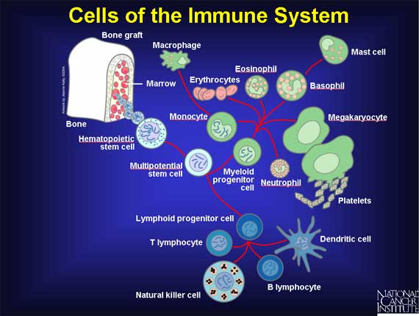
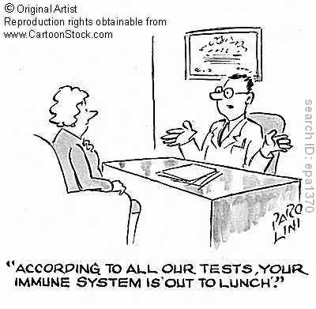
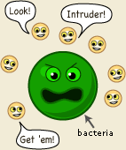
Chapter 11 Unit 9
The Immune System

Slide 2
The Immune System
The function of immunity is primarily provided by specific cells and organs of the circulatory system(blood cells and tissues)
The role of immunity is essential to the health and well-being of humans
When the system misfires or is crippled, a whole host of diseases can develop, such as AIDS, allergies, arthritis, and cancer

Slide 3
The Immune System
We live in an environment full of antigens(non-self or foreign)
Examples of some antigens:
Bacteria, viruses, fungi, foreign materials, and parasites
In abnormal situations, the immune system can mistake self for non-self and attack, this is known as an autoimmune disease(RA or lupus)
Sometimes, the system responds inappropriately to harmless substances, such as pollen or cat hair, this is known as an allergen
When one’s own cells become malignant, their structure changes, making them “different” and a response occurs
Many antigens can cause serious reactions, infections, diseases, and even death

Slide 4
The Immune System
The body has three main lines of defense against antigens:
1. Barriers: skin, mucous membranes in our lungs and gastrointestinal tract
2. Inflammation process: begins within seconds of an invasion, with redness, and swelling in that area
3. Antibodies: involves the actions of specific cells and other immune system components to attack the antigen

Slide 5
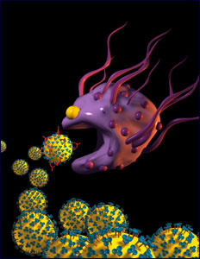
Origin Of Cells
Leukocytes(white blood cells) play a vital role in defending the body
All blood cells originate in the bone marrow and initially develop from stem cells
There are 5 WBC:
Eosinophils: 3% of leukocytes, fight against allergic reactions, they are weak phagocytes(this is engulfing or digesting antigens)
Neutrophils: 64% of leukocytes, these are the first to arrive at an infection
Basophils: 1% of leukocytes, small an produce the inflammation process
Lymphocytes: large leukocytes 25%, these contain B and T cells(talk about later)
Monocytes: 8% of leukocytes, largest wbc called “big eaters” that eat bacteria, monocytes are immature until they enter the tissue to fight infection and then they are almost large enough to see with the naked eye, in this stage they are called macrophages

Slide 6
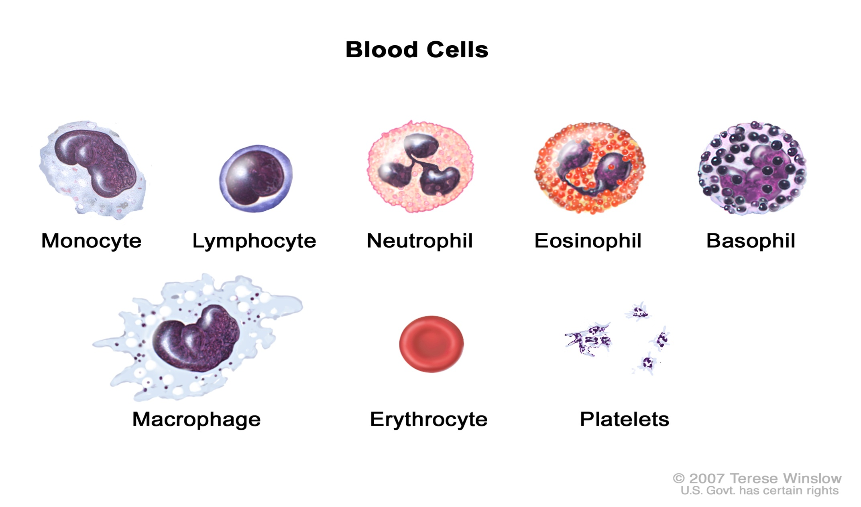
Five White Blood Cells

Slide 7
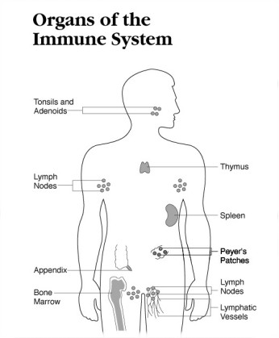
Organs Of The Immune System
The organs of the immune system are located throughout the body
They include:
Bone marrow:
Thymus: lives in your chest, between your breast bone and your heart
Lymph nodes:
Spleen:
Tonsils:
Adenoids:
Appendix:
Peyer’s patches:(are lymph nodes, located in the intestine)

Slide 8
The Immune System
Now that you know how lymph nodes functions, it is easy to understand why they become swollen and tender during periods of infection
It is because of the increased amount of cellular activity within the nodes
This also occurs when malignant cells break away and circulate into the lymph fluid and are trapped into nodes, this is known as metastasis
The assessment of tumors is called staging and is determined by the size of the tumor , the number of lymph nodes, and the metastatic progress

Slide 9
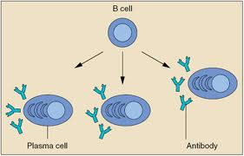
B Lymphocytes(one of our 5 WBC)
B Lymphocytes represent about 20 % of the total lymphocytes and act upon their targets by producing antibodies in a process called humoral immunity(body fluids)
Each B Lymphocyte is capable of making only one type of antibody, and only one specific antigen can activate it

Slide 10
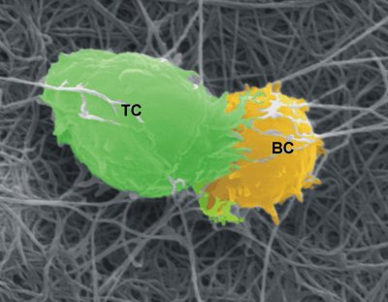
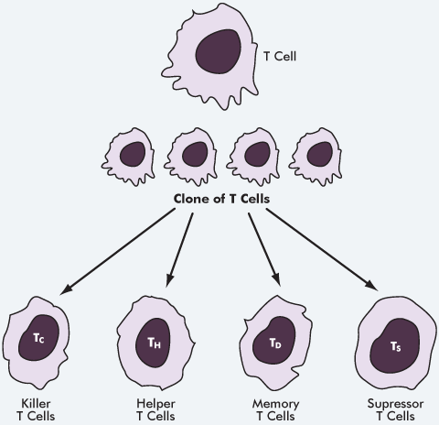
Lymphocytes T Cells
Lymphocytes are a small WBC that contain both T cells and B cells
T cells: directly attack invading organisms
They are present in four identifiable types:
1. Helper T cells: make antibodies
2. Suppressor T cells: stop T cells when the ‘battle” is under control
3. Killer T cells: can directly kill infected cells, unfortunately, they can attack transplanted tissue or organs
4. Memory T cells: have a memory from a previous experience with specific antigens and are prepared to act upon re-contact

Slide 11
Primary Humoral(B-cell or Antibody-Mediated)1st Response
In this response, an antigen enters the body and meets with one of the matching antibody sites
The B cell then connects and processes the antigen to attract the helper T cells
Helper T cells bind with WBC(macrophages) and begin the healing process(mitosis)
The immunoglobulin also come together in the 1st response
A full primary immune response requires 5 to 6 days to develop

Slide 13
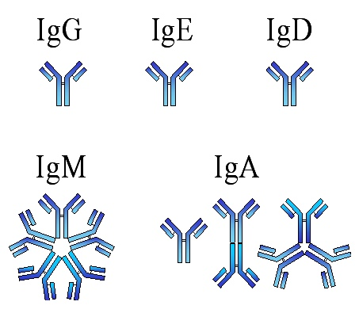
Antibodies
The antibodies from the B cells are protein substances belonging to a family of large molecules known as immunoglobulin(page 480)
There are five classifications of immunoglobulin’s
1. IgA(presence of body fluids)
2. IgD(regulate B cell activity)
3. IgE(fights against parasites, hives)
4. IgG(carries out antibacterial and antiviral activity)
5. IgM(found in the bloodstream and kills bacteria)
Their presence in the body can be measured by a blood test

Slide 14
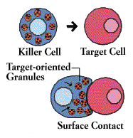
Natural Killer Cells
These are non T and non B cells, they are in the bloodstream system
Natural killer cells kills some cancer cell and cells infected with viruses
They produce holes in the target cell, leading to it’s destruction
Clinical studies have shown that it is well tolerated and some anti-tumor responses have been seen in patients with lung cancer, melanoma and lymphoma
As the majority of pregnancies involve two parents who are not tissue matched, successful pregnancy requires the mother's immune system to be suppressed. NK cells are thought to be an important cell type in this process.[

Slide 15
2nd Response
In a secondary response, the reaction is much faster, taking only 2 to 3 days
This is possible because left-over lymphocytes with memory are able to attack the antigen
Once one of the cells meets the same antigen, mitosis is immediate, and large numbers of appropriately matched calls and antibodies are produced to destroy the antigen

Slide 16
Primary Cell-Mediated Response(T-cell Activity)
This response of T cells is both quick and direct
Some T cells are vital to the operation of other cells
The helper T cells assist B cells to produce antibodies
Helper T cells identify antigens trapped by WBC(macrophages)

Slide 17
Immunizations
With the knowledge of immune reactions, it is easy to understand how immunizations and vaccinations provide protection against antigens
Vaccines are given in initial and in “booster” doses to provide memory cells and antibodies for longer periods
These methods provide active immunity against that specific disease
Tetanus is an example: antibodies from another source are injected into the person to provide a temporary immunity to counter the immediate attack of pathogens, that why this is given after an injury or animal bite

Slide 18
Diseases And Disorders HIV/AIDS
Acquired immunodeficiency syndrome(AIDS): is a worldwide epidemic
The tem AIDS refers to the most advanced stages of HIV(human immunodeficiency virus)
Globally, HIV is still increasing over time as the epidemic spreads to different countries
According to the CDC(2009) there are 50,000 people newly diagnosed with HIV each year in the US
The beginning of HIV was discovered in the 1980
The estimated number of AIDS diagnoses through 2010 in the United States was 1,155,792.

Slide 19
Diseases And Disorders HIV/AIDS
AIDS is an infectious disease caused by HIV, which renders the body’s immune system ineffective
The virus has been found in many body fluids but survives well only in those with numerous WBC’s, such as in blood, semen, and vaginal secretions
The virus invades the helper T cells and macrophages, hiding in their membranes

Slide 20
Diseases And Disorders HIV/AIDS
After HIV enters the body, it piggybacks onto a T cell and works its way inside of that cell
Once inside, the virus completely takes over the T cell and uses it as a virus-making factory to make a lot of copies of itself
The newly made viruses then leave the T cells and go on to infect and destroy other healthy T cells as they continue to multiply inside the body
After the virus invades the T cells, they can no longer properly fight infections.
Someone who is infected with the virus is called HIV positive, but it may take years for the virus to damage enough T cells for that person to get sick and develop AIDS

Slide 21
Diseases And Disorders HIV/AIDS
The virus can be transmitted by the following methods:
Unprotected sex with an infected partner
Sharing drug needles or syringes with an infected person
Women with HIV can transmit the virus to their babies during pregnancy, birth, or breast feeding
Blood transfusions(very low because of screening)
Health care workers from needle sticks or body fluids(very low, less than 0.01%)

Slide 22
Misconceptions Of HIV Transmission
Causal contact with an infected person(towels, toilet, bedding, swimming pools, sharing utensils)
Kissing(open mouth very low risk)
Mosquitoes
Tattooing
Body piercing
HIV infection from infectious bodily fluids outside the human body is essentially zero
Outside of the body, the HIV virus dies within minutes without the temperature necessary for its survival
A Western Blot Test(non-waived) is used to confirm an HIV diagnosis

Slide 23
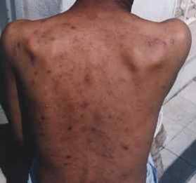
Signs And Symptoms Of HIV(list on page 488)
Early signs:
Many do not have symptoms when first infected
Within 1 to 2 month they may have flulike symptoms(fever, fatigue, headache, enlarged lymph nodes)
When they have these symptoms, HIV is present and they are highly contagious
Later signs:
Severe symptoms may not occur for about 10 years(this is when helper t cells are being destroyed)
Symptoms at this time may be:
Enlarge lymph nodes, fatigue, inflammatory
disease, fever, sweats, weight loss, rashes,
memory loss
Late signs:
HIV to AIDS
Pneumonia, cough, difficulty breathing,
fever, some cancers, meningitis, or chronic diarrhea
These are often resistant to treatment

Slide 24
HIV
HIV is treated with antiretroviral (ARV) therapy(HIV cocktails)
Antiretroviral drugs are used in the treatment and prevention of HIV infection. They work against HIV by stopping or interfering with the reproduction of virus in the body(20 approved meds)
Antiretroviral drugs interfere with the way HIV makes copies of itself and the way it spreads from cell to cell
Taking at least 3 medicines at the same time makes it harder for the virus to adapt and become resistant
If a pregnant woman has HIV, she will need to start an ART treatment. This is a very good way to make sure that her baby will not get the HIV.

Slide 25
HIV Medications $
Agenerase | $772
Aptivus | $1117.50
Combivir | $752.64
Crixivan | $570.96
Emtriva | $347.11
Epivir 300mg | $347.11
Epzicom | $813.55
Fortovase | $263.35

Slide 26
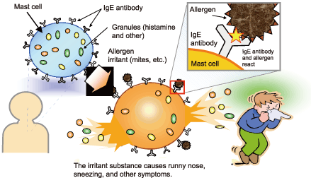
Allergies
Sometimes the immune system can damage instead of protect the body(from dust, animal hair, food, pollen, insects)
This is allergies and may damage tissues
Allergies may affect different areas of the body:
In the nose: rhinitis
In the lungs: as asthma
In the eyes: as conjunctivitis
On the skin: as eczema, dermatitis, or hives
In the digestive tract: vomiting or diarrhea
When exposed to an allergen, the antibody IgE(WBC- B cells) is produced resulting in a histamine responses

Slide 27
Cancer
Cancer is a group of diseases characterized by uncontrolled growth of abnormal cells
These cells accumulate and form tumors that may compress, invade, or destroy normal tissue
Cells have the potential to break away from a tumor and travel to other areas of the body
The spread of a tumor to a new site is called metastasis

Slide 28
Cancer
Cancer is the second leading cause of death
One out of every four deaths in the US is from cancer
Oncologists are physicians that specializes in the education and treatment of cancer
The medical term neoplasm is defined as a new growth
There are benign and malignant tumors
Benign tumors are slow growing and usually do not cause any problems

Slide 29
Malignant Tumors
Malignant tumors are cancerous and differ from benign in several ways:
Cancer cells alter cell structure
Cancer cells lack normal growth
Cancer cells grow rapidly and invade other tissues
Cancer cells escape the immune response
Cancer cells cause destruction of normal tissue

Slide 30
Classifications Of Cancer
Cancer can be classified according to its cellular origin
Cancers arising from epithelial tissues are known as carcinomas(breast cancer), and those from connective tissues are call sarcomas(bone or blood cancer, rare in adults)
Cancers can also be described according to their degree of grade
The grading system goes from grade 1(resembles a normal cell) to grade 4(grow rapid and look abnormal)
Size is measured in cm

Slide 31
Cancer Staging
Staging is a term used to identify the extent of spread
This is a system used worldwide
This is used to plan treatments, evaluations, outcomes, and prognosis
The method is known as the TNM system and uses a standard criteria:
T: the size of the tumor
N: the presence or absence and the extent of the lymph nodes
M: The presence or absence of distant metastasis
Number are added to the three components:
Example: T- Tumor size: T1
N- nodal involvement: N2
M- metastasis: M1

Slide 32
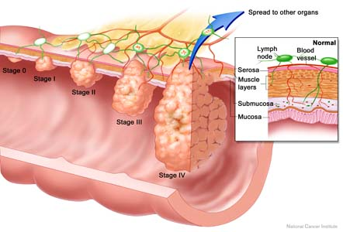
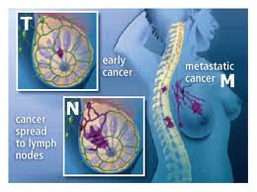
Stages Of Cancer

Slide 33
The Seven Warning Signals Of Cancer
Change in bowel and bladder habits
A sore that does not heal
Unusual bleeding or discharge
Thickening or lump in the breast or elsewhere
Difficulty swallowing
Obvious change In a wart or mole
Nagging cough or hoarseness

Slide 34
Diagnosis Tests For Cancer
The diagnosis of cancers cells can only be considered 100% accurate if a sample of cells are removes and examined under a microscope
A biopsy is a removal of a sample of tissue from the body for microscopic examination to determine a diagnosis
Some laboratory tests can help establish the diagnosis of cancer
Tumor imaging: a variety of radiology and imaging tests are used to aid in the diagnosis and staging of cancer, x-rays, CT scans, MRI’s, endoscopy, ultrasound, mammogram

Slide 35
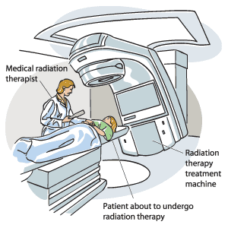
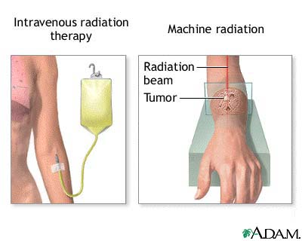
Treatment For Cancer
The major treatment methods for cancer are surgery, radiation, and chemotherapy
Radiation is the use of high-energy particles or damage to DNA of cancer cells
Chemotherapy involves the use of potent medications to treat cancer cells by altering cell division
It can be administered orally, intravenous, SQ, IM
Page 498(list of treatments)

Slide 36
Chronic Fatigue Syndrome
Chronic fatigue syndrome refers to severe, continued tiredness that is not relieved by rest and is not directly caused by other medical conditions
They believe that the virus or bacteria enters the body but does not set off a normal immune response
The cause is unknown
One treatment is exercise therapy of 1 hour sessions
This may be cause by the presence of high levels of antibodies of the epstein-barr virus(mono)

Slide 37
Lupus
This is a chronic disease of unknown cause in which striking changes occur in the immune system
It causes inflammation of various parts of the body
It can be life threatening if this occurs in the kidneys, lungs, heart, or brain
In lupus, the usually protective antibodies are produced in extremely large quantities and react against the person’s own tissues, this is referred to as an autoimmune disease
There is no cure for this disease, pain is controlled by ibu or Tylenol, rest and normal exercise

Slide 38
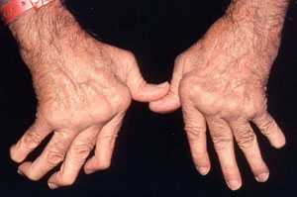
Rheumatoid Arthritis
Rheumatoid arthritis (RA) is a long-term disease that leads to inflammation of the joints and surrounding tissues. It can also affect other organs
The cause of RA is unknown
It is an autoimmune disease, which means the body's immune system mistakenly attacks healthy tissue
RA can occur at any age, but is more common in middle age, women get RA more often than men
Infection, genes, and hormone changes may be linked to the disease
RA usually requires lifelong treatment,
including medications, physical therapy,
exercise, education, and possibly surgery.
Early, aggressive treatment for RA can delay
joint destruction

