Slide 1
Chapter 12
Preparing For Clinical Duties

Slide 2
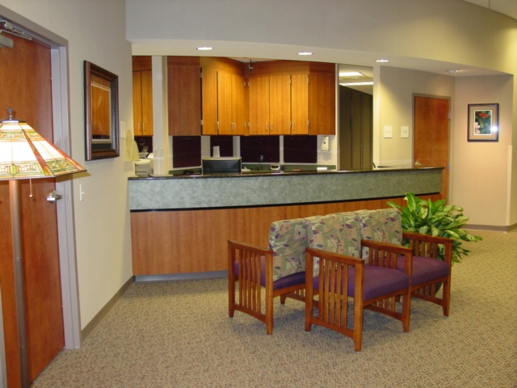
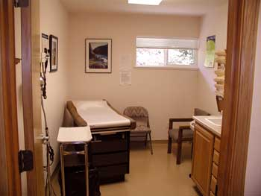
Keeping The Entire Medical Facility Clean
In the performance of clinical procedures, the medical assistant must be mindful of necessity of asepsis, which is a state of being free from all pathogenic microorganisms
Keep the medical facility clean and safe for all who enter
The reception area and the rest of the facility should be a pleasant and comfortable place for those who enter

Slide 3
Keeping The Entire Medical Facility Clean
It is your responsibility to take a look around to inspect your area before patients arrive( includes surfaces, chairs, and doorknobs)
Repeat the area throughout the day
Garbage's or biohazard bags need to be changed as needed(ex: dirty diapers; blood)
A solution of one-fourth cup bleach per gallon of tap water should be made fresh daily and kept readily available for cleanup
A disinfectant spray is a good idea to disinfect small areas(citrus fragrance)

Slide 4
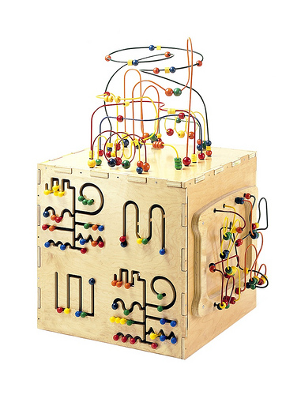
Keeping The Entire Medical Facility Clean
When working with children, it is very important to routinely clean and disinfect the children's area and exam rooms, including: toys and games
No small toys or objects should be allowed in the pediatric office

Slide 5
Keeping The Entire Medical Facility Clean
Remember to bring in those patients who are in obvious pain or distress, or feeling very sick as soon as they arrive, because it may be possible to help eliminate further problems and save further stress or embarrassment
Patients should be discouraged from eating and drinking in the reception area

Slide 6
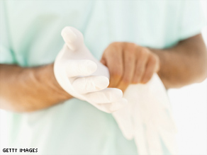
Wearing Gloves
Wearing gloves is necessary when cleaning up blood or bodily fluid
There are three very important reasons why latex or vinyl gloves are worn:
1. to provide protection as a barrier and prevent contamination of the hands when touching any blood or body fluid
2. to reduce the possibility that any pathogens present on your hands will be transferred to another
3. to diminish the chance of any pathogens being transmitted from you to patients as you go from one patient to another
Hand washing is a must before and after wearing gloves
Always remember to protect yourself and others

Slide 7
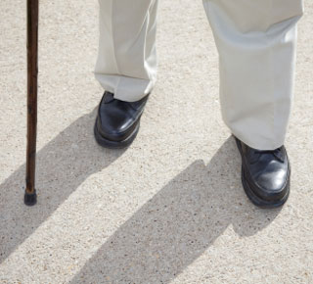
Avoiding Accidents
The entire facility should be inspected daily and as you bring patients in to prepare them to see the physician
Check for objects(cords, toys, rugs, wet floors)
Emergency exit signs should be clearly posted

Slide 8
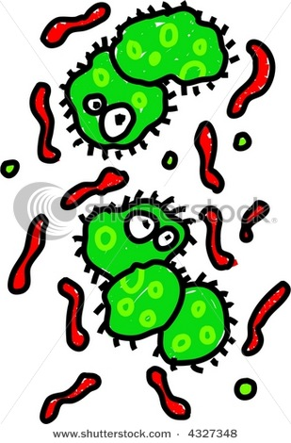
Guidelines For Preventing The Transfer of Disease
Microorganisms that are the cause of disease are called pathogens
They have certain requirements for growth and multiplication
If steps are taken to interrupt and prevent their growth, disease transmission can be reduced
You have a legal, moral, and ethical responsibility to protect yourself and others from such preventable problems
Obviously, the best way to do this is to establish a routine and stick to it

Slide 9
Hand Washing Guidelines
The first way to prevent the transfer of microorganisms is by washing your hands
This is the responsibility of all health care workers
You must develop the routine of hand washing before you begin your daily schedule
Hand washing should be done for approximately 20 seconds before and after seeing patient, after handling specimens or soiled or contaminated material
Wash your hands before and after eating, and when using the restroom

Slide 10
Hand Washing Guidelines
Minimal jewelry should be worn, because it is impossible to eliminate all pathogens
When a sink is not readily available use a commercial cleaner prep(alcohol base) for approximately one minute
Hand washing procedure is on page 606-607

Slide 11
Basic Guidelines For Lab Safety
Proper hand washing
Gloving is always a must
Cover all scratches, cuts, or any breaks in the skin
Never eat, drink, chew gum, smoke, place your fingers or pens in your mouth
Wear PPE(personal protective equipment) with splashing or spilled blood or body fluids
Clean up spills immediately
Work in a well lighted and quite area for better concentration
Dispose of all sharps, never recap a needle, never use your teeth to uncap a needle before an injection or blood draw
Discard all hazardous waste in proper container
Report all accidents/injuries to your supervisor immediately
Post emergency numbers near the telephone
Have available first aid supplies

Slide 12
Basic Guidelines For Lab Safety
Post clear emergency signs
Do not wear loose-fitting or bulky cloths or jewelry
Use air values or Bunsen burners with caution
Use disposable cups for drinking
Designate a “dirty” and “clean” sink in the lab
Caution when working with chemicals(pour at arm’s length)
At all times, extreme caution must be used by health care workers in handling needles, scalpels, and other sharp instruments
Note that many of the patients and co-workers may be allergic to latex

Slide 13
Disease Prevention
In the mid-1980s, following the frightening reality of the acquired immunodeficiency syndrome(AIDS) epidemic, the ways that health care professionals practice caring for patients has changed dramatically
Standard Precautions have been recommended by the CDC since 1987
In each physician's office there must be posted a statement in writing that agrees with compliance of the OSHA(occupational safety and health administration)regulations
Those who do not follow these regulations will be fined

Slide 14
Indirect and Direct Contact
Because diseases can be transmitted in different ways, a brief discussion regarding direct and indirect ways contact is necessary for you to realize and understand the potential danger that an infected person can have:
Droplet infection(cough or sneeze): ask the patient to wear a mask
You and others may catch this by indirect contact(handling a soiled tissue or touching a doorknob)

Slide 15
Standard Precautions Statement
All employees in this medical practice must follow standard precautions at all times in performing procedures that may expose them to bloodborne pathogens possibly contained in the blood and bodily fluids from any patient’s health status.
All employees must wear protective barriers that are appropriate for the procedure being performed to prevent possible infection.
Employees who work with direct patient contact must have HBV vaccine.
Any accidental needle sticks, other injuries, or contacts with potentially infectious body fluid must be reported to the physician at once for treatment and documentation

Slide 16
Disease Transmission
Become familiar with communicable diseases on page 615 and616
AIDS:
Direct contact blood to blood
Chickenpox:
Direct or indirect contact with droplet
Common cold:
Direct or indirect contact with infected person
Conjunctivitis(pinkeye):
Direct or indirect contact with eye discharge
Head lice:
Direct contact with infected person
Haemophilus:
Direct, indirect, or droplet with respiratory infection
Hepatitis A:
Direct contact with fecal contaminated food or water
Hepatitis B:
Direct contact blood to blood
Hepatitis C:
Direct contact blood to blood

Slide 17
Disease Transmission
Herpes simplex virus(cold sores):
Direct contact with infected person
Impetigo:
Direct contact with draining sores
Influenza:
Direct and indirect contact and by airborne secretions
Meningitis:
Direct contact, fecal-oral route and respiratory
Pinworms:
Direct contact from anus to mouth
Pneumonia:
Direct and indirect contact
Scabies:
Direct and indirect contact with infected clothing/bedding
Strep throat:
Direct contact with saliva or mucus
Scarlet fever(strep throat with a body rash)
Direct contact with saliva or mucus

Slide 18
Disease Transmission
If the person is susceptible to a disease it means that person is vulnerable to catching it
The body’s immune system has amazing abilities
Immunity is best when the body is in a state of good physical, emotional, and mental condition

Slide 19
Disease Transmission
All living organisms have requirements to sustain life and for growth and development
These requirements are oxygen, pH, temperature, nutrients, water, and a host to inhabit
5 microorganisms:
Viruses
Bacteria
Protozoa
Fungi
Parasites

Slide 20
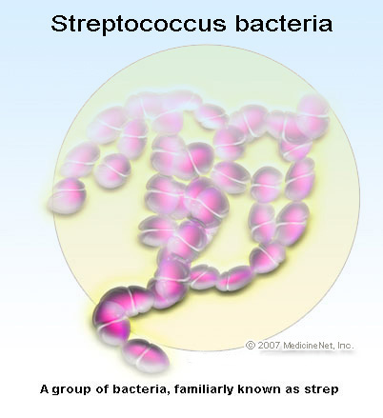
Disease Transmission
Viruses: smallest microorganisms(herpes, common cold)
Bacteria: single cell microorganisms multiples about every 20 minutes( e-coli, strep, whooping cough)

Slide 21
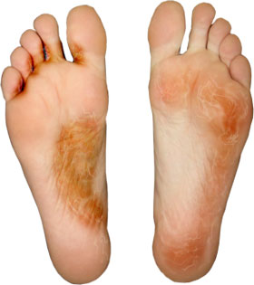
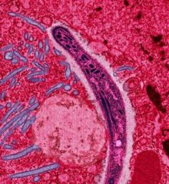
Disease Transmission
Protozoa: Complex microorganisms(malaria) They live in water or where it is damp
Fungi: simple parasitic plants(tinea pedis or athlete's foot) This fungus eats old skin cells and lives in moist areas

Slide 22
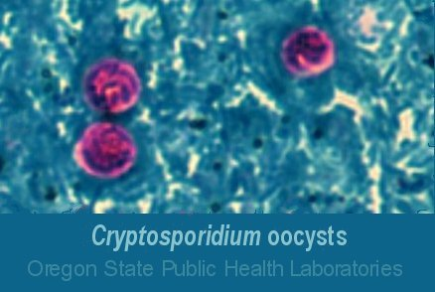
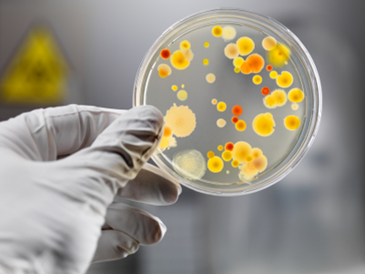
Disease Transmission
Parasites: A parasite is an organism that lives on or in a host and gets its food from or at the expense of its host. Parasites can cause disease in humans
Cryptosporidium: This parasite can be found in soil, food, water or surfaces that have been contaminated with feces from infected humans or animals

Slide 23
Infection Control
Three methods are recommended in addition to the Standard Precautions to diminish the spread of pathogens in the medical facility
Sanitization: is the process of washing and scrubbing to remove materials such as body tissue, blood, or other body fluids(ex: washing your hand to sanitize)
Disinfection: is a process by which disease-producing microorganisms, or pathogens, are killed(ex: using a germicide from contaminated instruments)
Sterilization: is the process that destroys all forms of living organisms(autoclaving)

Slide 24
Infection Control
Autoclaving : a pressurized device designed to heat aqueous solutions above their boiling point
A sterilized package will expired after 30 days (pay attention to the expiration date or shelf life)
Autoclaving package must be labeled with the expiration date, your initials, and the instruments in the package
Articles to be autoclaved must be sanitized and then wrapped in a double thickness of paper
Envelope packaging is manufactured for some instruments such as scissors
Autoclave tape has an indicator stripe that changes color when the proper temperature has been maintained for a long

