Slide 1
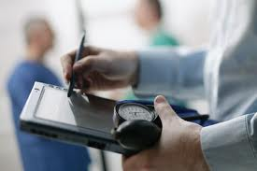
Chapter 13
Beginning the Patient’s Record

Slide 2
Screening
Screening is the process of obtaining information from patients to determine their medical condition
The French word triage means to sort and to prioritize
First priority(red flags): Chest pain, severe bleeding, head injury, poisoning, shock, and some burns

Slide 3
Phone Screening
The medical assistant who speaks to the patient over the phone must have knowledge of:
Medical Terminology
Anatomy and Physiology
Diseases and disorders
Emergency procedures
Medications
And they must use:
Communication skills
Problem-solving
Decision-making
Compassion
Self-control
Patients
Understanding

Slide 4
Phone Screening
Taking information regarding patient’s condition by phone requires careful listening and thorough questioning to ascertain the nature and the extent of the problem
This will help you determine how much time the physician needs with that patient or how soon the patient needs to be seen or called back

Slide 5
In-Person Screening
Taking to a patient one-on-one and asking questions about his/her personal condition requires professional communication skills and the assurance of privacy
This is used for screening and triaging
The purpose of the screening is to help patients focus on their main concern, called the chief complaint(ex: cough, fever, chest pain, physical, knee injury ect….)

Slide 6
In-Person Screening
Information you receive from patients is based upon symptoms they feel which are subjective
Subjective: symptoms or sensations are those that only the patient can perceive, such as pain, dizziness, itching, or numbness
Information or symptoms that can be observed, such as swelling, bruising, vital signs, and physical findings, are known as objective

Slide 7
In-Person Screening
Many physician use a method called SOAP notes for recording patients data
S= Subjective
O= Objective
A= Assessment
P= Plan

Slide 8
Factors Influencing Screening
Ensure Privacy: Close the door
Be aware of your biases: all patient must be treated with respect
Establish a relaxed atmosphere: Introduce yourself, sit at eye level
Be aware of you nonverbal messages: eye rolling, looking at the clock
Be sure the patient understands: Do not use medical terminology
Allow the patient to talk: don’t interrupt
Listen
Nonverbal communication: watch for patient’s body language: embarrassment ; not understanding

Slide 9
Conducting The In-Person Screening
What is done by the medical assistant during the in-person screening will be determined by the employing physician
Some prefer that you conduct only the chief complaint, others want all preliminary questioning done before the exam

Slide 10
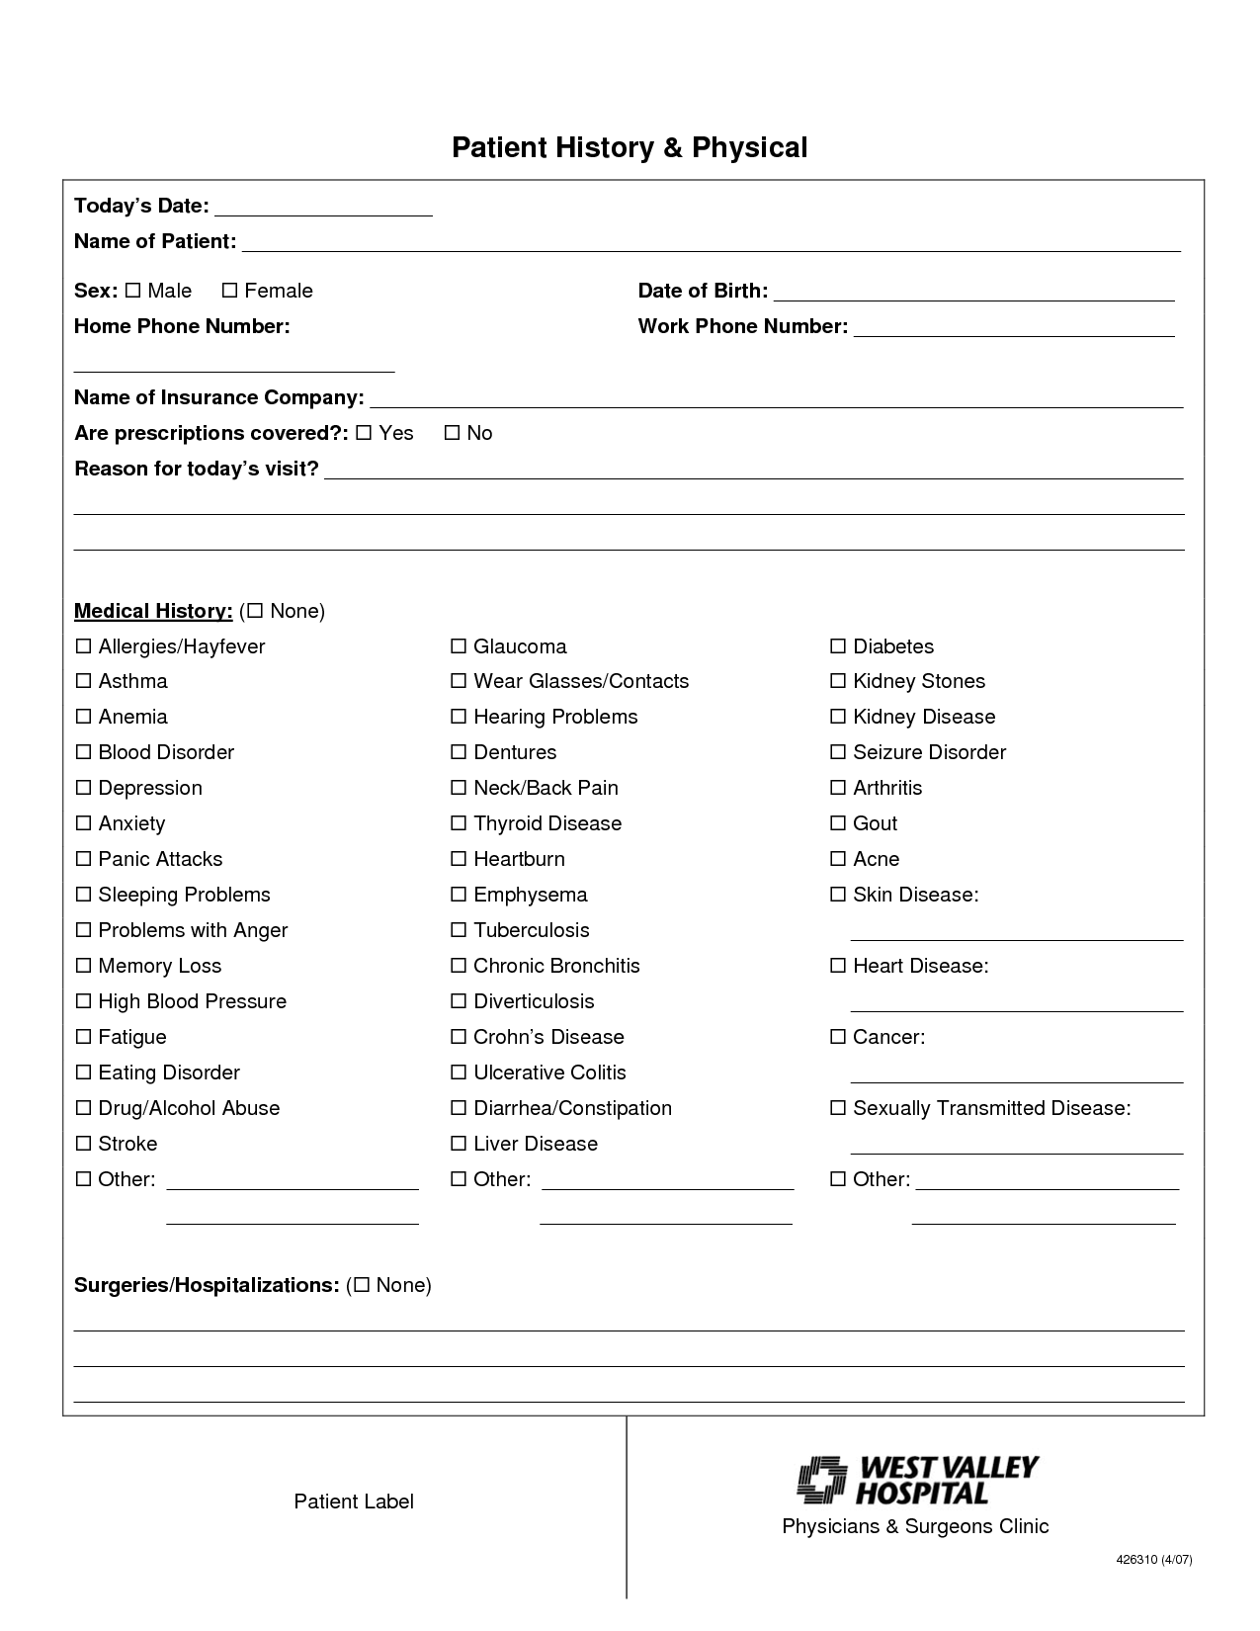
Conducting The In-Person Screening
Some offices will mail out the preliminary forms, others will ask the patient to come in 15 minutes early to complete this form
You will need to look over the form to for the chief complaint, then have the patient describe this complaint in details(this will help you determine the next step…. Ex: sore throat- you will obtain a rapid strep culture; pain with urination, you will need to obtain a urine specimen)

Slide 11
Conducting The In-Person Screening
When the patient has identified all the complaints and together you have determined the specifics of the symptoms, you can then summarize the results of your screening
Record the CC(chief complaint)
Example:
8/6/2011 CC: RLQ pain, intermittent x 3 days, nausea, no vomiting or diarrhea. Some relief by lying down. G. Jenks, MA

Slide 12
Body Measurements
Body measurements refers to height, weight, vital signs, and the circumference of head, chest, or abdomen of infants
This is extremely important with infants and children to ensure their proper growth and development
With adults, height reduction could indicate the presence of osteoporosis. A rapid weight gain could signal fluid retention
Measurement of vital signs provides essential information regarding the function of the circulatory and respiratory systems and helps to monitor any disease or conditions

Slide 13
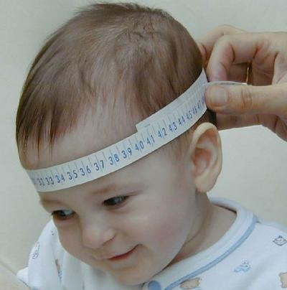
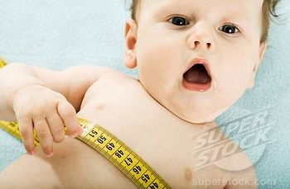
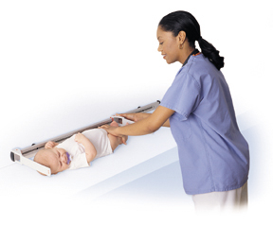
Head and Chest Circumference
OFC- occipital- frontal circumference is measured above the infants ears(measured up to 3 years old)
Chest circumference is measured just below the nipple line
When measuring an infants length, apply gentle pressure to straighten the legs

Slide 14
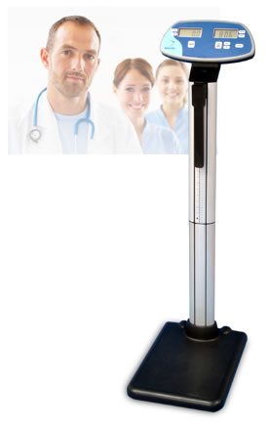
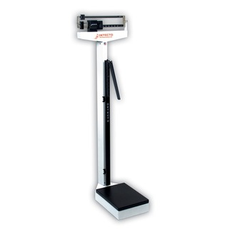
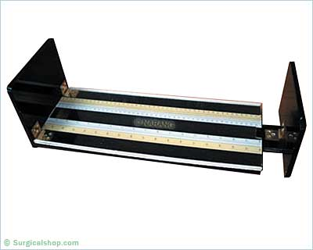
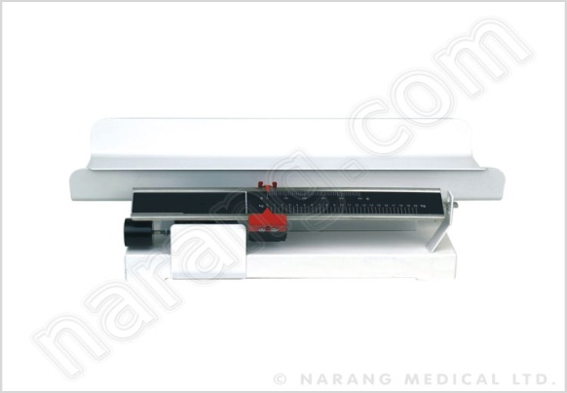
Height and Weight
You must be familiar with
a balance beam scale
The height bar is
calibrated in inches

Slide 15
Measuring and Weight the Patient
When you take a patient’s weight and height, have the patient remove their shoes and any heavy objects(coats, handbags)
Check the balance on the scale, needs to be at 0.
With height; raise the height bar above the patient’s estimated height and extend the measuring bar, move the bar down as needed, avoid the possibility of striking the patient
The patient should always face away from the scale with the back to the height bar
Height is measured mostly in inches

Slide 16
Inches to feet
How mach inches are in a foot?
12
How many feet is 60 inches?
5 feet
How many feet is 46 inches?
3 feet 10 inches
How many feet is 70 inches?
5 feet 10 inches

Slide 17
Vital Signs
Vital signs(cardinal signs) are used by health care personnel to identify the measurement of body functions that are essential to life
The four vital indicators are:
Temperature
Pulse
Respiration
Blood Pressure
The correct measurement of vital signs is extremely important
Never-ever estimate the measurement

Slide 18
Temperature
The temperature of the body indicates the amount of heat produced by the activity of changing food into energy
Conditions affecting body heat include metabolic rate, time of day, and amount of activity(sweating)
Not all people have the same normal temperature
An average normal oral temperature is 98.6
A person with a temperature above normal is said to be febrile
A person with a normal temperature is said to be afebrile

Slide 19
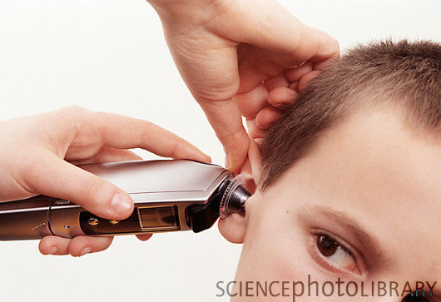
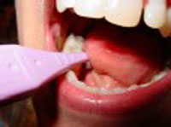
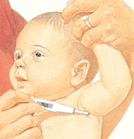
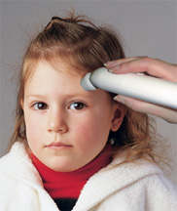
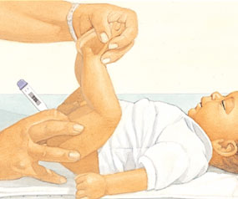
Temperature
The accurate measurement of temperature can help the physician make a diagnosis
Average Oral Axillary Rectal
normal 98.6 97.6 99.6
temperature:
Range: 97.6- 99.6 96.6-98.6 98.6-100.6
Page 645

Slide 20
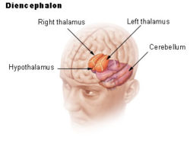
Temperature
The temperature regulating center in the body is located in the hypothalamus of the brain
During an infection(influenza) process, the presence of microorganisms cause pyrogens(a chemical circulating in the blood that causes a rise in body temperature) to be secreted, which raise the “set point” of the hypothalamic thermostat
Blood vessels constrict causing you to be cold, white blood cells increase to fight the infection, chills and shivering begin until the process is reversed, once this occurs the hypothalamus thermostat is reset
The extent of the infection determines the amount of the fever
A mild infection may cause the temperature to rise to 100.0 F
A moderate infection 102.0 F
Dangerous 104.0 F
Fatal over 106.0 F

Slide 21
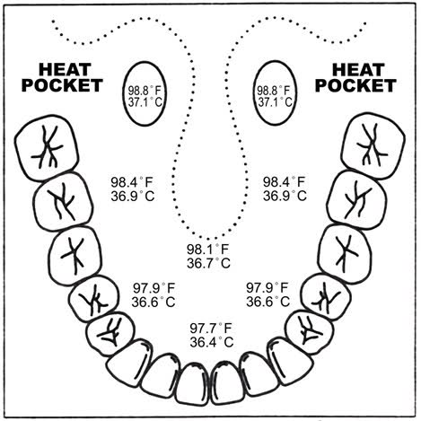
Oral Temperature
Oral temperature requires contact with mucus membranes, so a thermometer must be disposable or requires a barrier cover
This must be placed sublingually(under the tongue) into the heat pocket
Anything hot or cold by mouth may alter measurement. Wait for at least 15 minutes prior to measuring
Maintain the thermometer in place for the required period of time

Slide 22
Rectal Temperature
Rectal measurement is appropriate with babies(3mo and under)
Use the rectal(red) probe
Use a probe cover
The probe is inserted ¼ inch into
the rectum(use lubrication)
Steady the infants legs and ankles
Be prepared for the procedure to initiate urination or expelling of stool

Slide 23
Axillary Temperature
This is done by placing the thermometer in the axilla(armpit)
This method is the least accurate
Apply a probe cover, and insert the tip well into the axillary space with the probe extending down and slightly forward along the patient side
Lower that patients arm over the probe
Hold the probe in this position to maintain good contact

Slide 24
Tympanic(Aural) Membrane Thermometer
The thermometer operates by the principle of measuring the strength of the infracted heat waves generated by the tympanic membrane (hypothalamus)
You position the cover plastic tip properly inside the auditory canal and press the scan button, an infrared beam measures the heat waves

Slide 25
Temporal Thermometers
This measures the temperature of the skin over the temporal artery of the forehead
You place the cover plastic tip properly, press the scan button
Scan the forehead keeping the probe on the skin, press and hold the scan button while slowly sliding the thermometer across the forehead until reaching the hairline
If perspiration(makeup) is present, continue to
hold the button, lift probe from forehead, and
position on the neck behind the earlobe
This is closely related to the true
internal body temperature

Slide 26
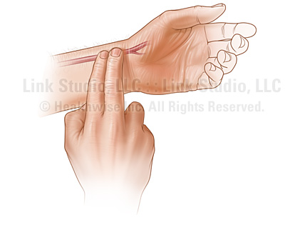
Pulse
Each time the heart beats, blood is forced into the aorta, temporarily expanding its walls and initiating a wavelike effect
This effect can be palpated(felt) in the arteries that are close to the body surface and that lie over bone or firm structure
The pulse can be felt in several locations on the body(659)
The radial pulse(ideal) is on the thumb side of the inner surface of the wrist, lying over the radius bone

Slide 27
Pulse
The average adult pulse rate 72 beats per minute
Pulse rate is directly related to age, the younger the person, the faster the heartbeat
Age Pulse rate
Less than 1 year 100-170
2-6 years 90-115
6-10 years 80-110
11-16 years 70-95
Midlife adult 65-80
Older adult 50-65
Page 659

Slide 28
Measuring the Radial Pulse
The patient should be completely relaxed and sitting comfortably or lying down
Never use your thumb to measure pulse rate; there is a chance you may feel and record your own heart rate in your thumb’s artery
Too much pressure may shut off circulation
Too little pressure will not compress the artery sufficiently
Applying the correct amount of pressure will take some practice and then become routine
Check your watch, begin counting when the second hand is at 3,6,9, or 12(this makes 30 seconds easier to observe)
Count the pulse for 30 seconds and multiply be 2

Slide 29
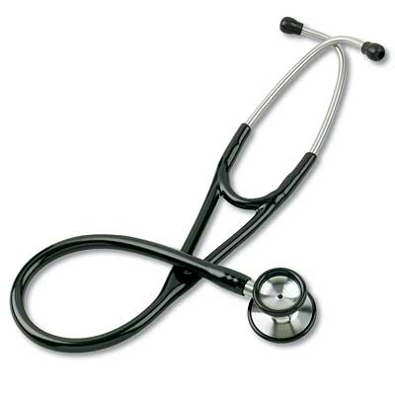
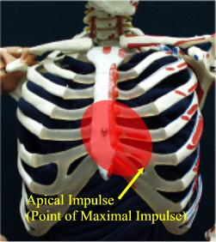
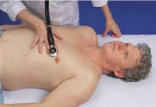
Measuring the Apical Pulse
In some instances the radial pulse may not be appropriate to measure, it will be necessary to listen to the heart at its apex with a stethoscope

Slide 30
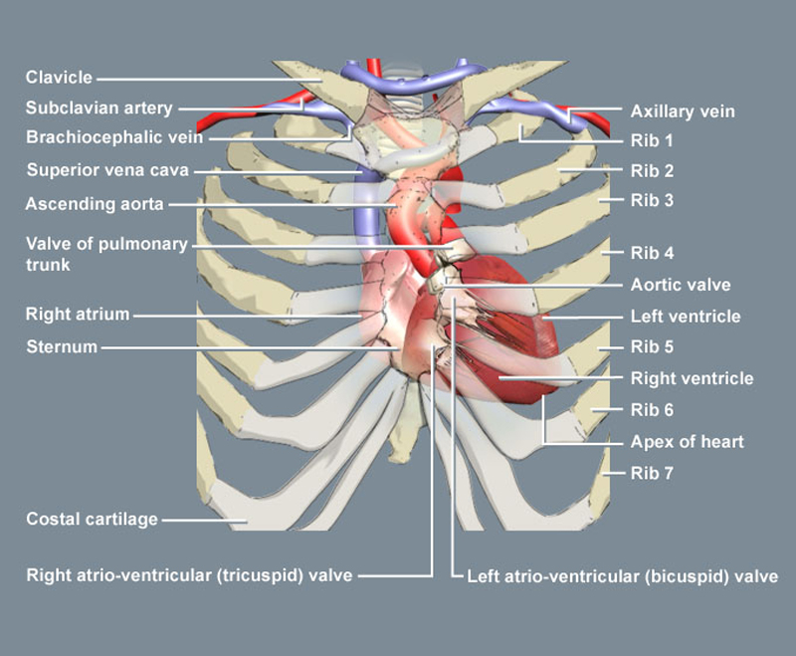
Measuring the Apical Pulse
The apical pulse is counted for a full minute
The bottom or lower edge of the heart is known as the apex
This is the point of maximum impulse of the heart against the chest wall
It can be palpitated at the left fifth intercostal space inline with the middle if the left clavicle

Slide 31
Measuring the Apical Pulse
Apical pulse is indicated for infants and small children because of their normally rapid heart rate, which is easier to hear and count
Patient’s with heart conditions, will require apical measurements for greater accuracy
Apical pulse is always indicated if you have difficulty feeling a radial pulse and believe you may be missing beats

Slide 32
Respiration
Respiration is the combination of total inspiration(breathing in) and the total expiration(breathing out) or inhale and exhale
It is important that the patient not be aware that this being done(they can alter their rate)
To accomplish this, it is common practice to observe and measure respiration rate immediately after the pulse rate, while maintaining your fingers on the radial pulse, using this method, the patient assumes you are still measuring pulse rate

Slide 33
Respirations
The normal respiration rate for adults is 16 to 20 times per minute
Newborns: range 30 to 80
Early childhood: range 20 to 40
Late childhood: 16 to 20
Abnormally slow respiration rate is known as bradypnea
Abnormally fast respiration rate is known as tachypnea
Excessively fast and deep breathing is known as hyperventilation

Slide 34
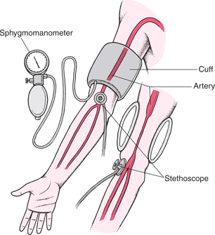
Blood Pressure
Learning to assess blood pressure accurately requires attention to details, careful listening, and correct technique
The term blood pressure means the fluctuating pressure that the blood exerts against the arterial walls as the heart alternately contracts and relaxes

Slide 35
Blood Pressure Phases
The phases of blood pressure are identical to those of the pulse
A contraction phase, known as systole, corresponds to the beat phase of the heart and is the period of greater pressure
The relaxation phase, known as diastole, corresponds to the resting or filling action of the heart and is the period of least pressure

Slide 36
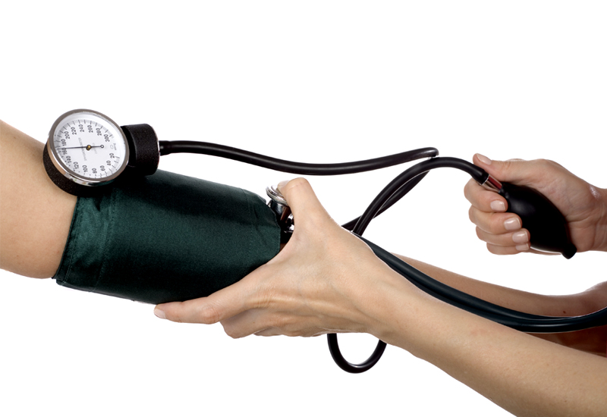
Normal Blood Pressure
Blood pressure is measured using a stethoscope and a sphygmomanometer(safig-mom-a-nom-meter)

Slide 37
Blood Pressure Readings
An adult should have a systolic pressure less than 120 and a diastolic pressure less than 80
Above 140/90 indicates stage 1 hypertension
Above 160/100 indicates stage 2 hypertension
Page 667

Slide 38
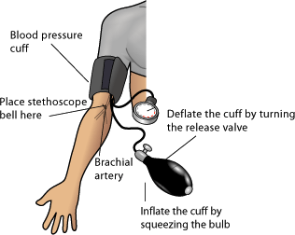
Measure Blood Pressure
Place the patient in a relaxed and comfortable sitting or lying position Expose the patient’s upper arm well above the elbow(bare arm)
Support the arm, slightly flexed
Place cuff over the brachial artery, with the bottom edge of the cuff 1 to 2 inches above the elbow
Apply the stethoscope at the antecubital space
With one hand, close the valve on the bulb, turning clockwise
Observing the manometer, rapidly inflate the cuff to about 160 mm
Open the valve, slowly releasing the air until the pulse is detected
Observe the dial reading
The very first pulse heard is the systolic reading
The very last pulse heard is the diastolic
After the reading deflate the cuff
rapidly and empty the air
Record you reading(chart)

Slide 39
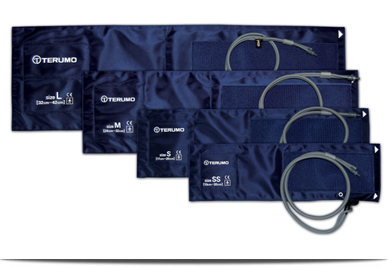
Cuff Size
The cuff size is important in measuring a patient’s pressure

Slide 40
Hypertension
Hypertension(above normal blood pressure) can result from things such as stress, obesity, high salt intake, and aging
Physical conditions may include kidney disease, thyroid dysfunction, neurological disorders and vascular conditions, which make circulation more difficult, therefore requiring a greater pressure to circulate blood

Slide 41
Hypotension
A blood pressure consistently below 90/69 indicates hypotension(below normal blood pressure)
This may be normal for some people
This may be present with heart failure, severe burns, dehydration, deep depression, or shock
A drop in blood pressure may occur when a patient changes from sitting to standing position
This is known as orthostatic hypotension
Typically, if the blood pressure is measured, it will show a drop of at least 20 mm systolic and 10 mm diastolic
You may need to perform orthostatic pressure on patient’s

