Slide 1
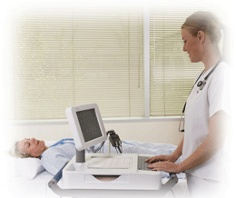
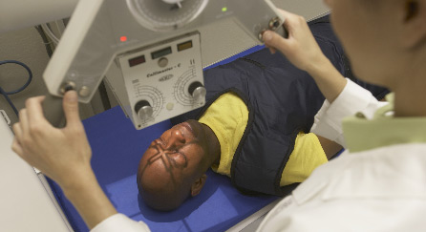
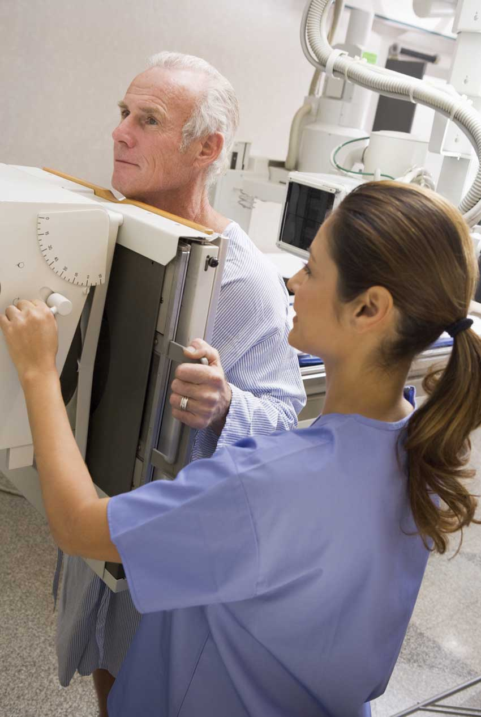
Diagnostic Tests X-Rays, and Procedures
Chapter 16

Slide 2
Diagnostic Tests X-Rays, and Procedures
The medical assistant has multiples roles in these tests
You will be responsible for instructing and preparing patients for procurers, tests, and x-rays
In some cases, you will either carry out the test(s) or procedures, or assist the health care provider

Slide 3
Skin Tests
These procedures are commonly used to determine allergic reactions in patients
They are the scratch, intradermal, and patch tests
These tests should always be performed under the supervision of a provider
These tests involves introducing an antigen directly into the patient’s skin to induce a reaction
If the reaction is negative, there will be no change in the appearance of the skin

Slide 4
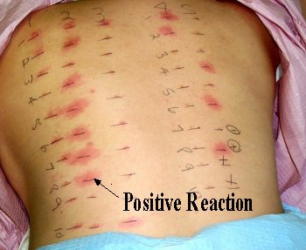
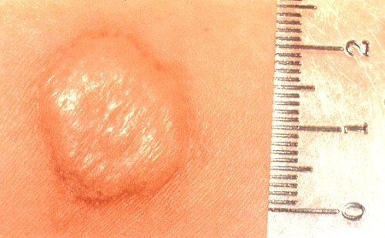
Skin Tests
A positive allergic reaction to a test is shown by a raised area on the skin, much like a mosquito bite, called a wheal(hive)

Slide 5
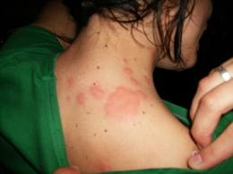
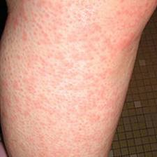
Skin Tests
A positive reaction is caused by interaction of the antigen and antibody, which releases histamine and is termed a hypersensitive reaction
Besides histamine, researchers are finding other chemicals released during the allergic response
Many have allergies to a variety of substances, including certain foods, pollens, dust, drugs, chemicals, venom of stinging insects, animals, molds, and other allergens
Certain irritants can make allergies worse
These include smoke, gasoline, paint, perfumes, and personal grooming products(hair spray, soaps, lotions ect)

Slide 6
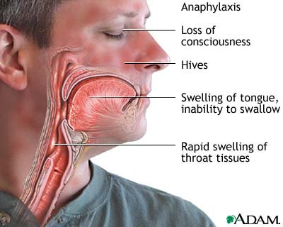
Skin Tests
Severe reactions can be life-threatening
A life-threatening reaction must be counteracted with an injection of adrenalin immediately to prevent anaphylactic shock, symptoms include intense anxiety, weakness, sweating, and shortness of breath
These might be followed by hypotension, shock, arrhythmia, respiratory congestion, laryngeal edema, nausea, and diarrhea

Slide 7
Skin Tests
Treatment for many allergy patients consist of an allergy immunotherapy program
Over a considerable period, which can be indefinite, this therapy gradually provides immunization against the substance to which the person is allergic
Increasing amounts of the allergen are injected as long as the patient can tolerate each dose
Following the injection the patient must wait for 20 min for possible reaction
You must keep a record of where the injection was administered and injection sites must be rotated

Slide 8
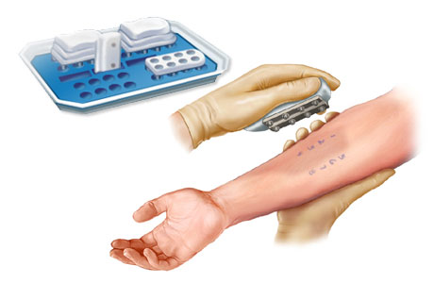
Scratch Test/Skin Prick Test
Sites for this test are the arms and the back
The test should be numbered in a pattern with washable ink on the surface of the skin
There will be some discomfort with this test(explain to the patient)
Several applicators have been dipped into various bottles of allergens and applied to the skin with small drops, reactions usually occur within 20 minutes
Have the patient report any reaction
Many physician evaluate the patient after 24 hours

Slide 9
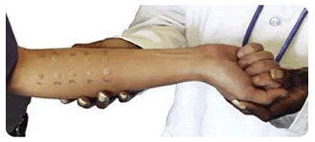
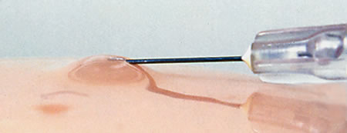
Intradermal Test
This test is thought to be more accurate, and is often performed if the scratch test is negative or unclear
Severe reactions may occur with this test
Intradermal test sites are performed at spaced intervals on the forearm or scapular area if the initial test is negative, it is often repeated with a stronger solution
Usually the reaction time is 15 to 30 minutes
Epinephrine should be kept on hand for any severe reaction(ordered by the physician)

Slide 10
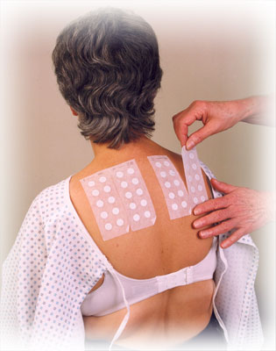
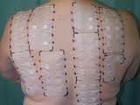
Patch Test
The patch test is done to determine the cause of contact dermatitis
A patch test consisting of a gauze square saturated with the suspected allergy-causing substance and placed on the surface of the skin and secured with non-allergenic tape
The results are read in 24 hours

Slide 11
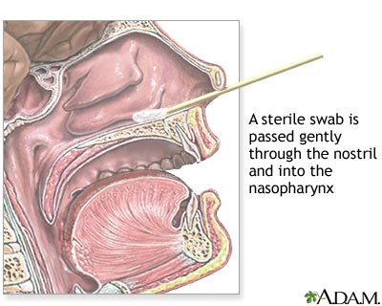
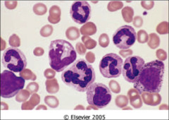
Nasal Smear
A helpful aid for years in the diagnosis of allergies has been a smear done with nasal secretions
This is a simple means of screening for allergies and is usually the first step in the testing program
They look for clumping of eosinophils(WBC)

Slide 12
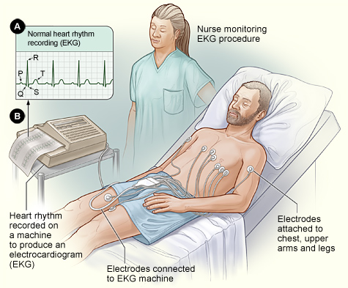
Cardiology Procedures
This procedure is used frequently to diagnose heart disease and dysfunction, this is called an electrocardiogram (EKG/ECG)
This is a painless and safe procedure(patient should be told this)

Slide 13
Electrocardiogram(EKG/ECG)
Through a process of electrical transmission, this machine traces impulses of the heart
To accomplish this, electrodes are placed on the patient’s limbs and chest and pick up by the electrical current produced by the contractions of the heart
The ECG/EKG is interpreted by the physician, usually the one ordering the procedure
The physician interpreting the ECG/EKG will compare the measurement, rate, rhythm, duration of the electrical waves, intervals, and segments with known normal ECG/EKG readings

Slide 14
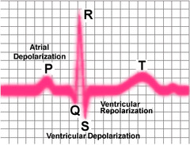
Electrocardiogram(EKG/ECG)
The heart is a four-chambered pump that produces a minute electrical current by muscular contraction
An electrical impulse originates in the modified myocardial tissue of the sinoatrial(SA) node, causing the atria to contact
This is known as atrial depolarization(this is the first part of the cardiac cycle)
The first impulse as recorded on the graph paper is termed the P wave, the impulses continues through the heart tissue to the artrioventricular (AV) node
The T wave on the graph paper follows, representing the repolarization of the ventricles, or the time of recovery before another contraction

Slide 15
The P wave is atrial depolarization
The QRS wave corresponds to the depolarization of the right and left ventricles
T wave represents the repolarization or (recovery) of the ventricles

Slide 16
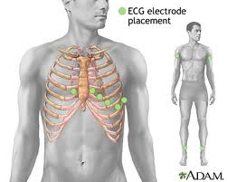
Placement Of Routine Electrocardiograph Leads
V1- Fourth intercostal space at right margin of the sternum
V2- Fourth intercostal space at left margin of the sternum
V3- Midway between position 2 and position 4
V4- Fifth intercostal space at junction of left midclavicular line
V5- At horizontal level of position 4 at left anterior axillary line
V6-At horizontal level of position 4 at left midaxillary line

Slide 17
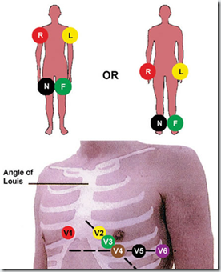
V1- Fourth intercostal space at right margin of the sternum
V2- Fourth intercostal space at left margin of the sternum
V3- Midway between position 2 and position 4
V4- Fifth intercostal space at junction of left midclavicular line
V5- At horizontal level of position 4 at left anterior axillary line
V6- At horizontal level of position 4 at left midaxillary line

Slide 18
Interference
As with any procedure, a full explanation must be given to the patient to gain cooperation
Providing privacy and draping the patient will ease the patient
The patient must be relaxed for a good tracing to be obtained, any movements can cause interference
Shivering, cell phones, power cords, creams, or oils on the skin can also cause interference
Artifacts are defined as EKG abnormalities or anything that causes an interference on the ECG recording

Slide 19
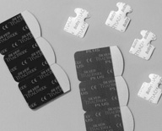
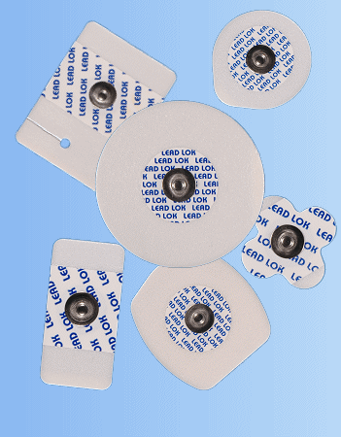
ECG/EKG
All of the computerized ECG machines require all disposable electrodes
These are used because of their convenience
They are expensive and should be used wisely to avoid unnecessary waste

Slide 20
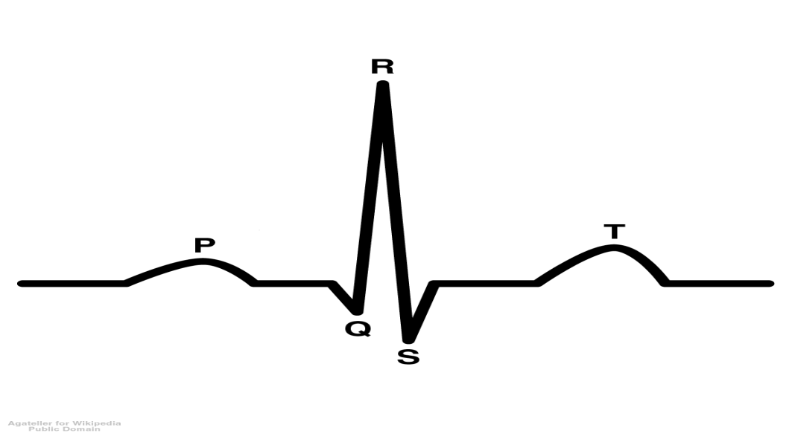
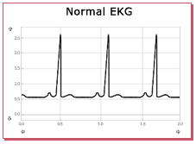
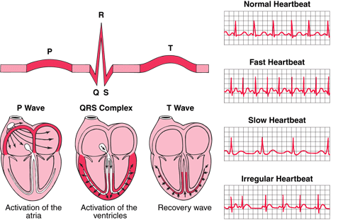
Normal ECG/Abnormal ECG

Slide 21
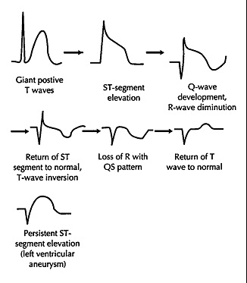
Normal ECG vs MI On ECG

Slide 22
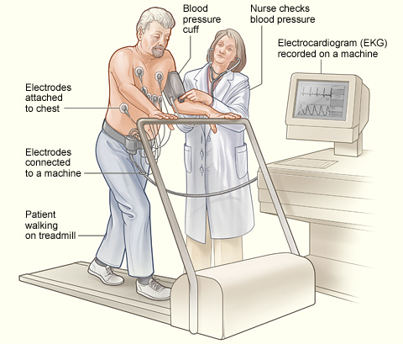
Stress Test
ECG stress tests are done on a routine basis for patients with a risk of developing heart disease
The stress ECG is done while a patient is exercising on a treadmill under careful supervision
The medical assistant will measure the patient blood pressure while the patient exercises on the treadmill
The purpose of this test is to detect the unknown cause of a patient's heart trouble

Slide 23
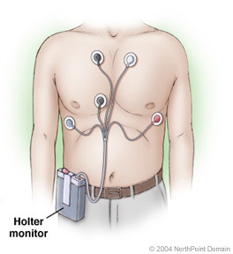
Holter Monitor
Patient’s who have normal routine ECG’s but still have intermittent chest pain or discomfort are often tested over a period of 24 to 48 hours by a devise known as a holter monitor
The patient will press the
“event button”
when any cardiac
symptoms are experienced

Slide 24
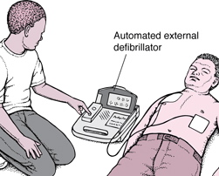
Defibrillator
These units are designed to provide counter-shock by a trained individual to convert cardiac arrhythmias into regular sinus rhythm

Slide 25
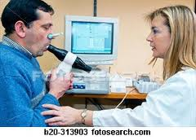
Vital Capacity Tests
Many physicians prefer to use the hand-held spirometer, which comes with vital capacity charts
This is done to evaluate patients who are suspected to have pulmonary insufficiency
This tests for the greatest volume of air that can be expelled during a complete slow, unforced expiration following a maximum inspiration

Slide 26
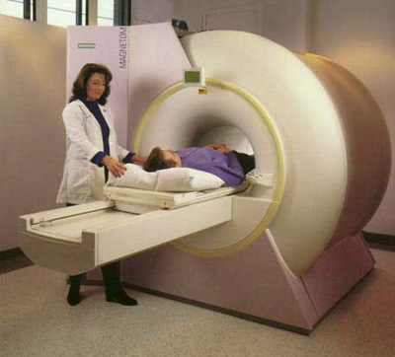
Magnetic Resonance Imaging
A technique to view structures inside the human body is an MRI
This noninvasive procedure, which may range from 30 to 60 minutes, requires that the patient lie on a padded table that is moved into a tunnel-like structure

Slide 27
MRI
Since the MRI uses a strong electromagnetic field, it is extremely important that any metal object be removed before the procedure is preformed
This metal may become hot and burn the patient, even mascara may have tiny metallic flakes(ask women not to wear this)
This procedure is contraindicated for patients who have pacemakers(metallic implant), in the first trimester of pregnancy, claustrophobic, or obese

Slide 28
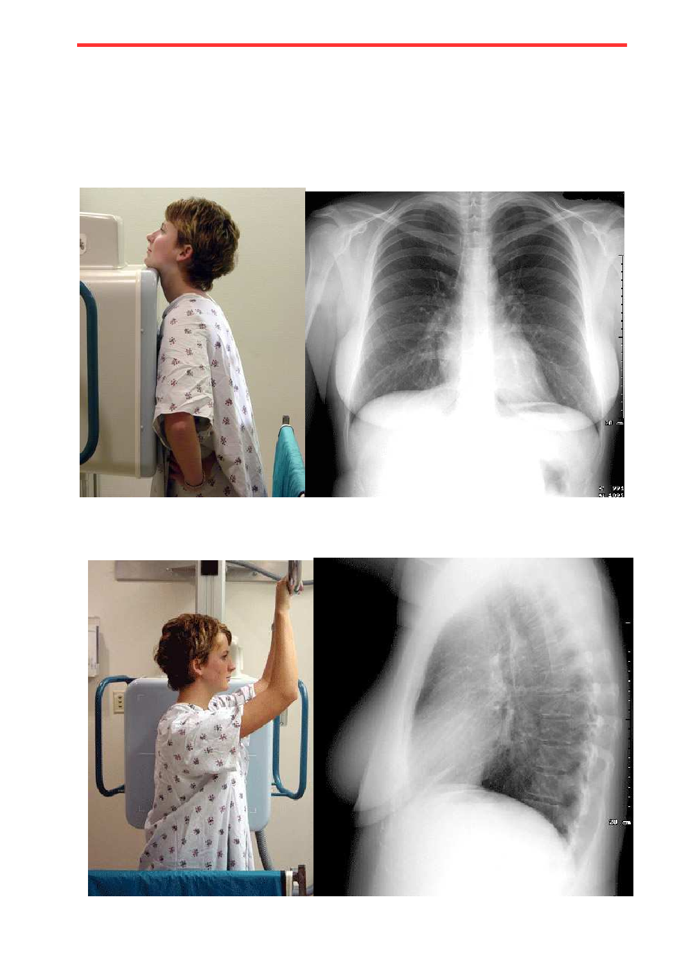
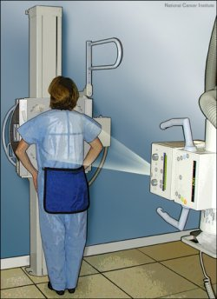
Chest x-ray
When a chest x-ray is the done the patient is asked to hold still in a few different positions
The film is taken when the patient takes a inspiration and holds it
PA: posteranterior view
AP: anteroposterior view
L: lateral view(side)

Slide 29
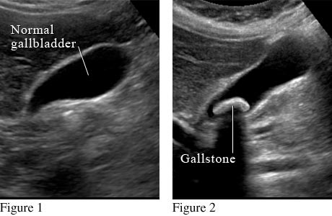
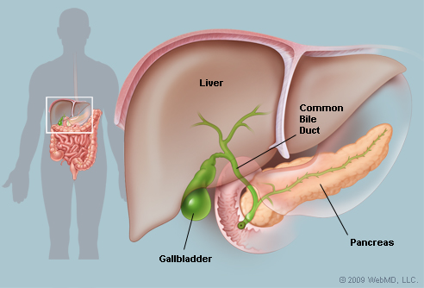
Gallbladder Ultrasound
The gallbladder stores bile that is produced in the liver to break down fat in the digestive process
When the gallbladder malfunctions, the patient experiences abdominal discomfort, nausea, and pain
An ultrasound is an image produced when continuous sound waves are projected toward the desired area to measure and record the reflected image

Slide 30
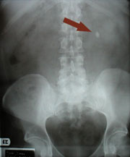
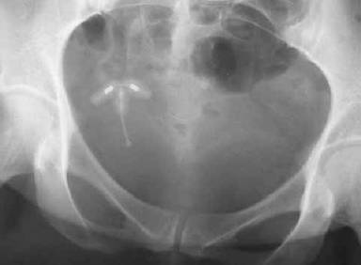
KUB
The KUB(kidney, ureters, bladder) is an x-ray of the patients abdomen
This is used to diagnosis urinary diseases and disorders(kidney stones)
This is also used for small children to look for small objects(blocked) that may have been swallowed, or for IUD placement
Swallowed a bb pellet IUD in the abdomen

Slide 31
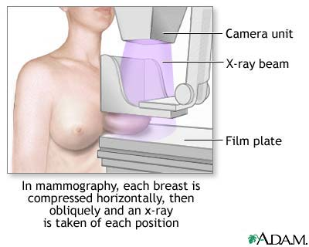
Mammogram
Mammogram aids in the diagnosis of breast masses as small as one cm in size or less
After age 40, women are urged to have mammograms every year
No deodorants, perfumes, or powders are to be used on the day of the mammogram, because the film on the skin could interfere with the radiograph

