Slide 1
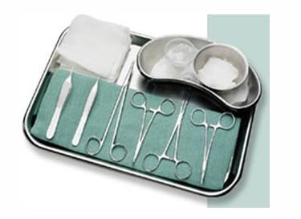
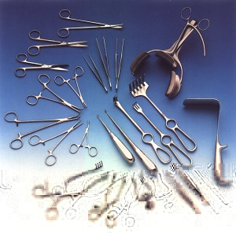
Chapter 17
Minor Surgery In The Medical Office

Slide 2
Minor Surgery In The Medical Office
As a clinical medical assistant, you may assist with a variety of sterile procedures, including in-office surgery
Maintaining medical asepsis is vital to prevent the transmission of disease before, during, and following any of the invasive procedures performed in the medical office or clinic
Setup for various procedures can vary slightly according to the physician, however, sterile technique will always remain the same for any invasive procedure

Slide 3
Instrument Care
Each instrument used in the performance of minor surgical procedures has a specific function
Most instruments should be cared for in the same manner
Some general rules:
1. Blood, tissue, or bodily fluids must not be allowed to dry on an instrument
2. Instruments should be soaked in a room temperature solution immediately after each use
3. Use the correct detergent/solution
4. Instruments should be soaked in a plastic container to prevent damage to the instruments
5. Separate sharp or heavier instruments from others to prevent damage
6. Scrub all surfaces and crevices with a brush to remove any foreign material
7. A careful visual inspection should be conducted before, during, and after every use
8. Damaged instruments should not be used

Slide 4
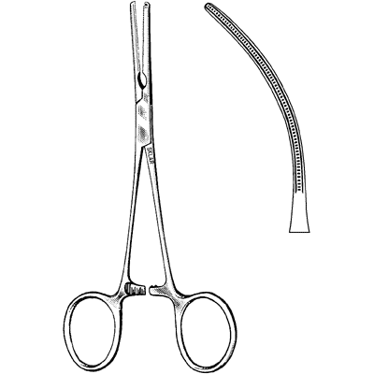
Instrument Components
Each part of an instrument’s structure has a specific function
Ratchet: Designed to close or clamp the instrument

Slide 5
Instrument Components
Ring handle:
Designed so you can hold this with your thumb and fingers

Slide 6
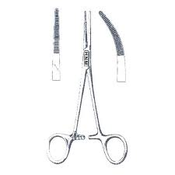
Instrument Components
Serrations: Little fissures into the surface of hemostats to prevent slipping

Slide 7
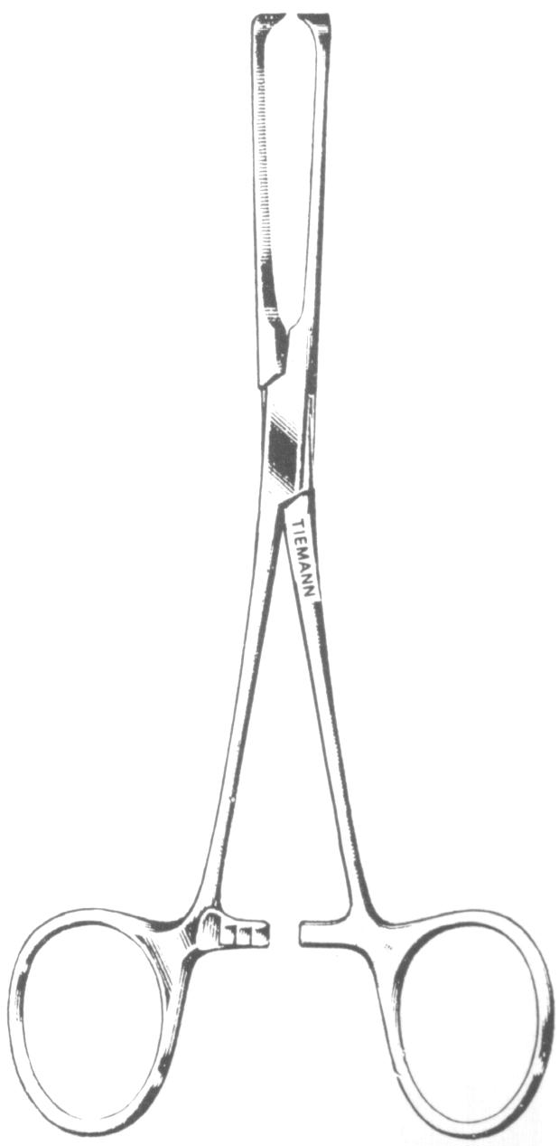
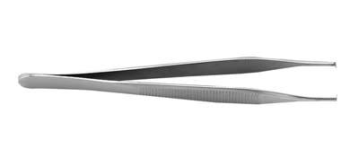
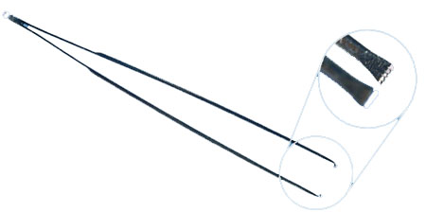
Instrument Components
Teeth: Very sharp and used to grasp tissue

Slide 8
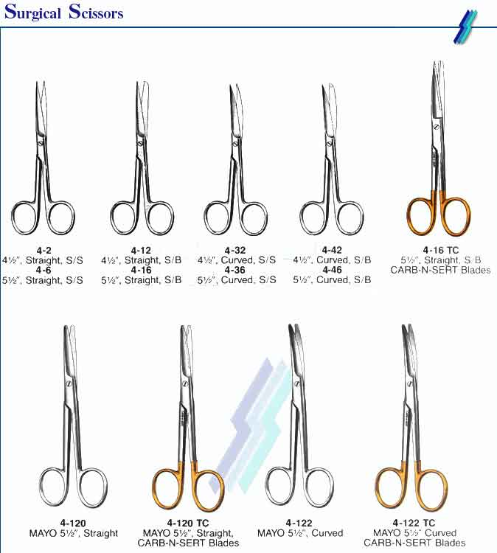
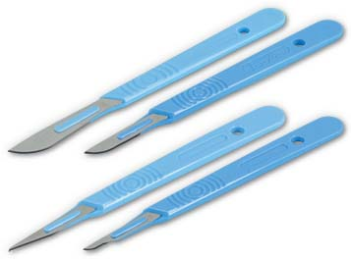
Instrument Classifications
Cutting includes scissors and scalpels

Slide 9
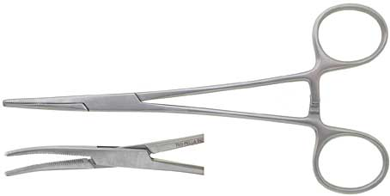
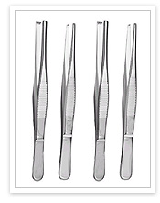
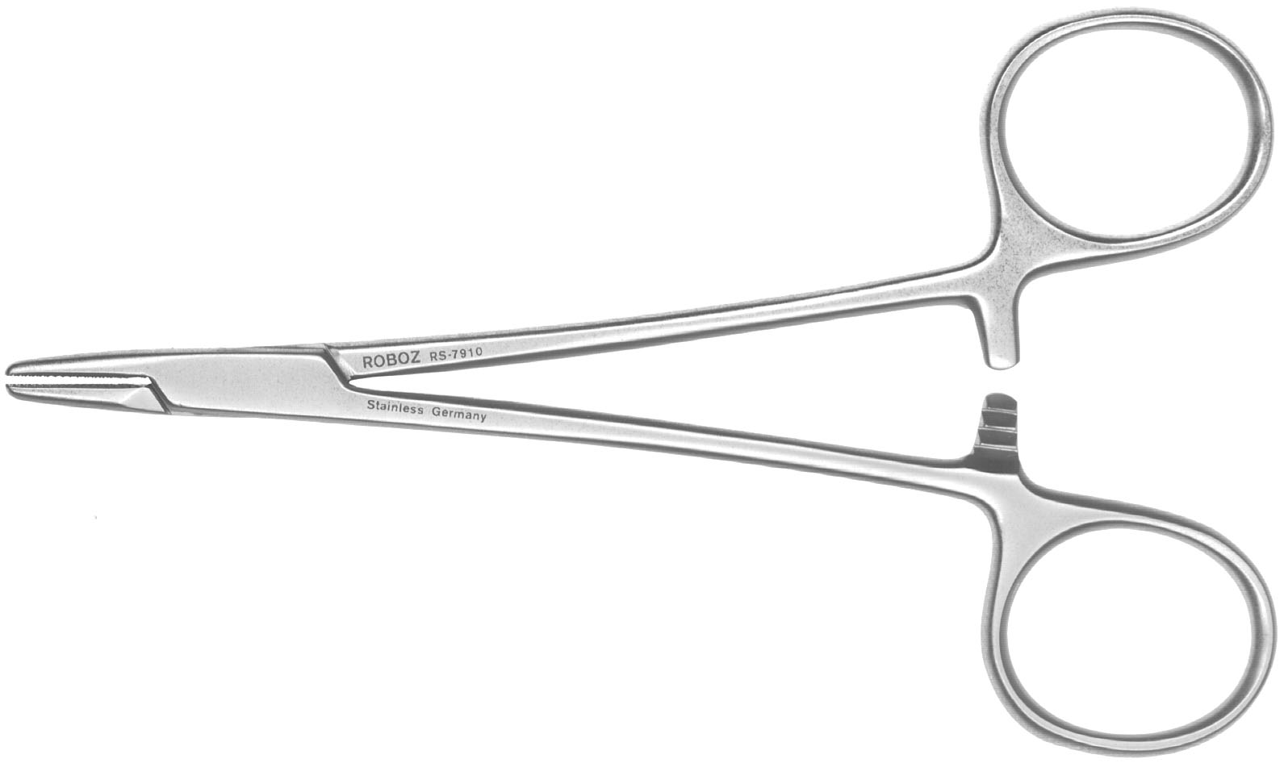
Instrument Classifications
Clamping or gasping instruments include:
Hemostats
Instrument used to clamp off blood vessels
Forceps
Instrument used for holding or seizing
Needle holders
Used to hold the suture needle

Slide 10
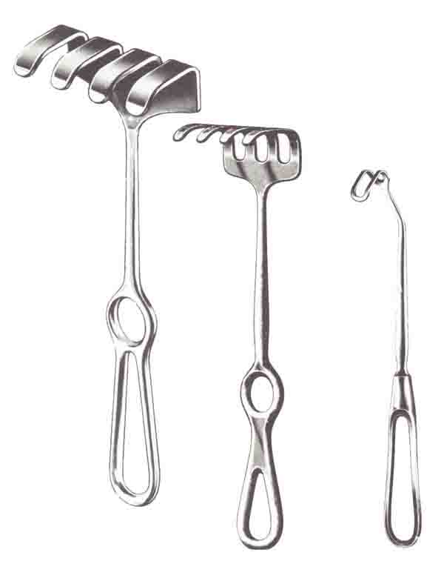
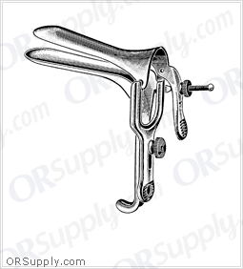
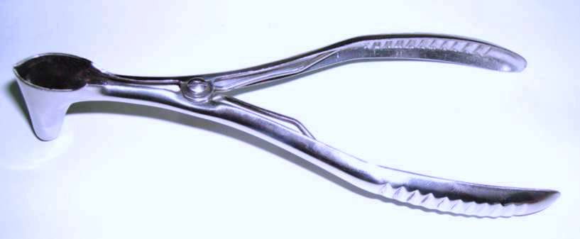
Instrument Classifications
Dilating or probing instruments includes:
Retractors:
Instrument used to draw back tissue and hold open a surgical site
Speculums
Used to enlarge a body cavity for better viewing
Nasal and vaginal

Slide 11
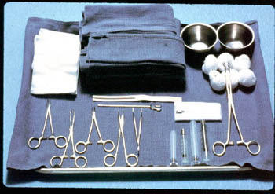
Preparing for Surgery
The day before the scheduled surgery, get all the necessary surgical instruments and supplies ready
All surgical instruments must be properly labeled and autoclaved
The basic setup for most minor surgical procedures includes:
Disposable scalpel
Hemostat
Needles and suture material
Suture scissors
Thumb forcep
Gauze squares(4x4’s)
Anesthetic medication vial(lidocaine)
given by the physician
Syringes
Towels
Bandages

Slide 12
Preparing for Surgery
Autoclaved items remain sterile for 30 days
Most items used today are disposable and come already sterile in the manufacturer's packaging
You need to make sure the package is not opened or torn to ensure sterility
The room where the surgery will take place and the sterile tray should be set up before the patient is escorted to the area to be prepared for the procedure

Slide 13
Sterile Tray Set Up
Disinfect the mayo tray and adjust the stand to waist level
Place the sterile drape on a clean surface
Open the pack, with the corners facing you
Grasp the sterile drape with the thumb and finger, lift the drape up enough that it unfolds but does not touch anything
Grasp the opposite corner and allow the drape to completely unfold and place on the mayo stand
Next open the all other sterile items and drop onto the sterile field(rule: never place items below waist level or above the neck level, never turn your back to the field)

Slide 14
Preparing The Patient
When the patient arrives for surgery, a consent form must be completed
The procedure should be explained and the patient should be given enough time to ask questions
The patient’s(guardians) signature, along with yours and the physicians signature, must be on the consent form, which will be scanned into patient's chart
The patient's vital signs and medical history should be taken and noted(including allergies)

Slide 15
Preparing The Patient
In procedures requiring biopsies, careful labeling and handling of the specimen is vital
The lab provides a formalin solution container to preserve the specimen, this container is sterile and the specimen should be placed in this solution with a sterile instrument
A completed lab request form should be completed with the specific laboratory order

Slide 16
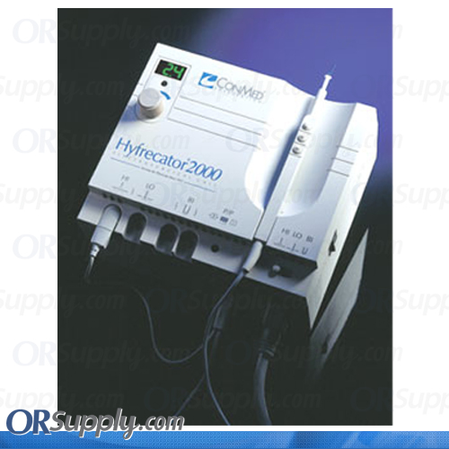
Preparing The Patient
In certain surgical procedures, such as the removal of warts or polyps, an electrocautery device may be used to stop the bleeding

Slide 17
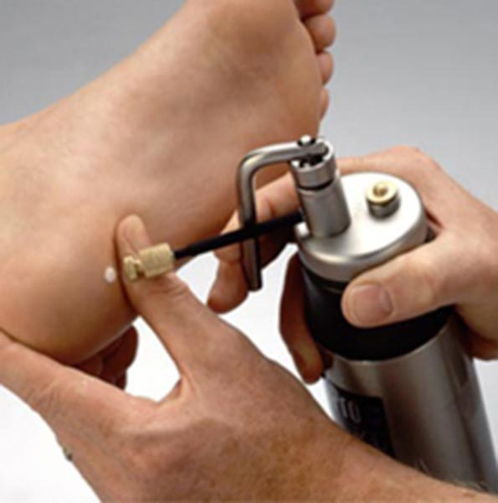
Preparing The Patient
Another method used in removing skin tags, warts, and other skin disorders and growths is by cryosurgery
This process used subfreezing temperature to destroy or remove tissue with liquid nitrogen

Slide 18
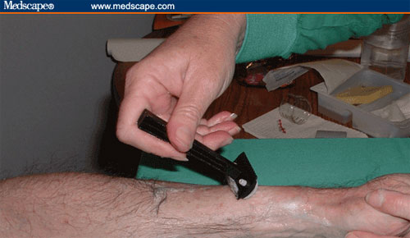
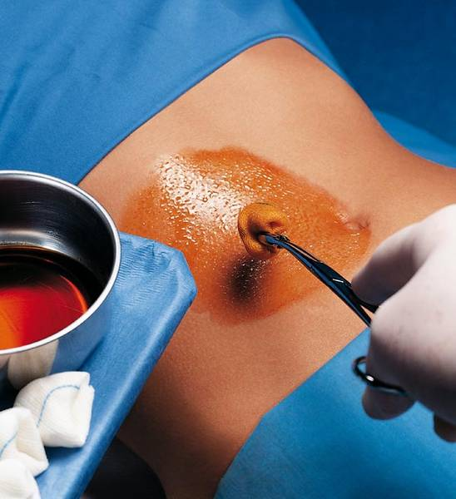
Skin Preparation
Preparation of the area of skin that will be affected by the surgical procedure, this is called skin prep
Because hair encourages microbial accumulation, it is sometime shaved
In preparing a surgical site, shave at a 30 degrees angle(page 886)
An antiseptic can be used to reduce microbial growth
To protect yourself and the patient you should wear sterile gloves when preparing the skin or changing a dressing
Iodine is the most common antiseptic used in surgery
This solution is applied in a circular motion from the site outward

Slide 19
Assisting With Minor Surgical Procedures
Many minor surgical procedures are now performed in the medical office or clinic
Medical assistants should have a general knowledge of the minor surgical procedures in their medical office
It is critical to maintain a strict sterile technique, any break in a sterile technique can result in an infection for the patient

Slide 20
General Information
Many physicians prefer to perform minor surgery on the day the patient is scheduled
The doctor may require that patients fast for a certain time before the procedure
Fasting lessens the possibility of nausea and vomiting, which some patients experience during and after surgery
Outpatient surgery in recent years has become more acceptable than ever before
Patients naturally feel more comfortable at home, following the same-day surgery most patient are sent home to recover
Printed post-op surgery instructions, with emergency phone numbers are given and explained to patient(or whomever is with patient)

Slide 21
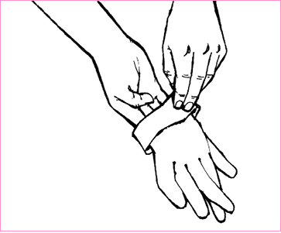
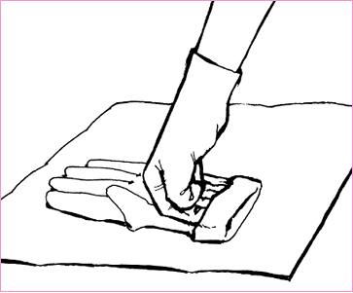
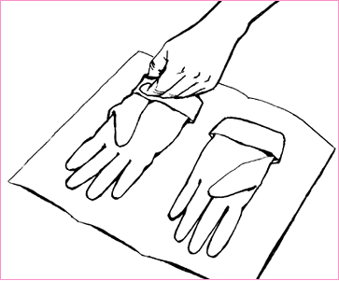
Sterile Gloves
If the physician wishes you to assist directly with the surgical procedure, sterile gloves must be worm
Before you put on sterile gloves, wash your hands for 20 seconds
Inspect the sterile gloves for any tears
Open the pack by pulling on the center paper folds
Grasp the fold of the inside of the cuff of the gloves with the thumb and fingers of your dominant hand
Insert your non-dominant hand into the glove on with your dominant hand by the turned-down cuff
Insert the fingers of your gloved non- dominant hand under the folded-down cuff of the glove, and insert your dominant hand
Check glove for and tears or holes

Slide 22
Suture Material
The term suture means a type of thread that is used to join skin of a wound
Sutures are made of catgut(absorbable), sheep intestines, silk, or nylon(needs to be removed)
Suture material are attached to needle of various lengths, sizes, straight and curved
Your efficiency preparation of setting up the treatment room will be appreciated by both the physician and the patient
Make sure follow up appointments are made for patients to return for a suture removal(5 to 14 days)
Check patients record for an updated tetanus immunization

Slide 23
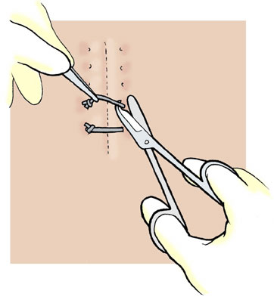
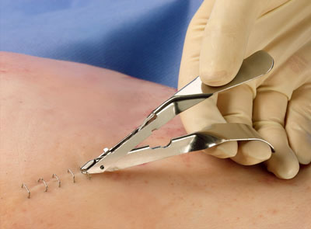
Suture Removal
In many offices, the medical assistant's responsibility to remove the sutures
Be sure to remove the same number of sutures as were inserted
Always check the physicians order for removal date, check for infection(if unsure have the physician check the site first)
Suture that are not removed will become infected(note any suture that have fallen out before the patient returns to the office)
Removal of staples is preformed with a staple extractor

Slide 24
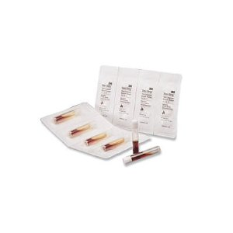
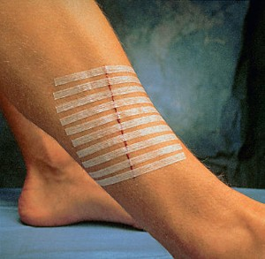
Suture Removal
After sutures or staples have been removed, physicians may order additional closure materials, called steri-strips applied with a glue called benzoin

Slide 25
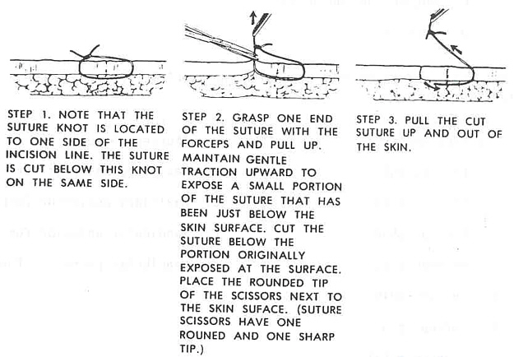
Suture Removal
Assemble all necessary items on the mayo stand
Put on gloves
Apply antiseptic solution(ask for allergies)
Remove suture(see below)
Pull on the suture with the forceps toward the healing lesion so that no stress is put on it
Use steri-strips if ordered

Slide 26
Protective Bandages
The type of bandage that the physician orders will vary and should be appropriate for the wound and the patient
Make sure you advise the patient to keep the dressing dry and clean
Inform the patient to return to the clinic for any signs of infection or concerns
A wound culture may need to be done
Application of an ace wrap increases circulation of the area, which helps the healing process

