Slide 1
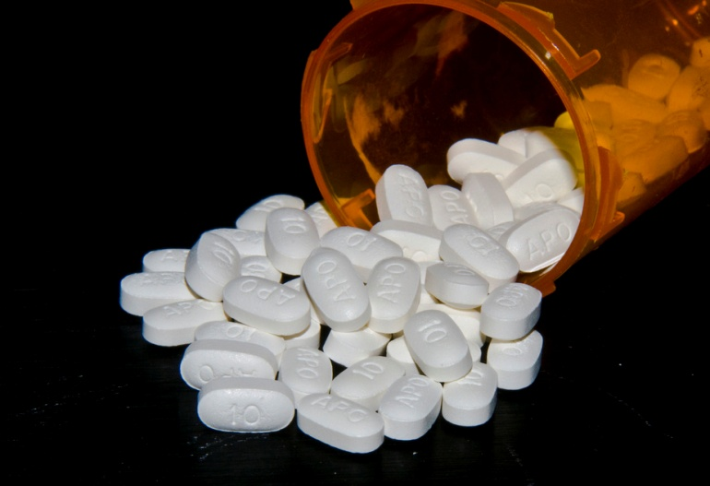
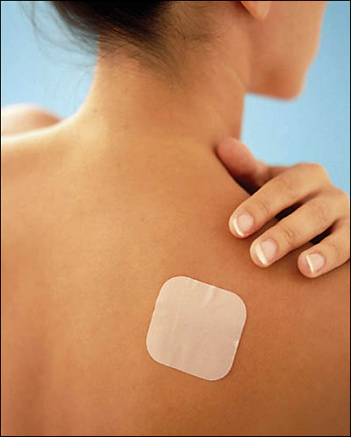
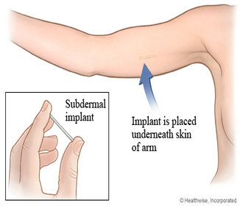
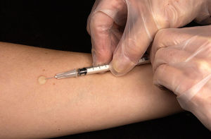
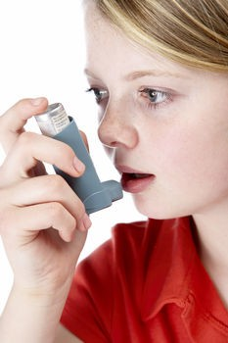
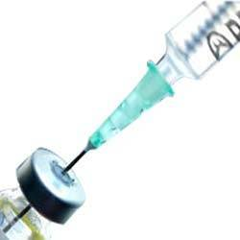
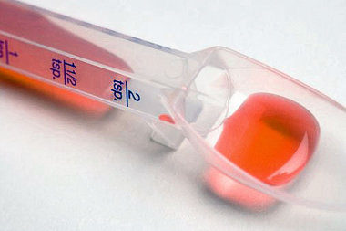
Chapter 18
Assisting With Medications

Slide 2
Assisting With Medications
Administering medications is one of the most sensitive and important duties that the medical assistant will perform
You must become familiar with the medications that are most frequently given to the patients treated in your office

Slide 3
Commonly Prescribed Medications
Depending on the type of medical practice, certain medications will be more commonly prescribed than others
The entire staff should become knowledgeable about all medication used in their practice
The list on page 902 Table 18-1(34, anti, sedatives, laxatives ect..) are commonly used drugs

Slide 4
Commonly Used Drugs
Anticoagulant: Prevents or delays or slows blood clotting(Heparin, Coumadin)
Antipyretics: Reduces fever(Tylenol, Aspirin)
Sedative: Produces a calming effect without causing sleep(Phenobarbital)
Antihistamines: Acts to counteract histamine(allergies/cold) Benadryl
Antitussives: Prevents or relives cough(Codeine)
Antibiotic: Is destructive to or inhibits growth of microorganisms(fights bacterial infection) Penicillin, Augmentin
Analgesics: Relives pain(Acetaminophen, Ibuprofen)
Anticonvulsant: Prevents convulsions(Dilantin)
Hypoglycemic: Lowers blood glucose level(Insulin)

Slide 5
Pharmaceutical References
The Physicians’ Desk Reference(PDR)
The PDR is one valuable resource that the medical assistant should keep handy in the medical office
The purpose of the PDR is to provide accurate, reliable, and current information about the most prescribed medications and related products
You may need to consult the PDR for the proper spelling, strength, or any other information concerning medication
Read pages 903-904

Slide 6
Guidelines For Using The PDR
Pink section: is the brand(and/or generic) name of the drug in alphabetical order
Blue section: Classification of the drug(Ex: narcotics, antifungal)
White section: Manufacture Index(Smith-Kline Pharmaceuticals: makes paxil)

Slide 7
Drug Categories And Classifications
Drugs are classified into different categories or groups:
Those that prevent disease(vaccines or immunizations)
Those that have a particular action on the body(analgesic/ helps with pain)
Those that have a target effect on organs and body systems(cardiac drugs)
How are they prepared(liquid, suppository, tablet. ect..)

Slide 8
Drug Categories And Classifications
Medications will often have more than one name:
A generic name: Are copies of brand-name drugs that have exactly the same dosage, intended use, effects, side effects, route of administration, risks, safety, and strength as the original drug. In other words, their pharmacological effects are exactly the same as those of their brand-name counterparts(ex: acetaminophen)
A trade name or brand name: is the name of the manufacturer and ADA gives the medicine(ex: Tylenol)
The brand name is usually written most clearly on any packaging. However, you will always see the generic name written somewhere on the packet (often in small print). Some medicines only have the generic name on the packet.
Generic names tend to be harder to remember than trade names

Slide 9
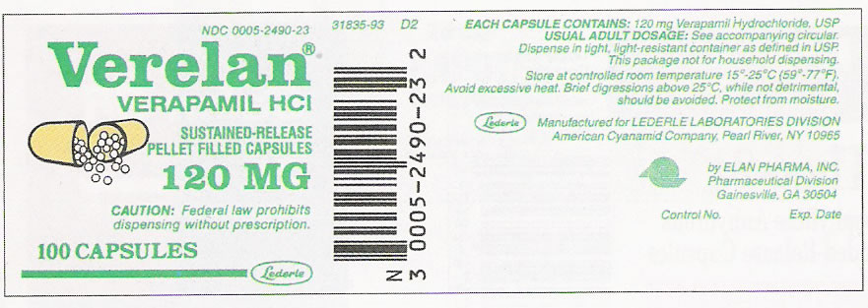
Drug Categories And Classifications
The trade name is usually capitalized and written bold
The generic name is usually smaller and under the trade name

Slide 10
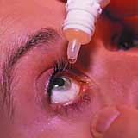
Drug Forms
Drugs are manufactured in many different forms, including:
Liquid: drug is dissolved or suspended in a solvent(water or alcohol)
Solid: tablets, capsules, caplets, lozenges, suppositories, and ointments
Transdermal: Small adhesive patch is placed directly on the skin
Ocular: Drugs of the eye
Implantable: Positioned beneath the skin(insulin infusion pump, Implanon: birth control)

Slide 11
The Medication Order
Before a prescription is written, a medication order must be given by a physician.
Get clarification on any medication if questionable
A medication order should contain the following information
-Full name of patient
-Name of medication
-Dosage and route of administration
- How often the medication is to be administered
-Date and time order was written
-Any specific directions
-Signature of the prescriber
-DEA (Drug Enforcement Agency number)if needed

Slide 12
Writing Prescriptions
All prescriptions are considered to be a legal document
Most narcotics(pain medication) needs to be pick-up by the patient(cannot be called in) and ID needs be shown to the pharmacy
Most prescriptions are computer-generated and have a tamper-proof watermark
When phoning in prescriptions, you must give the pharmacist all the information the prescription contains

Slide 13
Controlled Substances
All physicians who prescribe, dispense, or administer controlled substances in the United States must register with the United States Department of Justice Drug Enforcement Administration(DEA), under the Controlled Substances Act of 1970
Registration must be renewed every 3 years
A written, signed prescription must be presented to the pharmacist within 72 hours of time for a controlled substance to be in compliance with Drug Enforcement Administration (DEA) regulations

Slide 14
Controlled Substances(list on page 907)
Controlled substances included “street drug” such as heroin, cocaine, stimulants, depressants, narcotics and any drug derived from them
Controlled substances are categorized into five different schedules, base on their potential for abuse or addiction, as follows:
Schedule 1: These dugs have no recognized medical use in the U.S. and prescriptions for such drugs are prohibited(high risk for abuse)LSD,Heroin
Schedule 2: These drugs must have a written or types prescription, no refill, have DEA number(risk for abuse, may lead to psychological abuse)Morphine
Schedule 3: Prescriptions may be written or phoned, refill up to five times within 6 months(have a potential for abuse but less than 1 and 2)Hydrocodone, Depressants
Schedule 4: Prescriptions may be written or phoned, refill up to five times within 6 months(low potential for abuse)Phenobarbital
Schedule 5: Subject to state and local regulations(Very limited quantities of narcotics and low potential risk for abuse)codeine cough syrup

Slide 15
Recording Medications
Many factors need to be included in recording medication information on the patients chart
The following is a list of the details that should be included in recording medications
-Who: who ordered the medications
-What: what medication was given(including lot # and expiration date)
-When: the date and time the medication is administered(always check expiration date)
-Where: refers to the route(oral, sublingual, ect..)
-Why: Answer this question for the patient verbally or by educational material(this may help, if you have made a mistake)

Slide 16
Abbreviations And Metric Measurements
Abbreviations are on page 911(make flashcards)
bid- twice a day, tid- three times a day
Metric measurements are on page 912(make flashcards)
1 kg = 2.2 lbs

Slide 17
Storing Medications
The rule is “ a place for everything and everything in its place”
Label shelves
Categorize
Narcotics needs to be locked up
Immunizations need to be refrigerated or frozen
Check and discard properly if outdated
Be familiar with storage of all medications

Slide 18
Administering Medication
There are many methods of medicating patients and even though you may not administer every type, you should know something about each one
The methods of administering medication are:
- sublingual: under the tongue
- buccal: in the cheek
- topical: including sprays
-transdermal: medication is delivered across the skin

Slide 19
Administering Medication
Before you administer the medication, always be sure that you have the right:
1. PATIENT
2. MEDICATION
3. DOSE/AMOUNT
4. ROUTE/METHOD
5. DOUMENTATION
6. TIME/SCHEDULE
THESE ARE KNOWN AS THE SIX RIGHTS
Following any injection, a patient should wait 20 minutes, in case of an adverse reaction

Slide 20
Medication Errors
If an error is made with a medication, necessary steps must be taken immediately to report it to the doctor so emergency care can be given to the patient if necessary
Some errors may include:
Drug given to wrong patient
Wrong drug given to the correct patient
Incorrect drug dosage administered
Incorrect documentation placed in the patient’s chart
Drug given by the incorrect route
Drug given at the wrong time

Slide 21
Considerations For Medications
Considerations for route of administration may include:
Age of patient:
Physical condition
Body size or mass
Gender
Most oral medications are intended for absorption in the small intestine
The remaining methods are parenteral, or intended for absorption outside the digestive system(Sub Q, IM,IV)

Slide 22
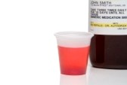
Routes Of Administration(ORAL)
This is one of the most common methods of administering medication
These medications are in the form of pills, tablets, capsules, caplets, lozenges, syrups, sprays, and other liquids, which are swallowed
Read liquid medication at eye level

Slide 23
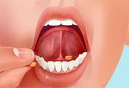
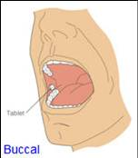
Routes Of Administration(Sublingual or Buccal)
The sublingual method involves placing a tiny tablet or spray under the tongue
This introduces the medication immediately into the bloodstream
Medication(spray or tiny tablet) may be introduced in the mouth between the gum and the cheek, this is called buccal

Slide 24
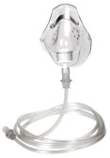
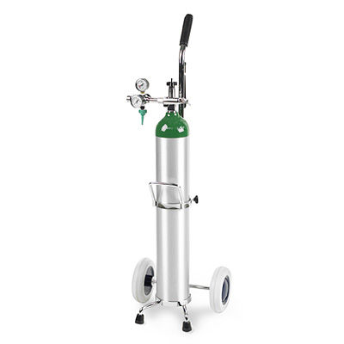
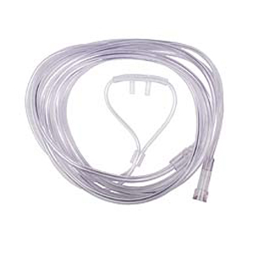
Routes Of Administration(Inhalation)
Medication given by the inhalation method are in the form of gases, sprays, fluids, or powders(mixed with liquid)
These are breathed into the respiratory tract
One form of inhalation is oxygen, and should be in every office for emergency use
Oxygen is used in liters per minute(LPM), and delivered by a nasal cannula or mask

Slide 25
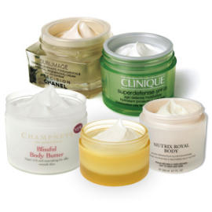
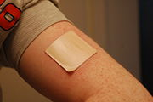
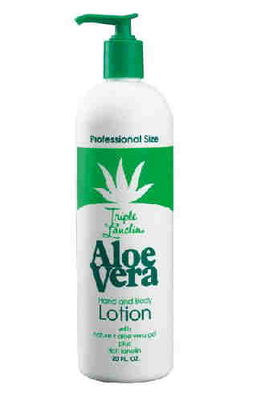
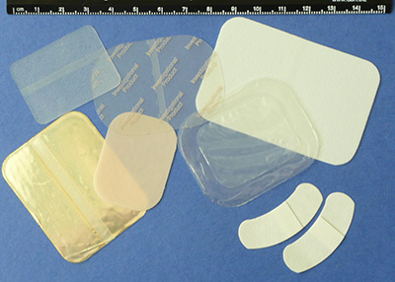
Routes Of Administration(Topical)
Topical medications are sprays, lotions, creams, ointments, paints, salves(aloe vera), wet dressings, and transdermal patches(ex: smoking patches)
With patches the desired amount is released into the patients tissues and into the circulatory system

Slide 26
Injections
Because the method of injections introduces the substance directly into the bloodstream, extreme caution must be practiced
The proper technique must be learned
There is always a possibility of anaphylactic shock
In this event a physician should be notified immediately, and epinephrine should be administered
Vital signs should be monitored until patient is stable

Slide 27
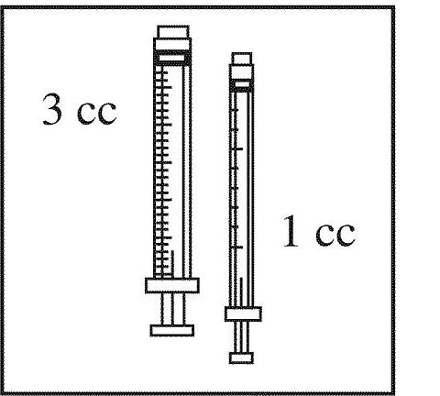
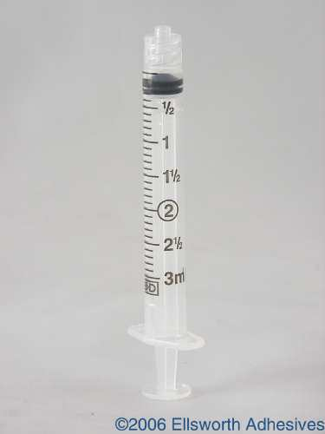
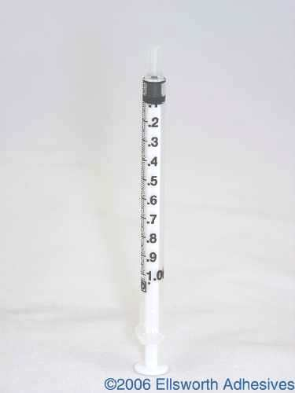
Injections
Syringes commonly used in the medical office include:
3mL syringe
Each small line represents 0.1 mL(CC)
Tuberculin syringe, is calibrated in tenths of a milliliter
This syringe has only a 1.0-mL

Slide 28
Part of a syringe
flange

Slide 29
Injections(syringe sizes)

Slide 30
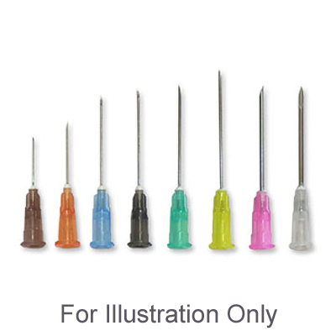
Needles
Needles come in a variety of lengths and gauges
When referring to a needle, a gauge describes how wide the diameter of the needle is
Gauge is the outside diameter of a needle
Needle Lengths: 5/8 inch, 1 inch, 1 ½ inch

Slide 31
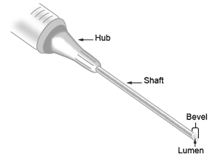
Parts of a needle

Slide 32
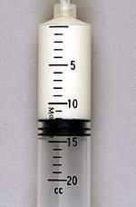
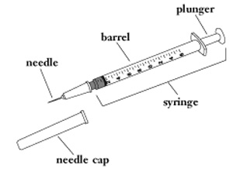
Injections
You need to properly read the amount of medication in the syringe
The plunger of the syringe has a black rubber tip at the end inside the barrel
You read the syringe by reading the calibration mark that lines up with the point on the black rubber tip of the plunger

Slide 33
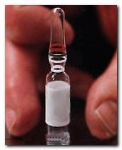
Withdrawal Medications From A Ampule
Ampule is a small glass vial that is sealed after filling
Flick the pointed end of the ampule(so medication is returned into the ampule)
Disinfect ampule neck with alcohol
Place a sterile gauze over the middle of the ampule
Grasp the tip of the ampule(with gauze) and snap off away from you, discard the tip(sharps only)
Remove liquid medication with a filter needle
Do not touch the rim(may cut you and you must maintain a sterile technique)
Discard the rest of the ampule(sharps only)

Slide 34
Withdrawal Medications From A Vial
There are single and multi-vials
Removal the needle guard(cap)
Alcohol the top of the vial
Insert needle into the vial(some medications you will need to add air ex: insulin)
Hold the vial upside down with your other hand
Plug back on the plunger and withdraw the desired amount(rule: do not re-introduce TB medication back into the vial)
Tap syringe lightly to removal air bubbles
Withdrawal the needle from the vial and change the needle
RULE: NEVER-EVER RECAP A NEDDLE

Slide 35
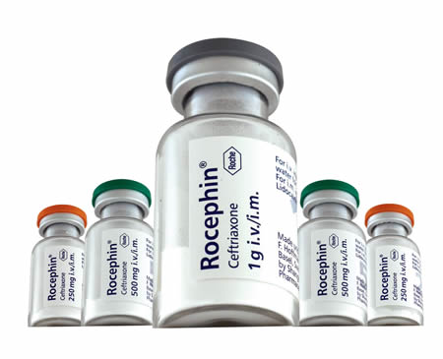
Reconstitute A Powder Medication
Powder medication must be mixed with a diluent
Use the proper amount of diluent for the medication(read the label carefully)
Insert the diluent into the power medication and gently roll the vial with your hand until thoroughly mixed

Slide 36
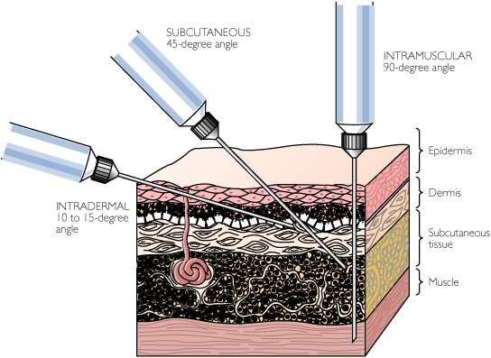
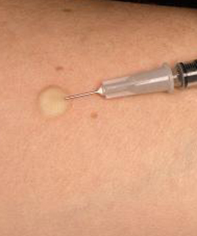
Administering Injections Intradermal
Intradermal Injections(ID)
Used in allergy and tuberculin testing
The intradermal injection is administered just under the surface of the skin with a fine gauge needle(23 to 25 gauge, 5/8 inch long)
The angle of the insertion into the skin is 10 to 15 degrees
The bevel of the needle should be up

Slide 37
Administering Injections Intradermal
A small wheal should develop at the site of the injection to give evidence that the medication is in the dermal layer of the skin
Very small amounts of medication(0.01 to 0.05 mL) are administered by this method of injection
A patient will return in
72 hours to have the test read

Slide 38
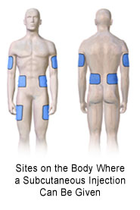
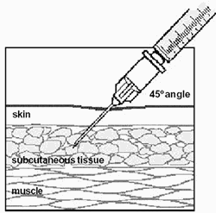
Subcutaneous Injection or Sub Q
Subcutaneous Injection(sub Q) injections are used to administer small does of medication, usually no more than 2 mL
The most often site is the upper outer part of the arm
The length of the need ranges from ½ to 5/8 inch and gauge is 25 to 27 G
Sub Q injections are administered at a 45 degree angle(pinch the skin)
Subcutaneous is found above muscle tissue

Slide 39
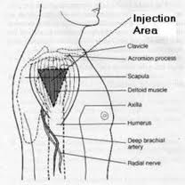
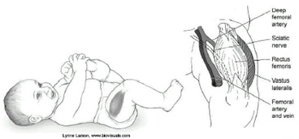
Intramuscular Injections
Intramuscular Injections(IM) injections are placed into muscle tissue
The most common sites are the deltoid,
ventrogluteal(next slide) and vastus lateralis

Slide 40
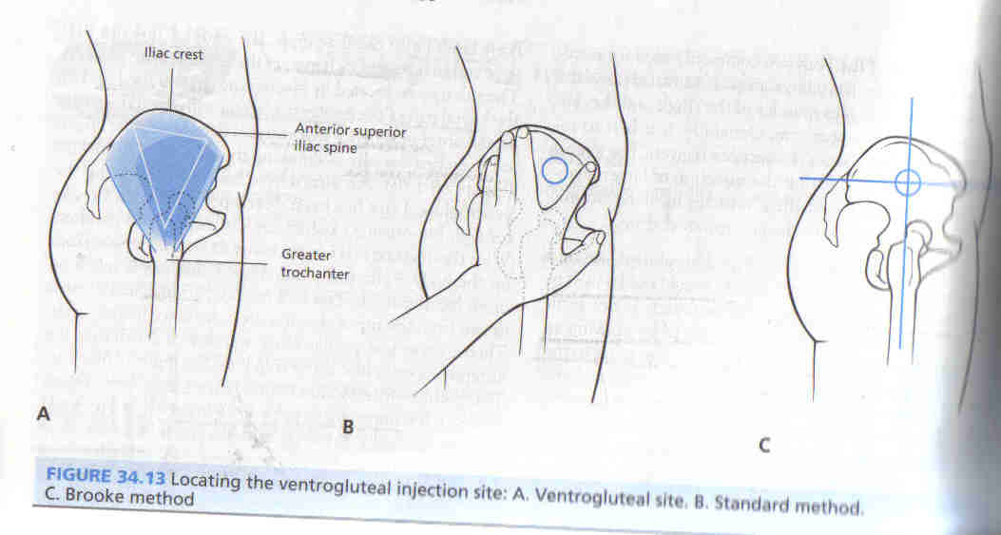
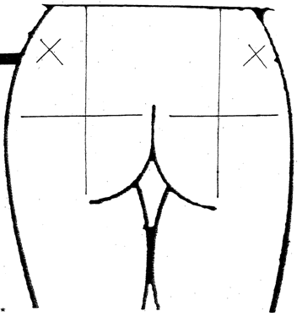
Ventrogluteal

Slide 41
Intramuscular Injections
The angle for a intramuscular injection is 90 degrees
Dosage may range from 0.5 mL to 3 mL
The gauge is between 18 to 23 G the length depends on the size of the patient and injection site

Slide 42
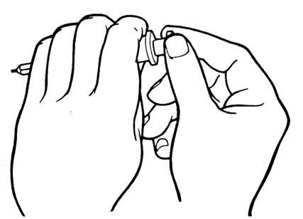
Aspirating Medications
An intramuscular injection is an injection given directly into the central area of a specific muscle.
In this way, the blood vessels supplying that muscle distribute the injected medication via the cardiovascular system
Aspirate at the injection site (while syringe and needle are within the muscle) by holding the barrel of the syringe with the non-dominant hand and pulling back on the syringe plunger with the dominant hand. If blood appears in the syringe, it is an indication that a blood vessel may have been punctured. The needle and syringe should be immediately withdrawn and a new injection prepared. If no blood is aspirated, continue by slowly injecting the medication at a constant rate until all medication has been delivered.

Slide 43
Aspirating Medications
Aspiration is not indicated for SC or IM injections of vaccines(immunizations)because there are no large blood vessels in the VL
Aspiration may be indicated for some IM injections including antibiotics, pain medications ect, Ventrogluteal because of the large amount of blood vessel
This is a 2011 study from the CDC

Slide 44
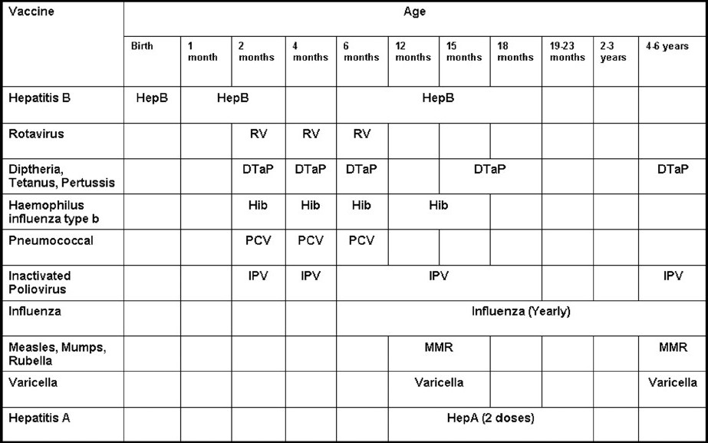
Types Of Vaccines

Slide 45
Immunization Schedule
When more than one dose of a vaccine against a particular disease, such as the Dtap injections, is referred to as a primary “series”
Each of these should be given with at least 6 to 8 weeks between each dose
The primary series requires a booster for the immunizations to most effective and complete

Slide 46
Disease Protection
Influenza: commonly referred to as the flu, is an infectious disease
Typically, influenza is transmitted through the air by coughs or sneezes
Typically, this vaccine includes material from two influenza A virus(including H1N1-swine flu)subtypes and one influenza B virus strain
Pneumonia: is a breathing (respiratory) condition in which there is an infection of the lungs
Germs called bacteria, viruses, and fungi may cause pneumonia
Bacteria and viruses living in your nose, sinuses, or mouth may spread to your lungs.
You may breathe some of these germs directly into your lungs

Slide 47
Disease Protection
Haemophilus Influenza Type B(HIB): is
a serious disease caused by a bacteria. It usually strikes children under 5 years old, caused by direct contact with respiratory droplets from nasopharyngeal carrier
Measles, Mumps, and Rubella(MMR):
Measles: is a very contagious (easily spread) illness caused by a virus.
The infection is spread by contact with droplets from the nose, mouth, or throat of an infected person. Sneezing and coughing can put contaminated droplets into the air
Mumps: is a contagious disease that leads to painful swelling of the salivary glands, also spread from person-to-person by respiratory droplets
Rubella: also known as German measles or three-day measles, is an infectious illness that is caused by a virus
This virus resides in the mucus of the nose and throat, and is transmitted when an infected person sneezes or coughs, spraying droplets into the air and landing in other people's noses or throats

Slide 48
Disease Protection
Diphtheria, Tetanus, Pertussis(DTaP):
Diphtheria: is an acute infectious disease caused by the bacteria, spreads through respiratory droplets, can spread through your bloodstream to other organs, such as the heart, and cause significant damage
Tetanus: Also referred to as lockjaw,
It is an infection of the nervous system with the potentially deadly bacteria
Infection begins when the spores enter the body through an injury or wound
Pertussis: also known as whooping cough(1022 cases in Utah 2013)
This is a highly contagious bacterial disease that causes uncontrollable, violent coughing.
The coughing can make it hard to breathe. A deep "whooping" sound is often heard when the patient tries to take a breath
Spread through sneezes or coughs

Slide 49
Disease Protection
Rotavirus: is one of the most common causes of diarrhea and severe infection (rotavirus gastroenteritis) is the leading cause of severe, dehydrating diarrhea in infants and young children
The virus passes in the stool of infected people before and after they have symptoms of the illness
Children can become infected if they put their fingers in their mouths after touching something

Slide 50
Disease Protection
Hepatitis A:is inflammation (irritation and swelling) of the liver
Hep A virus is found mostly in the stools and blood of an infected person about 15 - 45 days before symptoms occur and during the first week of illness
Hepatitis B: is irritation and swelling (inflammation) of the liver
Hepatitis B infection can be spread through having contact with the blood, semen, vaginal fluids, and other body fluids of someone who already has a hepatitis B infection

Slide 51
Disease Protection
Meningitis: is a bacterial infection of the membranes covering the brain and spinal cord (meninges)
The most common causes of meningitis are viral infections that usually get better without treatment, however, bacterial meningitis infections are extremely serious, and may result in death or brain damage, even if treated
Polio: is a viral disease that can affect nerves and can lead to partial or full paralysis(Franklin D. Roosevelt 32nd president)
The virus enters through the mouth and nose, multiplies in the throat and intestinal tract, and then is absorbed and spread through the blood and lymph system
Outbreaks still occur in the developed world, usually in groups of people who have not been vaccinated
Polio exists only in a few countries in Africa and Asia

