Slide 1
Job Seeking Skills

Slide 2
The Resume’
The first step before you can present yourself for employment is to develop a personal resume’
The goal is to make a favorable impression so you will obtain an interview for a position
It should be complete, accurate, and neatly organized
The purpose of the resume’ is to inform the prospective employer of how qualified you are for the position for which you are applying

Slide 3
The Resume’
A resume’ has certain elements:
At the top should be your name, address, phone number, and e-mail address
A couple of spaces below your personal information should be the specific position you are applying for
The next section includes information about your education(beginning with the most recent)
Next list all employment experience(most recent first)
Next list any memberships, volunteer, or community service
Next list references
There are different resume’ styles(use the style for the position your applying for)

Slide 4
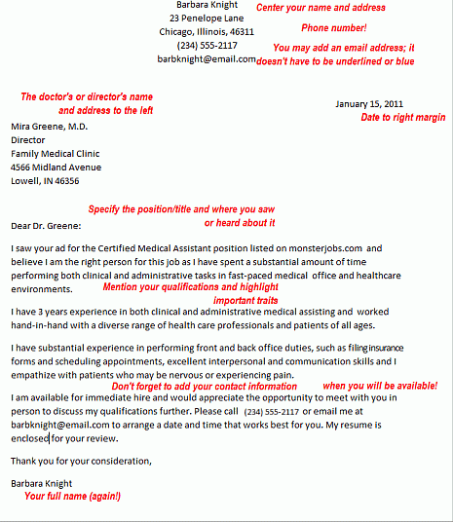

Slide 5
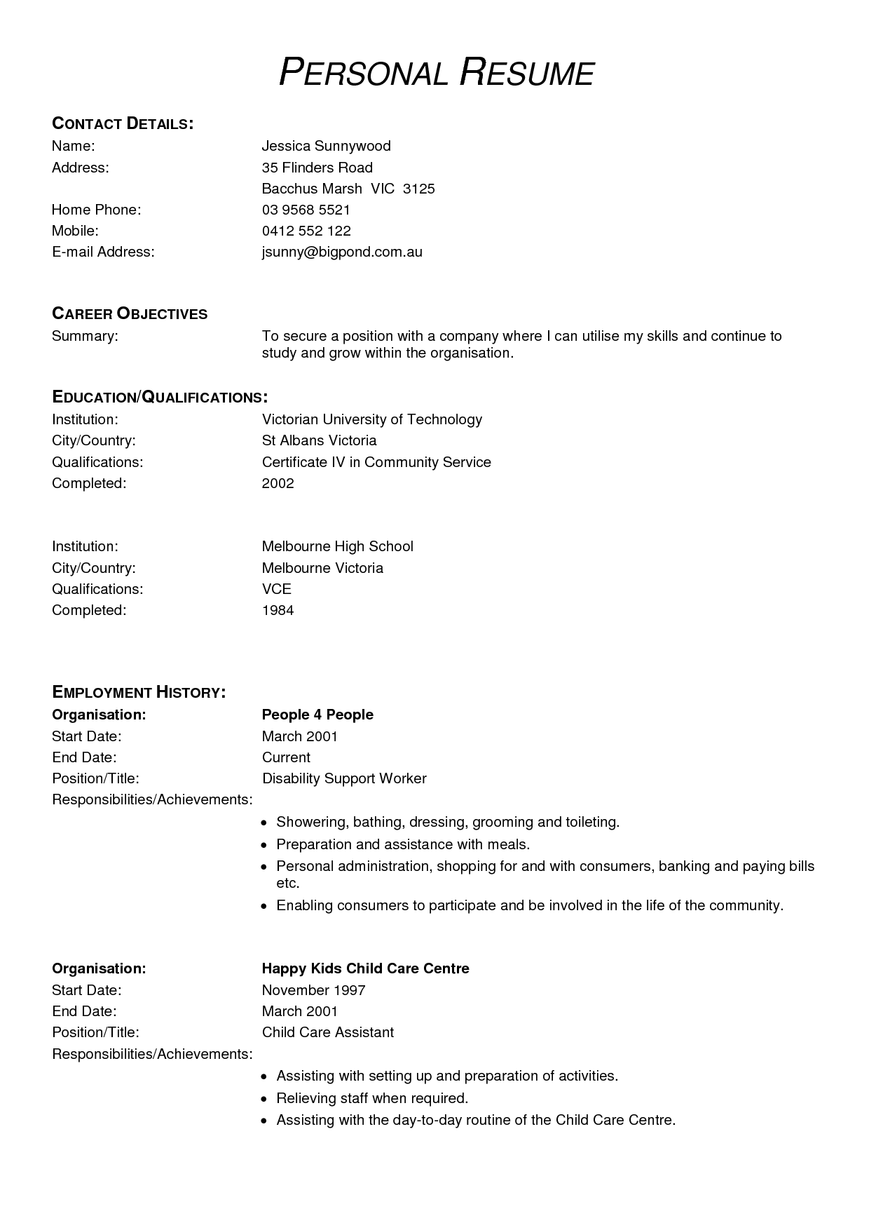

Slide 6
The Cover Letter
After you have perfected your resume’ you should do the same to compose a cover letter to send with it
The letter must state why you should be hired for the desired position
The letter should address the person who is interviewing and hiring
Make the letter simple and direct
Be sure to request an interview and make it clear when you can be reached

Slide 7
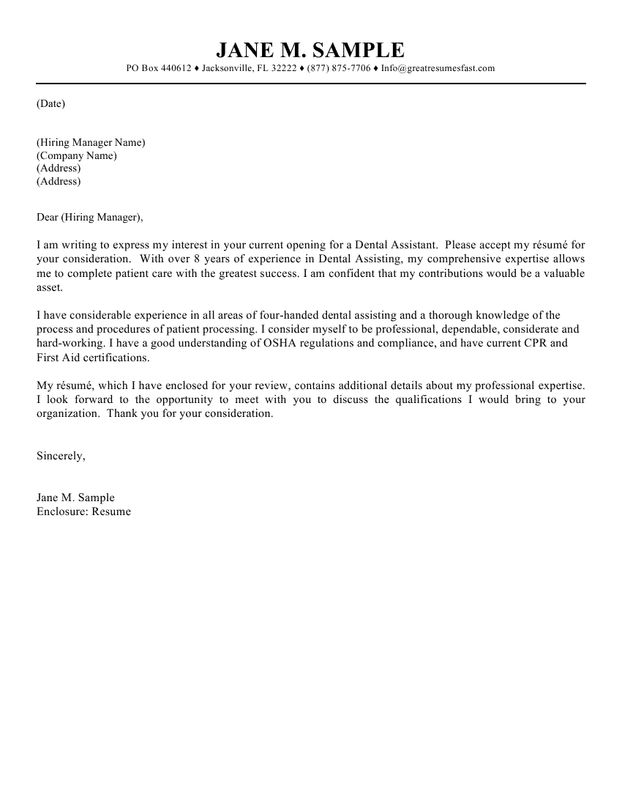

Slide 8
Resume’ and Cover Letters
Both the resume’ and the cover letter should be error free
Most employers will disregard the resumes with spelling and grammar errors, tears or smudges, or those that are too wordy or unorganized

Slide 9
The Interview
An interview is a face-to-face meeting between you and your prospective employer
The day of the interview you should allow sufficient time to get ready
Do not chew gum or smoke
Your appearance is extremely important, including your attitude
Dress for success
Appearance is an outward indication of who you are
Remember that you may convey mix messages by nonverbal communication

Slide 10
The Interview
All matter concerning personal cleanliness are vital
All of the following characteristics may interfere with the employment
bad breath, dirty fingernails, chipped nail polish, dirty or messy hair, overpowering aftershave or perfume, unclean teeth(food), unpleasant body odor, or complex problems
You should be 10 to 15 minutes early for your interview(do not arrive to early or to late)
Taking children or family members to your interview is inappropriate

Slide 11
The Interview
Introduce yourself with a firm handshake and a smile
Your manner should tell the interviewer you are happy to be there
You should be prepared to answer any questions concerning your career goals
Research questions about commonly asked questions by interviewers
Your answers should be brief, concise, and honest

Slide 12
The Interview
Do
Don’t
Arrive on time(10 to 15 min)
Show interest
Be immaculate in appearance
Display a positive attitude
Use courtesy
Act composed and poised
Dress appropriately
Keep good posture
Be late
Ask too many questions
Make excuses
Talk about personal problems
Act over-confident
Drum fingers, swing legs, tap foot
Overdress
Chew gum or smoke

Slide 13
Thank You Letter
Out of courtesy and to enhance your image with the interviewer, take the time to compose a follow-up letter shortly after the interview has taken place
A typed thank you letter is an indication of your interest

Slide 14
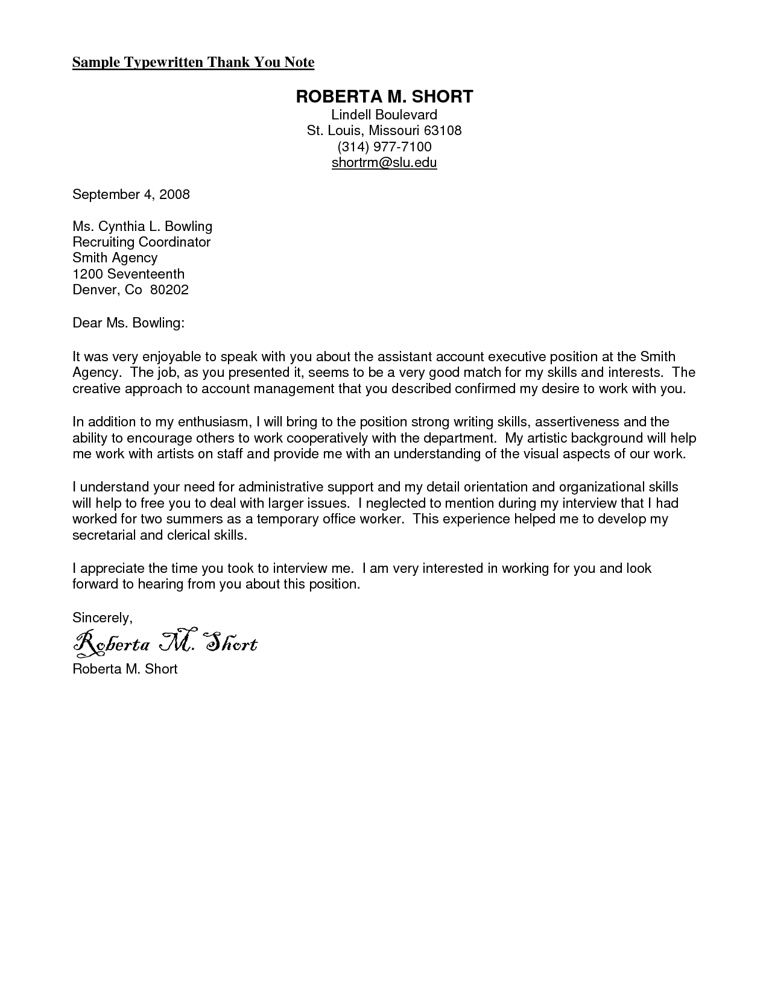

Slide 15
MA INTERVIEW TIPS
Research they company, know everything about their company
Some standard questions:
Tell me about yourself?
Why did you choose this career path?
Describe your ideal job?
Describe a difficult situation you had to deal with and how did you handle it?
What are your career goals?
Where do you see yourself in 5 years
Why do you want to work here?
Discuss your experience gained on your externship
Discuss your critical thinking skills
Demonstrate your enthusiasm for that job
End with a be positive note
Thank your interviewer and shake their hand

