Slide 1
Professional Communications
Chapter 4

Slide 2
Professional Communication
One of the most important skills a medical assistant can possess is the art of communicating effectively with others
In dealing with patients and their families, learning to listen and to offer advise in a calm, professional manner will help to reduce unnecessary stress for all concerned

Slide 3
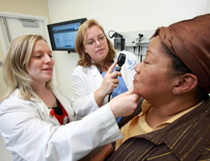
Verbal and Nonverbal Messages
Some patients may be hearing- or sight- impaired, developmentally disabled, or non-English speaking, and will therefore required extra understanding
There may be a family member or friend that will accompany the person, thereby helping with your task
It is important however, that you speak to all patients directly and acknowledge their presence

Slide 4
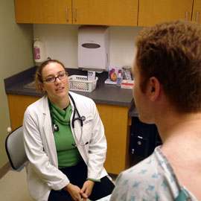
Verbal and Nonverbal Messages
When a patient comes in to the
clinic, there may be sources of
interference or distractions
It is best to speak one-on-one with
the patient in an area where there will
not likely be any distractions or interference
The spoken word must be in an articulate, clear manner if the intended message is to be received
Patients need to be spoken to in an unrushed manner so that the information has a chance to register and questions can be asked

Slide 5
Verbal and Nonverbal Messages
Listening involves giving attention to the persons trying to communicate with you
Active listening is the participation in a conversation with another by means of repeating words and phrases or giving approving or disapproving nods

Slide 6
Verbal and Nonverbal Messages
Common courtesy is an art that seems to have been lost to some degree
In a professional setting it is essential to be polite
Please and thank you, excuses me, and may I help you? Should be words in frequent use
In this way the entire health care staff will show respect for others and a sense of caring

Slide 7
Perception
Perception in the context of communication that may be considered as being aware of one’s own feelings and the feelings of others
Being perceptive is a skill acquired with experience and practice
Planning and thinking ahead will help you develop in this area

Slide 8
Body Language
The image you project is of utmost importance
Your overall appearance sends out messages to anyone who looks at you
Body language is a complex communication process
It involves unconscious use of posture, gestures, and other forms of nonverbal communication
It is possible to contradict a verbal message by an inappropriate facial expression

Slide 9
Facial Expression
Part of perception is being aware of how others think you feel, or see you
The most common example of positive, happy facial expression is a smile
Frowning and looking glum only add to other people’s troubles
It is especially important to be pleasant and friendly to those seeking medical attention, because their worries concerning their medical condition are already on their minds
A positive attitude and a receptive awareness will show in your facial expression
Eye contact shows that you are interested in giving and receiving messages of mutual concern and interest
Looking away while people are talking to you makes them feel that what they are saying is not important

Slide 10
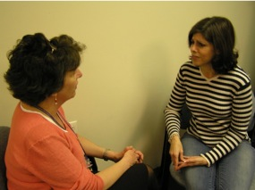
Gestures
Still another way of transmitting nonverbal messages is by gesturing
Gestures are body movements that enhance what is being said
When dealing with different cultures, some gestures, facial expressions, or remarks may be taken the wrong way
It is good practice to have an interpreter
Some gestures are positive including, thumbs up, okay, high five, applause, winking, and a handshake
Some negative gestures are crossed arms, looking at ones watch, rolling of eyes, taping of the foot or fingers, sighing, and talking under ones breath
A comfortable touch is helps patients feel that you care and gives them a sense of security and acceptance
There is also a proper distance you should maintain when speaking to others
It is important to identify a patient's nonverbal messages as well(Ex: saying their ok but making a painful facial expression or looking away)

Slide 11
Defense Mechanisms
Defenses are largely unconscious acts we use to help us deal with unpleasant and socially unacceptable circumstances or behaviors
They help us make an emotional adjustment in every situations

Slide 12
Repression
The most commonly used defense mechanism is repression, which is the forcing of unacceptable, or painful ideas, feelings, and impulses into the unconscious mind without being aware of it
We have all wished something unpleasant would happen to another person(hostility, jealousy, or intense anger)
These feeling do not vanish but are placed into our unconscious
Repression, like all of the defense mechanism, tends to protect us from unwanted messages about ourselves that make us feel bad
Example: A child who is abused by a parent later has no recollection of the events, but has trouble forming relationships.

Slide 13
Suppression
Suppression is a term to describe a condition in which the person becomes purposely involved in a project, hobby, or work so that a painful situation can be avoided
Some people throw themselves into work rather than deal with a relationship or situation
This is their way to avoid communication
People only fool themselves until something has been done to relive the stress this kind of behavior causes

Slide 14
Displacement
Displacement is the transfer of emotions about one person or situation to another
Example: having a bad day at work and then explodes anger toward a family member
Although this is done unconsciously, after the fact they realize their actions have been displaced from where they originated to an innocent, unsuspecting target

Slide 15
Projection
In projection, you might unconsciously blame another person for your own inadequacies, For example, if we are angry at a spouse but are too uncomfortable with the feeling to admit it, we may accuse our spouse of being angry rather than owning the feeling ourselves
Another example is an obese patient who has gained a few pounds, may blame the medical assistant by saying the scales are wrong

Slide 16
Rationalization
With rationalization, you justify behavior with socially acceptable reasons and tend to ignore the real reasons underlying the behavior
A person evades paying taxes and then rationalizes it by talking about how the government wastes money (and how it is better for people to keep what they can), another example might be, “I dieted all day; therefore, its ok to eat a couple of candy bars later in the evening after supper

Slide 17
Temporary Withdrawal
Temporary withdrawal is a defense mechanism that is retreat from facing a painful or difficult situation
Watching TV or reading excessively to avoid dealing with an issue are common types of withdrawal

Slide 18
Malingering
When you malinger, you deliberately pretend to be sick to avoid dealing with situations that are unpleasant or cause anxiety
A malingering individual may wish to get drugs, win a lawsuit, or avoid work

Slide 19
Denial
It is the refusal to admit or acknowledge something so that you do not have to deal with a problem or situation
A man hears that his wife has been killed, and yet refuses to believe it, still setting the table for her and keeping her clothes
Alcoholics vigorously deny that they have a problem.

Slide 20
Regression
Regression is behaving in ways that are typically characteristic of an earlier development level
This usually happens in time of stress
For example a college student consoles herself during finals week with eating hot fudge sundaes as she did as a child with her mother whenever problems at school piled up

Slide 21
Procrastination
Procrastination is defined as “always putting off until tomorrow what you could do today.”
This is a threat to us all
Co-workers will not be pleased to always bail you out because you never complete your work on time
Don’t make procrastination a habit

Slide 22
Mental And Emotional Status Influencing Behaviors
Medical assistants, have many opportunities daily to observe patients’ mental and emotional states
These observations have a direct influence on the medical assistants’ behaviors, which in turn directly influence their overall health
We must keep in mind that we are patients too
Stress in life can lead to illness

Slide 23
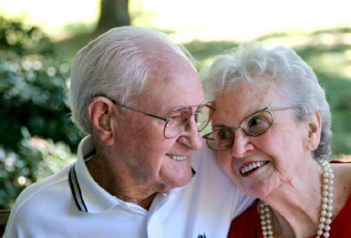
Communicating Emotional States
The medical profession's first responsibility is to the patient
Thus you need to be able to relate to people of all ages, from tiny infants to senior citizens

Slide 24
Right To Privacy
Medical information may be given to parties not concerned in the patient’s treatment only if the patient has signed a release of information form
You cannot leave a message on an answering machine(or voice mail) with this consent
The privacy of each patient must always be protected
You may be told personal information from a patient, this should be kept to yourself

Slide 25
Choice Of Treatment
Advising patients of the choices they have in the treatment of their illness is often apart of your responsibilities
Some patients have a difficult time making up their minds and may need additional information and further discussion before deciding to accept a treatment plan
You play an important part in reinforcing the physician’s order
Some patient’s may have a hard time interpreting the physician’s plan
It is important to advise patients to seek a second opinion if they harbor any doubts concerning their condition
Many insurance companies encourage second and third options before a treatment

Slide 26
Approach-Avoidance Conflict
Approach-avoidance conflict protects one from reaching a set goal that seems too difficult to complete
Example: A patient makes an appointment for the removal of a mass in the colon. The patient cancels the appointment at the last minute fearing that the biopsy may be cancer
They set a goal but does not follow through

Slide 27
Terminal Illness
Dealing with patients who have been diagnosed as having a terminal illness is a challenging and rewarding experience
Challenging because of its difficulty and rewarding because of the knowledge that you are giving supportive care with the patient and families
Many patients have a hard time accepting the diagnosis
Their initial reaction is denial

Slide 28
Terminal Illness
There are stages for patients with a terminal illness:
Denial: Patients wrestles with the diagnosis
Anger: Patients may lash out at others, maybe blaming them or even themselves
Bargaining: Some want to ‘buy” time, this gives them inner strength
Depression: Patient in this stage really need to talk to someone
Acceptance: This is a sad time for patients and their families

Slide 29
Hospice
Hospice provides some health care to those with terminal illness
Hospice helps the family provide care so that patients can remain in their comfortable, familiar home surroundings during the last days of their lives
This also make it more convenient for their families

Slide 30
Office Interpersonal Relationships
Dealing with the needs of patients on a day-to- day basis can sometimes become an overwhelming task
Some schedule can be overbooked; or an emergency arises
So when each employee contributes, the result is a good team that works together for quality patient care

