Slide 1
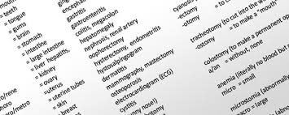
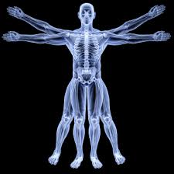
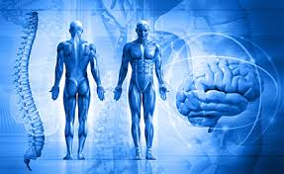
MA 11-1/MT 1&2
Medical Terminology
And
Anatomy and Physiology
Review

Slide 2
Review Med Term
A word component added to the beginning of a combining form?
Prefix
This is the part of the word that applies to a part of the anatomy?
Combing form or word root
The word component added to the end of a combining form?
Suffix

Slide 3
Review Med Term
cardi/o:
heart
cyt/o
cell
-otomy
sugical incision
dys-
painful
-uria
urine
phleb/o
vein
-graphy
recording a picture or record

Slide 4
Review Med Term
leuk/o:
white
erythr/o
red
ot/o
ear
thromb/o
clot
hem/o:
blood
-itis
inflammation
gastro
stomach

Slide 5
Review
arthr/o
joint
What is the correct spelling for the hipbone?
Ilium
-ologist
specialist
-osis
abnormal condition
hepat/o
liver
megaly
enlargement

Slide 6
A&P Review
Anterior or ventral:
Front
Posterior(dorsal)
Back
Superior
Top portion of the body
Inferior
Bottom portion of the body
Medial
Toward the middle of the body
Lateral
Away from the midline
Proximal
Nearest to the point of attachment
Distal
Distant from the point of attachment

Slide 7
A&P Review
Frontal or coronal plane:
Divides the body into front and back portions
Transverse plane:
Divides the body into upper and lower portions
Midsagittal plane:
Divides the body into right and left potions

Slide 8
A&P Review
Define:
Homeostasis:
Being in a steady state or normal
Anatomy:
The study of the structures of the human body
Physiology:
The study of the functions of cells, tissue, and organs of the body
Anatomical position:
Body upright, facing forward, with palms facing toward the front of the body

Slide 9
A & P Review
How many quadrants are in the abdomen?
4
Name them
RUQ, LUQ, RLQ,LLQ
Know the anatomy of the 4 quadrants page 312
How many regions in the abdomen?
9
Hypochondriac means?
Below the rib cage
Hyperchondriac means?
Above the rib cage
Epigastric means?
Above the stomach

Slide 10
Review
What group of organs are located in in the abdominal cavity?
Gallbladder, pancreas, spleen, stomach, liver, intestines
The appendix is located in what quadrant?
RLQ

Slide 11
Cell review
Cell membrane:
Regulates transport of substances into and out of the cell
Nucleus:
Contains our DNA, genes, and chromosomes
Nuclear membrane:
Regulates transport of substances into and out of the nucleus
Ribosomes:
Protein synthesis
Mitochondria:
Powerhouse
Lysosomes:
Cellular digestion

