Slide 1
Chapter 7
Facility and Records Management

Slide 2
Preparing for the day
Preparations procedures vary according to the type of practice you work
The medical assistant is often the first person into the office each day
Some of the responsibilities included with you facility may be to open and close the office

Slide 3
Opening the Office
The medical assistant should arrive on time to make preparation for receiving patients
If adequate time is no available, it seem like you can never get organized
There may be several things that need to be done before patients arrive
Unlock doors
Observe the reception room(temperature, appearance, safety check, check toys and books/magazines)
Retrieve telephone messages
Pull charts
Inspect examination rooms

Slide 4
The Receptionist
The medical assistant may fulfill the role of the receptionist, whose responsibility is to greet the patient
This is the first person the patient encounters
It is extremely important to be positive and friendly
You may need to answer phones, schedule appointments, or make routine calls
Be especially alert if a very ill patient enters the office
This patient should not have to wait in the reception area

Slide 5
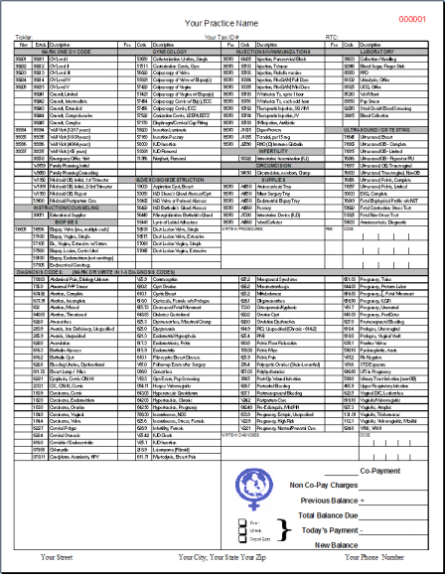
Charge Slips
The receptionist may also be responsible for preparing the charge slip also known as the encounter form
This has a list of procedures and codes for billing
Form will vary from one type to another, depending on you practice or specialty

Slide 6
New Patients
The receptionist will be responsible for the completion of new patient forms
Offer assistance if the patient is reluctant
You need to ask for insurance card(s) at this time, enter all information into the computer, and take copies for the patients chart
Before the patient can be seen, an charge slip is generated and then placed in a designated area until the patient is taken to an examination room

Slide 7
Closing The Office
At the end of the day, the examination rooms should be restocked and cleaned, and discarded material should be placed for pick-up
This saves time for the next morning
File any charts(check for completeness)
Turn off all appliances(autoclave)
Always walk through your area to complete your check list of things to do
Active alarm system

Slide 8
The Patient’s Medical Record
The patient history is the most important record kept in the medical office
In a lawsuit resulting from injury, the patient chart information could win or lose a case
Each office has its own method of charting
Some physicians will have you record the findings, some dictate their notes, others may write all their findings on progress notes
The majority of clinics/hospitals have computer-generated patient records
Computer-generated records begin with the patient's general information for billing and scheduling

Slide 9
HIPPA And The Medical Record
The Health Insurance Portability and Accountability Act of 1996 required many changes for health care providers as well as insurance providers
Help to maintain the privacy of health information
Established standards for any electronic transmissions of health information
Ensures the security of all health information

Slide 10
The Purpose Of REcords
The medical record has several important purposes:
It serves as a basis for planning care
Furnishes documentary evidence of the course of the patients treatment, and conditions
Evidence of communication between all health care professionals contributing to the patient’s care
Protection of the legal interests of the patient and the physician
Establishes a baseline for use in continuing medical education and research
Insurance companies perform audits routinely on this information

Slide 11
Parts Of The Medical REcord
Administrative
Financial and insurance information
Correspondence
Referral
Past medical records
Clinical data
Progress notes
Diagnostic information
Lab information
Medications

Slide 12
Administrative And Insurance information
This is a patient demographics:
DOB
SS#
Spouse name
Address
Work and home #
Insurance information
Emergency contact information
This should be updates at every visit

Slide 13
Correspondence
This is any follow up letters from specialists, insurance companies, or any other correspondence that should be filled in the patients chart

Slide 14
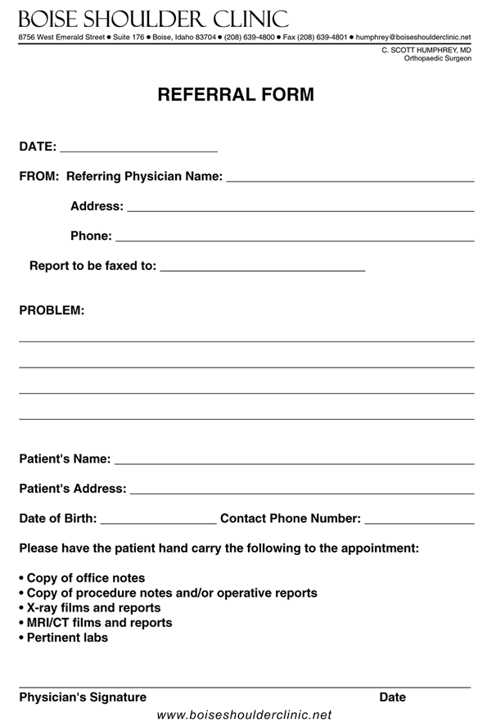
Referrals
In order for some insurance companies to pay for medical specialties a referrals needs to be generated
Failure to comply with these conditions could make the referring physician responsible for the cost of the diagnostic tests, or visits

Slide 15
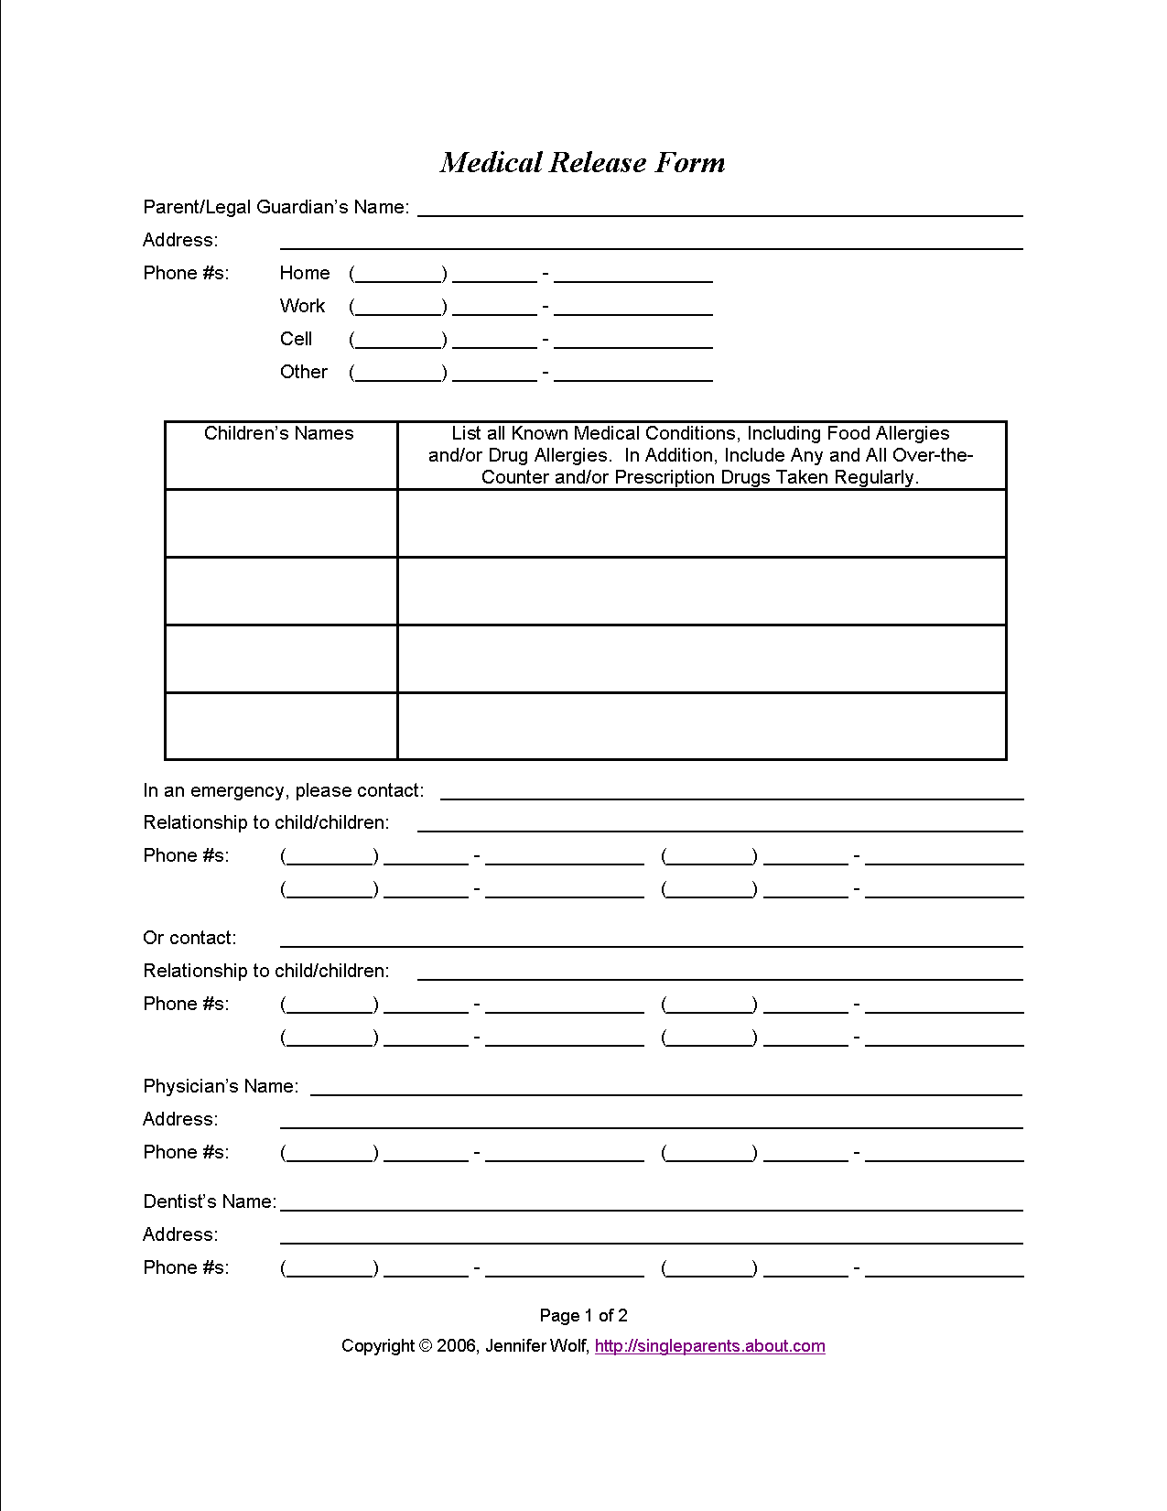
Past Medical records
Past medical records may be requested from a prior physician
Knowing the patient’s prior medical history is quite helpful in providing quality health care

Slide 16
Progress notes
This is a listing of visits, prescription refills, and call that pertain to the patient
At any time a patient has an interaction with anyone in the office, it should be documented in the progress notes
The progress not should be in chronological order, with the most recent date on top

Slide 17
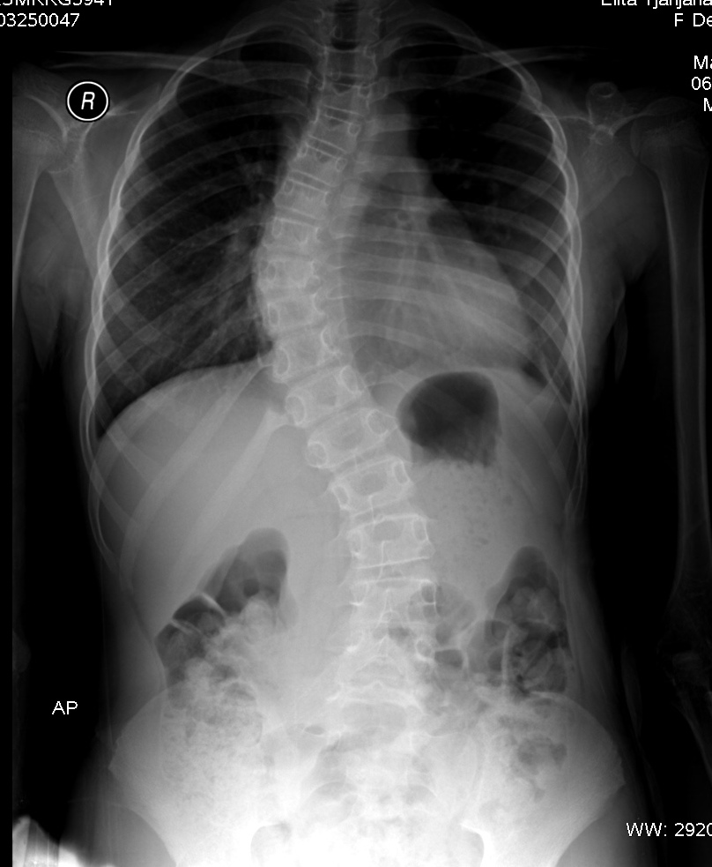
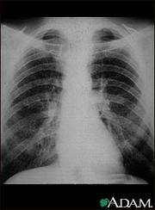
Diagnostic information
All x-rays and non-lab related testing should be placed in this section

Slide 18
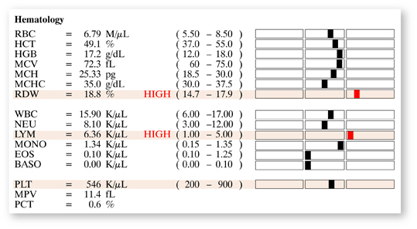
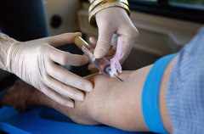
Lab Information
All lab reports should be placed in this section
They should be in chronological order

Slide 19
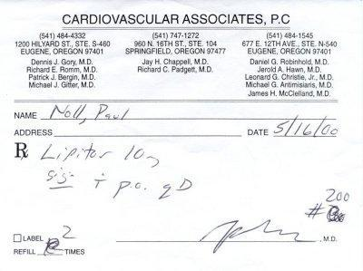
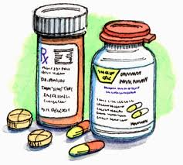
Medications
Copies of prescriptions and documentation of any medications that are administered in the office are placed in this section of the chart

Slide 20
tracking medical records
Every office has a system to track outstanding work that must be completed before releasing the chart to be filed or closed(computer)
Division may included
Charts to be filed
Prescription refills
Lab results
Coding/financial corrections
Charts awaiting dictation
Referrals
Many physicians are procrastinators when it comes to completing paperwork/charts in the office
It is the duty of the medical assistant to see that it gets done, even if this requires a daily reminder

Slide 21
The problem-oriented medical record
In 1970, a professor of medicine, originated a system of recordkeeping for patients known as POMR
The POMR is designed to establish a relationship between the patient profile, complaints, review of systems, physical examination, laboratory findings, and other relevant information.
Includes:
S
O
A
P

Slide 22
Filing steps
Folders or cards are easily filed alphabetically or numerically, but the procedure for filing reports and letters require several steps
Step One: Insect reports- divide reports according to priority
Step Two: Indexing- file materials under the patients name by illness, procedure, treatment, ect…
Step Three: coding- Code for billing
Step Four: Sort- Sort in alphabetical filing(mail or reports)
Step Five: Storing- Locate the file drawer, place the most recent material on top

Slide 23
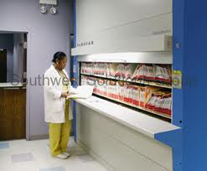
Filing Storage
Every office that requires you to file paper records will have storage units for this purpose
Files come in many different styles, shapes, and sizes
There are vertical or lateral file cabinets, card index files, open shelf files, and tub files

Slide 24
Filing systems
Most filling systems are based directly or indirectly on an alphabetic arrangement
In alphabetic filing, the names of persons, films, or organization are arranged as in the telephone directory
In numerical filing, the material is arranged in numeric order in the main file

Slide 25
Filing alphabetically
This is the most common method of filing
There are rules to filing material alphabetically
Rule 1: The surname, or last name is considered first, the first mane or initial is second, and middle name or initial is third
Example: John E. Brown- is filed as Brown, John E.
Rule 2: Names are filed in alphabetically in an A-to-Z sequence
Example:
Allard, Wm
Allen, E. S.
Allen, Edna
Allen, Wm. A.
Allen, William

Slide 26
Filing alphabetically
Rule 3: A prefix, such as Mc, Mac, Le, is considered part of the surname
Rule 4: In filing a married women, used her legal name, Mrs., is disregarded
Rule 5: Most firm names are filed as they are written
Example: Herb’s Auto Service
Rule 6: Firm names that include the full name of an individual are filed as you would any other name
Rule 7: With a firm name with the, this is disregarded
Rule 8: And, for, or of is disregarded
Rule 9 Co, inc ect will need to be spelled out

Slide 27
Filing alphabetically
Rule 10: Hyphenated name as used as one unit
Rule 11: Number are spelled out
Rule 12: Professional title are not considered(Dr, Prof)
Rule 13: Terms of seniority are not considered( Junior, Senior, Third)
Rule 14: File names of federal, state, government by political division
Example: Drug Enforcement Division

Slide 28
Filing Numerically
This is the second filing method
Most offices use the same number of digits for each number assigned, and the numbers are always filed in order from smallest to largest
A system using six digits would begin 000001, 000002, 000003, and so on
Some patients are assigned numbers, which are separated into two(2s) or three(3s) The number are read from the right hand group of numbers to the left hand group
The read the middle numbers next, and then the first group of numbers
Example
02-17-25
10-17-25
08-17-35
12-25-35

Slide 29
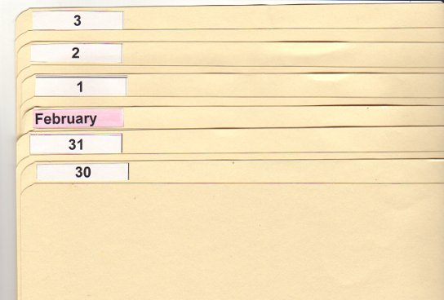
Using a chronologic(tickler) file
This is commonly called a “tickler file” and is used as a follow up method for a particular date
It consists of dividers with the names of all the months and dividers numbered from 1 to 31 for the dates of the month
Some offices have patient fill out cards to ne sent as a reminder for a follow up appointment

