Slide 1
Chapter 8
Collecting Fees

Slide 2
Collecting Fees
The medical assistant may be involved in explaining fees and payment policies and virtually every aspect of collecting for the services the physician has provided
Physicians must set their fees based on their professional financial profile and the fees appropriate for similar specialists in the community
The physician considers the time spent with the patient, the complexity of the diagnosis, and the treatment

Slide 3
Collecting Fees
You will find that insurance companies and government agencies establish a fee profile for the physician based on charges averaged over a period of time
Example: Physical for a 65 year old male is billed by the physician for $84.00 but Medicare will only pay the average fee of $65.00

Slide 4
Personal Data Sheet
The patient should complete a personal data sheet at the initial office visit
It is important to verify and update the patient’s current information including:
Phone number
Address
Insurance information
DOB
Patient’s occupation and business phone number

Slide 5
Payment Planning
The medical assistant can assist patient’s who are going to have a baby, elective surgery, or extensive therapy by helping them develop a payment plan
Some physicians will use a cost estimate sheet to give the patient an idea of the cost
This may be your responsibility to explain the cost with the patient
If the patient needs to pay a substantial sum out-of-pocket, the medical assistant should discuss with the patient the manner in which payments will be made
If this is done a truth and lending consent form must be signed in your presence, and kept on file for 2 years

Slide 6
Credit Card Usage
Our society enjoys convenience
Credit cards are used in almost every facet of personal business, including paying copayment, deductibles, and co-insurance
Checkbooks are bulky, and many people do not even carry checkbooks(many places do not except checks)
Acceptance of credit and debit card payments is especially helpful when placing a call to a patient who owes a balance on a delinquent account
Another advantage of credit card use for paying for medical services is that the monies are generally available to the physician within 24 hours of depositing

Slide 7
Bookkeeping Terms
Some of the basic terminology used in recording office business transactions include:
Daily journal: Patient charges and receipts are recorded here each day
Account: Will show charges, payments, and balance due for a patient
Account receivable: All outstanding accounts
Posting: Transfer from one record to another
Debit: A charge, added to an existing balance
Credit: A payment, subtracted from existing balance
Balance: Difference between debit and credit
Adjustment: Professional courtesy discount(write-offs)
Debit balance: Amount paid is less than the total due
Credit balance: Amount paid is greater than was due, or account is being paid in advance of service

Slide 8
Daily Log
A Daily log should be kept for each patient for charges and no-charge visits
They should be itemized, and a total should be put in the charge column
Payment should be placed in the credit(paid) column
Note the check or money order number, type of credit card used, or weather cash was paid
Always give the patient a receipt for payment made

Slide 9
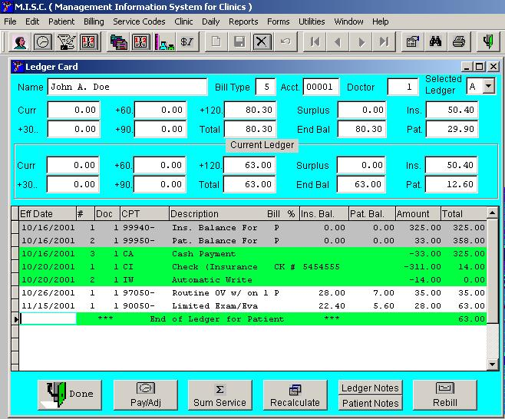
Patient Accounts
Many health care providers use computerized billing systems that allow for timely filing of encounters and statements
Some use ledger cards
This makes it possible to increase efficiency by using the one that best suits the practice needs

Slide 10
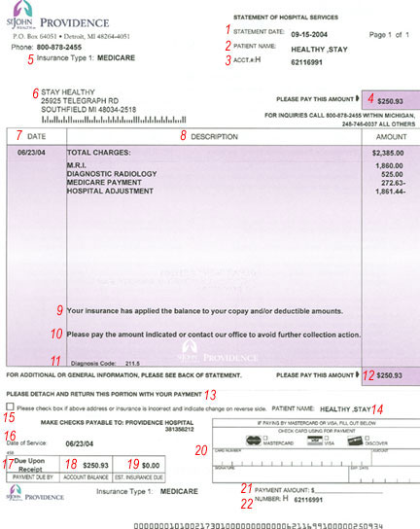
Statments
Statement must be accurate
If your office uses monthly billing, send out bills on the last day of the month
A statement is figures for charges and payments

Slide 11
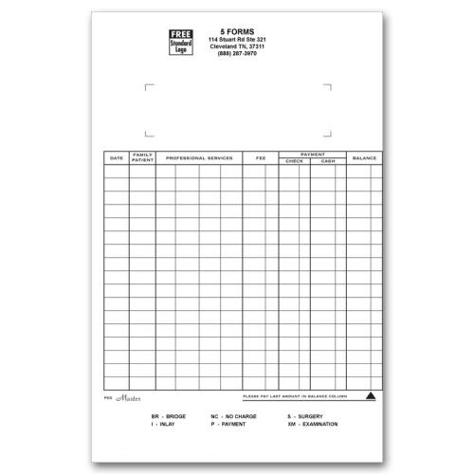
Bookkeeping
As a bookkeeper, the medical assistant prepares the daily log or journal and posts charges and payments on the patients ledger card or enters the payment into the computer
The patients ledger card is a record of all charges or services rendered, any payments made by the patient or the insurance company, and any adjustments

Slide 12
Bookkeeping
The entries on a daily log are called journalizing
The entries should be kept in chronologic order
Note that it is easy to transpose numbers, so double check you entries for any mistakes
When the balance is carried forward it is important to record it under “previous balance” for the next day

Slide 13
Exceptions To Usual Procedures
There are a number of exceptions to the usual billing procedures
Physicians who specializes in sports medicine and examine athletes may be paid by the school or team referring the patient
The next of kin will receive the bill for a deceased patient at the last known address(do not address this to the deceased patient)
When a patient has filed bankruptcy, you may send no more statements and can make no attempt to collect the account(credit the account)

Slide 14
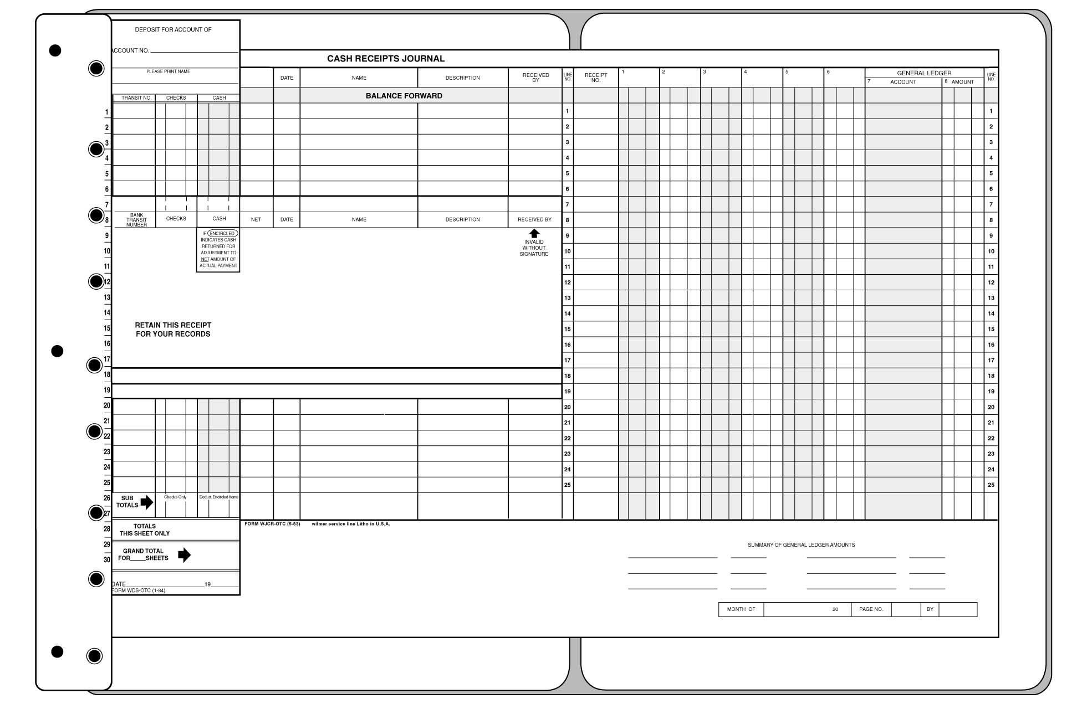
Pegboard
This is referred to as the write-it-once system
This system shows that you can make an entry on the ledger, the day sheet, and the charge slip simultaneously
The base or board has pegs, which you should place up and to the left
This log holds all of your daily entries
When you check in a patient, pull the appropriate ledger card

Slide 15
Billing And Collections
Billing is most common use for a computer in the medical office
Practice management software offers a variety of services, such as posting electronic, diagnoses, and monthly or year-to-date billing information
Software should include Current procedural terminology(CPT), these are for procedures codes and International classification of Diseases(ICD9), these are for diagnosis codes and for processing insurance information

Slide 16
Billing And Collections
The computer terminology for a patient ledger is account history
This is simply a record of the information that should be obtained for every new patient
All of this information can be obtained by viewing the Patient Data Sheet
Some computers can be programmed to create charge slips(also referred to as “walk out” slip, or superbill), the computer can create a statement or receipt to be handed to the patient before he or she leaves the office
Computerized insurance claims can greatly improve cash flow
A claim can be completed in a matter of seconds for every patient visit

Slide 17
Collecting Overdue Payments
Computers can help in analyzing accounts receivable for accounts past due
This process is know as aging of accounts
It is a means of dividing accounts into categories according to the amount of time since the first billing date
Accounts are considered current if within 30 days of the billing date
No accounts should be referred to a collection agency unless the physician has given approval for this to be done

Slide 18
Advantageous Collection Opportunities
If you are working with the patient insurance company and they have a co-payment(at the time of service) collect only the co-payment
If they are uninsured(self-pay) collect all the fees in full
The best opportunity for collecting is when you have the patient in the office
Collection calls need to made during business hours, you could be held liable for harassment if calls are made to early or to late

Slide 19
Making The Collection Call
Prior to making the collection call you should review the account to verify whether any payments have been posted
Review all notes on the collect report
Know where the patient balance is coming from-which is know as date(s) of service(DOS)

