Slide 1
Development of an Insurance Claim
CMS-1500 FORM

Slide 2
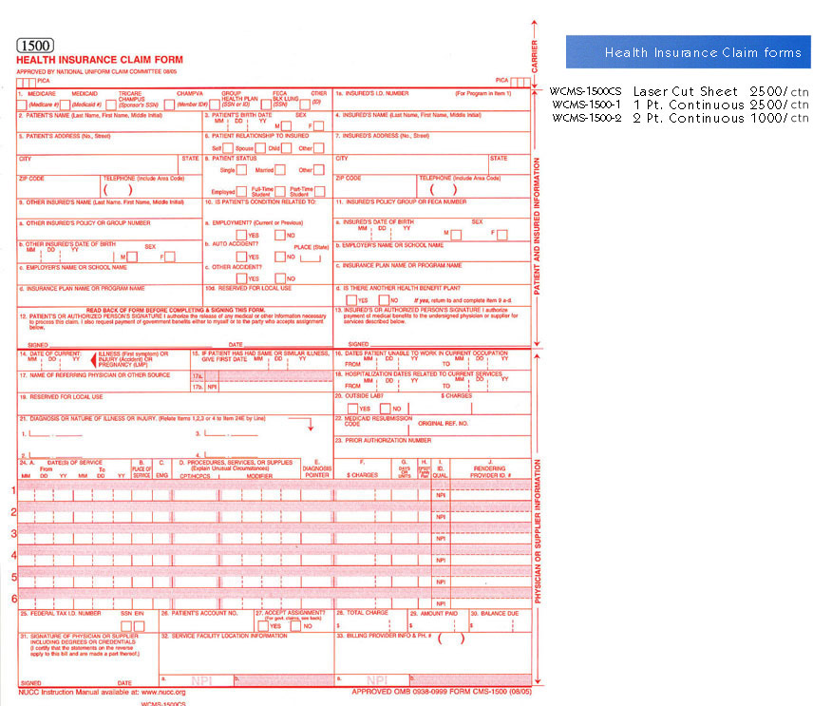

Slide 3
Development of an Insurance Claims
The processing of an insurance claim is initiated when the patient calls to schedule an appointment
CMS-1500 claim is used to report professional and technical services
Patient encounter form (or super-bill) is used to generate the provider’s claim for payment

Slide 4
Development of an Insurance Claims
Information from the patient’s encounter(or super-bill) or patient’s record is transferred to the CMS-1500 claim
Information includes, patient demographics and insurance policy identification, ICD-9 codes, and CPT codes

Slide 5
How To Fill Out A CMS 1500 Form
1. Type of insurance(group if they have a group number and individual if self-employed)
1a. Is insured’s ID number(FIRST, LAST, MIDDLE INITIAL ALL IN CAPS)
2. Patient’s name
3. Patient’s DOB(MM/DD/YYYY) and sex
4. Insurance holders name(Type same name if self)
5. Address and phone number of patient
6. Patient’s relationship to insured(other is for significant other)

Slide 6
How To Fill Out A CMS 1500 Form
7. Insured’s address and phone number(put SAME if patient is the card holder)
8. Patient’s marital status and employed or student
9a-9d- fill out only if patient has a secondary insurance
10a-10c- always fill out for patient’s condition(auto always gets billed first)
11. Insured’s group number
11a Insured’s DOB
11b. Insured’s employment or school
11c. Insured’s plan name(BCBS)
11d. If they have another health plan(secondary insurance)
12. Authorization to release any information to insurance(always put SIGNATURE ON FILE)
13. SIGNATURE ON FILE

Slide 7
How To Fill Out A CMS 1500 Form
14. Date of initiation of the course of treatment(MM/DD/YYYY)
15. Leave blank
16. Dates an employee is unable to work
17. Name of referring physician
18. Hospitalization dates
19. For therapy only
20. Outside labs and charges
21. Up to eight diagnosis codes
22. Leave blank(prior authorization are not done anymore)
23. Leave blank (same as above)

Slide 8
How To Fill Out A CMS 1500 Form
24a. Date of service(required fields) MM/DD/YYY
24b. Place of service(required field)
24c. Leave blank
24d. CPT codes
24e. Enter 1,2,3,4 ect to match codes
24f. Enter charge for each listed service
24g. How many days for the service
24h. Leave blank
24i. NPI numbers for 24j
24j. NPI Providers

Slide 9
How To Fill Out A CMS 1500 Form
25. Provider federal tax Id number
26. Patient’s account number assigned by the provider’s system
27. Accept assignment needs to be checked for Medicare patient’s
28. Total all charges here
29. Enter the amount that the patient paid on the covered services only(co-pay)
30. Leave blank(balance will vary)
31. Signature of provider(SIGNATURE ON FILE)
32. Enter complete address for the location where services were performed(no punctuation) ex : Physician Practice Inc
123 N Main Street
Anytown IL 60610
32a. Enter NPI of the facility
32b.
33. Enter the provider of service phone number, billing name, address, and zip code

