Slide 1
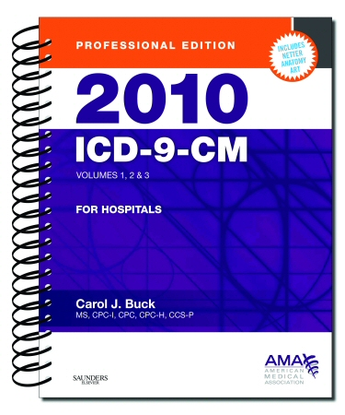
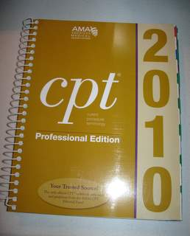
CPT And ICD-9

Slide 2
CPT Codes
CPT is Current Procedural Terminology
CPT are for services and procedure codes reported on insurance claims
Provides a list of identifying and descriptive codes for reporting procedures and medical services
Uniform language that describes medical, surgical procedures and services
CPT codes are submitted as claims with linked ICD-9-CM codes

Slide 3
CPT Codes
CPT defines nature of the presenting problem as “a disease, condition, illness, injury, symptom, sign, finding, complaint, or other reason for the encounter, with or without a diagnosis being established at the time of the encounter

Slide 4
CPT Codes
Improvements to CPT are underway
In 2002
AMA completed the CPT 5 Project, resulting in the establishment of three categories of CPT codes
Category I codes
Category II codes
Category III codes

Slide 5
Category 1
Category 1
Procedures/services identified by a five digit CPT codes
Codes traditionally associated with CPT organized in six sections:
Evaluation and Management(E/M) 99201-99499(new or established patient)
Anesthesia 00100-01999, 99100-99499
Surgery 10021-69990
Radiology 70010-79999
Pathology and Laboratory 80047-89356
Medicine 90281-99199, 99500-99607

Slide 6
E/M
Evaluation and management(codes 99201-99499)
Located at the beginning of CPT because these codes describe services most frequently provided by physicians
For established patients
Is a patient who has received services from the physician (same specialty in the same group practice)within the past three years
E/M code reported to a payer
Must be supported by documentation in the patient’s record

Slide 7
E/M Evaluation and management
E/M code selection is based on three key components:
Extent of history
Extent of examination
Complexity of medical decision making
All key components must be considered when assigning codes for new patients

Slide 8
E/M Evaluation and management
Determined by:
Straightforward
Low complexity
Moderate complexity
High complexity
Once the extent of history, extent of examination, and complexity of medical decision making are determined
Select the appropriate E/M code

Slide 9
Qualifying Circumstances for Anesthesia
When situations or circumstances make anesthesia administration more difficult and increases the patient’s risk factor

Slide 10
Surgery Section
Surgery section is organized by body system
Some subsections are further subdivided by procedure categories
Incision
Excision
Introduction or removal
Repair, revision, or reconstruction
Grafts
Suture
Other procedures

Slide 11
Radiology Section
For diagnosis radiology, ultrasound, radiation oncology, and nuclear medicine

Slide 12
Pathology and Laboratory
Organized according to the kind of pathology or laboratory procedure performed
Organ or disease oriented panels
Drug testing
Therapeutic Drug Assays
Consultations (Clinical Pathology)
Urinalysis, chemistry, hematology and coagulation immunology
Microbiology

Slide 13
Medicine Section
The CPT Medicine section classifies noninvasive or minimally invasive diagnostic and therapeutic procedures(Examples: IV, immunizations, acupuncture, anesthesia)

Slide 14
CPT
CPT code number format
A five-digit code number and description identifying each procedure and service listed in CPT
CPT Appendices
CPT contains appendices located after the Medicine section and Index
Insurance specialist should become familiar with changes that affect the practice
CPT appendix: A-M

Slide 15
Modifiers A-M
Coding tip:
List of all CPT modifiers with brief descriptions is located inside front cover of coding manual
Clarify services and procedures performed by providers
Have always been reported on claims submitted for provider office services and procedures
EXAMPLE: The additional information that can be conveyed by these codes includes whether a procedure is discontinued, done on the left or right side, reduced, multiple procedures done in the same session, etc.

Slide 16
Appendix A
Detailed description of each CPT modifier
Appendix B
Annual CPT coding changes Added, deleted, revised CPT codes
Appendix C
Clinical examples for evaluation and Management (E/M) section codes
Appendix D
-Add-on codes
Appendix E
Codes exempt from modifier -51 reporting rules
Appendix F
CPT codes exempt from modifier -63 reporting rules
Appendix G
Summary of CPT codes that include moderate (conscious) sedation
Appendix H
Alphabetic index of performance measures by clinical condition or topic
Serves as a crosswalk to the category II
Appendix I
genetic testing code modifiers
Appendix J
Electro diagnostic medicine listing of sensory, motor, and mixed nerves
Appendix L
List of vascular families that is intended to assist in selection of first, second, third, and beyond third-order branch arteries
Appendix M
Crosswalk of deleted to new CPT codes

Slide 17
Steps To Use A CPT Book(7 steps)
Step 1:
Read introduction in CPT coding manual
Step 2:
Review guidelines at beginning of each section
Step 3:
Review procedure
Step 4:
Refer to CPT index
Locate main term for procedure or service documented
Step 5:
Locate sub-terms and follow cross references
Hint: if the main term is located at the bottom of the CPT index page, turn the page and check to see if the main term and sub-terms continue
Step 6:
Review descriptions of service/procedure codes, and compare all qualifiers to descriptive statements

Slide 18
Steps To Use A CPT Book(7 steps)
Step 7:
Assign applicable code number and any add-on (+) or additional codes needed to accurately classify statement being coded
Tip: You may have to translate medical terms:
Examples:
Placement of shunt: Insertion of shunt
Pacemaker implantation: Pacemaker insertion
Suture laceration: Repair open wound

Slide 19
ICD-9 Coding
The International Classification of Diseases (ICD) 9th edition is the classification used to code
The ICD is used to provide a standard classification of diseases for the purpose of health records
The World Health Organization (WHO) assigns, publishes, and uses the ICD to classify diseases and to track mortality rates based on death certificates and other vital health records.Medical conditions and diseases are translated into a single format with the use of ICD codes

Slide 20
ICD-9 Coding
Many physician’s ofﬁ ces are specialized. So you will most likely end up
working with a limited number of sections in the ICD-9-CM book.
EXAMPLE
If you are working for a gastroenterologist, you would rarely, if ever, use
codes for mental disorders 290—319.

Slide 21
ICD-9 Coding
Always code the primary reason that the patient is interacting with the medical professional.
Organization of the ICD-9 manual:
Volume 1 – Diseases Tabular List
Volume 2 – Diseases Alphabetical List
Volume 3 – Procedures Used for Hospital Inpatient Coding
Physicians only use Volumes 1 and 2
Volume 2: The Alphabetical List
Found in the front half of the ICD-9 book.
Always consult the Alphabetic List first before deciding whether or not to code a 3, 4 or 5 digit code.
Organized by “main terms” which are printed in bold-faced type for ease of reference.
Diseases – Influenza or Bronchitis
Conditions – Fatigue, Fracture or injury
Nouns – Disturbance or Syndrome
Adjective – Double, Large or Kink
Note: Many conditions can be found in more than one place.

Slide 22
ICD-9 Coding
Always use the first code if diagnosis is unspecified
Ex: Hypertension
401.9
Some diagnosis may have a “SEE” also condition
Ex: RIB Fracture closed
807.0

Slide 23
ICD-9
V codes are for health care visits with no concerns
Ex: Pregnancy , Well child checks V20.2 or flu vaccines V72.9
E codes are for poisoning including drug overdoses and drug interactions

