Slide 1
Oral And Written Communications
Chapter 6

Slide 2
Answering The Telephone
The telephone is the center of all activity in the medical office
The professional attitude conveyed is critical to the success of the business of practicing medicine
Most medical facilities have
multiple lines that must
be answered as soon as
possible
You should answer the phone by
the third ring

Slide 3
Telephone Screening
An established phone screening manual should be kept near the phone for reference
The assistant must learn how to logically proceed through a set of question and give the standard advice that has been pre-authorized by the physician
This process is known as telephone screening

Slide 4
Nonemergency Calls
If the person on the phone needs additional information or if the call is going to take a while(longer than one minute) ask the caller if you may call them back with the information
Be sure to check the caller’s phone number and the best time for them to be reached

Slide 5
Transferring Telephone Calls
If you need to transfer a patient's call to another department or office, first give the caller the phone number, extension number, and person’s name.
Stay on the phone while you transfer the patient, when the person answers, explain who is waiting to speak to them, and give them the patients name and a short explanation for the call
Never blind transfer a caller

Slide 6
Documenting Telephone Messages
Documenting telephone messages is of vital importance and should be treated likewise
It is equally important that the date, time, and a brief message regarding the call be recorded
All messages that are urgent should be given priority and handled as soon as possible
Calls should be returned in the order of importance
Follow HIPAA and confidentiality when return calls

Slide 7
Documenting Telephone Messages
Important elements in a telephone message are:
Caller full name(patient's name)
Brief note indicating the nature of the call
Action required
Date, time, and name of person receiving the call
Correct phone number(s)
Time they may be reached

Slide 8
Common Types Of Phone Calls
The most frequent types of calls are:
Referrals
Patient’s who are calling for appointments, perceptions, or results of tests
Emergency calls
Other physician’s, hospitals, or laboratories
Personal calls and general business calls

Slide 9
Appointments
Patients who call for an appointment should be given two appointment times
Do not say:
when would you like to come in
Ask if they prefer morning or afternoons
Do not say:
Are you patient here
It is better to say when were you last seen
Do not say:
What’s the problem
Say what is the reason for your visit

Slide 10
Prescriptions
Each office will have it’s own protocol for prescriptions
The general rule is that the medical assistant does not give out information or call in a prescription without the expressed direction of the physician
Many physicians prefer to have prescriptions and refills faxed
If this is a new prescription always ask if the patient has any allergies to medications, pharmacy name and phone number, and document when, where, and the pharmacist’s name in the chart

Slide 11
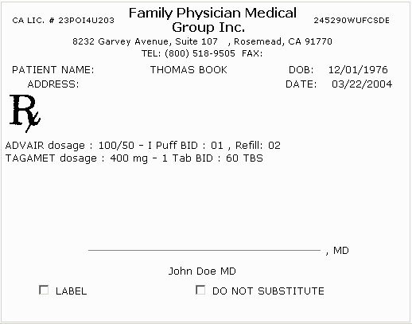
Prescriptions
When calling in a prescription to a pharmacy you will need to give:
Patients full name and DOB
Prescription name, strength, quantity, number of refills, sig(how often and when), physician's full name, phone number, DEA(control substance), and your name and title
Example:

Slide 12
Test Results
Always observe your office’s policy for releasing any test results
Most physician's will want to speak to the patient directly when results are abnormal, while some will want the medical assistant to give the results
Make sure you understand the information that you need to give the patient(ask if this is not understood)

Slide 13
Professional Calls
When a physician telephones to speak to your physician, politely ask the caller for his name and inform the physician
If you are taking x-rays or laboratory results, make sure you repeat the information so you have accurate results, always record the persons name giving you the report

Slide 14
Difficult Calls
There are a few calls that will be a challenge to you no matter when they are received
These can include a call from an angry patient, a prank call, or an obscene call
As with any phone call you receive, you should be tactful, professional, and as courteous as possible
When an angry patient phones you and begins to rant and rave, ask them calmly, and in a smoothing voice to tell you his concerns
If the caller uses profanity, tell the caller that you will not continue the call unless you can be spoken to in a courteous manner
Referring a patient to the office manger may be your only option
What ever the case, document the nature of the problem and the outcome

Slide 15
Follow –up Calls
Often physician's advice patients to call the next day to report their progress
You should determine whether you are to take a message or if the physician wishes to speak to the patient directly

Slide 16
Physician Visits Outside the Office
When a patient calls and requests a house call, be sure you check with your physician before scheduling
You need to establish a method of recording these visits, for the charges for their service

Slide 17
Finding Phone Numbers
It is a good idea to keep an up-to-date index of the most frequently used phone numbers by the telephone
Emergency numbers:
poison control
ambulance
security
ect….

Slide 18
Appointment Strategies
One of the most primary and vital functions in the course of managed care is the scheduling of appointments
Managing time well for the physician and support staff will help keep patient flow at a satisfactory pace and promote a good professional working relationship
Some unexpected emergencies and other unpredictable situations may arise

Slide 19
Establishing A Matrix
The computer program(book) must have a fixed matrix
The matrix refers to the practice of blocking off time slots and a format for establishing a time schedule for an appointment
If you have an appointment book never use a pencil(HIPAA law)
Always keep the appointment book on file for 3 years

Slide 20
Appointment Strategies
Office hours may be scheduled with appointment made during specific times, or left as an open block of time(sick visits)
The entire staff must be aware of the intended schedule of the physician(s)
A computerized appointment system automatically locates the next available time, gives you a record of all appointments already made, allows you to locate a specific date and time, and prints copies of the daily schedule

Slide 21
Maintaining The Schedule
After a period of time, through trial and error, each medical practice staff arrives at a schedule that works best for them
The time slots needed for various procedures, exams, and consultations can then be handled in short, medium, and extended appointment times

Slide 22
Canceled or Missed Appointment(no-shows)
If a patient canceled or does not show up for the scheduled appointment, it should be noted in the person's chart and the appointment time given to another patient as soon as possible

Slide 23
Maintaining the Physician's Schedule
In addition to scheduling patients, the medical assistant has the responsibility to help the physician stay on schedule
It is a necessary courtesy for you to explain tactfully to all the patients who are waiting(how long and why)
Remember that each patient has the right to feel that their time is just as important as yours

Slide 24
Handling Late Patients
There are occasional patients who seem to be late for every appointment
In this situation, you may schedule them after you come back from lunch to work them in or at the end of the day
Late arrives can be told to reschedule their appointment
Late and missed appointment should be document in their chart

Slide 25
Follow up appointment
It is the medical assistant’s responsibly to assist patients with their payments, and any necessary follow-up or referral appointments after the physician has seen them
Some offices send out reminder cards for yearly exams(pap test, physicals, mammogram) in the mail or by email

Slide 26
Appointments
You will find that the patients will frequently ask to speak with the physician
Never say:
The doctor is busy
Say the physician is with a patient now
Ask if you may take a message and we will return your call as soon as possible

Slide 27
Written Communication
What is written communication?
Its often called correspondence, the communication by the exchange of letters
In a physician’s office, written communication is often necessary:
To inform the staff of a policy or decision
To contact professional colleagues
To send personal message
Ect…..

Slide 28
Communication and HIPAA Regulations
Communication that include personal information about patients require special handling:
To request a consultation from a specialist
To provide results to the referring physician from a specialist
To request any medical records

Slide 29
Inner office Communication
This is an informal, memo-style communication that is usually specific to one concern
If you want to ensure that everyone read the memo, a copy must be given to each person
They initial or sign stating they have read the memo then it circulates(back to sender)

Slide 30
Personal And Professional Letters
Physician may ask for your assistance with a personal or professional letter
A competent medical assistant should be able to compose the necessary letter after receiving the specific information desired
All the physician will need to do is provide a signature(and proofread)

Slide 31
Preparing Written Communication
Almost everyday, the mail-carrier arrives, there will be something received that requires a response
Some physicians will allow you to open and sort their mail, while others will handle this on their own

Slide 32
Spelling, Parts Of Speech, Sentence Structure, Punctuation Marks, And The Eight Parts Of Speech
Probably the most important criteria about any communication is that it be written using proper grammar and punctuation and have no misspelled words
Page 142-145 goes over rules and examples for composing a letter

Slide 33
Alternative Ways To Communicate
There are many ways to receive and send information in today’s technological society
Some common methods are fax, pager, cellular phone, voice mail, conference call, teleconferencing, e-mail, and the internet

Slide 34
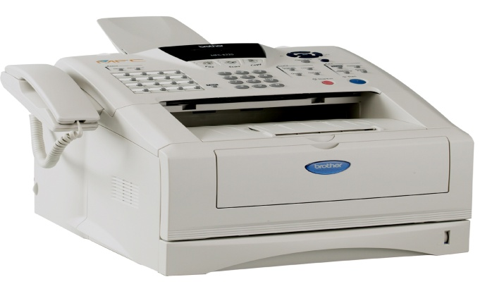
Fax Machine
A fax machine is connected to a telephone line
The machine scans a document and converts the image to electronic impulses that are transmitted over the telephone lines
The fax machine may also be able to store multiple documents in memory and have automatic redialing when a busy signal is detected
The fax machine should always be kept in a confidential room(HIPAA)
Always use a cover page(this has confidential on it, and will be the first page received)

Slide 35
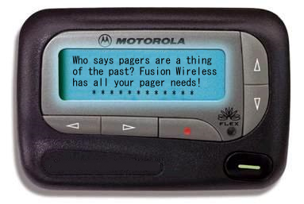
Pagers
Some physicians wear pagers so they can be contacted regardless of where they are or what they are involved in
A pager is a small electronic device that is activated by a telephone signal
When you wish to contact a physician, you simply dial the number, after it rings, a series of beeps will be heard, and you enter the phone number from which you are calling or a voice message and then hit the pound key on your phone
This will produce a beeping or vibration, the number or message will be displayed in the pager’s small viewing area

Slide 36
Voice mail
Voice mail is another way to communicate
It is similar to a telephone answering machine, except voice mail can receive messages and place them in your “mailbox” even if the phone is busy
These message can be retrieved by accessing the voice mail using a personal identification number

Slide 37
Conference Calls
The telephone can be used to conduct conversations with several people in various locations at the same time
This allows business to be conducted, meeting to occur, and professional or personal communication to be carried out

Slide 38
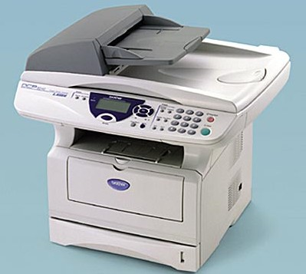
Copy Machine
The copy machine is extremely important to the efficiency of the office
A photocopy of correspondence, an insurance form, a patient’s record, laboratory reports, or account information is often needed
Remember that the copier is
not for you personal use

Slide 39
Printers
To produce hard copy from computer files, you must have a printer
Laser printers are more expensive, but have a better quality
A toner cartridge inside the printer contains the printer’s powered “ink” cartridge and should last for 5000 pages of text

