Slide 1
The Senses
Chapter 11 Unit 3

Slide 2
Senses
Have you ever been to a fireworks show?
Bright bursts of lights in various colors, booms and crackles of explosions, and the scent of gunpowder are all part of the experience
We can enjoy because of our senses.

Slide 3
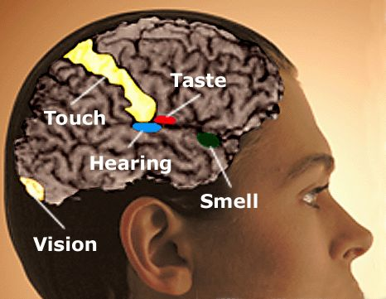
Parietal lobe: hearing, touch, smell, and taste
Temporal lobe: helps with the sense of smell
Occipital: vision

Slide 4
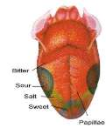
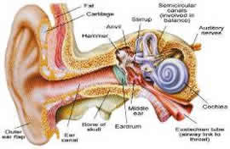
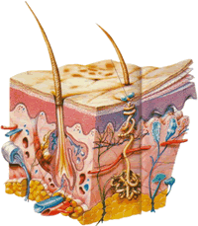
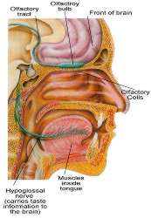
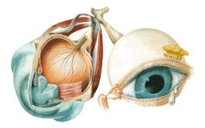
The Senses
The human being is able to communicate with the surrounding environment because of a miraculous network of nerves coordinated with the organs of five special senses, which allow us to see, hear, taste, smell, and touch
Knowledge of the environment requires the cooperation of three factors:
1.the sense organs to perceive
2. intact cranial nerves to transmit
3. a functioning area of the brain to interpret the received stimuli
A stimulus is anything the body is able
to detect by means of its receptors
Receptors are the peripheral nerve
endings of sensory nerves
that respond to stimuli

Slide 5
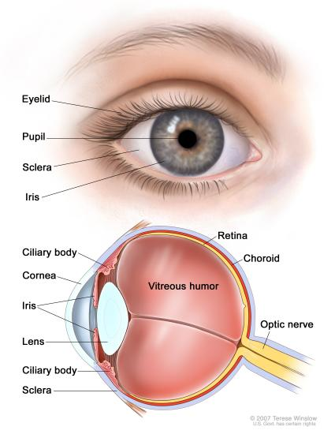
The Eye And The Sense Of Sight
The structure of the eye is frequently compared with that of a camera
The eye is located within the bony orbital cavity of the skull
For additional protection,
the outside of the
eye is covered with
tough, white fibrous
tissue called the sclera

Slide 6
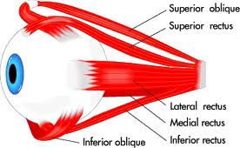
The Eye And The Sense Of Sight
The sclera helps maintain the shape of the eyeball, and have six muscles attached and are anchored in the skull, this permits the eye to roll up and down, in and out, and in combinations of these directions

Slide 7
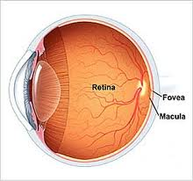
Focusing The Image
Both the eye and the camera have a lens to focus an image onto a surface for “recording.”
In the eye this is the retina(talk about later)

Slide 8
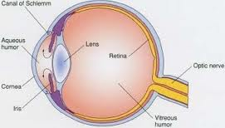
Focusing The Image
In the eye, the shape of the elastic lens is automatically altered by ciliary muscles to focus objects onto the retina
The shape of the lens is quite rounded in childhood but becomes more convex with age until it is nearly flat in the elderly, causing difficulties

Slide 9
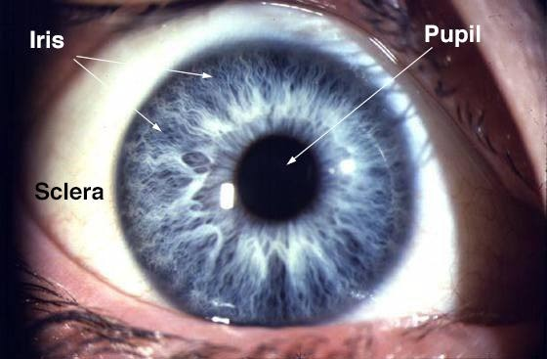
Controlling Light
The iris is the colored part of the eye: brown, green, blue
It is a ring of muscle fibers located behind the cornea and in front of the lens.
It contracts and expands, opening and closing the pupil, in response to the brightness of surrounding light.
Just as the aperture in a camera protects the film from over exposure, the iris of the eye helps protect the sensitive retina.

Slide 10
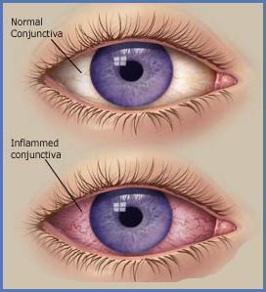
Surface Membranes
A mucous membrane called the conjunctiva lines the inner surfaces of the eyelids and covers the anterior sclera surface of the eye

Slide 11
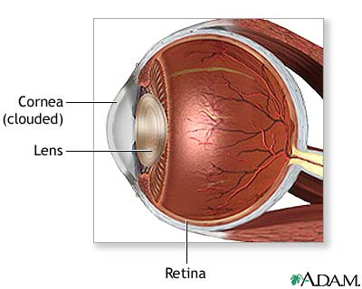
The Cornea
The cornea is a clear, dome-shaped surface that covers the front of the eye.
It is the first and most powerful lens in the eye's optical system.
To keep it transparent the cornea contains no blood vessels.
Tears that flow over it and aqueous humor in the chamber behind it keep it nourished.
When you hear of eye banks and eye transplants, it is the cornea that is being replaced.
The cornea can be damaged from: accidents, infections, and genetic defects.

Slide 12
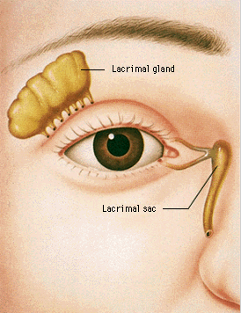
Focusing The Image
Further protection for the eye is provided by lacrimal glands, which secrete tears to moisten and cleanse the surface of the membrane(When we cry we get a runny nose)

Slide 13
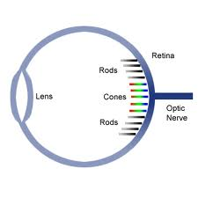
The Retina
The retina is the film of the eye.
It converts light rays into electrical signals and sends them to the brain through the optic nerve and is composed of nerve tissue
The retina is where most of the problems leading to vision loss occur.
Retina has rods: that detect light(7 million) and cones: that detect colors(100 million)

Slide 14
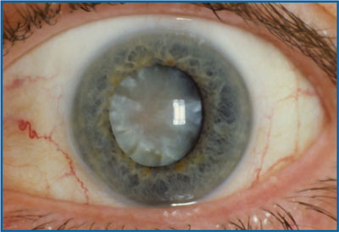
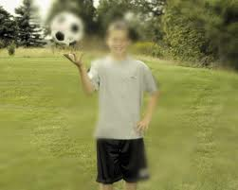
Diseases And Disorders Of The Eye
Age related macular degeneration: This alters the light-sensing retina in the back of the eye
This is a gradual loss of central vision; however, side(peripheral) vision may remain
Cataract: This is a gradual cloudiness of the lens; the condition causes a painless, gradual blurring and loss of visual acuity(usually over 70 year of age)

Slide 15
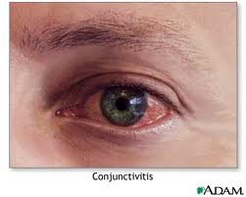
Diseases And Disorders Of The Eye
Conjunctivitis: This condition is caused by inflammation of the conjunctiva
It usually begins in one eye and spreads rapidly
It is usually cause by an infection and also referred to as “pinkeye.”

Slide 16
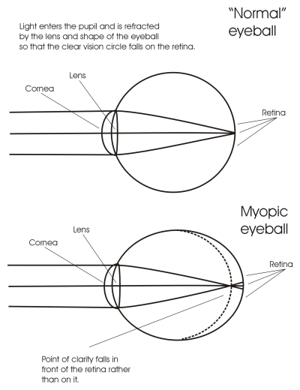
Diseases And Disorders Of The Eye
Myopia: This condition is also known as nearsightedness
Objects can be seen distinctly only when close to the eyes
The cause is a misshapen(large) eyeball so objects are refracted in front of the retina

Slide 17
Latin Vision
OD stands for oculus dexter and indicates the RIGHT eye OS stands for oculus sinister and indicates the LEFT eye OU stands for oculus uterque and indicates BOTH eyes

Slide 18
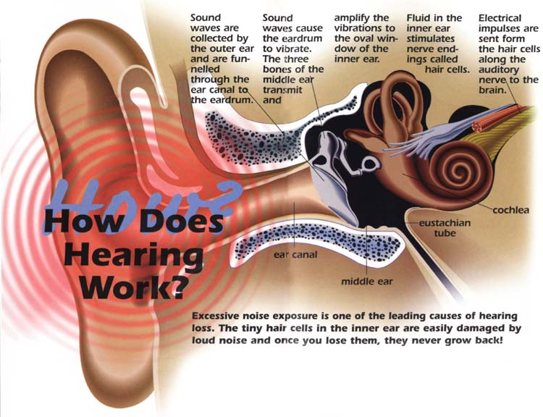
The Ear And The Sense Of Hearing
The ear is capable of receiving vibrations in the air and translating them into the sounds we recognize: the more the vibrations per second, the higher the frequency, or pitch, of the sound; the stronger the vibration, the louder the sound

Slide 19
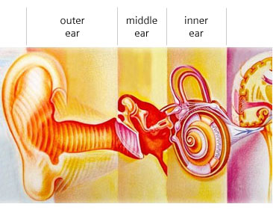
The Ear
The ear has three major areas:
The outer ear
The middle ear
The inner ear

Slide 20
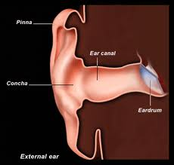
The Outer Ear
Vibrations are picked up by the pinna(auricle) of the outer ear and directed down the external auditory canal to the tympanic membrane(eardrum)

Slide 21
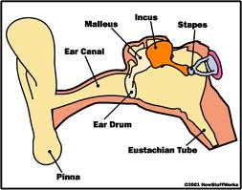
The Middle Ear
The sound vibrates the membrane and the malleus attached to its inner surface
The malleus “strikes” the incus which moves the staples
These three small bones are located in the middle ear
FYI: They are the smallest bones in the body

Slide 22
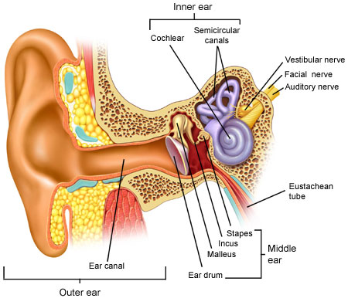
The Inner Ear
The vibrations continue from the middle ear through to the cochlea, with specialized nerve cells
The inner ear also contains three semicircular canals, and are responsible for maintaining equilibrium(balance)

Slide 23
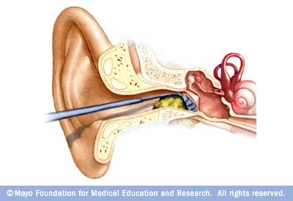
Diseases And Disorders Of The Ear
Auditory canal obstruction: This refers to anything in the ear canal that in some manner occludes the opening
Can be cerumen(earwax) or any foreign objects(bean, pea, bead, or insect) children often put objects in their ears
This may consist of removal technique appropriate to the obstruction

Slide 24
Hearing Loss
Hearing loss is a condition of reduced ability to perceive sound at normal levels
The loss can be gradual or sudden
Common causes are acute infections, buildup of earwax, middle ear infection, swelling, head trauma, tumor

Slide 25
Meniere’s Disease
Meniere’s disease is a disorder of the inner ear, usually affecting one ear
This condition is characterized by severe vertigo(dizziness) and tinnitus(ringing in the ears).
The cause is unknown, but probably results from an abnormality in the fluids of the inner ear

Slide 26
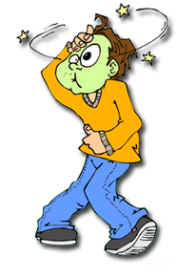
Motion Sickness
A condition that occurs when involving movement(planes, boats, cars)
This is characterized by loss of equilibrium, perspiration, headache, nausea, and vomiting
This disorder results from excessive stimulation of the inner ear receptors or confusion in the brain between the visual stimulus and movement perception

Slide 27
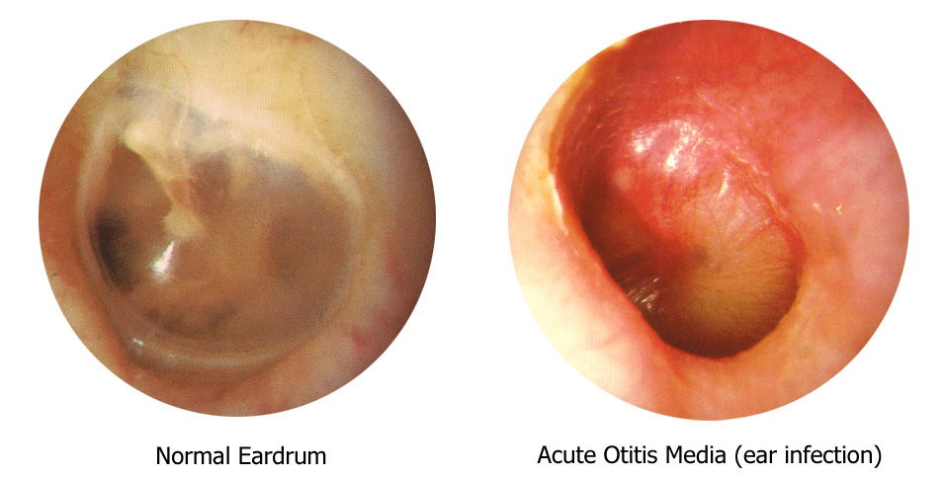
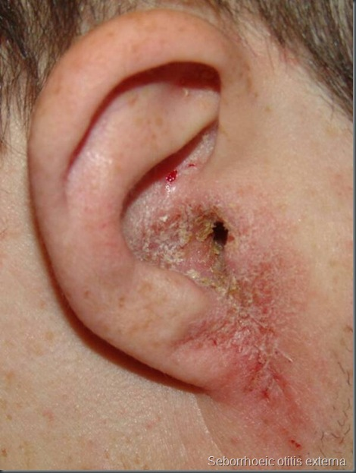
Otitis Externa And Otitis Media
Otitis externa is an infection of the external auditory canal
Causes pain and hearing loss(also called swimmer’s ear)
Treatment is pain drops, pain medication(IBU, Tylenol), and antibiotic drops
Otitis Media is an infection of the middle ear
Associated with respiratory tract infections
Causes severe, deep, and throbbing pain, fever, and hearing loss
Treatment includes antibiotic (penicillin or sulfa) and pain medication

Slide 28
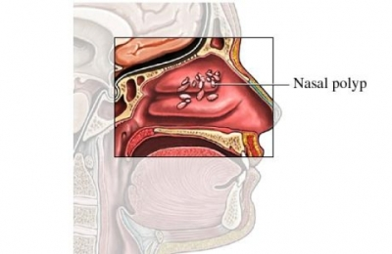
Nasal Polyps
These usually benign growths, most often multiple, and in both sides of the nose, may occur in large enough numbers and size to obstruct the airway
Diagnosis is made by a nasal x-ray
Treatment usually includes removal of polyps

Slide 29
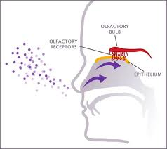
The Nose And The Sense Of Smell
The sense of smell is due to the olfactory organ in the top of the nasal cavity
The organ is connected by nerve fibers, which run through tiny holes in the skull bone above the nasal cavity, to the olfactory center in the brain
These odor detectors can “smell” something only after it is dissolved
in the mucus secretions

Slide 30
Diseases And Disorders Of The Nose
Epistaxis(nosebleed): The presence of blood originating from the nose, may be from the mouth or swallowed into the throat
Some causes may be from nasal infections, inhalation of irritating substances, high blood pressure, chronic aspirin use, anemia, or leukemia
Treatment depends

Slide 31
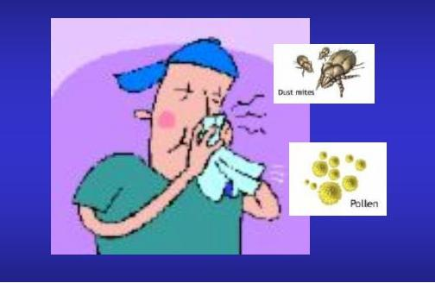
Rhinitis
Rhinitis is a reaction to airborne allergens
Many symptoms are the result of the body’s attempt to dilute or remove irritants coming into contact with the mucous membranes

Slide 32
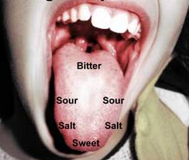
The Tongue And The Sense Of Taste
Your sense of taste comes from the taste buds on the tongue.
Taste buds are the parts on the tongue that allow us to taste.
The four kinds of taste buds are sweet, sour, bitter, and salty.
Moisture is supplied by the salivary glands in sufficient quantities to affect taste

Slide 33
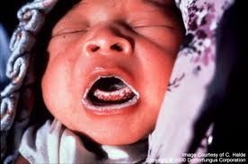
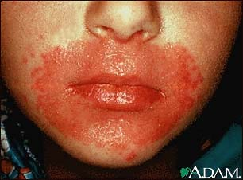
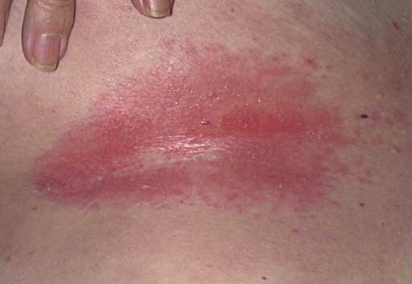
Diseases And Disorders Of The Mouth And Tongue
Candidiasis: this disease is a fungal infection of the mucous membranes of the mouth and throat
The organism can cause infection in other locations, such as the nails, skin(diaper rash), vagina, and GI tract
Signs are cream-colored or white patches of exudate

Slide 34
Oral Cancer
Oral cancer: any lesion or growth within the mouth is not normal and should be examined
No one knows for certain the exact cause of oral cancer
Oral cancer, is linked to alcohol and tobacco
Surgical removal is
recommended to
determine the form of cancer

Slide 35
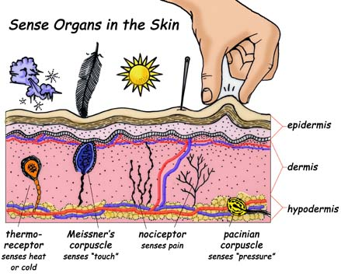
The Skin And The Sense Of Touch
The sense of touch requires direct contact with the body through contact receptors
Each of the contact receptors in the skin has its own perceptive function, enabling us to feel the many different sensations of pain, touch, pressure, heat, cold, traction, and tickle

